Slide 1
LCLM 5005
Organisational Culture
Week 5:
Organisational Structure & Organisational Culture.
Prepared by:
Oluwaseun (Olu) Adegbite, PhD.
BA (Hons) Leadership and Management Skills for the Workplace

Slide 2
Last Week (i.e., Week 4)
We considered…….
Theories of Organisational Culture:
The Hofstede’s Cultural Dimension.
Schein and the Three Levels of Organisational Culture.
Johnson and Scholes developed the Cultural Web
Handy’s Culture Types.
The Deal and Kennedy’s Cultural Types.

Slide 3
This Week (i.e., Week 5)
We aim to do the following:
Organisational Structure & Organisational Culture.
Organisational structure.
Types of Organisational structure.
Organisational structure and culture.

Slide 4
Important Announcement!
Have you started working on your assignment C1?
The academic session is available for you!
You can liaise with your lecturer to book one-to-one session with him/her.

Slide 5

Week 5
Influence of Organisational Culture on Firms Structure

Slide 6
Organisational Structure
An organizational structure is a system that outlines how certain activities are directed in order to achieve the goals of an organization.
These activities can include rules, roles, and responsibilities.

Slide 7
Organisational Structure
Why do we need structure in organisations?
In group of 3 or 4 students, can you come up with some answers?

Slide 8
Organisational Structure
These are some of the likely reasons:
Structures helps organisations to achieve….
Monitoring the activities of the organisation;
The economic and efficient performance of the organisation and the level of resource utilisation;
Accountability for areas of work undertaken by groups and individual members of the organisation;

Slide 9
Organisational Structure
These are some of the likely reasons:
Structures helps organisations to achieve….
Co-ordination of different parts of the organisation and different areas of work;
Flexibility in order to respond to future demands and developments, and to adapt to changing environmental influences; and
The social satisfaction of members working in the organisation.

Slide 10
Organisational Structure
Structure provides the framework of an organisation and its pattern of management.
Some structure is necessary to make possible the
effective performance of key activities and to
support the eff orts of staff .
The manager needs to understand the importance and effects of structure, and the variables that influence the most appropriate structure for a particular organisation.

Slide 11
Types of Organisational Structures
Traditional Organisational Structures
Simple Structure
Functional Structure
Divisional Structure
Traditional Structure is synonymous with Centralization
The degree to which decision-making is concentrated at a
single point in the organizations.
Organizations in which top managers make all the decisions
and lower-level employees simply carry out those orders.

Slide 12
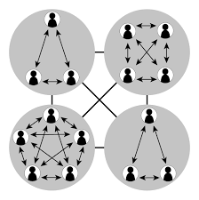
Types of Organisational Structures
Organic Organisational Structure –
Aligns with decentralisation - organisations in which decision-making is pushed down to the managers who are closest to the action.

Slide 13
Types of Organisational Structures
Traditional is also known as mechanistic organisational structures.
This is different from organic organisational structure.
Largely a mechanistic organization is a rigid and tightly controlled structure. Whereas …
An organic organization is highly adaptive and flexible.

Slide 14
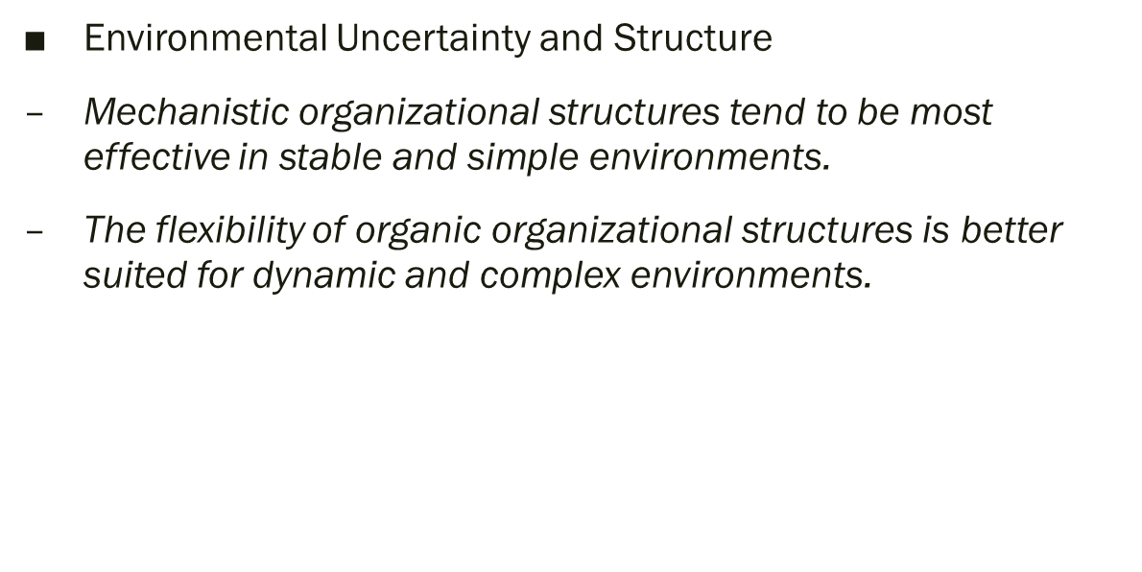

Types of Organisational Structures
Mechanistic vs Organic Organisational Structures.

Slide 15
Types of Organisational Structures
Mechanistic Organization
Organic Organization
• High specialization
• Rigid departmentalization
• Clear chain of command
• Narrow spans of control
• Centralization
• High formalization
• Cross-functional teams
• Cross-hierarchical teams
• Free flow of information
• Wide spans of control
• Decentralization
• Low formalization

Slide 16
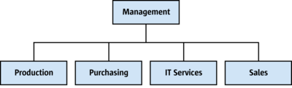
Types of Organisational Structures
Traditional Organisational Structures:
Simple Structure
An organizational design with low departmentalisation, wide spans of control, centralized authority, and little formalisation

Slide 17
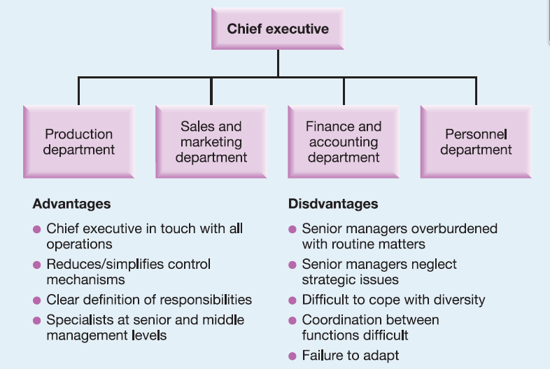
Types of Organisational Structures
Traditional Organisational Structures:
Simple Structure

Slide 18
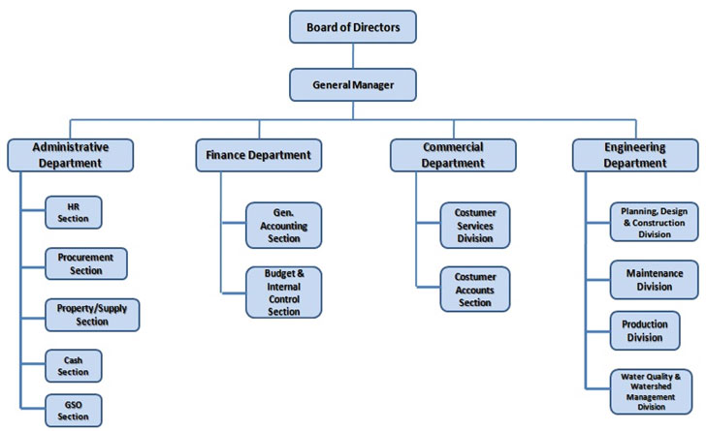
Types of Organisational Structures
Functional Structure
An organisational design that groups together similar or related occupational specialties

Slide 19
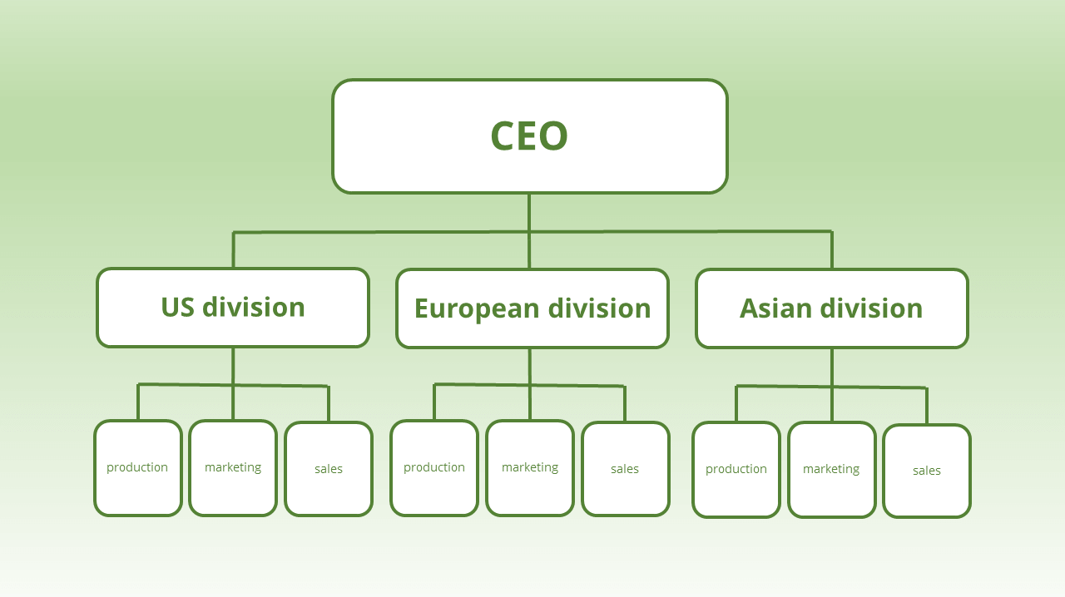
Types of Organisational Structure
Divisional Structure
An organizational structure made up of separate, semiautonomous units or divisions.

Slide 20
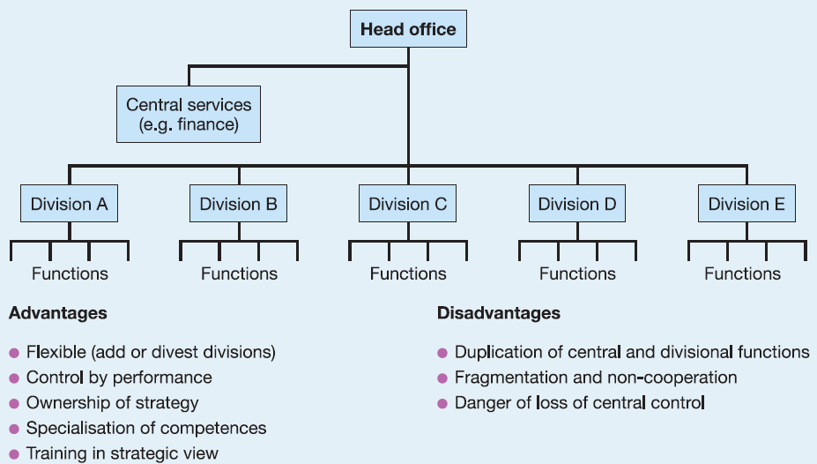
Types of Organisational Structures
Divisional Structure

Slide 21
Class Activity 1
Group Activity (3 to 4 students per group)
Draw and present the organisational structure of UWTSD Birmingham (Feel free to gather additional information by interviewing staff if required).
Each group should take turn to:
Explain the advantages and the disadvantages of the structure.
(Duration of task: 25 minutes).

Slide 22
Types of Organisational Structure
Other Types of Organisational Structure

Slide 23
Types of Organisational Structure
Other Types of Organisational Structure

Slide 24
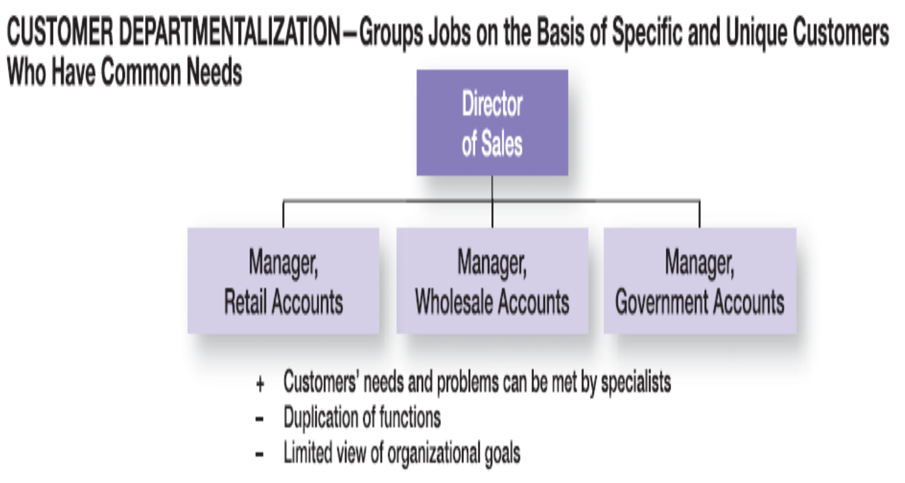
Types of Organisational Structure
Other Types of Organisational Structure

Slide 25
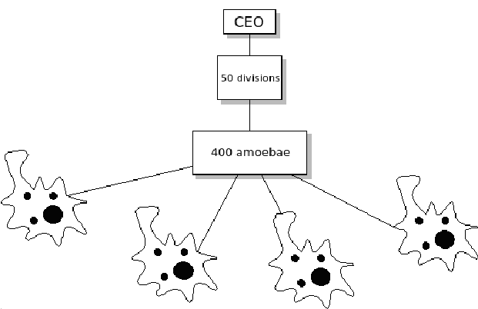
Types of Organisational Structure
Amoebae Structure

Slide 26
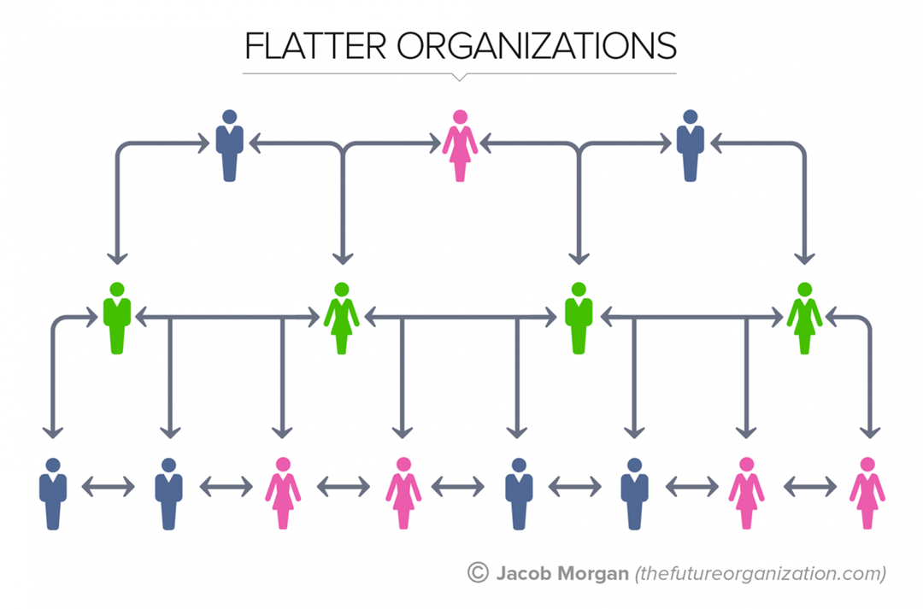
Types of Organisational Structure
Flat Structure

Slide 27
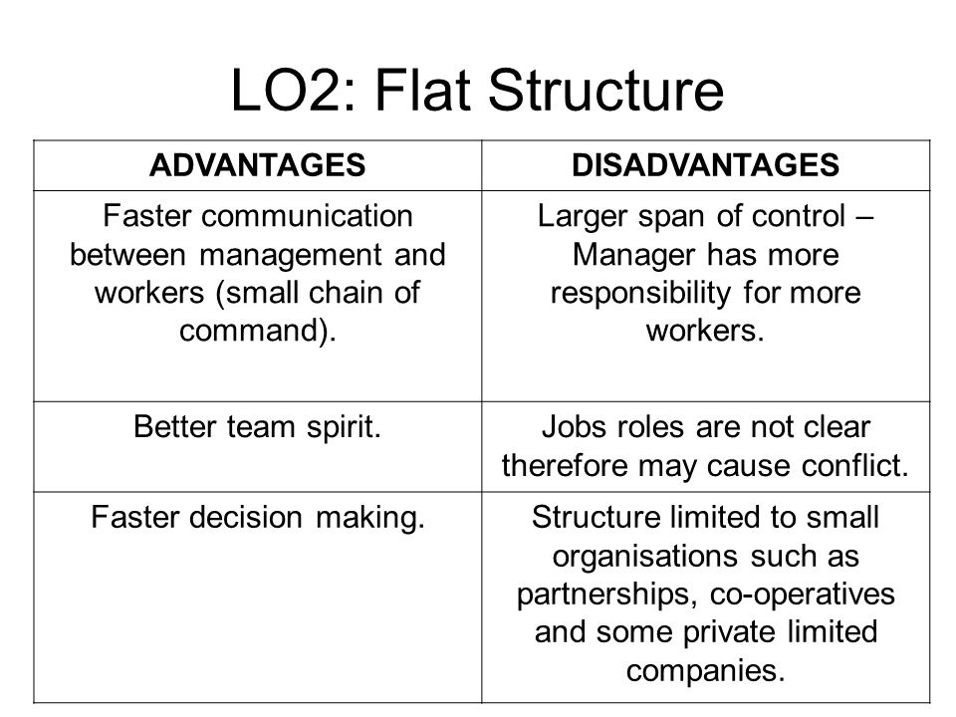
Types of Organisational Structure
Flat Structure

Slide 28
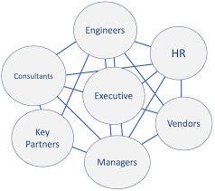
Types of Organisational Structure
Organic Structure
An organic organization is highly adaptive and flexible.

Slide 29
Organisation Structure and Culture
A major determinant of an organisation’s structure is its culture.
The structure of work organisations also involves the wider context of societal structures and cultures.

Slide 30
Organisation Structure and Culture
Managers and supervisors need to adopt a style of behaviour and leadership based on openness, respect and trust that encourages the generation and implementation of new ideas.

Slide 31
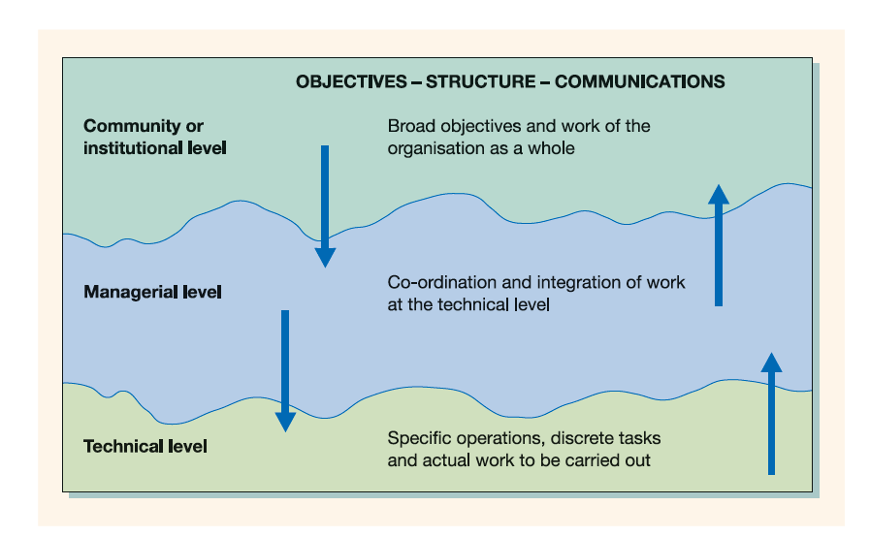
Organisation Structure and Culture
Organisational structure and culture both intersect and function to achieve organisational set objectives.

Slide 32
Class Activity 2
Go to a website of a large organisation you are familiar with and find its organisational chart (Note: Not all organisations provide these!).
Explain the type of organisational structure adopted by the organisation.
Why is the organisation structured this way?

Slide 33
Class Activity 2
Write down your answers.
Take turn to discuss your answers with the rest of the class.

Slide 34
Important Tips
Good organisation structure does not by itself produce good performance.
But a poor organisation structure makes good performance impossible, no matter how good the individual managers may be.
To improve organisation structure . . . will therefore always improve performance.

Slide 35
Important Tips
In the final analysis, …..
It is important that we understand what organization is, what it does, and the grounds on which it can be justified because it is not just a means to achieving better economic performance but also exerts a profound influence on the societies in which we live . . .
The form of organization we employ transports values back into society and carries a message about how to treat other people.

Slide 36
Summary…Today we have examined…
Organisational Structure & Organisational Culture.
Organisational structure.
Types of Organisational structure.
Organisational structure and culture.

Slide 37
Next Week, We will look at…
Business Ethics, Social and Environmental Responsibility
Reasons for Unethical Business Behaviour.
Ways of Encouraging Ethical Business Behaviour.
Social Responsibility Towards Stakeholders.
Meeting Ethical, Social and Environmental Responsibilities.

Slide 38
References
Alvesson, M. (2013) Understanding Organizational Culture. Second edition. London: SAGE.
Cacciattolo, K., (2014). Understanding Organisational Cultures, European Scientific Journal November 2014 /Special Edition vol.2
Deal, T. E. & Kennedy, A. A. (2000) The New Corporate Cultures: Revitalizing the workplace after downsizing, mergers and reengineering, London-UK, TEXERE Publishing Limited.
Mullins, L., & Christy, G. (2016). Management & Organisational Behaviour (Eleventh ed., Always learning).
Schein, E.H. 1990. Career anchors: Discovering your real values. San Francisco: Jossey-Bass/ Pfeiffer.

