Slide 1
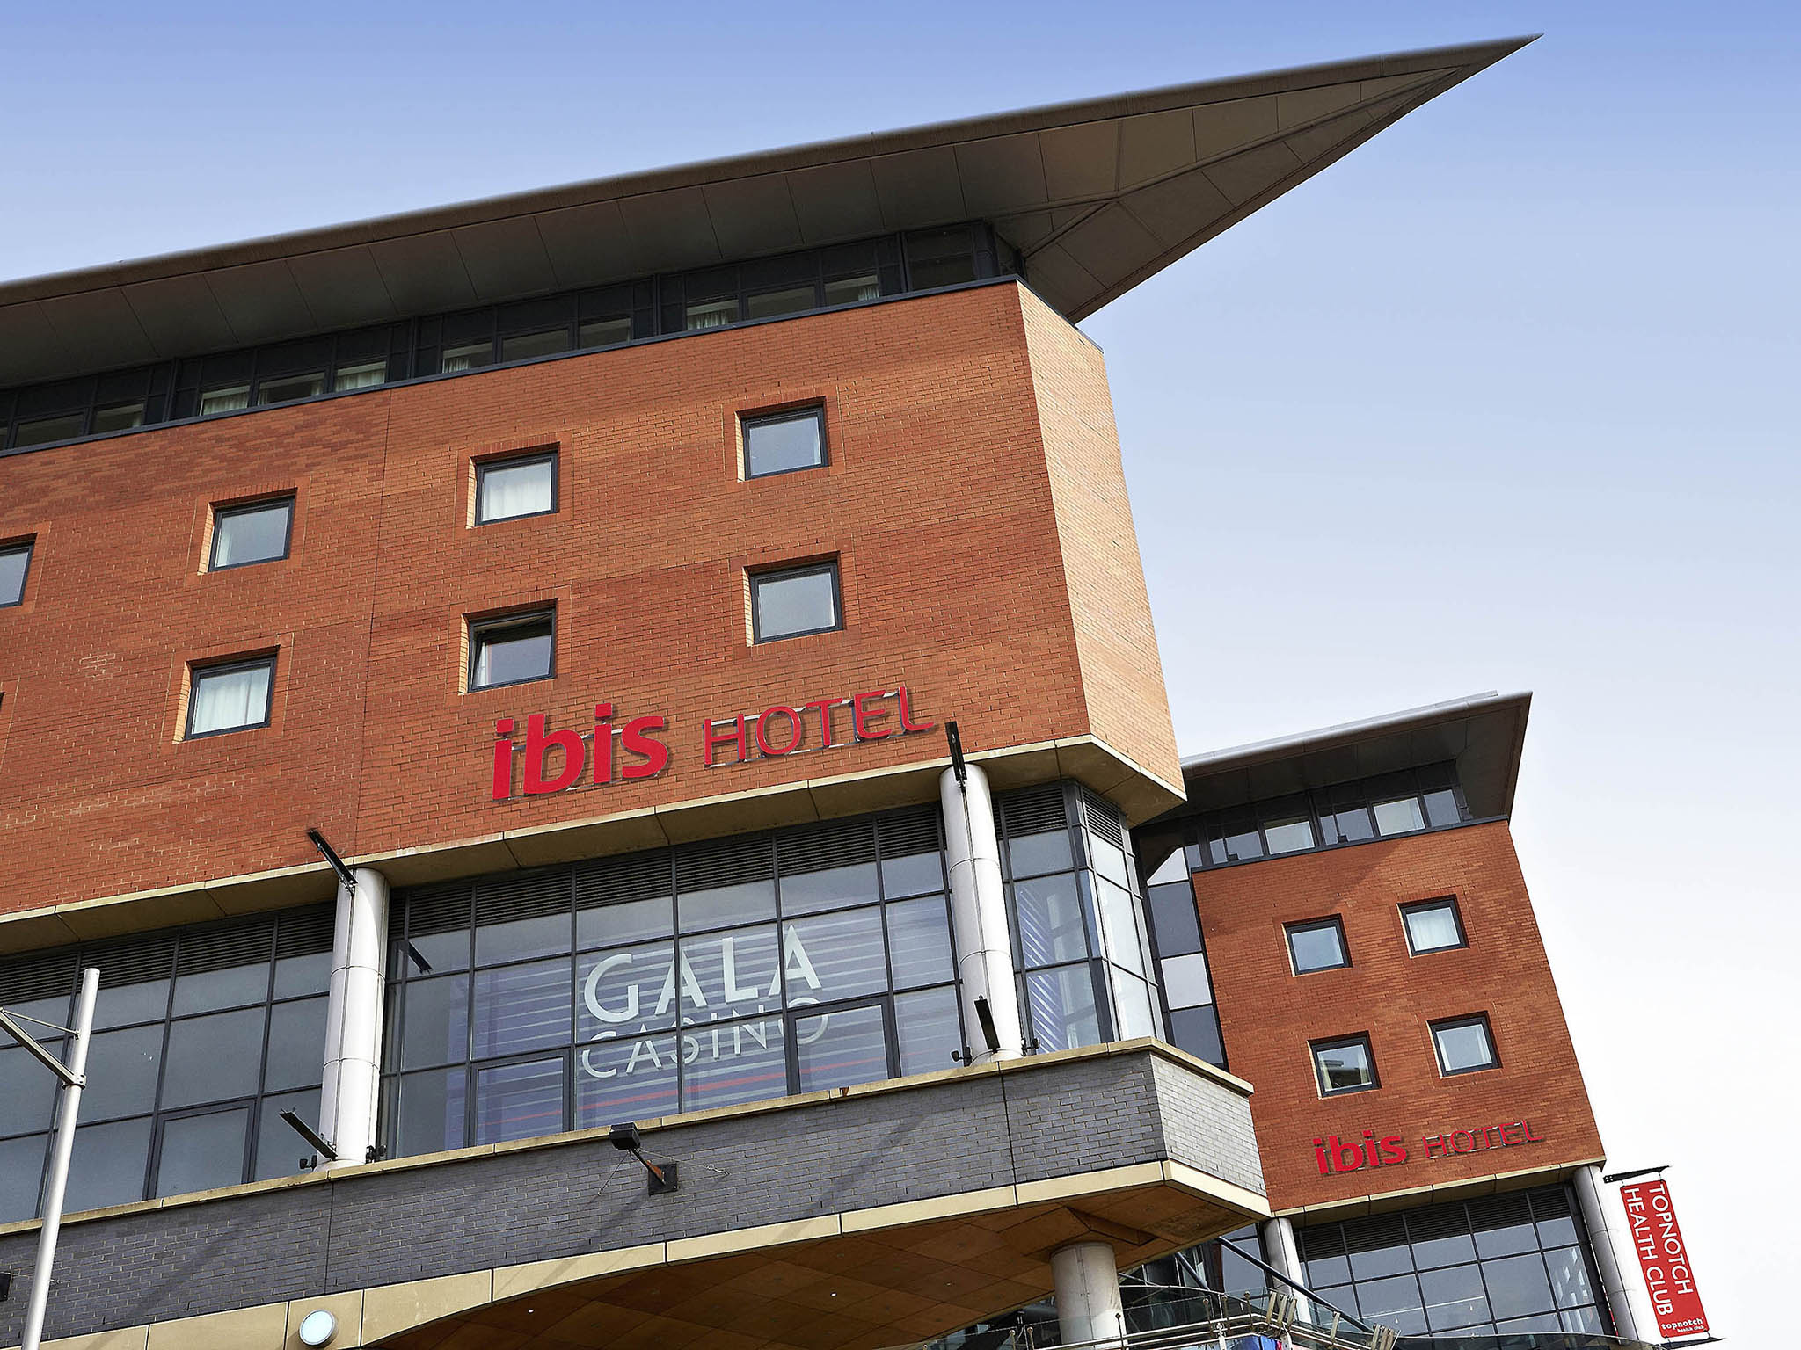
Health and Safety Guide for Room Cleaning at IBIS Hotel
Student: Olga Brinza 2242685

Slide 2
Contents:
Personal Protective Equipment (PPE) in housekeeping
Slip, Trip, and Fall Hazards
Correct use of chemicals in housekeeping
Manual handling
Electrical Hazards
Step-by-step guide on room cleaning
Health and Safety Regulations
Reference list

Slide 3
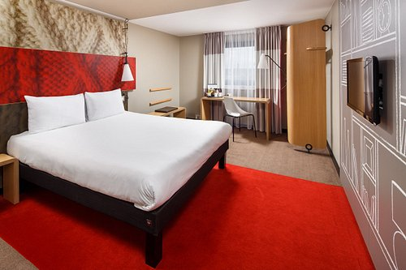
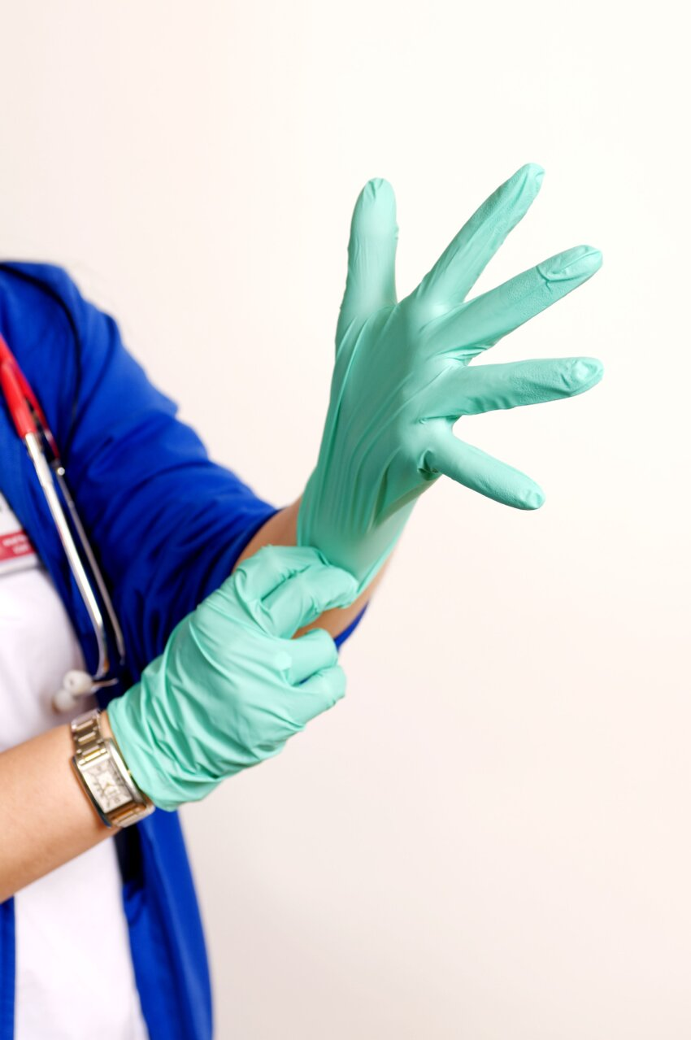
PPE
Wear gloves, protective eyewear, and aprons when handling cleaning chemicals or potentially contaminated surfaces.
Ensure PPE is properly fitted and in good condition.
Dispose of used PPE in designated waste bins after each cleaning session.

Slide 4
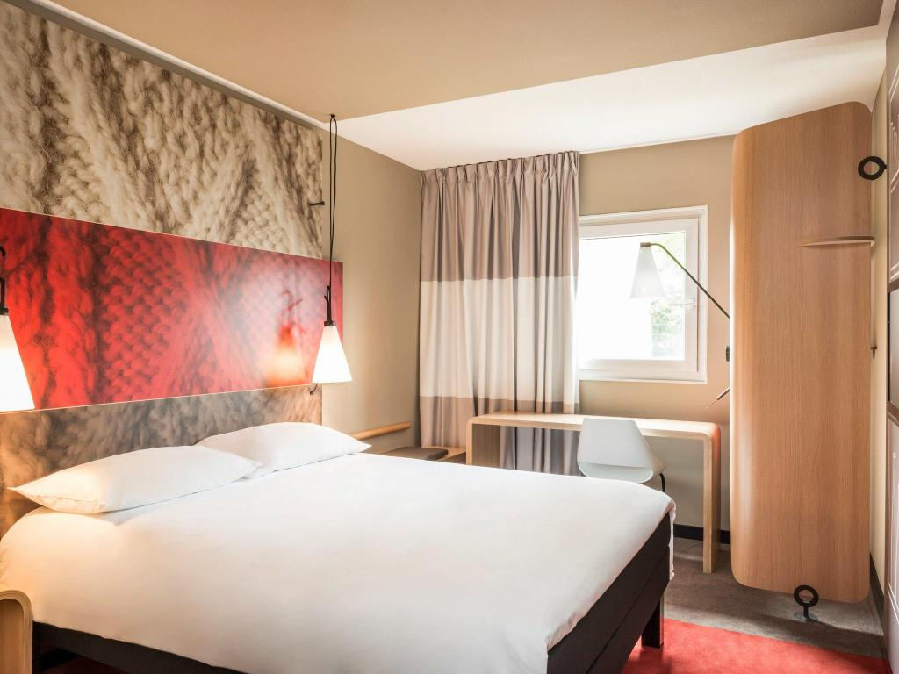
Slip, Trip, and Fall Hazards
Keep floors dry and clean by immediatly cleaning up any liquid or debris.
Use caution signs and barriers to alert guests and staff of any slippery surfaces.
Maintain proper lighting in all areas to provide visibility and reduce the risk of trips and falls.
Bin all the rubbish.
Mind all the cables and leads that can cause trip and fall hazards.

Slide 5
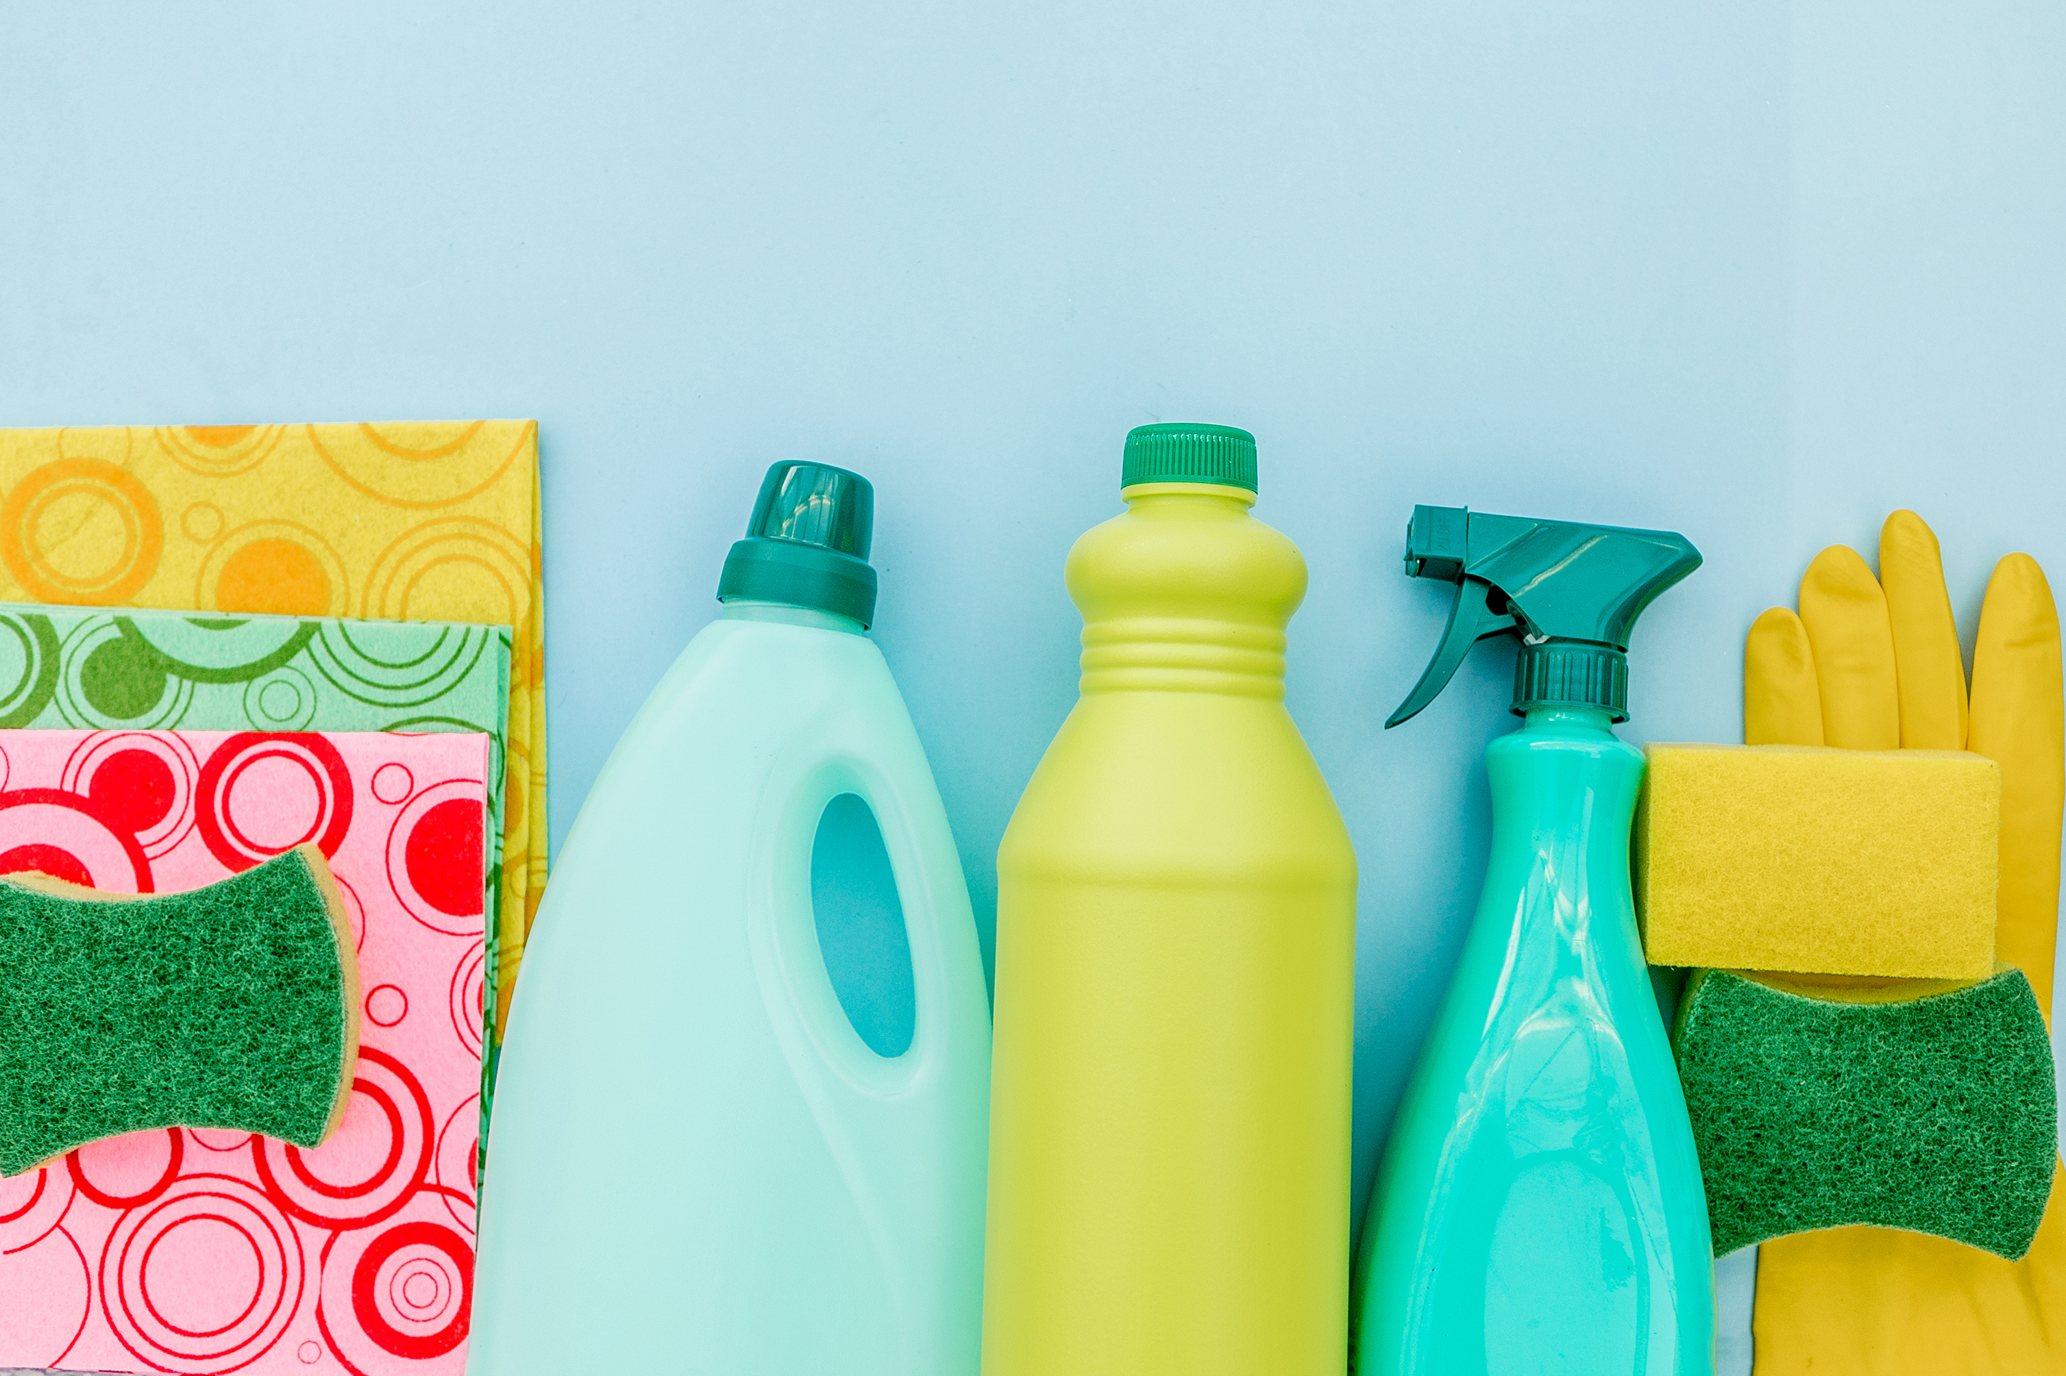
Chemicals
Follow
manufacturer’s usage instructions for diluting and using cleaning chemicals.
Consider
the room ventilation room when a cleaning chemical is being used.
Store
them out of reach of guests and make sure the lids are kept on securely.
Wash
hands to prevent chemicals burns on your skin or surfaces.
Ensure
the correct labeling of cleaning products.

Slide 6
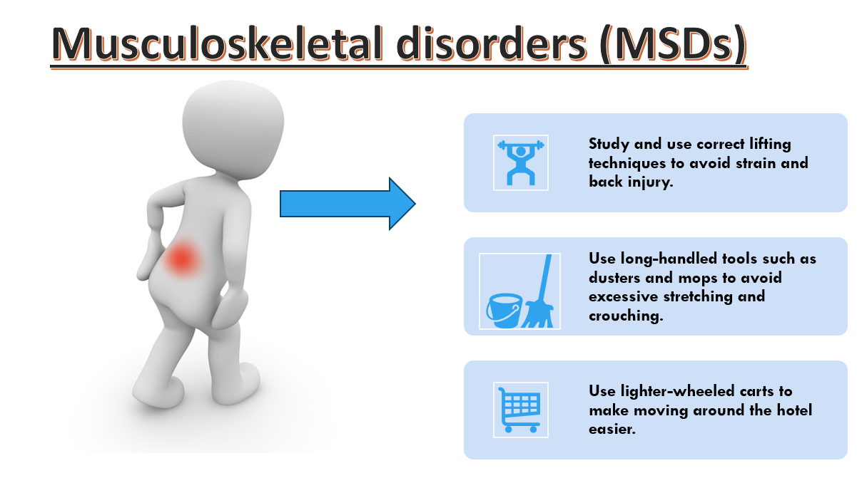

Slide 7

Damaged electrics
Inspect and maintain cleaning equipment regularly to ensure safe and proper operation.
Check for frayed wires, loose plugs, and blown light bulbs.
Report immediately any electrical damages.

Slide 8



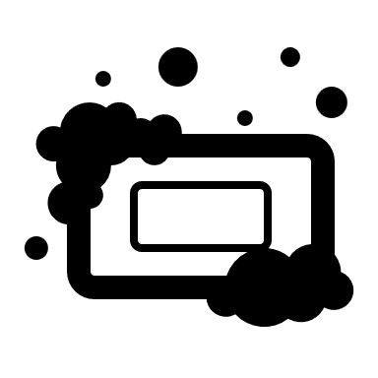

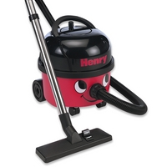




Step-by-step procedure for room cleaning
1.Preparing Cleaning Supplies and PPE
2.Room Inspection
3. Ventilation
4.Dusting and Surface Cleaning
5.Cleaning the Bathroom
6.Vacuuming and Floor Cleaning
7.Final Touches
8. Inspecting the Room
9.Storing Equipment and Supplies
10.Documentation and Reporting

Slide 9


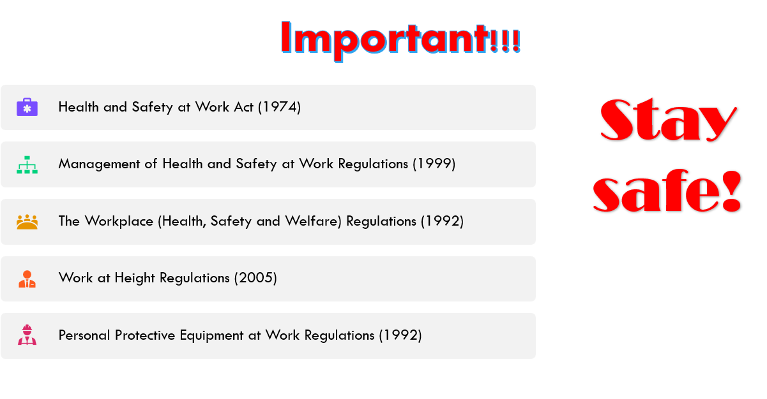

Slide 10


