Slide 1
Research Methods and Professional
Development
ACFA7004
Leadership Development
Emotional Intelligence

Slide 2
Previously……….
What is Leadership?
What is Management?
Leadership Theory

Slide 3

Today………
Emotional Intelligence

Slide 4
What is Emotional Intelligence?
Emotional Intelligence (EI) is the ability to recognize, understand, and manage emotions in oneself and others. It plays a crucial role in personal and professional success.
Five Key Components of EI (Goleman’s Model)
  1. Self-awareness – Recognizing your own emotions
  2. Self-regulation – Managing emotions effectively
  3. Motivation – Using emotions to achieve goals
  4. Empathy – Understanding others' emotions
  5. Social skills – Building strong relationships

Slide 5
Why is Emotional Intelligence Important?
Helps in conflict resolution and better communication
Improves leadership and teamwork skills
Enhances decision-making and stress management
Leads to better mental health and overall well-being

Slide 6
Emotional Intelligence in Computing & Technology
Teamwork & Collaboration: EI helps developers and engineers work better in teams
Leadership & Management: EI is essential for project managers and tech leads
User Experience (UX) Design: Understanding emotions improves product usability
Conflict Resolution: Handling disagreements in tech teams effectively

Slide 7
How to Improve Emotional Intelligence?
Practice self-awareness: Reflect on your emotions daily
Manage stress effectively: Use mindfulness and relaxation techniques
Develop empathy: Listen actively and consider others' perspectives
Improve social skills: Engage in constructive conversations and networking
Seek feedback: Learn from others to grow emotionally

Slide 8
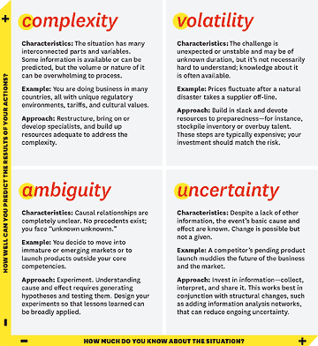

Slide 9

Personal Leadership
Personal leadership is the ability to take responsibility for all aspects of your life and leading it in the direction that is best for you.
It makes you responsible, organised and accountable to the goals you set.
According to Calvert (2014), Successful Leaders know their Personal Leadership Philosophy (PLP) and communicate it by living it passionately everyday in all they say and do. They have taken the time to determine who they are, their values and priorities. They know their course...

Slide 10
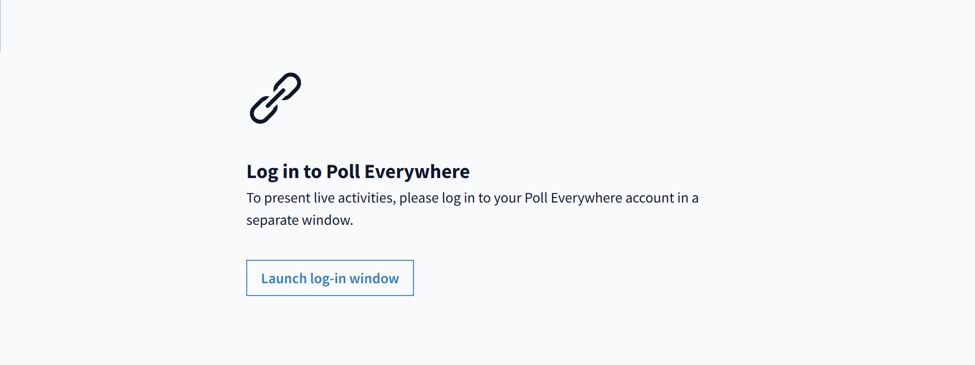
Do you procrastinate?

Slide 11

Academic Procrastination – How do we manage this?
55 days per year are wasted on procrastinating – potentially wasting 218 minutes doing unimportant things (Alik, 2015)
Academic Procrastination.pdf

Slide 12
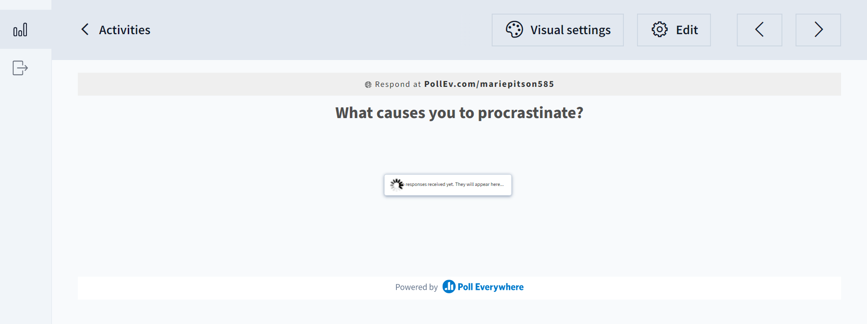
What causes you to procrastinate? List up to three activities

Slide 13
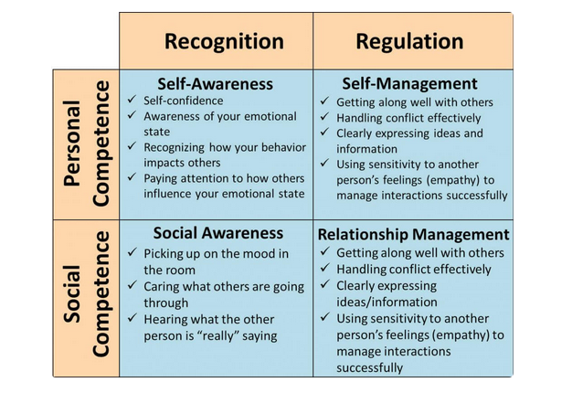
Image: Riopel, (2019)
Notes:
Self-Awareness
Self-awareness involves being able to read your own emotions and recognise their impact. It also involves knowing your strengths and limits and having a sense of self-confidence.
It’s about having the ability to both recognise and better understand moods and emotions and about understanding what drives those moods and emotions and how that affects others.
In order to practice this skill, you must develop an awareness of your own emotional states.
Self-Management
Self-management competencies involve having a sense of achievement, displaying honesty, integrity and, trustworthiness and being able to keep disruptive emotions under control.
It also involves having a sense of optimism, being adaptable and flexible and recognising and seizing opportunities as they arrive. Those who practice this competency accept responsibility and learn to choose their own emotional response.
Self-management also involves learning to re-frame stressful situations into situations that are simply challenging. Tuning into those emotional triggers can help you better manage your emotions as well.
Social Awareness
Social awareness competencies involve being able to sense other people’s emotions, understanding their unique perspectives and learning to take an active interest in things they are concerned about.
It also involves having a sense of organisational awareness and a sense of service.
Relationship Management
Relationship management involves having a sense of teamwork and collaboration, being an inspirational leader and learning how to resolve disagreements.
Those who are well versed in this competency know how to guide and motivate others, and use a wide range of tactics for persuasion.
Relationship management also involves being able to initiate and lead people in a new direction and learning how to bolster other’s abilities through feedback and guidance.
Personal competence is comprised of self-awareness and self-management, which focus more on you individually than on your interactions with other people. Personal competence is your ability to stay aware of your emotions and manage your behaviour and tendencies.
Social competence is comprised of social awareness and relationship management. Social competence is your ability to understand other people’s moods, behaviour, and motives in order to improve the quality of your relationships.
Recognition – recognising it
Regulation – controlling it

Slide 14
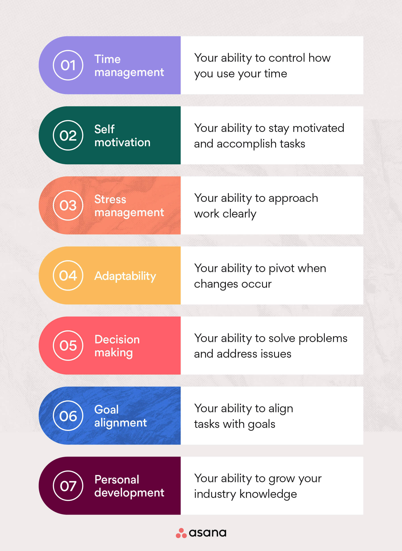

Self Management
Notes:
Throughout your academic journey and indeed your career you will have been sign posted toward self-management, but what does this actually mean?

Slide 15
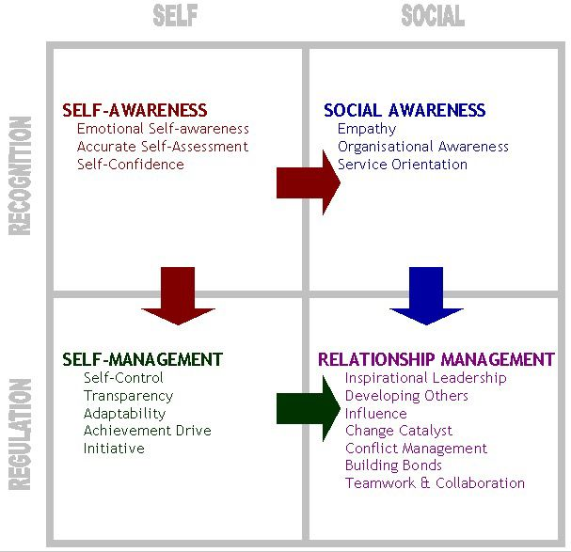
Notes:
We need to consider how we develop ourselves, both from a personal perspective and how our actions and decision affect our colleagues or other individuals.

Slide 16
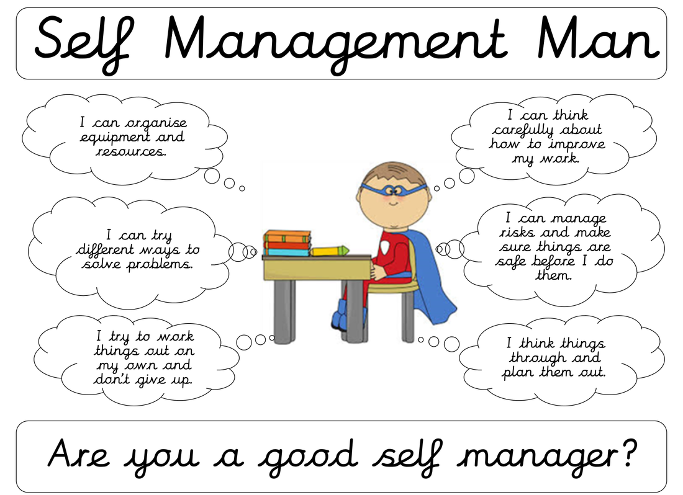
Self-management
[self-management]
NOUN
management of or by oneself; the taking of responsibility for one's own behaviour and well-being.
Notes:
Self-management is your ability to regulate your behaviours, thoughts, and emotions in a productive way. This means excelling in both personal and professional responsibilities for the benefit of yourself and your team. Management activities can be split into two domains: the functional and the behavioural. Essentially, a manager must be capable of performing the routine functional tasks, such as planning, budgeting, staffing, etc., as well as having good people skills and emotional intelligence. I want to take an opportunity to look at the epitome of disorganised, pretentiousness all rolled into one manager. Basil Fawlty – a fictional character from 70’s sitcom Fawlty Towers. Basil is all management and indeed leadership should not be, not only with regard to his employees, but also himself. He is literally his own worst enemy. the key to leadership is to “Select good people, trust them, and delegate authority while retaining responsibility.”
Basil’s philosophy might read more along the lines of “Select the cheapest available labour, do not trust them to do anything important, never relinquish authority, and always blame someone else.” Where a good manager would accept responsibility for poor service, Basil believes there is always an individual to blame, and he will go to great lengths to prove it.
Does he motivate his staff with promise of financial rewards, job satisfaction or self-actualization? No. Basil believes the best way to motivate staff is with threats and/or physical violence. Managers should be there to handle conflict; but without Basil, there would be no conflict to manage. Basil’s management style is summed up by what is known as ‘The Basil Fawlty Effect‘ – where “leaders who feel overwhelmed by their responsibilities lash out at others to temper their own inferiority.”

Slide 17
Fawlty Towers – Fire Drill
Fawlty Towers: Fire drill - YouTube
Notes:
Not sure how many of you have heard of Fawlty Towers and the character Basil Fawlty, but for those who haven’t been initiated, Basil Fawlty is the owner of a small Torquay Hotel – his leadership and indeed management style/approach has been looked at during lectures on Leadership and management for the past 30+ years due to his unique way of doing this – by this I mean he does everything the way current studies on leadership say we should avoid. However, managers with his approach have done and continue to exist in the 21st century, albeit a little less with the physical responses. This particular clip shows his self-management or lack thereof.

Slide 18
Emotional Intelligence
Your ability to recognise and understand emotions in yourself and others, and your ability to use this awareness to manage your behaviour and relationships (Bradberry, 2020)
Daniel Goleman Introduces Emotional Intelligence | Big Think – YouTube
How managers develop emotional intelligence: New study (oxford-review.com)
Emotional Intelligence Quiz | Greater Good (berkeley.edu)
Undertake the Emotional Intelligence Quiz ☺
Notes:
Intangible
Affects how we manage behaviour, navigate social complexities, and make personal decisions that achieve positive results
EI linked to being top performer and standing out from colleagues

Slide 19
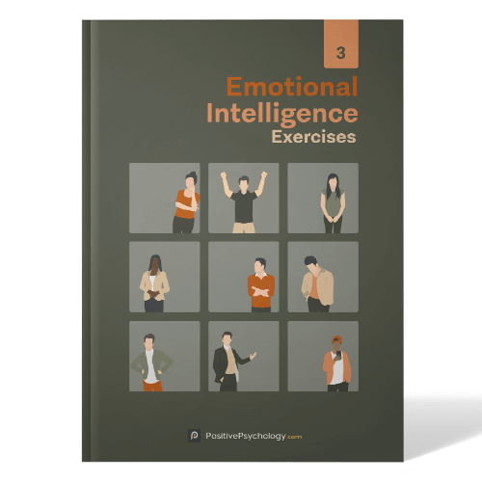
Worth a look….
15 Most Valuable Emotional Intelligence TED Talks on Youtube (positivepsychology.com)
Notes:
A PDF of Emotional Intelligence Exercises will be shared on Moodle

Slide 20

Great Leaders Never Stop Learning
Researching and questioning concepts is a key attribute of leadership
  How can this be improved?
  Do others use similar approaches?
  Why
  What
  Daniel Goleman Suggests Ways to Boost Emotional Intelligence - YouTube
Notes:
Be aware of your shortcomings
Leaders need to know all of their biases, predilections and weaknesses. It’s crucial information for a boss to have, but it’s not always easy for them to receive such feedback from their colleagues and underlings. Even when they’re told they won’t face retribution or punishment for their comments, many people still find it difficult to offer genuine criticism.
Engage in daily reflection
Every day, take 5- 10 minutes to think about the challenges you’ve recently handled and the ones you’ll soon face.
Regulate your feelings
No matter how much preparation and reflection you put in, there will be employees, colleagues, clients and associates who anger, frustrate or annoy you. Sudmann candidly admits there will be “all these moments you face as a leader when you think, “Argh! Stop doing this!”
That’s where the practice of “reframing” comes in. When those teeth-grinding times occur, suggests Sudmann, “stop and ask yourself … on a scale from 1 to 10, how important is this issue right now?”
Exhibit Self Control – In order to successfully lead yourself you must get a grip on your more extreme passions. – do you procrastinate.

Slide 21
Why is leadership important for an individual during their research journey?
It makes you responsible, organised and accountable to the goals you set.
In other words, personal leadership can be used to improve your well-being since it makes you organised and accountable

Slide 22
This week we have looked at
Leadership from a theoretical perspective
Looked at emotion and its impact on performance
Looked at personal leadership and self management

Slide 23

Thank You

Slide 24
References and Further Reading Links
Bourke, J. and Titus, A. (2019), Why Inclusive Leaders Are Good for Organizations, and How to Become One, [Online] https://www.why-inclusive-leaders-are-good-for-organizations-and-how-to-become-one(hbr.org)(Accessed 21st February 2022)
Personal Leadership https://sourcesofinsight.com/the-power-of-personal-leadership/

