Slide 1
E-Commerce Development

Slide 2
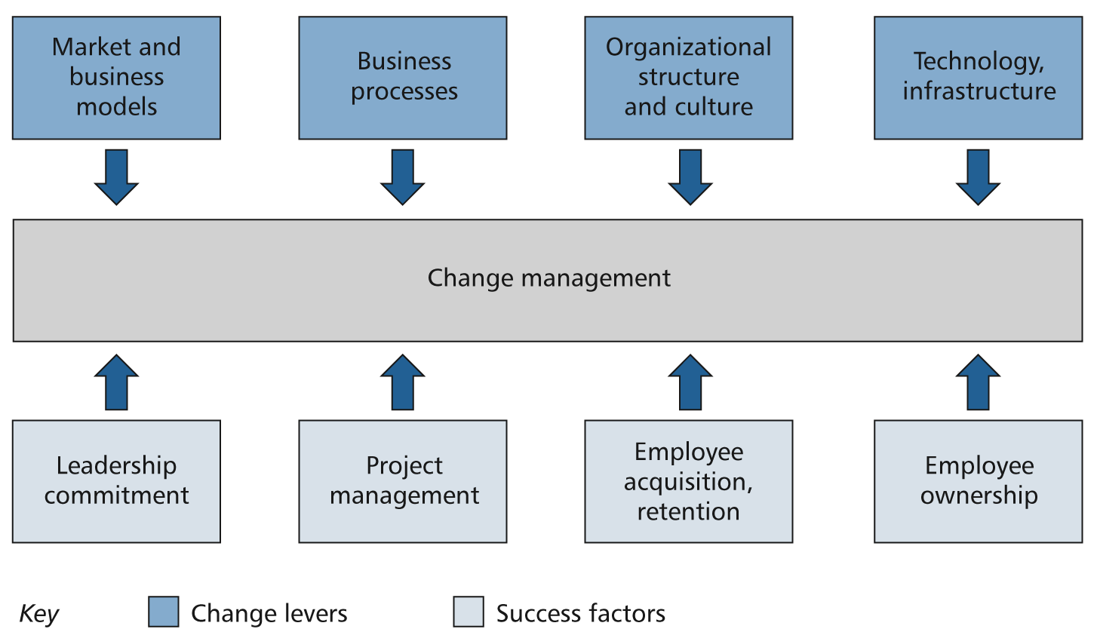
Key factors in a successful E-Commerce Project
Chaffey(2010)

Slide 3
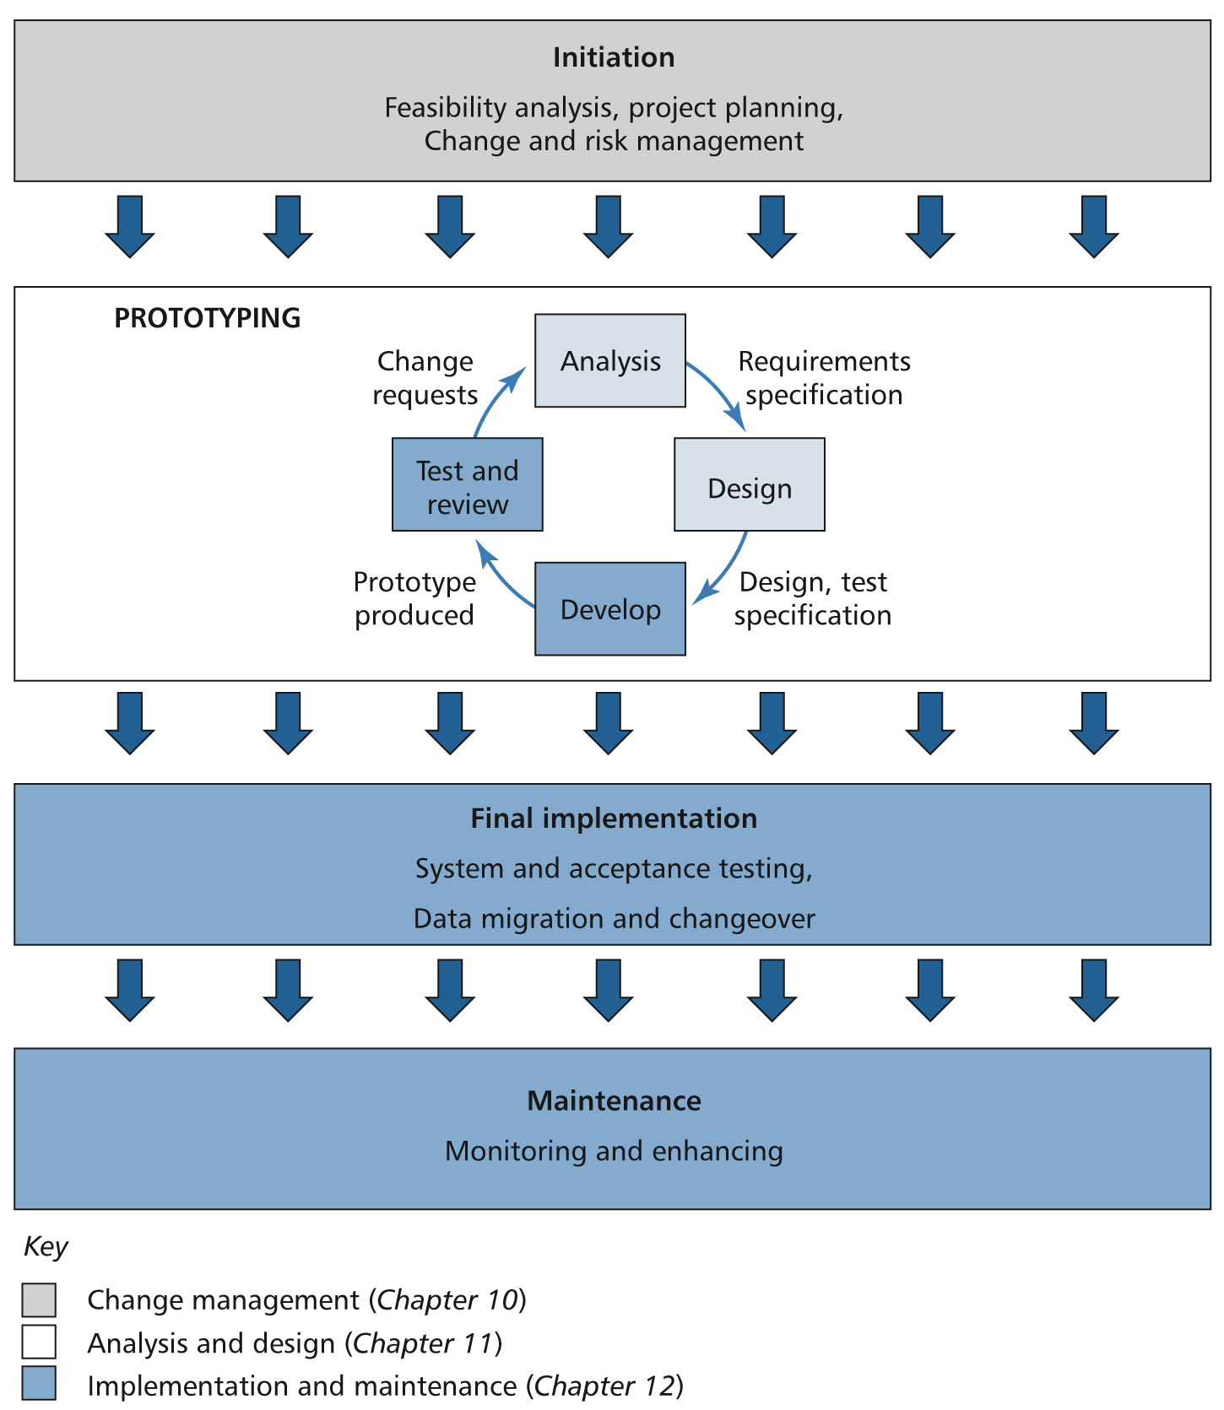
Stages in developing an e-commerce solution

Slide 4
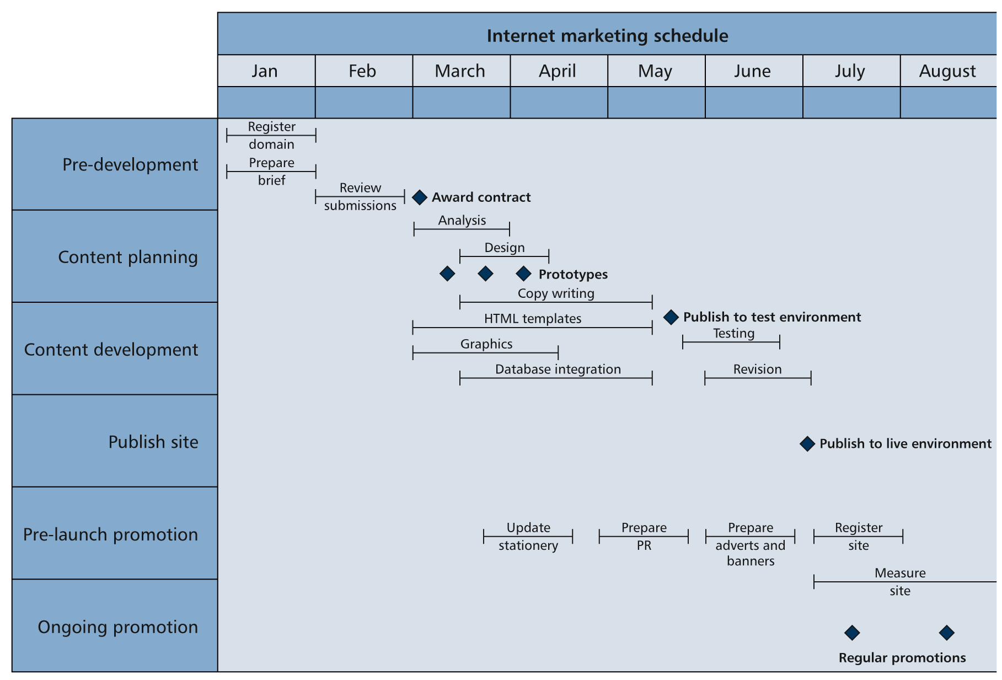
Example Development Schedule

Slide 5
Organisational structures for e-commerce
Organizational structure | Circumstances | Advantages | Disadvantages
(a) No formal structure for e-commerce | Initial response to e-commerce or poor leadership with no identification of need for change. | Can achieve rapid response to e-commerce service responses (e-mail, phone). Priorities not decided logically. Insufficient resources | Poor quality site in terms of content quality and customer
(b) A separate committee or department manages and coordinates e-commerce | Identification of problem and response in (a) | Coordination and budgeting and resource allocation possible. | May be difficult to get different departments to deliver their input due to other commitments
(c) A separate business unit with independent budgets | Internet contribution is sizeable (>20%) | As for (b), but can set own targets and not be constrained by resources. Lower risk option than (d) | Has to respond to corporate strategy. Conflict of interests between department and traditional business
(d) A separate operating company | Major revenue potential or flotation. Need to differentiate from parent | As for (c), but can set strategy independently. Can maximize market potential | High risk if market potential is overestimated due to start-up costs
Which would you recommend for your business from assignment 1?

Slide 6
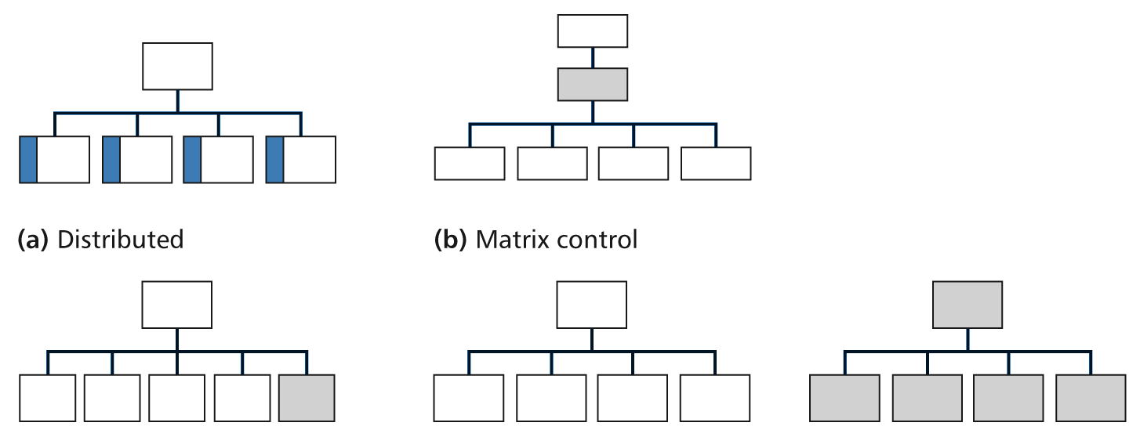
Summary of alternative organizational structures for e-commerce suggested in Parsons et al.
Summary of alternative organizational structures for e-commerce suggested in Parsons et al. (2006)

Slide 7
Identify risks for e-business project
Risk | Probability | Impact | Solution
Insufficient senior management commitment | 5 | 7
High staff turnover/key staff leave | 6 | 5
Project milestones not met, overrun budget | 8 | 6
Problems with new technology delaying implementation (bugs, speed, compatibility) | 8 | 8
Staff resistance to change | 4 | 4
Problem with integrating with partner’s systems (e.g. customers or suppliers) | 6 | 8
New system fails after changeover (too slow or too many crashes) | 3 | 9
Notes:
Solution
Education/training/lobbying by e-business manager to achieve buy-in
Use monetary incentives and improve working environment
Appoint experienced project manager and provide support and resources needed. Manager will perform risk management such as this
Allow sufficient time for volume, performance testing
Education, training identification of change facilitators amongst staff
Tackle these issues early on, identify one contact point/manager for each of partnerships
See solution to delayed implementation

Slide 8
Template Example: Zen Cart
http://www.zen-cart.com/
How much does it cost to use Zen Cart?
What skills are needed to customise the template? (see the Wiki)
Evaluate an example of the Showcase Shops.
Would you recommend a template based system for you business from Assignment 1?

