Slide 1
5 brands/people I’m inspired by

Slide 2
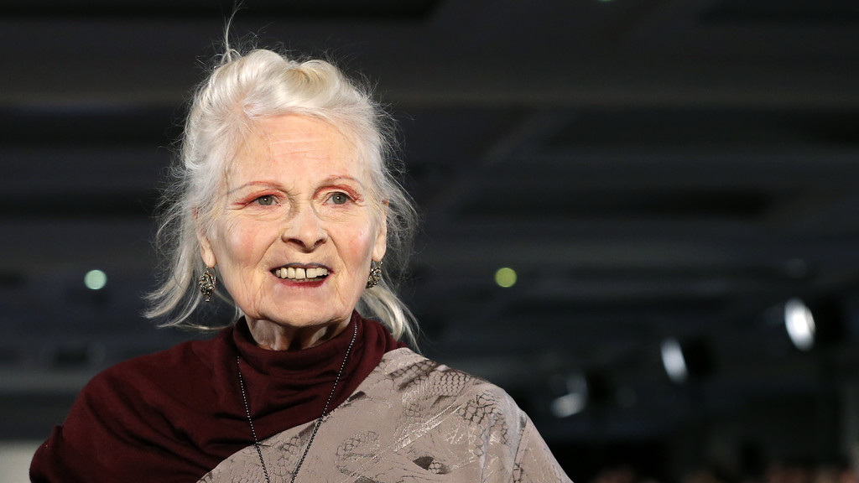
Vivienne Westwood

Slide 3
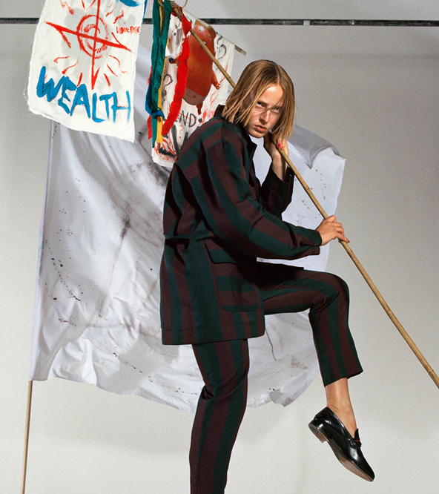
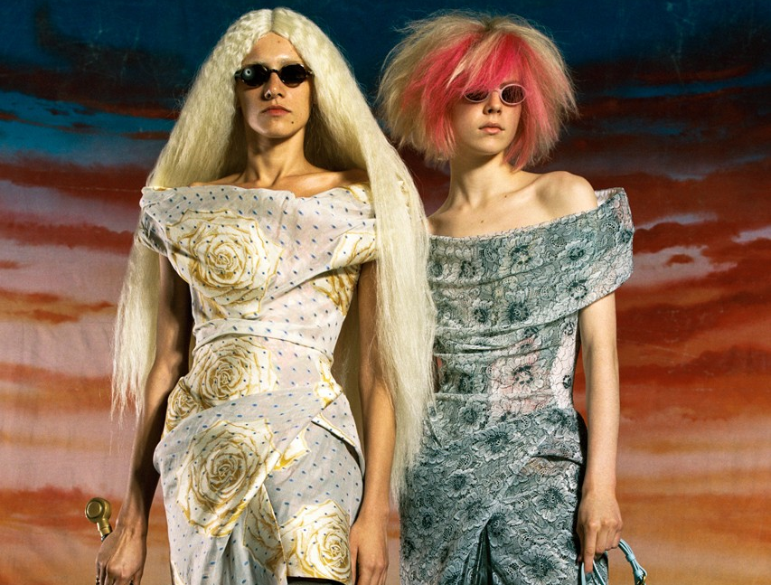
Fall 2020
Westwood is a fashion designer and business woman.
I have always looked up to Vivienne Westwood for her rebel aesthetic in her work and the stories of how she got to where she is today.
I feel that her work is always up to date with the trends and current social issues in society so will never go out of date because they are like current with the history of society at the time.

Slide 4
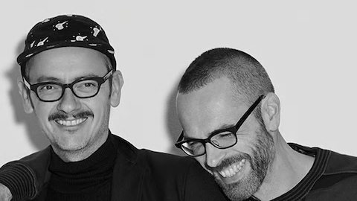
Viktor and Rolf

Slide 5
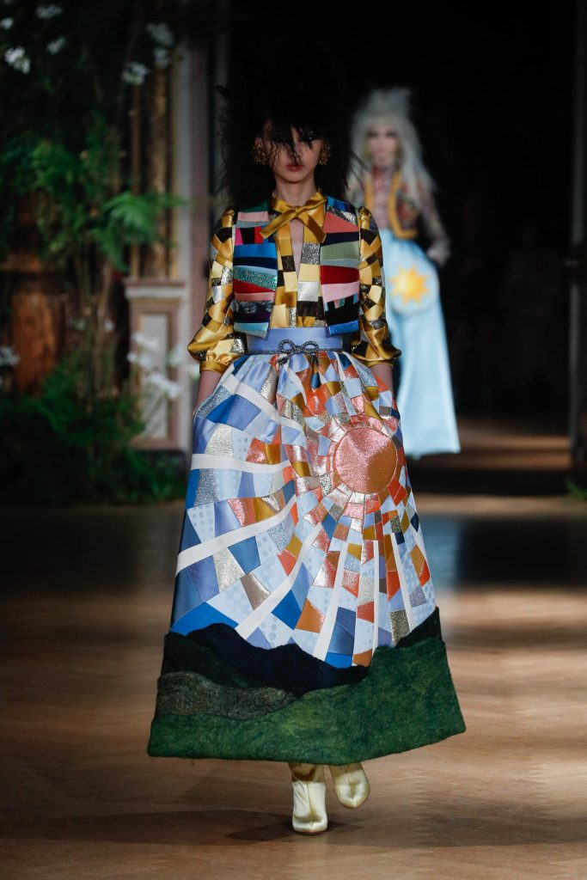
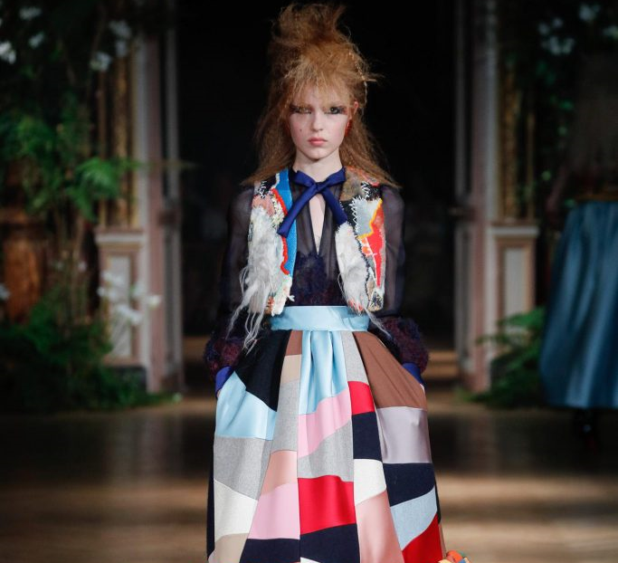
Couture AW19/20
Viktor and Rolf are Dutch designers that specialise in making conceptual fashion pieces.
Their work proves that fashion and art can be combined, and I like that Viktor & Rolf have pursued to challenge the fixed idea that fashion and art can be united.

Slide 6
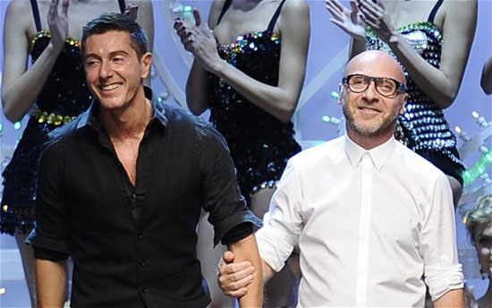
Dolce & Gabbana

Slide 7
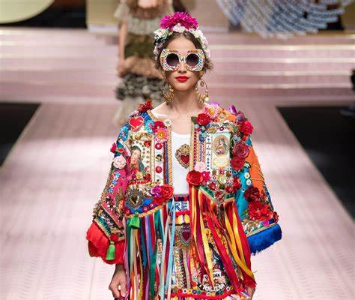
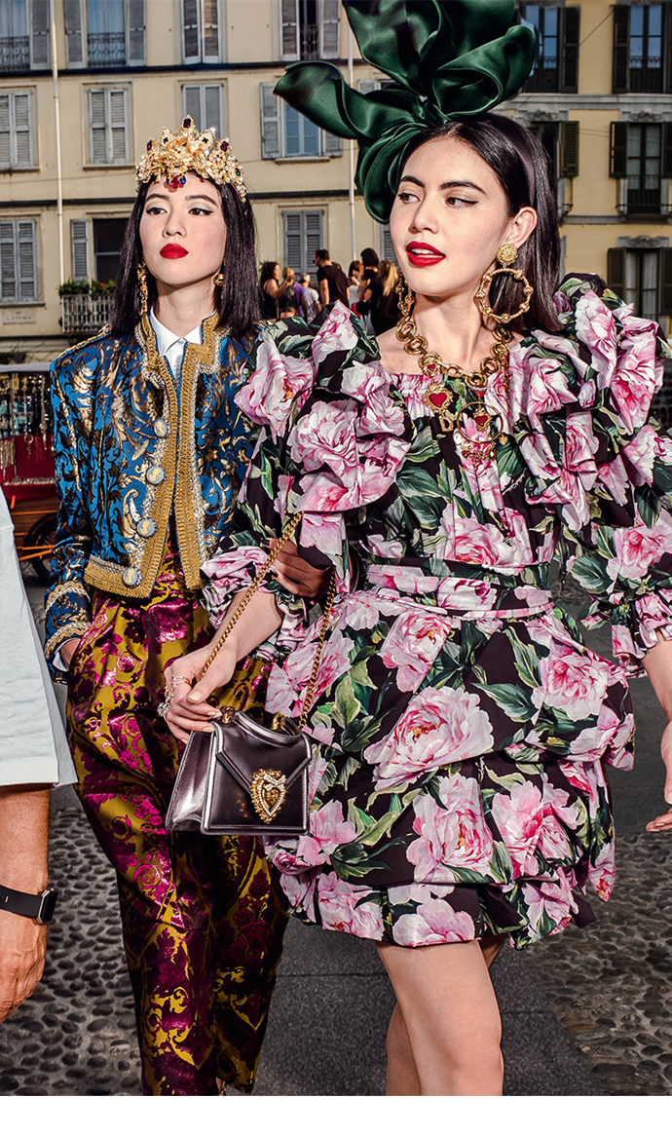
SS19
Dolce & Gabbana is an Italian luxury fashion house founded in 1985 in Legnano by Italian designers Domenico Dolce and Stefano Gabbana.
I have always been a big fan of Dolce & Gabbana because they make high quality fashion pieces inspired by Italian heritage this makes the designs florescent and quirky.
For their recent Devotion bag, a portion of proceeds from the sales will be donated to Humanitas University to aid their critical global health initiatives.

Slide 8
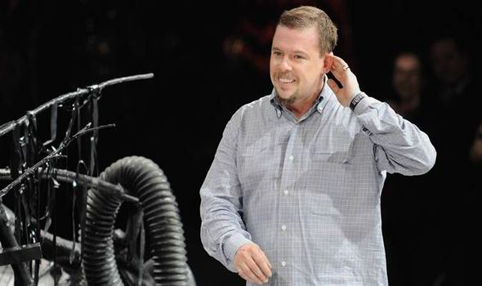
Alexander McQueen

Slide 9
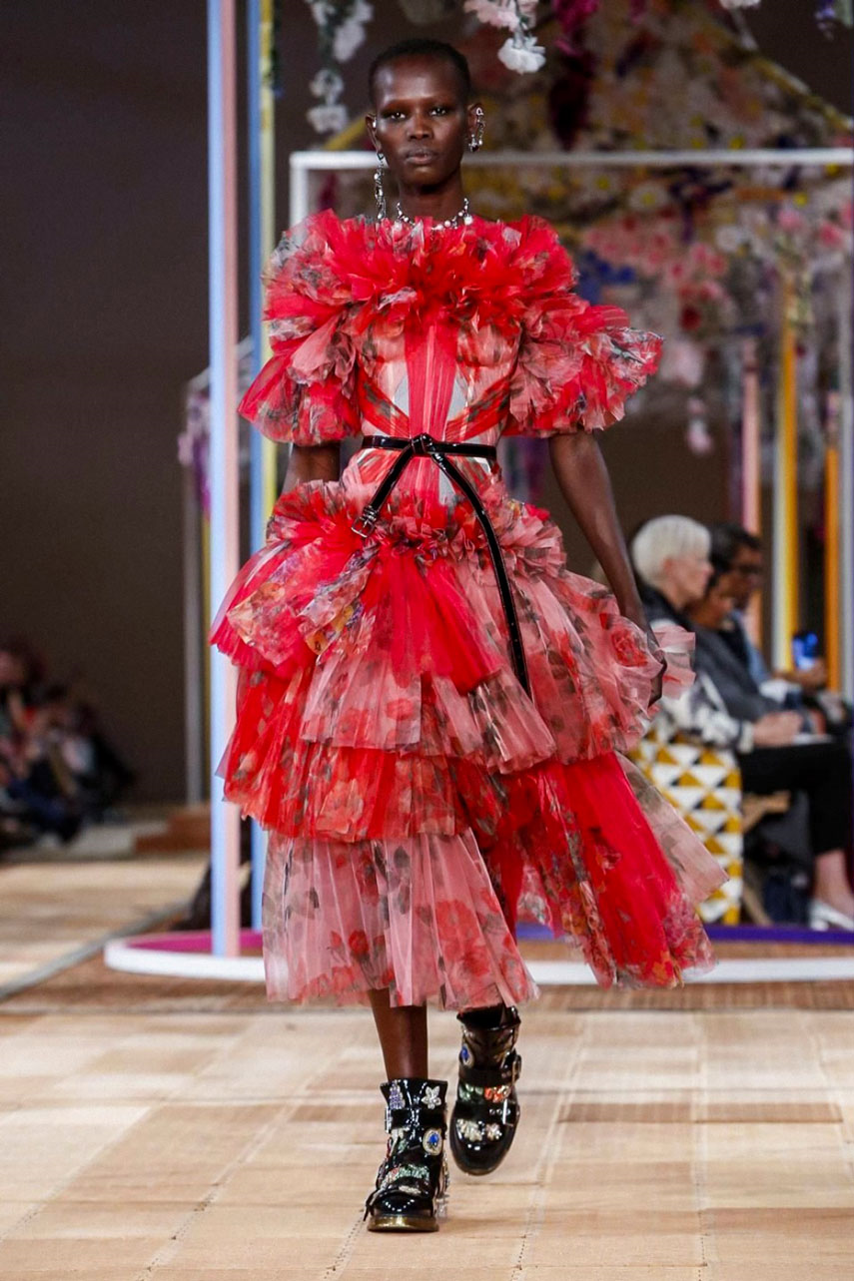
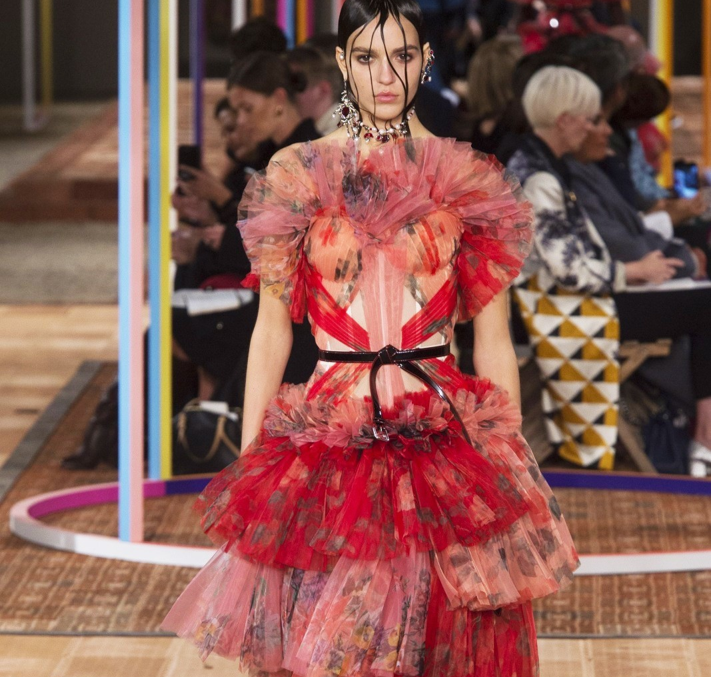
Fall 18
McQueen was a British fashion designer and couturier. He worked as chief designer at Givenchy from 1996 to 2001.
The fact he can address a controversial topic through fashion and create colourful, wild pieces is what I aspire to be.
McQueen's work has always challenged the media, and this is what I love.

Slide 10
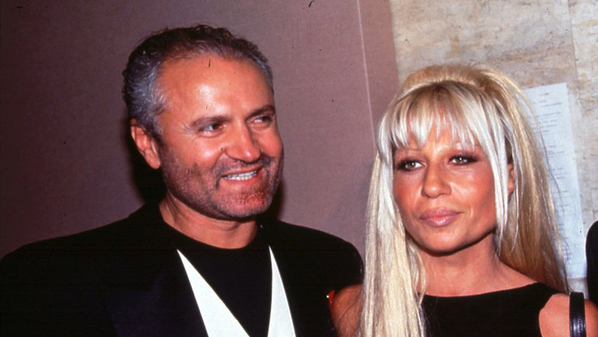
Versace

Slide 11
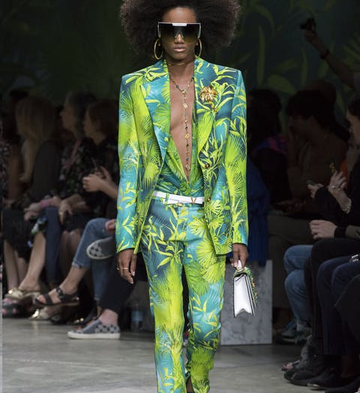
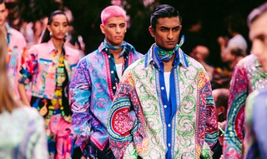
Giovanni Maria Versace was an Italian fashion designer and founder of Versace.
Donatella Francesca Versace who is Giovanni’s sister is an Italian fashion designer and businesswoman. She is the current chief creative officer of Versace.
I have always been inspired by Versace throughout my university experience because of not only the bold colours but the elements of heritage and traditional prints that cover the garments.
SS20

