Slide 1
PID Presentations
Student name: Dumitrita Munteanu

Slide 2
Content
Introduction........................................................................
New project........................................................................
Investor...............................................................................
Project manager..................................................................
Responsibility..............................................................
Partners.......................................................................
Costs............................................................................
SWOT ANALYSIS...........................................................
PESTLE ANALYSIS.........................................................
Macroeconomy...........................................................
Microeconomy............................................................
Conclusion..................................................................

Slide 3
My plan is to add more amenities at Marriott Hotel “Forest Of Arden” in Coventry, United Kingdom. I would like to extend the golf court and add tennis court, basketball field and aquapark.
Time Scale:18/07/2020-05/12/2021
Project initiator: General Manger at Marriott Hotel, Forest of Arden
Project Manager: Dumitrita Munteanu

Slide 4








Priorities
Priority objectives
1)To updates the rooms with a new technology;
2)To add a swimming pool, and to create a special kids’ area.
3)To find more staff, to babysit and look after the kids of the guests;
4)Tennis camp, if we create this, we can have contract with the school or other associations to come for playing.
5)Develop a list with new amenities to be added more guests
6)Lead a marketing team

Slide 6
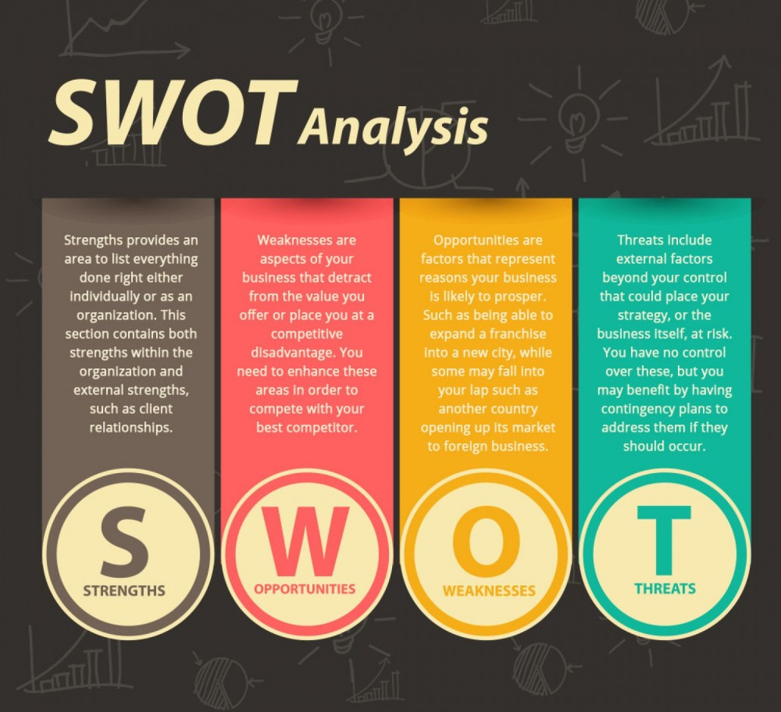
SWOT Analysis

Slide 7
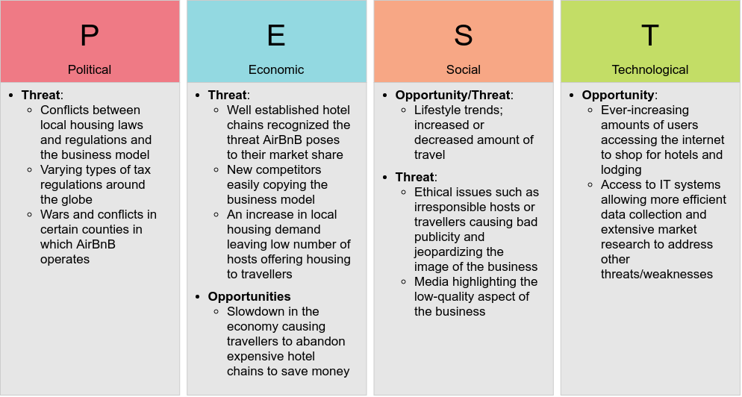

Slide 8
PESTLE
Political
These factors determine the extent to which a government may influence the economy or a certain industry
Economical
Economically we need to focus on how well the new activities in the business will respond to the economical changes that are happening at drastic speeds.
Social
People will remain the most important factor as the business will always depend on them. Whether or not we talk about the potential guests or the workforce at the Hotel.
Technological
All over the world there are newly added technological advancements that are rapidly changing the business world
Legal
For the business to work without any unnecessary obstacles, there must be a great solid legal foundation.
Environmental
As we see how big of an impact the pollution have on our atmosphere and the wellbeing of all species and natural resources, it is important to note that given the amount of work necessary and the products and services needed in order to keep a business running

Slide 9
Microeconomy
Microeconomy
The local government is also struggling to keep the economy going on the microscale and the unemployment and trade deficits have giving rise to the opportunity of cheap credit. The local authorities and financial services are much more willing to do business at lower cost which can be an ideal place for investment capital to fund new projects.

Slide 10


Macroeconomy
Macroeconomy
The recent crises has created obstacles for many projects, but due to the unemployment rate and the drop in demand across all sectors, the project has a big opportunity to save costs with the right deals made with the employed workforce and the companies needed to finish the project.

Slide 11
Conclusion
The conclusion so far is to look no further than funding a new and fresh project for the Marriot Hotel for long term gains and exploit the current economic crisis and take the advantages of being prepared for the aftermath of the crisis.

Slide 12
References
1)Speth, C., 2015. La Matrice SWOT. 1st ed. Primento Digital, p.22.
2) Luenberger, D., 1995. Microeconomy Theory. New York: McGraw-Hill, pp.22-65.
3) Entrepreneur. 2020. Business Plans: A Step-By-Step Guide. [online] Available at: <https://www.entrepreneur.com/article/247574> [Accessed 18 June 2020].
4) Babin, B., Carr, J., Griffin, M. (2019) Business Research Methods. 2nd Ed. Andover, UK: South Western Cengage.

Slide 13
Thank you

