Slide 1
time management
My Personal Development
By Andrea Wilson

Slide 2
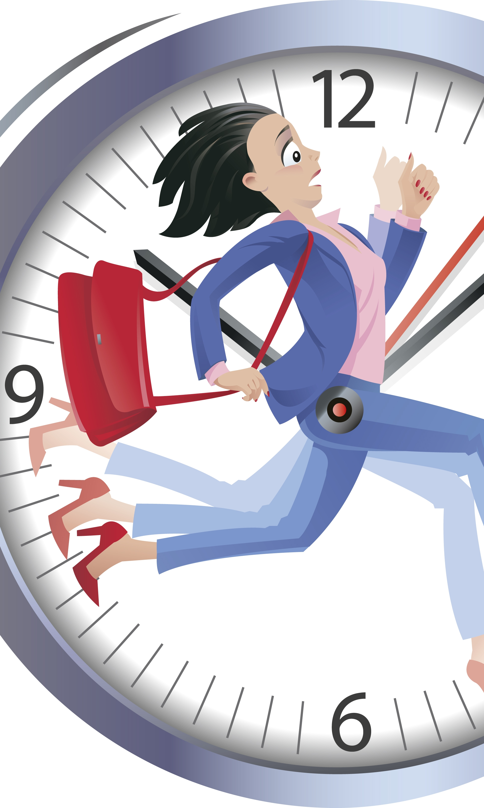
There Is never enough hours in a day.

Slide 3
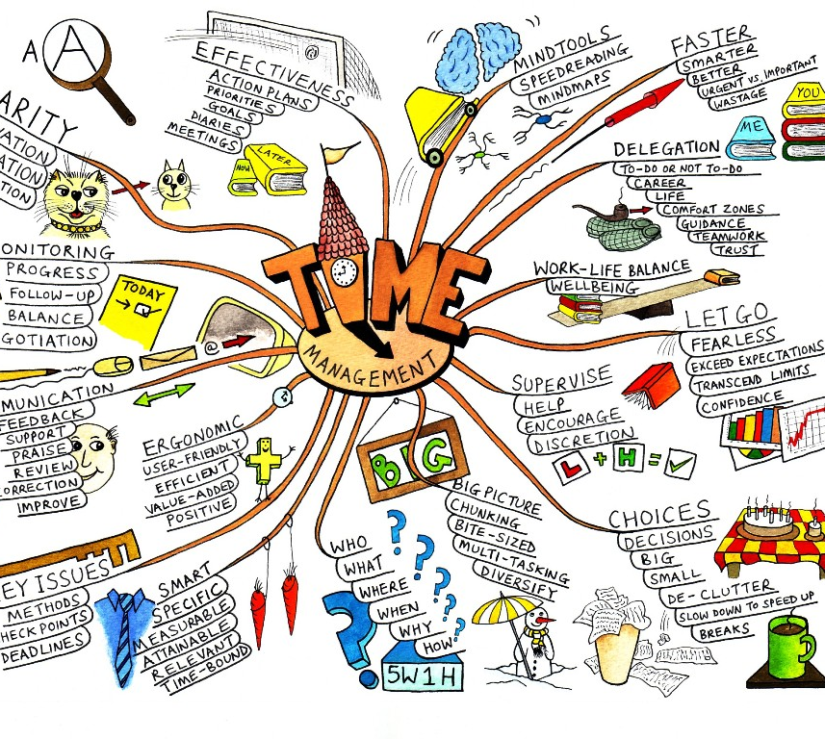
Everyone leads busy lives

Slide 4
WHERE DO I Reflection
What prevents me from managing my time well?
What's important to me?

Slide 5

Procrastination is a wASTE OF TIME, JUST DO IT!

Slide 6
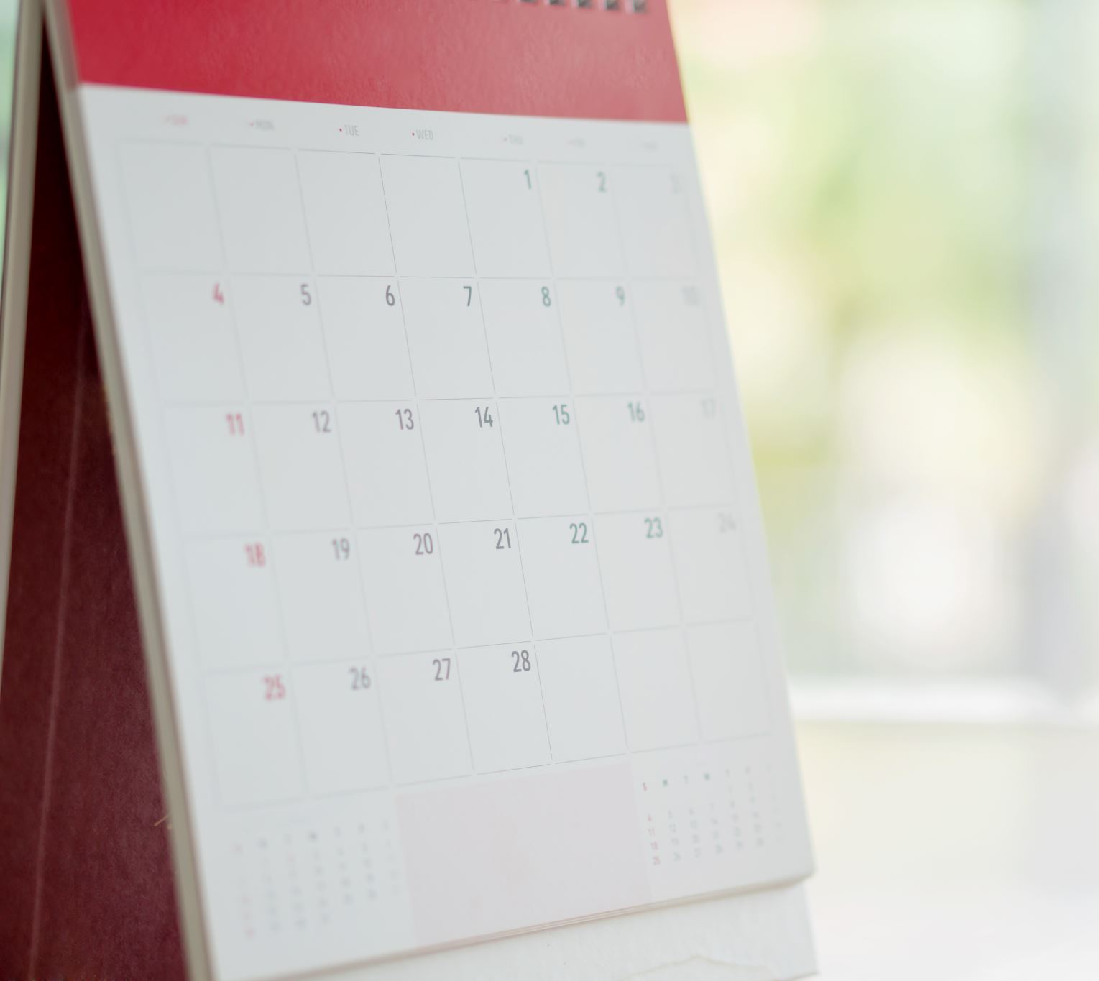
Organising myself
Writing lists.
Keeping a diary of deadlines/events.
Keeping to a schedule and using a weekly planner.
Organising my things at home.
Setting myself small achievable goals.

Slide 7




Finding a balance

Slide 8

ANY QUESTIONS?

Slide 9
REFERENCES
Abraham, N., Shekhar, A., & Guest Post. (2018, August 13). 5 Tips To Get Creative Through Hobbies. Retrieved December 8, 2019, from https://www.dailyhawker.com/health-fitness/5-tips-to-get-creative-through-hobbies/.
Balke, A. (2017, November 14). Grow up, use Mindmaps. Retrieved December 6, 2019, from https://www.monitis.com/blog/best-mind-map-tools-free/.
Burkeman, O. (2016, September 12). Why you feel busy all the time (when you're actually not). Retrieved December 8, 2019, from https://www.bbc.com/future/article/20160909-why-you-feel-busy-all-the-time-when-youre-actually-not.
Cottrell, S. (2013). The study skills handbook. Basingstoke: Palgrave Macmillan.
Deb, S. (2018, October 14). Opinion: Social media is turning us into nasty people. Retrieved December 6, 2019, from https://www.livemint.com/Opinion/MZpWbwrUb5AvrbDuVLUcbI/Opinion--Social-media-is-turning-us-into-nasty-people.html.
Do everything better. (n.d.). Retrieved December 7, 2019, from https://lifehacker.com/.
James Clear. (n.d.). Procrastination: A Brief Guide on How to Stop Procrastinating. Retrieved December 8, 2019, from https://jamesclear.com/procrastination.
Moda. (2015, September 23). Fashion and Sustainability FAQs. Retrieved December 6, 2019, from http://katefletcher.com/fashion-and-sustainability-faqs/.
Pemberton, B. (2019, May 11). Sleep expert reveals how you can get to sleep in just ONE minute by 'hugging yourself'. Retrieved December 6, 2019, from https://www.thesun.co.uk/fabulous/9051899/sleep-expert-fall-asleep-one-minute-hugging-yourself/.
Spending time Together. (2017, February 24). Retrieved December 8, 2019, from https://933fmthefish.com/content/family/spending-time-together.

