Slide 2
Introduction
Module Name: Networks and Cyber Security Essentials
Module Code: ACCA4024
Applied Computing - WISA

Slide 3

Networks and Cyber Security Essentials
Module Lecturers
Mr. Munyaradzi Nicholas Murira
m.murira@uwtsd.ac.uk
Room : Cisco Lab (205) IQ Building.
TUESDAYS: 16:00 – 18.00 : Tutorials
Friday :11:00 -13:00 : Lecture
Module Information
Lectures and Tutorials
Attendance and Practice
Assessments: Two Components 50% & 50 % Weightage

Slide 4
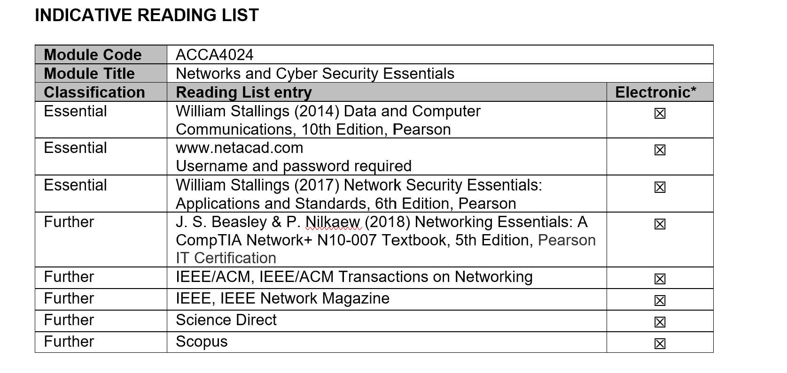
Reading List
Cisco Networking Academy Course Enrolment
Enrolled for CCNA –Intro to Packet Tracer

Slide 5
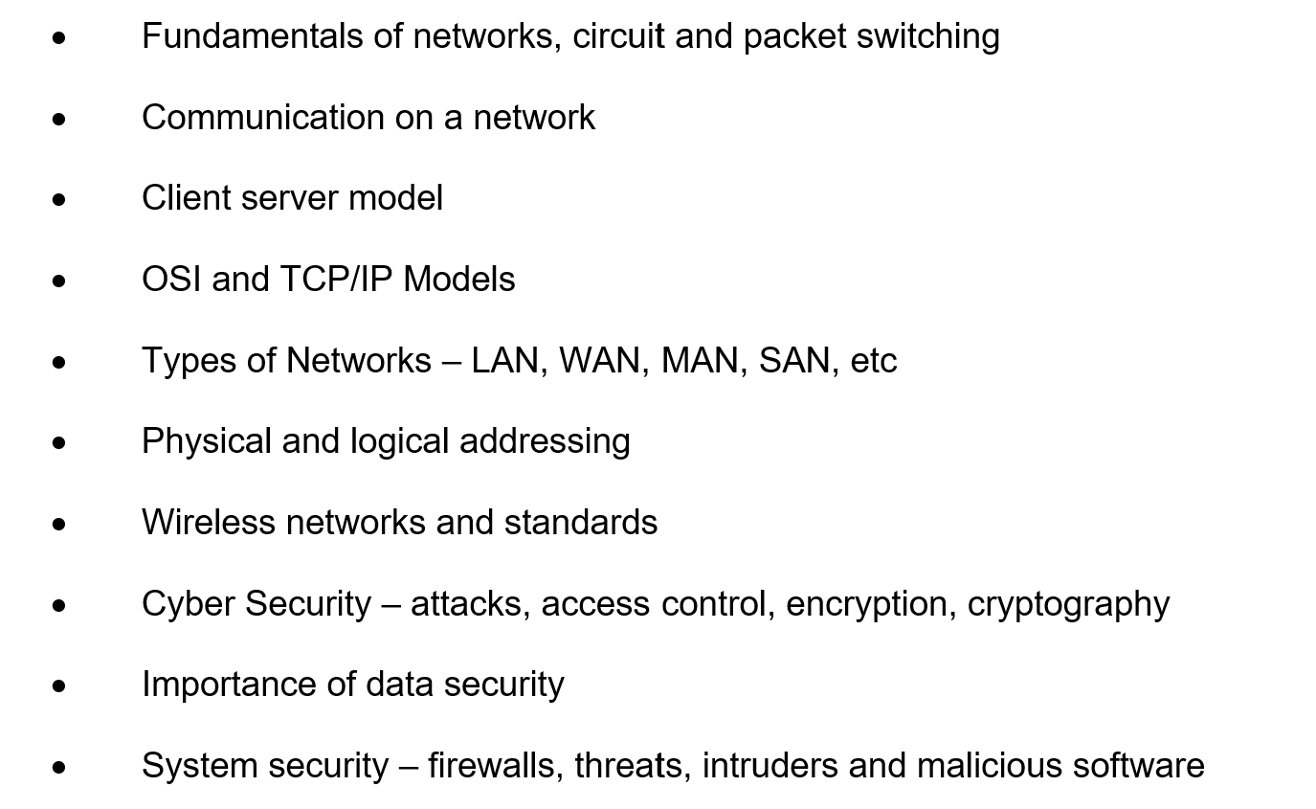
Topics to cover
Advanced routing protocols, distance vector and link state routing protocols
OSPF – single and multi-area
Network design and management
Network security concepts
Access control lists
Network Address Translation for IPv4 & IPv6
Virtual Private Networks and IPSec concepts
Network QoS
Network virtualisation and automation

Slide 6
Assessments
To provide the students with an understanding of the key concepts and fundamentals of data communications, computer networks and security of data and devices in a network.
LEARNING OUTCOMES
Upon the successful completion of this module, the student should be able to:
Develop fundamental understanding of network basics in terms of architecture, devices, application and protocols.
Demonstrate systematic understanding of security policies and measures to mitigate internal and external attacks and threats in a network.

Slide 7
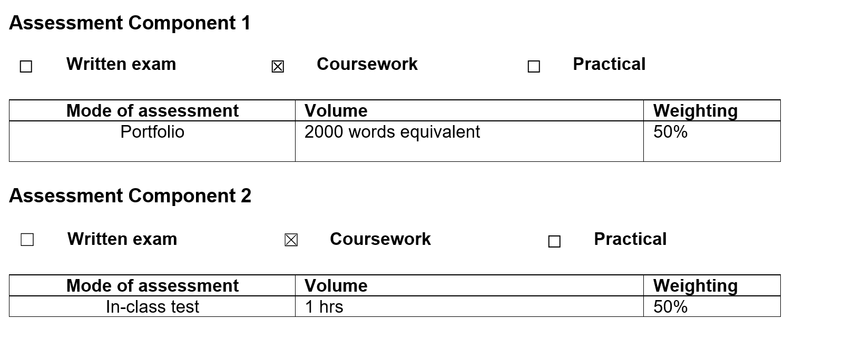
Assessments

Slide 8
Any Questions?

