Slide 1
Supporting Abilities & Behaviours
P150923

Slide 2
CONTENTS PAGE
Disability
Partnership
Law
Myself example
Key aspect working with disabilities
Advantages/Disadvantages
Recommendations
Social Model
Equality
Conclusion
Questions
Reference List

Slide 3

What Is Disability?

Slide 4
‘‘Partnership working in health and social care brings together separate organisations so that they can benefit from pooled expertise, resources and power sharing’’
(Sheehy, 2017)

Slide 5
Partnership
‘‘The health law partnership: a medical-legal partnership strategically designed to provide a coordinated approach to public health legal services, education, advocacy, evaluation, research, and scholarship’’
(Pubmed.Gov, 2018)

Slide 6
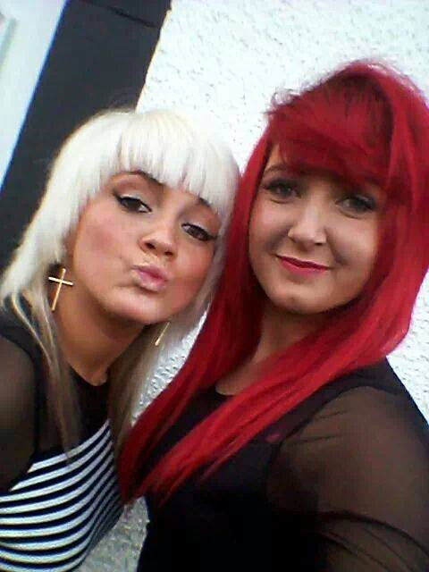
Example (myself)
LSA
Social Worker
Foster Carer
Doctor
Police Force
Counsellor

Slide 7

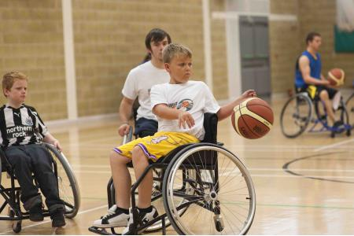
Partnership working with young children with disabilities require different needs to other partnerships, meaning there is more professionals involved, aiming to achieve the best outcome for that individual youth.
(Slowinski, 2018)

Slide 8
Challenges
STRENGHTS
Good staff relationship
Same Outcomes
Effective Resources and skills put into place
Happiness
WEAKNESSES
Personality clash
Professional Opinions
Miscommunication
Different funding streams
Challenging individuals
(Tasmanian Government , 2018)

Slide 9
Recommendations
Resolve any issues sooner rather than later
Hold professional meetings with employee’s, sit down and discuss issues going on and stop it there and then
Communicate success
Provide correct training
Build level of trust
Understand differences and challenges in ones life
Charity work- fund raising

Slide 10


Organisations

Slide 11
Social Model & Medical Model
This model states, people with a disability are effected by barriers in society not an impairment.
Removing these barriers offer more independence and equality.
What is wrong with the person and not what the person needs
The disabled person is the problem
(Scope, 2018)

Slide 12

Questions

Slide 13
Reference List
Sheehy, R. (2017, 06 15). Bridge. Retrieved from https://www.bridgesupport.org/bridge-blog/partnership-working-health-social-care (Accessed 15.1.19)
Barnardos. (2019). Retrieved from Believe in children: http://www.barnardos.org.uk/
Disability Sport. (2014). Retrieved from Disability Sport: http://www.disabilitysport.org.uk/facts-and-figures-about-disabled-people-in-the-uk.html
EGCP. (2019). Retrieved from East Grampian Coastel Partnership: http://egcp.org.uk/partnership/partnership-background.html
GOV.UK. (2019). Retrieved from GOV.UK: https://www.gov.uk/definition-of-disability-under-equality-act-2010
Pubmed.Gov. (2018). Retrieved from Nationial Libary of medicine nationial institute of health: https://www.ncbi.nlm.nih.gov/pubmed/24669809
Scope. (2018). Retrieved from Equality for disabled people: https://www.scope.org.uk/about-us/our-brand/social-model-of-disability
Slowinski, S. (2018, 12 7). Partners for youth with disabilities. Retrieved from https://www.pyd.org/
Tasmanian Goverment . (2018). Retrieved from Department of health and human services: https://www.dhhs.tas.gov.au/wihpw/principles/cultural_change
Team Wales. (2019). Retrieved from Sport Wales: http://sport.wales/about-us/how-we-work/working-in-partnership.aspx

