Slide 1


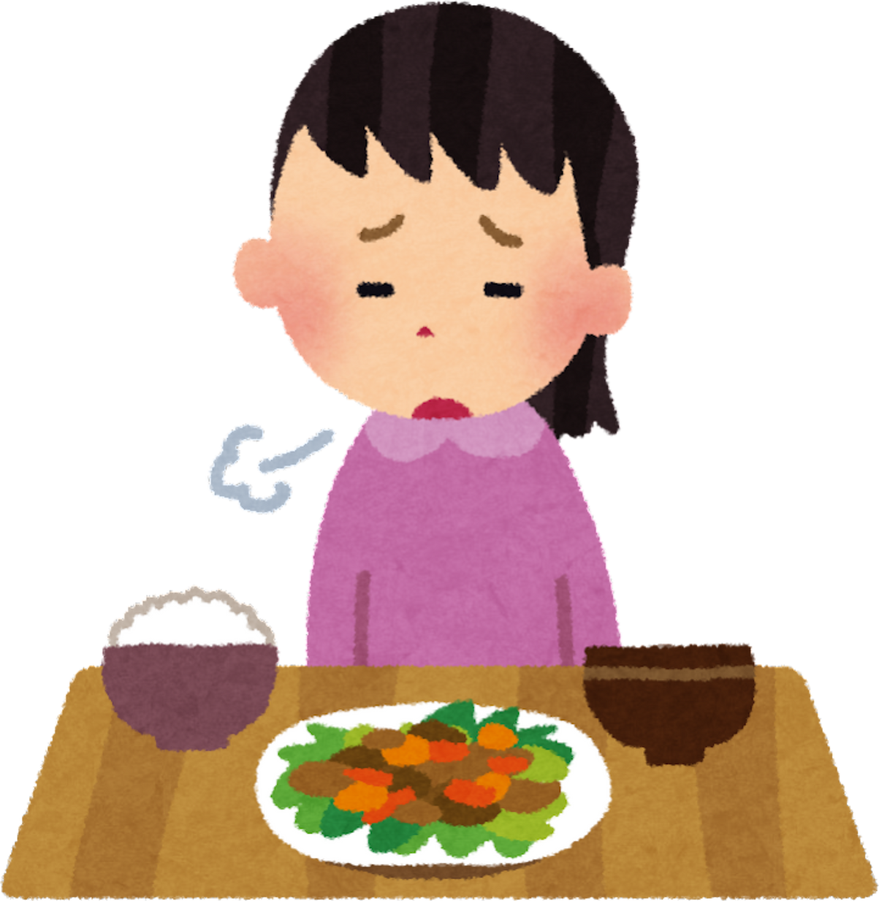
Anorexia Nervosa (ICD-11 6B80): from stigma to supportive, modern eating-disorder care
Name: Somia Kausar
Student id: 2239088
Programme: BSc (Hons) Health and Social Care
Module: Psychological Classifications and Provisions (BMHP6029)
Submission Date: 2 Nov 2025

Slide 2
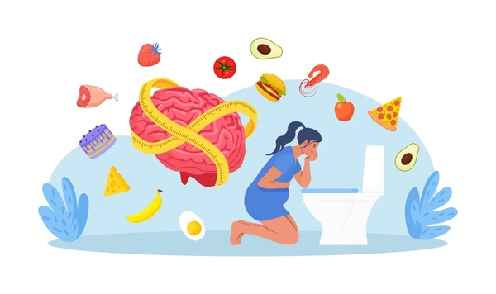
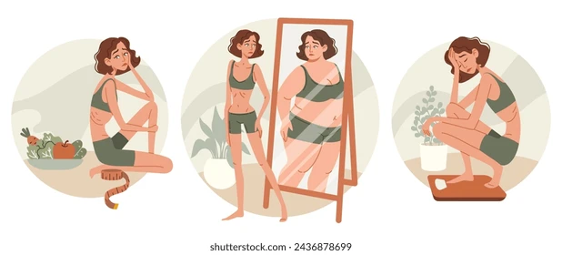
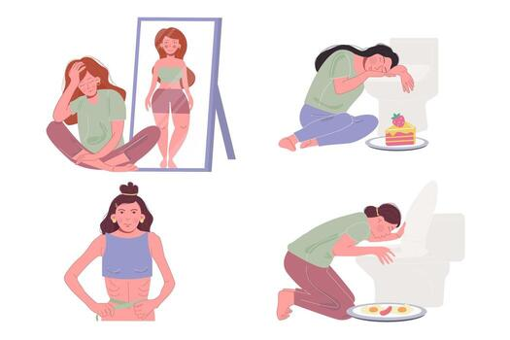

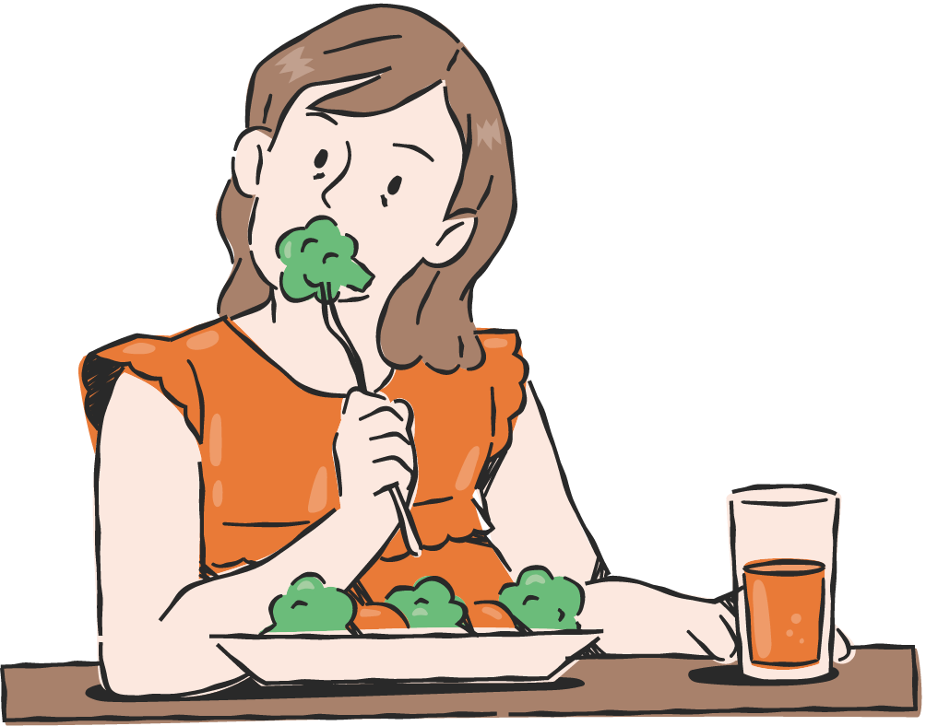

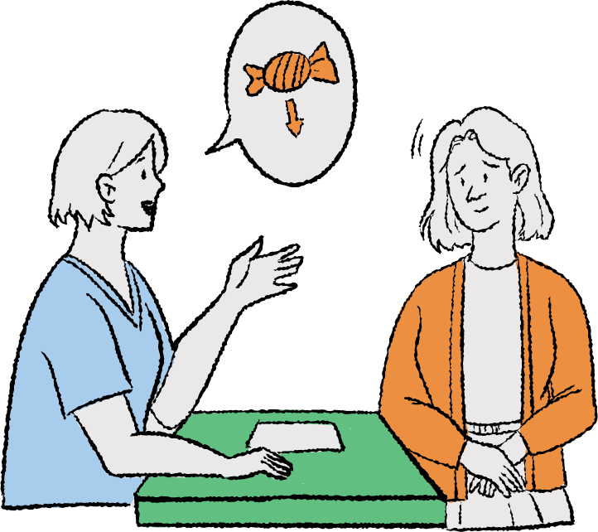
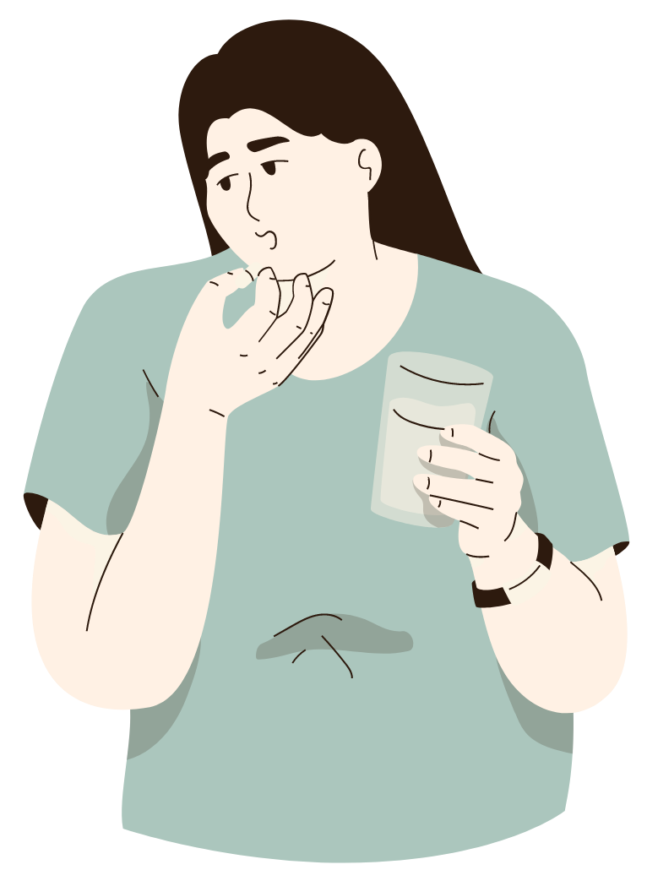
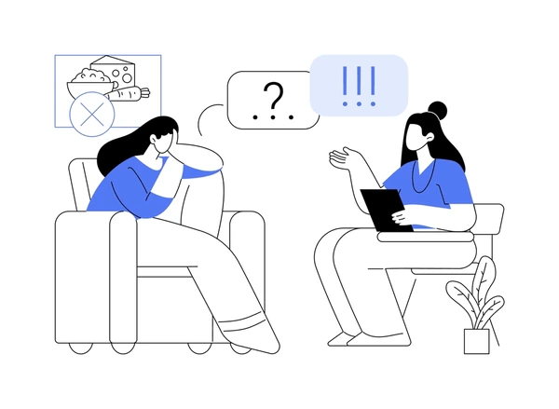
1) Overview & Why it matters
  Anorexia nervosa (AN) is a serious eating disorder with restricted intake, low weight or rapid weight loss, and distorted body image/over-valuation of weight/shape (WHO, 2024).
  It harms the heart, hormones, bones and brain. It can be life-threatening without timely care (RCPsych, 2022).
  Demand rose after COVID-19. More young people are identified with eating problems and start treatment, stretching services (NHS England, 2023; Lancet Diabetes & Endocrinology, 2023).
2) Classification (ICD-11)
  ICD-11 code 6B80 defines AN and specifies clinical descriptions and diagnostic requirements (CDDR) to improve reliability (WHO, 2024).
  Clinicians record severity, rate of weight change, and functional impact to guide risk and care plans (WHO, 2024).
3) Brief history: from blame to care
  Older practice sometimes used coercion and long hospital stays; families were not actively involved in treatment. Outcomes were mixed and stigma was common (surveillance). (NICE, 2024).
  Shift: modern policy promotes early help, family involvement, and evidence-based therapy (NICE NG69 updated, 2024). (NICE, 2024).
4) Stigma, discrimination, inequality
  Many still feel shame and self-stigma, which blocks help-seeking. Campaigns must name stigma and offer safe routes into care (Wall et al., 2024).
  Inequalities exist for minority ethnic groups and people who do not fit stereotypes (e.g., males, higher-weight, diverse cultures). Services must adapt materials and access points (policy reviews, 2023–2024; NHS 2023 data). (NHS Digital, 2023).
5) Current UK care pathway
  Medical risk first: check vitals, ECG, bloods; watch for refeeding syndrome; follow MEED Medical Emergencies in Eating Disorders for red flags and urgent admission (RCPsych, 2022).
  Communication: use calm, non-shaming language; validate distress; avoid labels like “anorexic” (NICE, 2024).
6) What works
  Young people: Family-Based Treatment (FBT) is first-line; parents help restore nutrition with clinician coaching (NICE, 2024). Real-world results are positive (Oshukova et al., 2023).
  If FBT is not acceptable/effective: CBT-E is a key option; growing adolescent evidence supports feasibility and outcomes (Dalle Grave and Calugi, 2024).
  Adults: offer an evidence-based therapy (e.g., CBT-E; MANTRA) with carer input where helpful (NICE, 2024).
  Medication: no drug “cures” AN. Olanzapine may help some adults with weight/obsessions; evidence remains limited, especially for young people (NICE, 2024)..
7) Early intervention model
  FREED (First Episode Rapid Early Intervention for Eating Disorders) targets people 16–25 with recent-onset EDs; it cuts waits and improves engagement (Richards et al., 2021).
  FREED sets 48 h engagement call, 2-week assessment, 4-week treatment targets; fidelity studies show useful adherence benchmarks (Richards et al., 2021).

Slide 3






8) Literature-led critical analysis: attitudes, practice, policy
  Attitudes: framing AN as a “choice” fuels shame and delays care. Community data link perceived stigma and lower help-seeking; services should build trust and confidentiality into first contacts (Wall et al., 2024).
  Practice: the MEED standard makes risk visible and actionable; when used, teams spot arrhythmias, electrolyte shifts, dehydration earlier and prevent refeeding syndrome (RCPsych, 2022).
  Policy: NICE NG69 centres FBT/CBT-E, shared decisions, and carer involvement; 2024 surveillance updates involuntary-treatment guidance and emphasises compassionate practice (NICE, 2024).
  Access & capacity: post-pandemic referrals increased; editorials call for investment to match need and cut waits (Lancet D&E, 2023; NHS England, 2023).
  Therapy choice: adolescent data show FBT effective in clinics (Oshukova et al., 2023). CBT-E is valuable where FBT is not acceptable or insufficient, and can be used across ages (Dalle Grave and Calugi, 2024; NICE, 2024).
  Medicines: adjunctive role only; OPEN feasibility suggests olanzapine may be acceptable to some young people but evidence is early (Said et al., 2024).
9) Lived experience & communication
  Ask “What feels hardest about food right now?” and “What support feels safest?” (NICE, 2024).
  Use person-first language (e.g., “a person living with anorexia”). Avoid weight-centric praise or moral language around food (NICE, 2024; Wall et al., 2024).
10) Gaps & challenges
  Waiting times and thresholds still block early care; young people report “not ill enough” experiences (NHS England, 2023; Lancet D&E, 2023).
  Health inequalities: materials and pathways often don’t fit language and culture needs; adapt outreach and engagement (NHS Digital, 2023).
  Workforce: staff need MEED training and protected time for family-work and meal support (RCPsych, 2022; NICE, 2024).
11) Recommendations (policy & practice)
  Embed early access: commission FREED-style pathways for 16–25s (targets: 48 h call / 2-week assessment / 4-week treatment) (Richards et al., 2021).
  Resource core therapies: ensure capacity for FBT and CBT-E; offer choice when one isn’t acceptable (NICE, 2024; Dalle Grave and Calugi, 2024).
  Make safety routine: roll out MEED education to ED, paediatrics, GP, ambulance and acute teams (RCPsych, 2022).
  Cut stigma: co-produce materials with lived experience; show recovery stories; make first contact private and welcoming (Wall et al., 2024).
  Close inequality gaps: translate resources; partner with community and faith groups; track access by ethnicity/IMD to act on gaps (NHS Digital, 2023).
12) Key message
  Kind, prompt, family-centred, evidence-based care saves lives.
  Early help and respectful language open the door to recovery.

Slide 4
REFERENCES
  Dalle Grave, R. and Calugi, S. (2024) ‘Enhanced cognitive behaviour therapy for adolescents with eating disorders: development, effectiveness, and future challenges’, BioPsychoSocial Medicine, 18, 18. https://doi.org/10.1186/s13030-024-00315-7
  National Institute for Health and Care Excellence (2017, updated 2024) Eating disorders: recognition and treatment (NG69). London: NICE. Available at: https://www.nice.org.uk/guidance/ng69 (Accessed 29 Oct 2025).
  NHS England / NHS Digital (2023) Mental Health of Children and Young People in England, 2023: Part 5—Eating problems and disorders. Available at: https://digital.nhs.uk/data-and-information/publications/statistical/mental-health-of-children-and-young-people-in-england/2023-wave-4-follow-up/part-5-eating-problems-and-disorders (Accessed 29 Oct 2025).
  Oshukova, S., Suokas, J., Nordberg, M. and Ålgars, M. (2023) ‘Effects of family-based treatment on adolescent outpatients treated for anorexia nervosa in the Eating Disorder Unit of Helsinki University Hospital’, Journal of Eating Disorders, 11, 154. https://doi.org/10.1186/s40337-023-00879-9
  Richards, K. L., Flynn, M., Austin, A., Lang, K., Allen, K. L., Bassi, R., … Schmidt, U. (2021) ‘Assessing implementation fidelity in the First Episode Rapid Early Intervention for Eating Disorders service model’, BJPsych Open, 7(3), e98. https://doi.org/10.1192/bjo.2021.51
  Royal College of Psychiatrists (2022) Medical Emergencies in Eating Disorders (MEED): Guidance on recognition and management (CR233). London: RCPsych. Available at: https://www.rcpsych.ac.uk/improving-care/campaigning-for-better-mental-health-policy/college-reports/2022-college-reports/cr233 (Accessed 29 Oct 2025).
  Said, O., Stringer, D., Sengun Filiz, E. et al. (2024) ‘Olanzapine for young PEople with aNorexia nervosa (OPEN): results of a feasibility study’, BMC Psychiatry, 24, 779. https://doi.org/10.1186/s12888-024-06215-y
  The Lancet Diabetes & Endocrinology (2023) ‘Eating disorders: care not keeping up with demand’, The Lancet Diabetes & Endocrinology, 11(9), p. 625. https://doi.org/10.1016/S2213-8587(23)00234-6
  Wall, P.L., Fassnacht, D.B., Fabry, E., O’Shea, A.E., Houlihan, C., Mulgrew, K. and Ali, K. (2024) ‘Understanding stigma in the context of help-seeking for eating disorders’, Journal of Eating Disorders, 12, 126. https://doi.org/10.1186/s40337-024-01086-w
  World Health Organization (2024) Clinical descriptions and diagnostic requirements for ICD-11 mental, behavioural and neurodevelopmental disorders (CDDR). Geneva: WHO. Available at: https://www.who.int/publications/i/item/9789240077263

