Slide 1

ACFA7004 – Research Methods and Professional Development
Title:
Evaluating Bias in ML Models for Healthcare Diagnostics: A Methodological and Ethical Perspective.
Student: Shaidhul Hasan (ID: 2442113)

Slide 2
Research Context/Background
Main Focus : The fundamental issue of achieving excellence without equity.
Context: Machine Learning (ML) is revolutionizing healthcare diagnostics (e.g., medical imaging and risk prediction).
The Urgency: However, ML's power is compromised by algorithmic bias—errors that disproportionately affect minority demographic groups (e.g., race, gender).
Key Evidence: Studies show these biases are not theoretical; they lead to tangible harm, such as misdiagnosis or underestimation of care needs for specific patient populations (e.g., Obermeyer et al.).

Slide 3
Research problem
Main Focus: Defining the precise, high-level problem this research addresses.
The Challenge: Current ML models, trained on historically non-representative data, perpetuate and amplify systemic health disparities.
The Problem Statement: Although the existence of bias is known, the discipline lacks an empirical foundation that correlates technical mitigation efficacy with a data scientist's level of ethical literacy or professional training.
Conclusion: The problem is a socio-technical gap where advances in algorithms have outpaced the ethical awareness and governance needed for responsible implementation.

Slide 4
Aim
To critically appraise the causal relationship between algorithmic bias and equitable healthcare outcomes by synthesizing empirical evaluation and qualitative inquiry, ultimately advancing a novel, socio-technical framework for Responsible AI practice.

Slide 5
Objectives
Quant.: To empirically quantify and compare diagnostic performance disparities across critical demographic subgroups (e.g., age, gender, ethnicity).
Quant. & Critique: To critically evaluate and benchmark the efficacy of pre-processing, in-processing, and post-processing bias mitigation techniques.
Qual. & Synthesis: To qualitatively investigate and critique current ethical awareness among data scientists and explore its correlation with mitigation implementation.

Slide 6
Brief Literature review and summary
Main Focus: Critically evaluate two streams of literature that justify the mixed-methods approach.
Technical Literature: ML models achieve high performance (e.g., CNNs for imaging). However, fairness metrics (e.g., Equal Opportunity) often conflict, creating a fundamental philosophical dilemma—there is no single definition of fairness.
Ethical/Professional Literature: Frameworks (e.g., Floridi et al., WHO) stress accountability, but implementation guidelines are vague. Research shows data-science education often results in ethical blind spots among practitioners.
Summary to Gap: The literature is strong on what bias is and why it is wrong, but weak on how to reliably fix it while measuring the human-factor impact. This justifies our original synthesis of empirical testing and professional critique.

Slide 7
Research Methodology (Quantitative Component)
Main Focus: Detailing the core technical innovation—the comparative study.
Design: Mixed-Methods Strategy (Rigorously justified for statistical and contextual analysis).
Data & Models: MIMIC-III (Clinical Data) and NIH Chest X-ray (Imaging Data). Models include CNNs and Logistic Regression.
The Originality (Benchmarking): We will implement and rigorously compare three distinct bias mitigation strategies to identify the most efficient intervention point:
  Pre-processing (e.g., Data Re-sampling)
  In-processing (e.g., Adversarial Debiasing)
  Post-processing (e.g., Equalized Odds Post-Processing)
Evaluation: Using multiple fairness metrics (Statistical Parity, Equal Opportunity, etc.) to acknowledge the complexity of fairness.

Slide 8
Research Methodology (Qualitative Component & Ethis)
Title: Research Methodology: Qualitative Rigor and Ethics
Main Focus: Defending the complexity of the qualitative analysis and the ethical rigor.
Qualitative Component: Semi-structured interviews with data scientists and ethics educators.
Rigor: Analysis uses the Rigorous Thematic Analysis (Braun & Clarke) model, supported by NVivo software. This is crucial for allowing contextual, nuanced narratives to emerge.
Ethical Considerations: MANDATORY: Ethics approval will be secured. All participant data will be anonymized and consent obtained.
Advanced Judgement: We acknowledge the meta-ethical challenge of using historically biased datasets to study bias, demonstrating our ability to make sound judgements in the absence of complete data.

Slide 9
Project Planing and Resources
Main Focus: Showing a realistic plan and justifying resource use.
Methodology Resources:
  Data: MIMIC-III, NIH Chest X-ray
  Software: Python (TensorFlow, Scikit-learn), NVivo (for qualitative analysis).
  Hardware: Access to cloud computing/GPU resources (implied for CNNs).
Timeline (7 Months for Proposal): A Gantt Chart illustrates the structured plan.
Key Message: The quantitative benchmarking (Months 3-5) and qualitative analysis (Month 6) are the most intensive and critical phases.
Risk Management (Implied): The detailed benchmarking strategy (comparing 3 types of mitigation) acts as a primary risk mitigation strategy against the failure of any single technique.

Slide 10
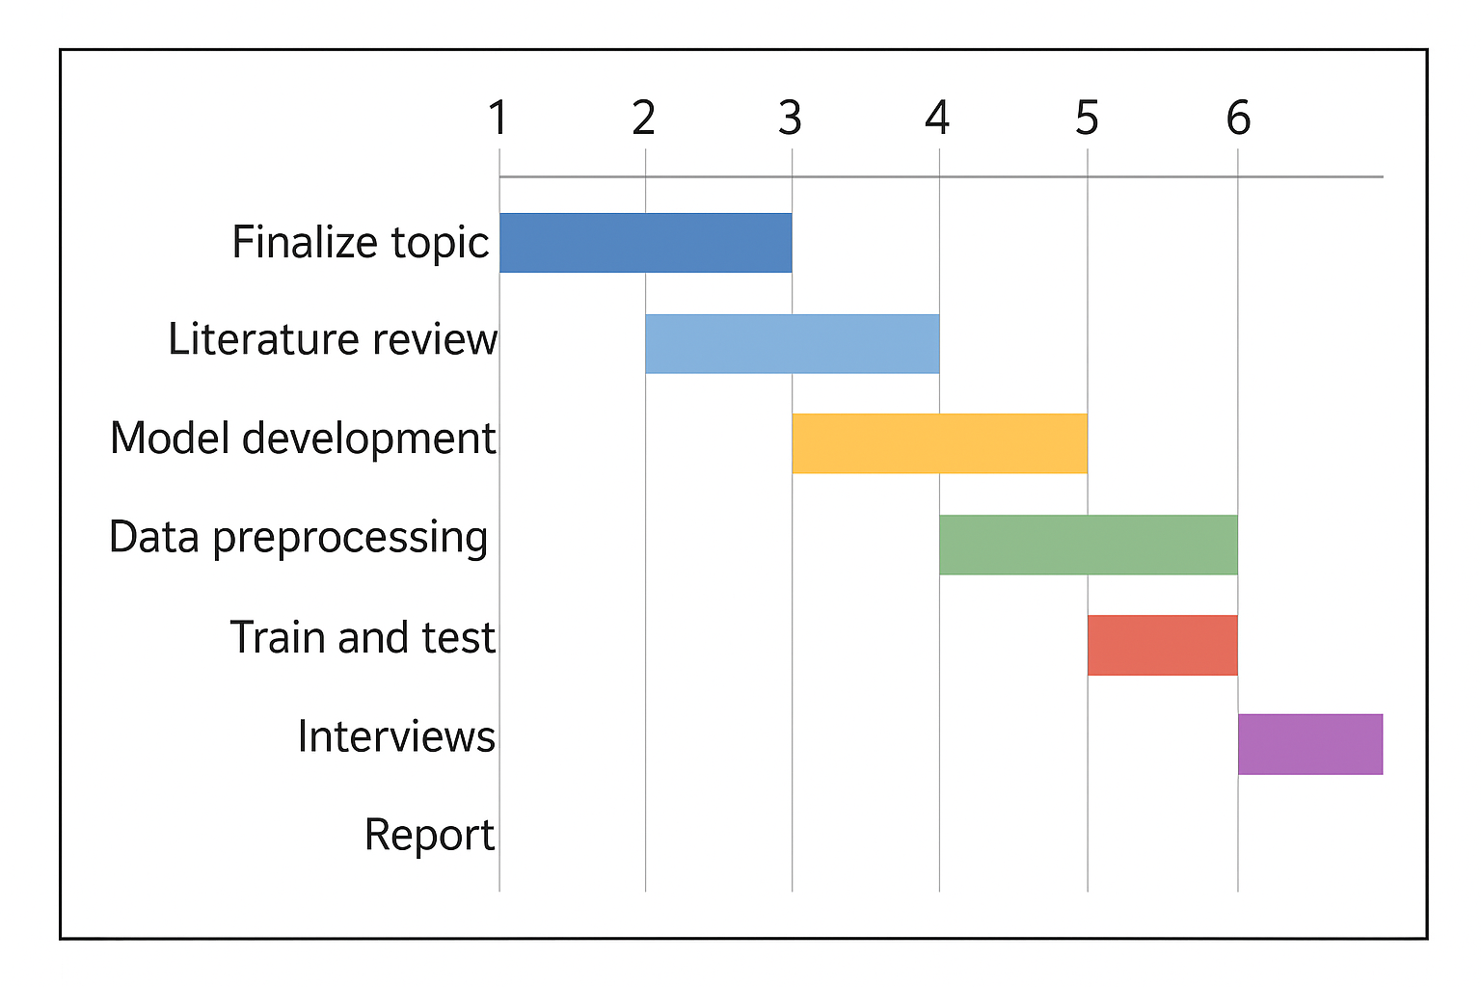
Gantt chart

Slide 11
Project Impect and Limitation
Project Impact:
  Methodological: Provides empirically justified, best-practice recommendations for bias mitigation.
  Professional: Offers actionable insights for integrating ethics into data science curriculum and Responsible AI governance.
Limitations (Critical Self-Awareness): Key limitations include model scope and the reliance on a purposive, small sample for interviews. We contextualize our results within these boundaries.

Slide 12
Conclusion
This research provides the systematic understanding, critical evaluation, and originality required to advance equitable outcomes in this safety-critical domain. Our findings will not just measure bias—they will prescribe practical, tested solutions and ensure the people building the systems are equipped with the necessary ethical literacy to make AI a force for justice in healthcare.

Slide 13
Reference
[1] Z. Obermeyer, B. Powers, C. Vogeli, and S. Mullainathan, “Dissecting racial bias in an algorithm used to manage the health of populations,” Science, vol. 366, no. 6464, pp. 447–453, 2019.
[2] J. Buolamwini and T. Gebru, “Gender shades: Intersectional accuracy disparities in commercial gender classification,” Proc. Mach. Learn. Res., vol. 81, pp. 1–15, 2018.
[3] N. Mehrabi, F. Morstatter, N. Saxena, K. Lerman, and A. Galstyan, “A survey on bias and fairness in machine learning,” ACM Comput. Surv., vol. 54, no. 6, pp. 1–35, 2021.
[4] J. Zhang and T. Holstein, “Bias amplification in pre-trained neural networks: Challenges for transfer learning,” J. AI Ethics, vol. 3, pp. 125–138, 2023.
[5] S. Esteva et al., “Dermatologist-level classification of skin cancer with deep neural networks,” Nature, vol. 542, pp. 115–118, 2017.
[6] P. Rajpurkar et al., “CheXNet: Radiologist-level pneumonia detection on chest X-rays with deep learning,” arXiv:1711.05225, 2017.
[7] A. J. Larrazabal, N. Nieto, E. Peterson, and D. H. Milone, “Gender imbalance in medical imaging datasets produces biased classifiers,” Nature Commun., vol. 11, no. 1, 2020.
[8] E. Daneshjou et al., “Disparities in dermatology AI systems,” Lancet Digit. Health, vol. 4, pp. e406–e416, 2022.
[9] H. Singh and P. Kumar, “Algorithmic fairness in cardiology AI models,” IEEE Access, vol. 11, pp. 58510–58525, 2023.
[10] R. Binns, “Fairness metrics: A comparative analysis,” Data & Society J., vol. 2, 2021.
[11] S. Barocas, M. Hardt, and A. Narayanan, Fairness and Machine Learning, MIT Press, 2023.
[12] R. K. Eubank and T. Patel, “Adversarial de-biasing for healthcare AI,” IEEE Trans. AI, vol. 5, no. 3, pp. 145–156, 2024.
[13] T. Beauchamp and J. Childress, Principles of Biomedical Ethics, 8th ed., Oxford Univ. Press, 2019.
[14] L. Floridi et al., “AI4People—An ethical framework for a good AI society,” Minds & Machines, vol. 28, no. 4, pp. 689–707, 2018.
[15] World Health Organization, Ethics and Governance of Artificial Intelligence for Health, Geneva: WHO, 2021.
[16] R. Binns, M. Veale, M. Van Kleek, and N. Shadbolt, “’It’s reducing a human being to a percentage’: Perceptions of justice in algorithmic decisions,” CHI Conf. Hum. Factors Comput. Syst., 2018.
[17] A. Mitchell and L. Henderson, “Embedding ethics into data-science education: A review of pedagogical practices,” Comput. Educ., vol. 197, 2025.

Slide 14
Thank You!

