Slide 1


Health and safety guide for the housekeeping team at holiday Inn- an IHG hotel

Slide 2
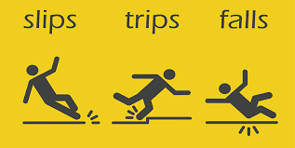

Identifying Potential Risks
Wet surfaces, loose rugs, and cluttered pathways pose risks for slips, trips, and fall
How do you prevent it? Jones, L. (2023)

Slide 3
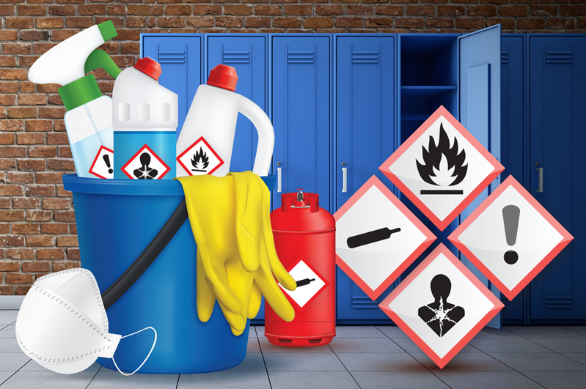

Identifying Potential Risks
Chemical Exposure
skin irritation
respiratory issues
or more severe health problems
Also fires and explosions
Jusoh, Z. et al, 2016.

Slide 4

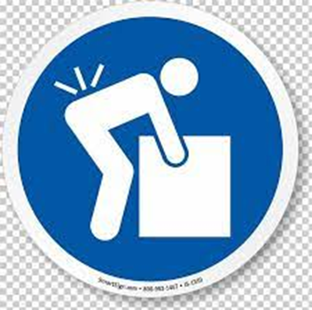
Ergonomic Strain
Improper movements can lead to musculoskeletal injuries
(Wami, S.D., Dessie, A. and Chercos, D.H., 2019).

Slide 5




Precautions
Always read and follow instructions on cleaning product labels.
Read warning signs when floors are wet or undergoing cleaning procedures.
Take regular breaks to prevent fatigue and maintain focus.
Take a break.

Slide 6

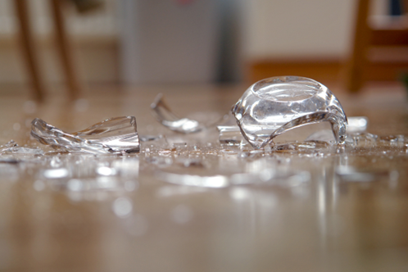
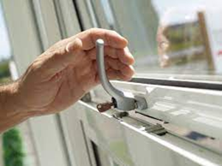
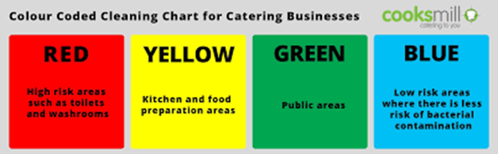


Procedures
Inspect the room for any potential hazards such as broken glass or sharp objects.
Ventilate the room by opening windows or using exhaust fans before using any cleaning chemicals.
Start cleaning from the highest point in the room (e.g., dusting ceiling fans) and work downwards to minimize dust resettling.
Use color-coded cleaning cloths to avoid cross-contamination between different surfaces.
Practice "clean as you go" to maintain tidiness and prevent clutter buildup.
Dispose of waste properly in designated bins, paying attention to recycling guidelines.
Inspect equipment regularly for signs of damage and report any issues to maintenance immediately.
Kline, S., Almanza, B. and Neal, J., 2014.

Slide 7

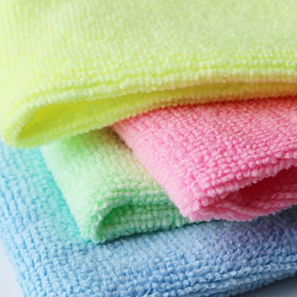
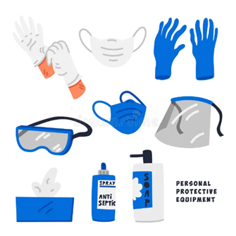
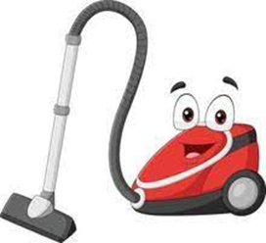

Room Cleaning Essential Equipment Needed
It’s very important to be prepared and use the right product for the right job such as……

Slide 8
Control Measures in Mitigating Hazard
Avoidance Reduction Equip Acceptance
Some practical tips on mitigating slips/trips/falls include:
Ensure that walkways are clear and well-lit, and promptly clean up spills.
Create a system for safely storing and handling cleaning chemicals e.g. proper labeling and storage away from food and drink
Provide training on proper lifting techniques and encourage the use of ergonomic tools such as lightweight vacuum cleaners and adjustable-height carts.
Bednarska, M., 2004.

Slide 9
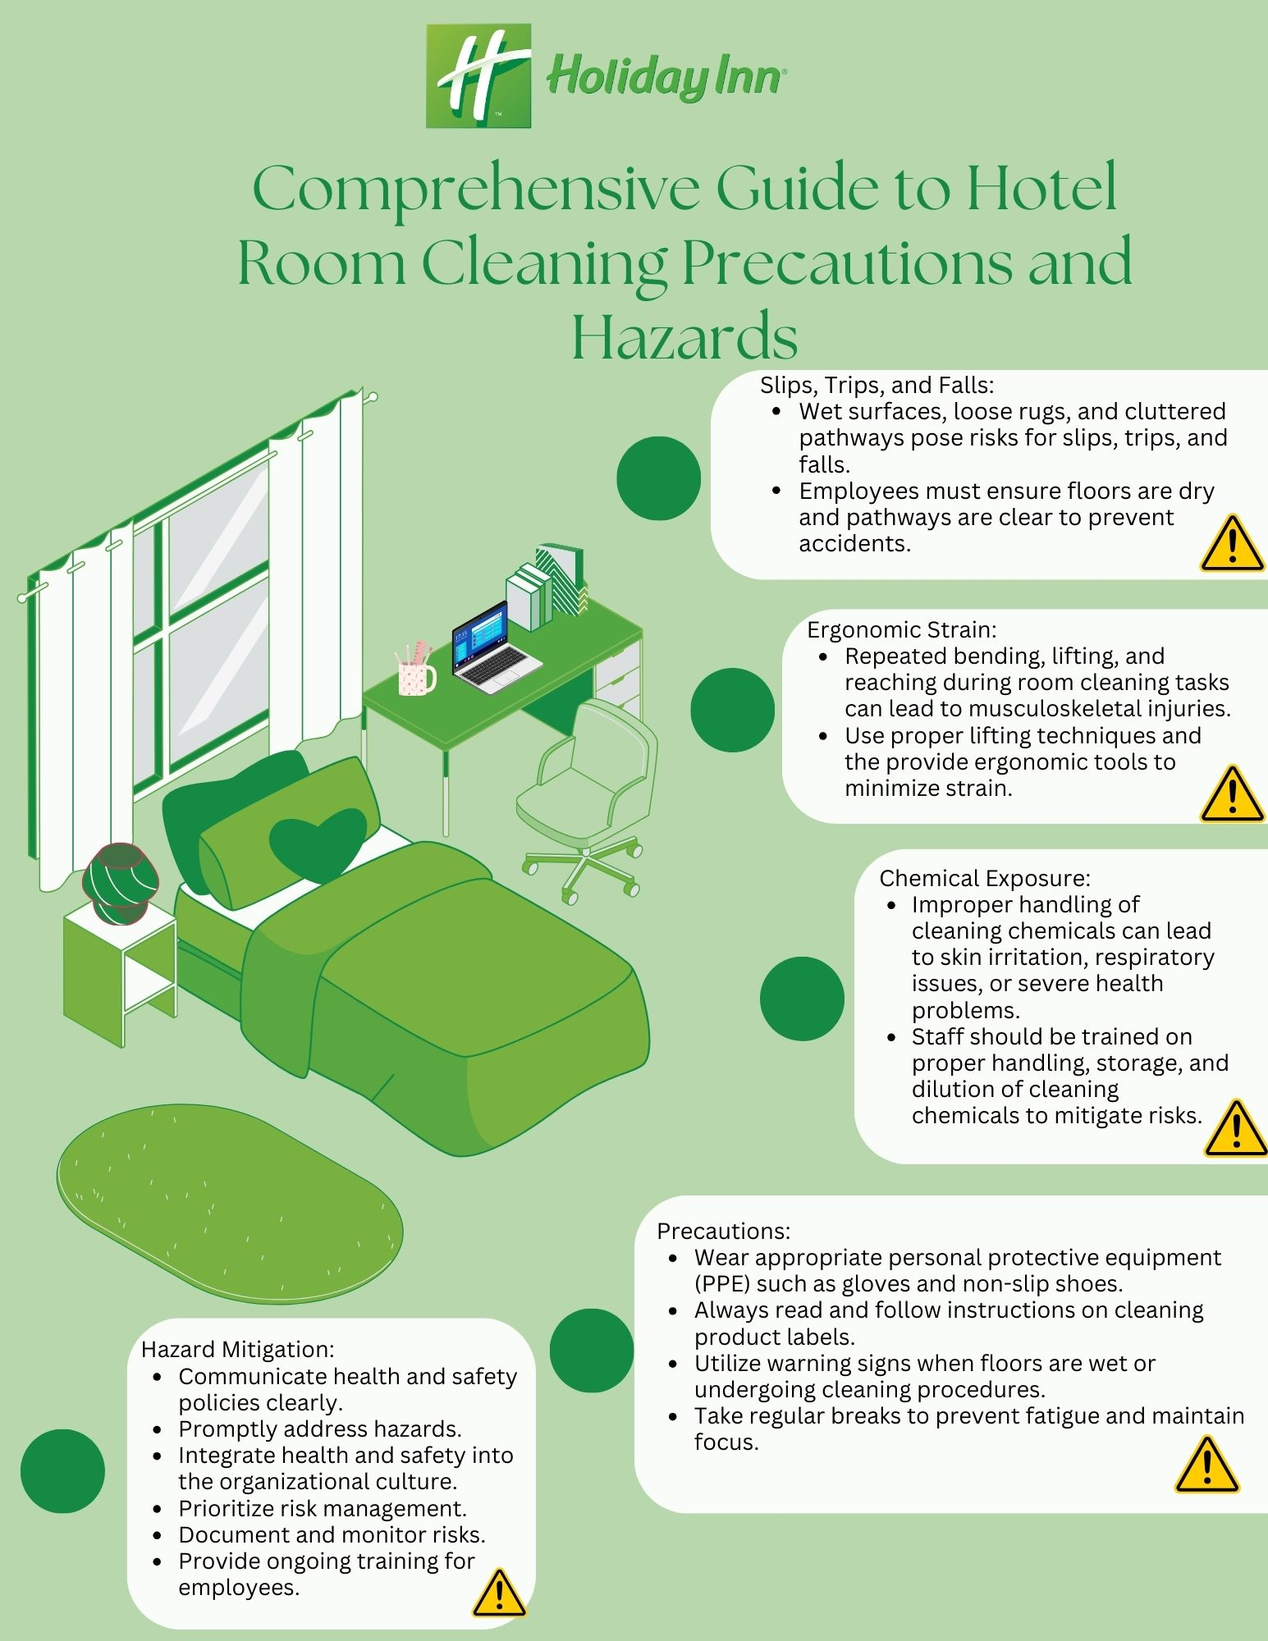
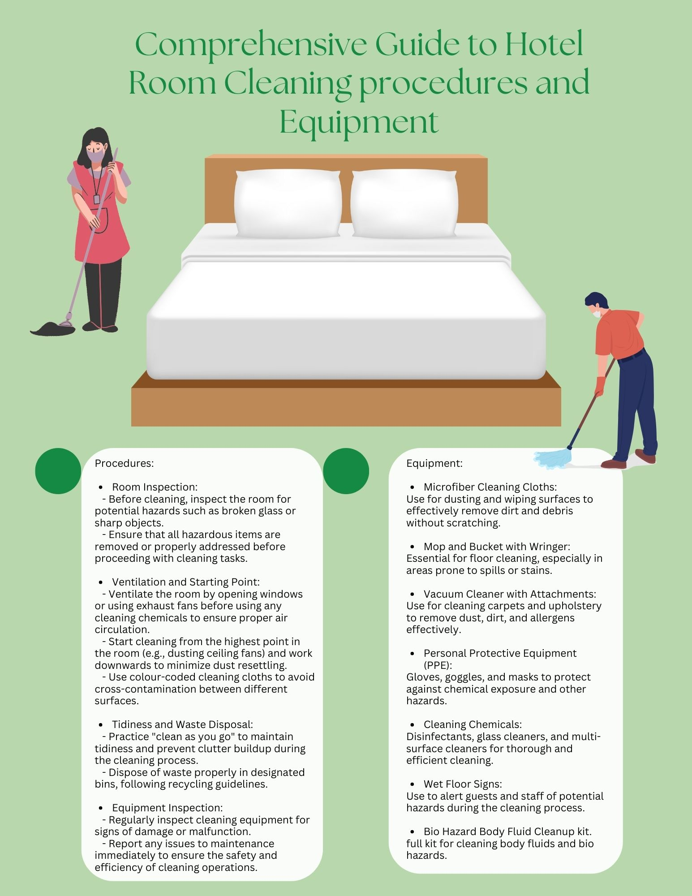

Slide 10
Conclusion
Risk assessment are crucial to preventing accidents in the workplace – will reduce risk and accidents and injuries
Employees must follow our guidelines on Health and Safety policy at Holiday Inn
Mitigating hazards is critical
Ongoing training to ensure employees and all aware of all housekeeping guidelines
Health and Safety is everyone’s business – we must all do what we can ensure employers, employees and customers are happy and safe when at the Holiday Inn.

