Slide 1
International Busines communications
Module code:LCBB6001
Module Tutor: Charles Nwaogwugwu

Slide 2
Student 1 :Tatyana Nikolova-1912953
Student 2 :Bozhidar Minev- 1921806
Student 3: Radoslav Ivanov-1909208
Student4 : Radostina Ilieva-1921577
Student 5: Lora Yonova(team leader)-1917344

Slide 3
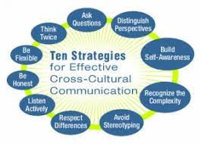
Introduction
The purpose of the presentation is to identify the cultural differences.
It will identify the issue in the operation using the Hofstede cultural model (Minkov & Kaasa, 2021).
The presentation will also address the barrier to operation in the different cultures.
The cross cultural communication, attitude of working at the workplace and power relation issues is the major barrier of operations.
Notes:
The presentation is to include the two companies from the United Kingdom and China. The cultural differences affect the JV operation when there is a collaboration of the two companies from culturally diversified places (Kaasa, 2021). The study will focus on identifying the cultural differences, barriers to operation and negative impact on the overall health of the organization. The study will also focus on eliminating the existing issue and overcoming the crisis accordingly. Further, the research would like to give recommendations for a China-UK joint venture in the process of corporate operation, which could enable the joint venture to succeed.

Slide 4
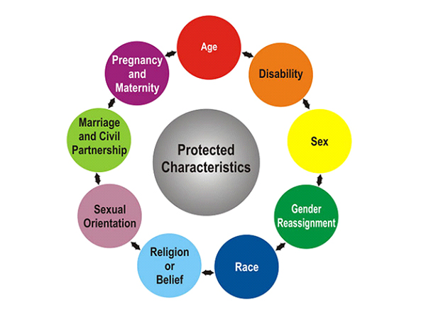
GlaxoSmithKline plc(UK culture)
GSK is a British multinational biotechnology and pharmaceutical company.
GSK was established in 2000 (Cooke et al., 2019).
It is listed on the London stock exchange.
The global healthcare giant is concerned with the improvement of quality of life (Morente, Ferràs & Zizlavsky, 2018).
GSK is engaged in vaccine development pharmaceutical activity and consumer healthcare
Notes:
GlaxoSmithKline is one of the world’s largest pharmaceutical companies, merged from Glaxo Wellcome plc and SmithKline Beecham plc in 2001, to become GlaxoSmithKline plc, but its origins can be traced back to 1715. This make it the longest continually running British pharmaceutical company. Thus, GSK has global recognition and potential brand value and is known for its large collaboration and has depicted innovative culture. GlaxoSmithKline plc has been functioning multinational for more than two decades (Morente, Ferràs & Zizlavsky, 2018). It has offered significant progress and development in the context of company culture. It is a global leader in developing medicine related to respiratory disease and human immune virus. The working culture in the company consists the aim of the managers to motivate , focus, develop and care for their teams, so the people can grow, be their best and feel welcome, valued and included. The fundamental principles in the United Kingdom business culture are courtesy, politeness , discipline and punctuality.(Business Etiquette in the UK )

Slide 5
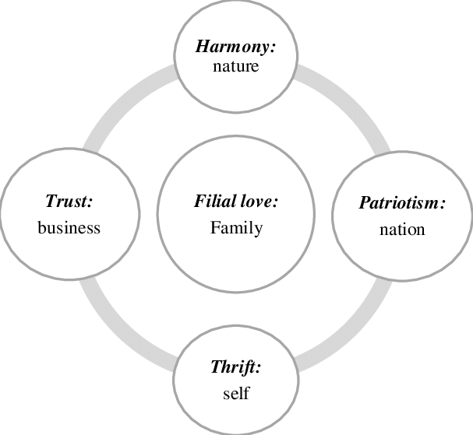
Walvax Biotech (Chinese Culture)
The organization was established in 2001.
It is a China-based multinational company.
It is a leading vaccine innovator, producer and distributor (He & Filimonau, (2020).
The company produces pharmaceutical and biotechnology-based products.
Walvax has developed ARCoV that is a Covid-19 vaccine and haemophilus influenzae vaccine.
Notes:
It is a bio pharmaceutical company that which is focused on the development and innovation of vaccines for different diseases and blood products. The organization manages pharmaceutical and biotechnology product development and distribution. It is known for research and development on a global scale (Beugelsdijk & Welzel, 2018). Walvax has developed ARCoV that is a Covid-19 vaccine and haemophilus influenzae vaccine ,for the prevention of infectious diseases such as meningitis. . It is one of the largest vaccine distributors in China. With the purpose of “ Help everyone live a healthy life “ Walvax aims to be the leader in public health ,sustainably providing high quality and innovative products to protect against the world’s deadliest diseases. “ Walvax is an affiliate of Yunnan Walvax Biotech Co.,Ltd and with its 400 employees, the company has been driving biotechnology vaccine innovation and development in China, with significant expertise in freeze-drying technologies , which make vaccine preservation and transportation easier “. Chinese business culture is largely influenced by Confucianism. Thus ,its concept of Guanxi implies that a relationship network is crucial and based on the values of solidarity, loyalty, modesty and courtesy. (world business culture)

Slide 6

Difference between the companies
GlaxoSmithKline and Walvax Biotech announced the cooperation agreement for a joint venture.
The companies belong to different countries and manage different cultures.
GSK has a 65% equity partnership and the walkway has 35% (Gallego-Álvarez & Pucheta-Martínez, 2021).
The difference in the size of the ownership may influence the management operation and resistance. The Chinese manger will focus on the use of disciplined team while the UK manager may impose the friendly culture (Dan, 2019).
GlaxoSmithKline utilizes the potential strategy for expansion.
The companies are quite different from each other in terms of size and strength.
Notes:
For multinational companies, in order to survive in the competitive world , they have to expand overseas by using some market entry strategies.(Hill,C. International Business,Boston,2007) During the process of expanding overseas, some factors of micro environment ,multinational companies have to face huge challenges from cultural differences around the globe , especially for a joint venture which involves in two companies which come from different countries as it is GlaxoSmithKline plc with its cooperation with Walvax Biotechnology. Co,. They belong to different countries and their employee strength is also different from each other. (Wang & Fränti, 2022). The company differs from the other in terms of market capitalization , innovative capability and brand recognition at a local level. It may influence the claim of ownership and the English manager is to focus on design of operation and marketing in their style but the Chinese managers have the good knowledge of Chinese market. Walvax is known locally (Dan, 2019). It has major permission in China for the development and distribution of vaccines.

Slide 7

Difference between the companies
The employees of the organization belong to the United Kingdom and China.
They speak different languages Mandarin and English.
GlaxoSmithKline culture is driven by performance (He & Filimonau, (2020).
The company requires formation of product as per the consumer requirement.
The UK manager needs to have a good understanding of the packaging and safety strategy (Pirlog, 2020).
The UK manager will use the UK standard and the Chinese has their own national standard for packing and product safety.
Notes:
It has been noted that both companies belong to different countries and different cultures and are also managed by different clients. Walvax is listed on the Chinese Stock Exchange and is committed to provide safe bio-medicine (such as vaccines ,blood products, etc) with excellent quality and advanced technology for domestic and foreign market. GlaxoSmithKline plc on the other hand is a global biopharma company with a purpose to unite science, technology and talent to prevent and treat diseases. . GlaxoSmithKline is responsible for managing its operation in the United Kingdom and different parts of the globe (Pirlog, 2020). The Chinese managers in JV speak in Mandarin and it is difficult for English manager to understand their language and has little knowledge of the market. The company develops innovative partnerships with multiple organizations including Walvax. The Chinese company is known for the development of early-stage the virus. GlaxoSmithKline has a potential international market and Walvax has occupied the national market more strongly.

Slide 8
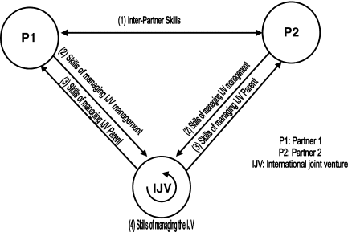
Cultural issues in collaboration
Both companies differ in terms of global operation and market size.
GSK maintains a more universalized culture as it is a multinational company.
The employee of Walvax strictly adheres to language belief and hierarchy (Noll, Filatova & Need, 2020).
People from the UK celebrate in the office and consider socializing activities.
It is common to visit pubs in the UK.
The management of Walvax is found to be more hierarchal.
The management values the senior managers.
Notes:
The workers in GlaxoSmithKline follow UK culture and are engaged in social activity. They believe in relationships and create unique personalities in office culture. The management of Walvax find it difficult to manage the workplace environment when it comes to the building of hierarchy, development of team and management of specific discipline for Chinese’s market. The manner and behavior of the employees are different from each other and it is difficult for the employees from GlaxoSmithKline to manage their interaction and teamwork with the management and employees of Walvax to their relationship attitude and system of hierarchy (He & Filimonau, 2020). The key factor for the success of the joint venture is the understanding of guanxi on the part of the UK partner. It is important to be understood the culture ,and inter-cultural variation in order to develop and sustain effective inter-firm relationships in business markets .(Hall, 1977 & 1990;Hofstede, 2001; House et al, 2004)

Slide 9
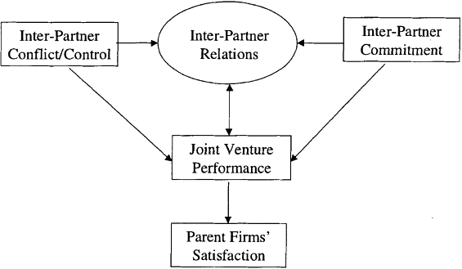
Conflicts
The team from two cultural backgrounds will have varied opinion on marketing and product development (Alsanoosy, Spichkova & Harland, 2020).
The marketing team from GlaxoSmithKline uses social media and Google for promoting the product and new initiative.
The Chinese government has restricted the use of Facebook and Google.
The management of organizational structure will be a major issue as the joint venture is predominantly cubed by GlaxoSmithKline plc.
Notes:
In the context of globalization, many international companies are paying more attention on their corporate strategies to expand to different countries. The cultural differences between the home country and the host country are considered as the vital cause to enable the joint venture to succeed. (Hofstede, G., Minkov, 2010) The organization needs to manage the operation in different cultures. There will be an ideological clash in the area of research and development marketing and distribution as GSK utilizes facebook and Google in marketing (Artina, Desnasari, Fitriyah & Rizkita, 2020). It will be difficult for the marketing team from the UK to utilize the social network in China as they are to change the social media platforms.

Slide 10
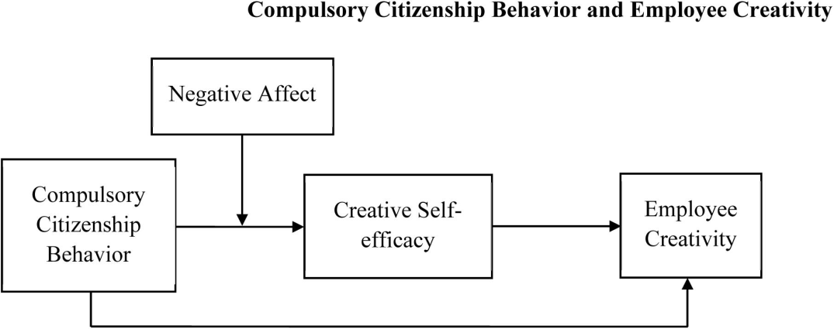
Employee behavior
The employee in the UK culture is found to be more relaxed in workplace culture.
Walvax employees are more sincere and disciplined in the management of office culture.
There is significant flexibility when it comes to the writing of emails in GlaxoSmithKline (Ferreira & Ferreira, 2018).
Walvax management maintains formal culture.
it is important to understand the employee behavior of the different countries using Hofstede cultural model.
Notes:
It has been noted that Chinese companies have a significant discipline and formality in the management of office environments. GSK executives maintain a high degree of flexibility and have a warm relationship. The verbal and nonverbal communication is not very formal in the company but Walvax maintains a high degree of discipline and formality (Kaasa, 2021). It is a major point of difference between the two companies and the collaborative effort may be challenging for the human resource managers of both companies as a result of formal culture in Walvax and flexible attitude of employee in GlaxoSmithKline plc. One of the reasons for Joint venture failure is to understand the cultural differences between two countries ,as a result in embarrassing blunders, strain relationships, and drag down business performance. To analyze the differences in cultural value, one of the most popular frameworks for classifying national cultures is proposed by a dutch social psychologist and management scholar , Geert Hofstede., known as Hofstede’s Cultural Dimensions Theory.

Slide 11
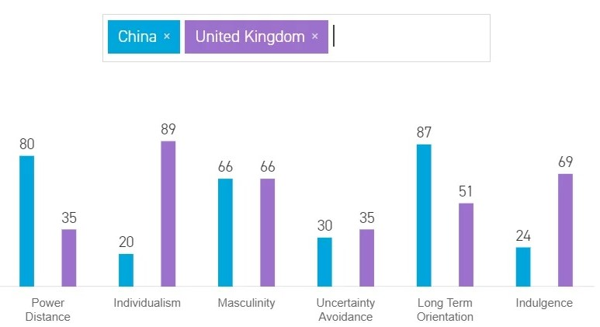
Hofstede cultural dimensions
Hofstede provides a proper solution of organizational and intercultural challenges. Cultural differences causes barrier to communication. Hofstede's cultural dimension incorporates six dimensions.
The cultural dimension provides a better understanding of the pattern and national differences.
These are:
POWER DISTANCE INDEX: power indicates equality and inequality. Power allows the building of leadership quality authority and management in time.
The UK has 35% score in power distance and China scores 80% for building hierarchy (Dimitrov, 2018). An 80 indicates that the vast majority of Chinese people are content with the current level of inequality.
It's in the best interest of a business to encourage employee initiative and leadership.
Only 35 percent of Britons are willing to accept the current inequality in Britain, according to a new poll.
In other words, it implies that people will expect to be treated as equals in some way because they have a sense of fairness.
INDIVIDUALISM VS COLLECTIVISM: Individualism refers to a way of life in which people are preoccupied with their own interests and those of their families.
Groups and teams are more important in a collectivist society.
With an individualistic score of 89, the United Kingdom tops the list.
Individuals in China are expected to put the interests of the group ahead of their own, resulting in a score of 20.
The individual need and groups may differentiate the element of Identity. Low power distance culture focuses on equality. The difference in the preference of identities influences the operative capability of the organization. 89% people in the UK prefer to develop individualist society (Dan,2019). 20% Chinese population considers the need for collectivist culture.
Notes:
The UK has 35% score in power distance and China scores 80% for building hierarchy (Dimitrov, 2018). This aspect demonstrates that not all members of a society are on an equal playing field.
The level of tolerance for unequal power distribution among these less powerful members and organisations can be characterised by the concept of power distance.
A score of 80 was given to China, which suggests that the vast majority of Chinese people are okay with the current level of inequality.
It is to a company's advantage to encourage leadership and self-initiative among its employees.
The United Kingdom, on the other hand, is ranked number 35, which suggests that the vast majority of people living in the United Kingdom do not accept the current level of inequality.
It suggests that people will have an expectation that they will be treated as equals in some way, and that this expectation will be influenced by their sense of fairness.
Individualism versus Collectivism: Identity is associated with the attention of an individual or group. The Uk scores 89% as the people are asked to manage the assignment individually. China scores 20%as they prefer to ask assignment collectively. the power and identity define the capability and efficiency of the company in the management of employee relations and interaction with the client. The company in high power distance manages strong management and uses an autocratic leadership style (Pirlog, 2020).
People in a society that values individualism are primarily concerned with themselves and their homes.
On the other hand, people in societies that are more collectivist place a higher value on groups or teams.
The United Kingdom received an individualistic score of 89, which was the highest of any country.
A highly collectivist culture, as indicated by a score of 20, can be found in China. In this culture, individuals prioritise the welfare of the group over their own needs and goals.

Slide 12
Hofstede cultural dimensions
UNCERTAINTY AVOIDANCE: Uncertainty avoidance deals with a society’s tolerance for uncertainty and ambiguity. The manager high certainty avoidance are rule bond. At 30% China has a low score on Uncertainty Avoidance, which means Chinese are comfortable with ambiguity. Chinese language is full of ambiguous meanings that can be difficult for western people to follow. UK Scores 35% in uncertainty avoidance, which means that as a nation they are quite happy to wake up not knowing what the day will brings.
LONG VS SHORT TERM ORIENTATION: the communities are deeply connected with time and space. The different communities prefer to look back past and manage the challenges of the present and the future. The people with short term orientation manage the present with new method's (Beugelsdijk & Welzel, (2018). A society's ability to maintain ties to the past while also embracing the challenges of the present and the future is captured in this subdimension.
China's score of 87 indicates that people act in the best interests of the group rather than their own.
The UK scores of 51% which is neutrally for its time orientation . China scores 87% in this dimension, which means that it is very pragmatic culture.
Notes:
The concept of uncertainty avoidance suggests that the future of a society is difficult to both predict and control. As a direct consequence of this lack of knowledge , people may experience feelings of anxiety .Both China and the United Kingdom scored between 30% and 35%of a possible 100 %. They both have low score on the uncertainty avoidance ,which indicates they are comfortable operating in environments with high degree of ambiguity.
On another side the differences in long term versus short term orientation examine how a society manages to keep its historical connections alive while simultaneously adapting to new circumstances in the present and the future.
The score of 87 for China indicates that people prioritise the welfare of the group over their own needs and desires most of the time. Chinese society show an ability to adapt traditions easily to changed conditions , a strong propensity to save and invest , thriftiness ,and perseverance in achieving results. ( www.Hofstede-insights.com/country-comparison/ )
On the other hand, residents of the United Kingdom with their score of 51 % a dominant preference in British culture can not be determined.

Slide 13
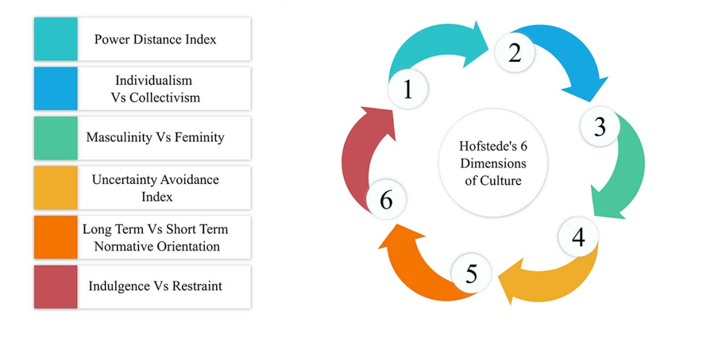
Hofstede cultural Dimensions: UK and China – Masculinity vs Femininity
A high score on this metric indicates that social norms like achievement and achievement-oriented competition are important motivating factors.
Societies are concerned with other factors, such as living standards, if they have a low score
Both the People's Republic of China and the United Kingdom are 66 out of 100 masculine societies.
To many Chinese, work is more important than family or leisure. In recent years, there has been a widespread trend in China.
For better wages and working conditions in cities, migrant farm labourers left their families behind.
In contrast to more feminine cultures like Scandinavia, people in the United Kingdom have clear expectations for their work and personal lives.
Notes:
If this dimension receives a high score, it indicates that forces like competition and achievement are important in motivating society.
If the score is low, it suggests that the society is more concerned with other aspects, such as the standard of living.
Both China and the United Kingdom have scores of 66, indicating that both countries have masculine societies.
Although China gets the same score ,the masculine is characterized by some features that the solid traditional role of male achievement , the men would be proud by his children and sacrifice family and leisure time to work ,especially in the poor region the men would exerted their power to manual work like crops.
In contrast to more feminine cultures, such as those found in Scandinavian countries, the people who live in the United Kingdom are held to high standards of performance in both their professional and personal lives. Although the score of these two countries is the same, but the situation is not expressed as the score showed us. The result reflects the fact that the society and the culture emphasis on the equality between sexes.

Slide 14
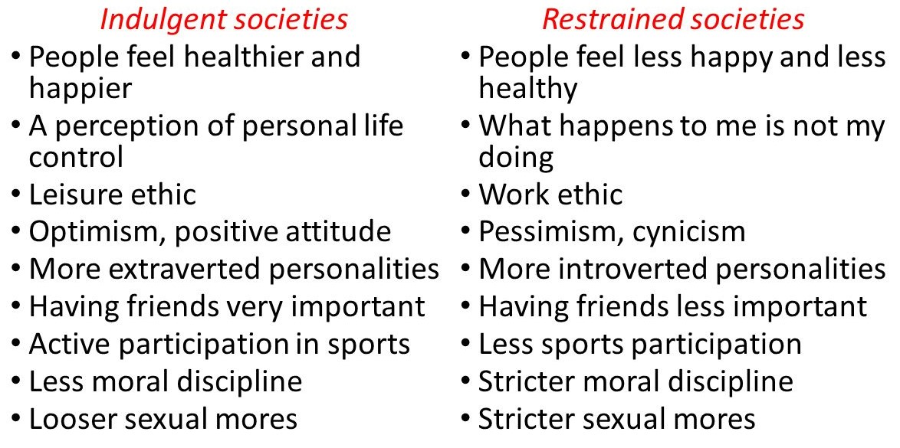
INDULGENCE VERSUS RESTRAINT UK AND CHINA
INDULGENCE- freedom to have good things in life
Weak control- Indulgence
Strong control- Restraint
China has a low score of 24%- it is seen as a Restrained society.
UK has a high score of 69%-it is classified as Indulgent.
Notes:
The final dimension was added in 2010 in order to capture more recent research conducted around the themes of happiness, made by Michael Minkov, a Bulgarian sociologist and creator of the extensive World Values Survey. (Hofstede, G., Minkov, M. 2010 ). The challenge that confronts humanity and relatively the Joint Venture collaboration is the degree to which small children are socialized. “ Indulgent cultures will tend to focus more on individual happiness and well-being ,leisure time is more important , and there is greater freedom and personal control. This is in contrast with restrained cultures where positive emotions are less freely expressed and happiness, freedom, and leisure are not given the same importance” (Maclachlan, 2013 ). In a result of the low score of China, people have a tendency to cynicism and pessimism. The high score of the UK generally exhibit a willingness to understand their impulses and desires with regard to enjoying life and having fun ( www.Hofstede-insights.com/ country-comparison ).

Slide 15
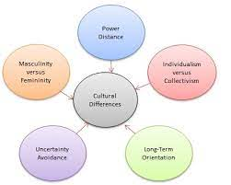
Cultural sensitivity in China / The differences from the UK
. A nation's cultural values have a significant impact on its national identity and psychology.
Government leaders are influenced by the public's values and opinions, which are conveyed to them through the media and other means of information, both directly and indirectly.
Traditions that shape the Chinese people's values include harmony and generosity; courtesy; wisdom; honesty; loyalty and filial piety; and benevolence.
Negotiation differences
Notes:
Certain factors can affect cultural sensitivity : religion ,ethnicity( race) ,national origin (language ), or gender.( en.m.Wikipedia.org) The national psychology and identity are both influenced to some degree by a nation's cultural values.
The public opinion and the values of the citizens are communicated to the leaders of the state through the media and other information channels, which influences both the direct and the indirect decisions regarding foreign policy.
Harmony, beneficence, righteousness, courtesy, wisdom, honesty, loyalty, and filial piety are examples of traditional Chinese cultural values that have a significant influence on the psyche of the Chinese people. The British announced that the schoolchildren should be taught “fundamental British values as democracy, the rule of law, individual liberty,and mutual respect and tolerance of those with different faiths and beliefs”. The fundamental principals of business in UK are courtesy, politeness, discipline and punctuality. The British are known for their ironic humor ,which they may use when doing business.
There are a number of key cultural norms and values that western leaders like UK need to be aware of in their business life in China. Attitudes to time vary among cultures, the Chinese prefer slower negotiations , whilst the UK , believe that time is money and are in a hurry to conclude the deal. UK is short term oriented, which means quick negotiations.

Slide 16
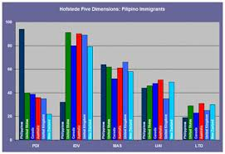
Face negotiation theory
Face negotiation theory was developed by Stella Ting Toomey in 1985.
It helps to understand the cultural differences of the people from different cultures and countries (Wang & Fränti, 2022).
the theory posited "face", or self-image when communicating with others, as a universal phenomenon that pervades across cultures.
People from UK culture is comfortable with bargaining but avoid haggling.
They focus on fair game.
In china, The best compromises are derived only through the ritual back-and-forth of haggling.
Notes:
Speaker notes: it has been noted that the face negotiation theory identifies the disagreement and rapport among the different employees. Cultural differences are identified in the different activities. The people in western countries prefer to be individualistic and the people in eastern countries are collectivist. Individualistic people are aggressive and progressive (Alsanoosy, Spichkova, Harland, 2020). There is a higher chances of conflict when there is a communication and negotiation. People from UK culture is comfortable with bargaining but avoid haggling. They focus on fair game. In China, The best compromises are derived only through the ritual back-and-forth of haggling.

Slide 17
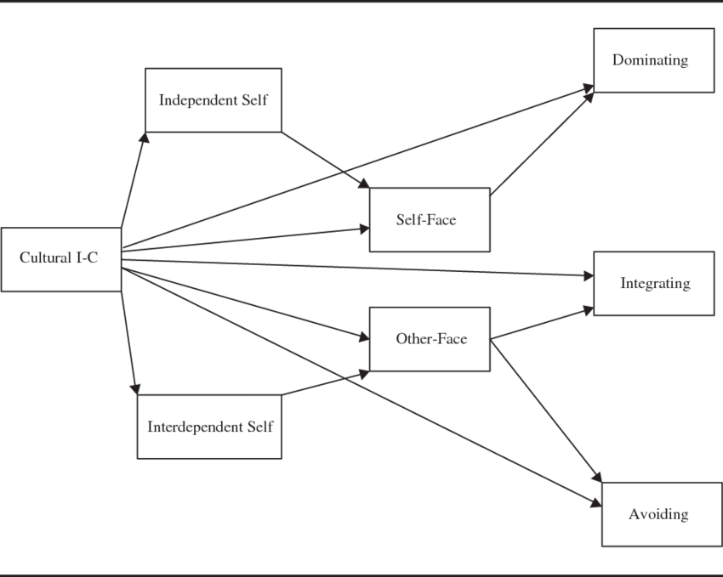
Failure factors of joint ventures
Inability to come to an agreement on a joint venture. Joint venture agreements are extremely important and cannot be understated.
Make certain that your JV's foundation is covered by a comprehensive contract.
The budget is not sufficient. One of the partners in the Joint Venture could go bankrupt if they are having financial difficulties
Notes:
Speaker notes: it has been noted that the behavior of the employee in the company is found to be flexible and friendly (Ferreira & Ferreira, 2018). The executives from the UK will have a better understanding of cultural diversity when they undergo face negotiation and ensures accommodating others with less aggressive attitudes. they are more inclusive and recognize others autonomy. There must always be a leader or someone who makes decisions at the helm of every relationship.
When it comes to a joint venture, the same rule holds true: someone has to be in charge.
Ensure that the right people are selected for leadership roles.
Compatibility. A person who owns a business should avoid forming a joint venture with another person who owns a business if they do not share the same values and ethics in order to increase their chances of being awarded a contract.

Slide 18
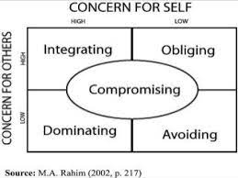
Failure factors of joint ventures
. Control issues. The presence of a leader or decision maker is required in every relationship.
There must be a leader in a joint venture as well.
Check to make sure the right people are chosen to lead.
Compatibility. Businesses should avoid joint ventures with others who do not share their values and ethics in order to secure a contract
Notes:
the most common barrier is associated with cognitive constraint. If the executives from two cultures do not understand each other for their language and cues, there may be some misunderstanding or conflict. The culture focuses on regulating the potential display of employee behavior (Liu & Meyer, 2020). The employee of the company has depicted a significant behavioral constraint as the people from the United Kingdom have very friendly behavior but Chinese people maintain high cultural values and it influences verbal and nonverbal communication.
If there is not enough money, It could be catastrophic if one of the partners in the joint venture was experiencing financial difficulties.
The straightforward explanation for this is that the financially troubled partner will drain the resources of the joint venture, making it impossible for the partnership to put money away for rainy days or for future growth.

Slide 19
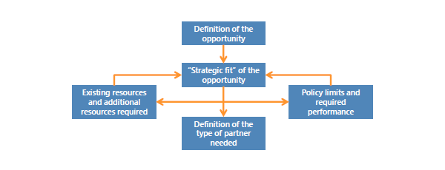
Barriers to operation
It has been noted that the study of the cultural dimension theory and face negotiation theory reveal wide gaps.
It is difficult for the UK people to manage their communication and behavioral activities in Chinese culture (Wang & Fränti, 2022).
Language is a major barrier to communication.
The UK and China have a variety of cultural, linguistic and religious gaps.
The functional and operational activities are different from each other in the context of the environment.
Notes:
the differences in the culture and communication have a significant negative impact on the organization. The linguistic differences and traditional gaps have significant changes within the workplace environment. The decision making will be largely influenced under the communication gaps (Cooke et al., 2019). The UK people consider democratic decision making while Chinese individual will respect the decision from the top. Both theories have revealed that the cross cultural communication is importance and lack of cross cultural understanding will affect the operation of the joint venture. High context culture like China , has tendency to cater towards in-groups (such as family, friends and colleagues ) and information and knowledge is shared between them( Hall, E ,1990).On the other hand , low context culture ,like UK, has tendency to cater towards out-groups ,where family, friends and colleagues are all separate from each other and things are shared less exclusively(Jiao,2007).

Slide 20

Religion
The professionals of GlaxoSmithKline follow Christianity.
There will be the imposition of value system from Chinese and Christianity religion.
The employee from Chinese culture and Christianity require different calendar holidays.
The trading cost is high as there is a difference in the shared belief among the partners and workers (Hamadneh et al., 2021).
Notes:
Both pharmaceutical companies will have to focus on the path to religious freedom for the employee. Both companies do not share similar values and it may sometime influence the workplace environment (Hamadneh et al., 2021). The arrangement of holidays for people from different backgrounds will have an issue with productivity as the employee may not be available on different occasion. The pharmaceutical company will find it difficult to manage the scenario in a proper and effective way. The influence of religion is subtler than language. According to Gomez-Mejia and Palich (1997), religion may be the most significant cultural feature after language .Generally ,religion has a complete set of doctrines , as well as informal written customs and behavioral habits, to regulate the thoughts and behaviors of believers. It is source of their ethics and guide for correct action, including that in business management( Richardson, 2014).

Slide 21

Communication barrier
The people from two different linguistic backgrounds will face difficulty in communication and decision making.
Language differences
Incorrect and inadequate communication channels
The misunderstanding between the worker and the manager may increase if they are unable to communicate properly.
Notes:
In order to have successful implementation in a joint venture , companies need to be aware of potential barriers prior to entry. In Chinese (or “high-context “) culture ,verbal communication is most accurately interpreted in the context of non-verbal communication (such as gestures , stance and tone), social hierarchy and other background information . It is possible for the non-verbal aspects of communication to override what is being stated explicitly. In contrast, UK (or “low-context) culture , the verbalized message is the principal source of information, rather than the context. Business interactions are expected to be direct and forthright. The indirectness may be considered devious. Because of the fundamental differences in the role and context of communication , it is important for both countries to understand the assumption of the other culture. Chinese style of communication aims to preserve the group harmony , they tend to speak in terms of “we” ,rather than “ I”. The meaning and usage of the word “no” represents a fundamental difference between Chinese and British communication practices . From British point of view, no usually means no. The Chinese are reluctant to use the word no because the overall relationship may be in jeopardy. Chinese communicate no through a range of phrases and supporting facial expressions , gestures ,silence and deferral of the issue at hand. In British point of view , this indirectness can be interpreted as indicative or secrecy or dishonesty or showing disinterest or incompetence. A simple word as no carries the potential for long ,complicated misunderstandings between Chinese and British business associates. It is difficult for the leader to manage the team in the joint venture environment as a result of gaps in communication (Liu & Meyer, 2020).

Slide 22
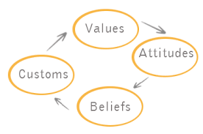
Beliefs
The UK culture has a tendency of individualism.
The Chines people considers fundamental connection and collectivism.
The individual leaders are valued in the UK (Froese, et al., 2019).
The responsibility of decision making is entrusted with the entire team (Zhou, 2021).
Notes:
Western cultures are based on individualism rather than collectivism .For instance, in British society , there is an emphasis on individual rights rather than placing the whole society above oneself. This is clearly different in China where the country , society or family are based above oneself. The traditional cultural values that influence the psyche of the Chinese people are: harmony ,benevolence, righteousness, courtesy , wisdom, honesty , loyalty and filial piety. The fundamental British values are: Democracy, The rule of law , individual liberty and mutual respect, tolerance for those with different faith and beliefs.

Slide 23

Method of Operation
The method of operation is found to be quite different between the two companies.
Glaxo Smith is a multinational company and functions globally.
It is more concerned with an agile approach in the operation management and management of resources.
The UK people prefer quality and Chinese people need to manage control over the entire team(He & Filimonau, 2020).
Walvax Biotechnology Company manages the innovation and focuses on vaccine development and operation.
Notes:
the method of operation of GlaxosmithKline is found to be smooth and it offers great convenience to the employee. Walvax has significant focus on product innovation and is engaged mainly in superior production. GSK follows universal HRM policy while Walvax uses local HRM theory in the management of employee where owner is responsible or allocating the duty and responsibility (Lu, Yu, Wang & Hong, 2020). the foreign-funded multinational corporations (MNCs) that HRM is considered to be most systematic and sophisticated, resembling that of Western practices.The difference in language and belief may affect understanding of each other. The UK executive may follows six sigma but Chinese people may follow lean method.

Slide 24
Recommendations - Training
There must be a common language for all employees to communicate with each other. The English language is the most widely used in the world. Consequently, the company needs to encourage and train Chinese employees.
Language should be emphasised in the workplace as a means of conveying concepts and facts. Effective communication necessitates the use of language.
In addition, some employees can learn English in order to better communicate and share information with British colleagues, which will aid in the joint venture's success.
Notes:
Speaker note: the cross-cultural strategy of communication, cultural understanding and religious belief will help the manager to effectively overcome the challenges and manage the scenario in a significant and effective way (Ferreira & Ferreira, 2018). The cross-cultural training and development of balanced management will help to eliminate the barriers of communication, culture, belief and religion. The effective management of resources and human capital will allow the organization to be successful in the context of the pharmaceutical industry in China. the training on diversity and inclusivity will enhance the team collaboration and ensure positive outcome. It is extremely important to ensure that all employees communicate using the same language. The language that is spoken by the most people on earth is English. As a consequence of this, the company ought to foster and cultivate its Chinese workforce.
Encouragement to use language as a means of communicating ideas, concepts, and facts should be given to workers. Language is absolutely necessary in order to have successful communication.
Additionally, some employees can choose to study English in order to improve their ability to communicate and share information with their British counterparts, which will ultimately contribute to their success in the joint venture.

Slide 25
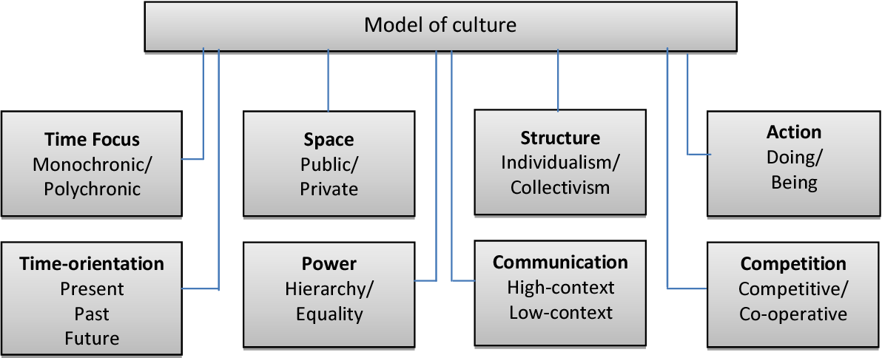
Recommendations - Communication
Communication-The smooth running of a China-United Kingdom joint venture depends on having an efficient communication system in place.
Joint venture communication depends on a thorough understanding of each partner's culture.
Chinese employees, in contrast to their British counterparts, will never voice their personal opinions during meetings.
Notes:
The successful operation of a China-United Kingdom joint venture relies heavily on the existence of an efficient communication mechanism.
In most cases, the foundation for an efficient communication mechanism in a joint venture is a comprehensive comprehension of both cultures involved.
In contrast to their counterparts in the United Kingdom, Chinese employees never share their personal thoughts and opinions in group settings such as meetings.

Slide 26
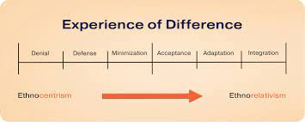
Application of Bennet model
Development models of intercultural sensitivity enhance the standard of communication in the joint venture.
The cultural sensitivity refers to the strong feeling for self culture. Disrespected is not tolerated.
It will allow the individual to learn the process to experience, interpret and interact with people from cross-cultural backgrounds (Liu & Meyer, 2020).
It has two ways to work together in JV.
One allows denying the difference and defence enables to acknowledge each other but is threatened by each other (Zhou, 2021).
Denial: The employee of the UK and China may forget that they are working with people from diverse cultures. This denial will unify them into a single team.
Notes:
the theory will support the organization in the minimization of conflict from cultural sensitivity and it will enhance a better understanding of each other's culture and avoid cultural differences (Wang & Fränti,2022). It will focus on determining the definition of Identity in the entire process of integration. The denying of the cultural differences is considered to be highly effective means of eliminating the barrier of communication.

Slide 27
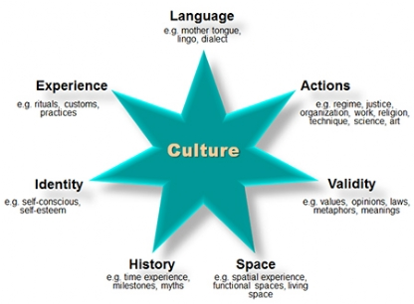
Conclusion
The linguistic barrier and cultural differences are the major issues that the company faces.
The power difference has a big gap.
There is a good support in the area of cooperative attitude.
The Bennet theory will be highly effective in the context of the workplace .
the success of JV is dependent on successful elimination of these cultural and linguistic barriers.
Cross-cultural competence and linguistic understanding training will help the manager to overcome the differences.
Notes:
Because the process of globalisation is accelerating at such a rapid rate, multinational corporations are stepping up their efforts to internationalise their businesses by implementing market entry strategies.
Differences in cultures across the world present significant difficulties for businesses that operate on a global scale, particularly joint ventures.
The research investigated the cultural obstacles that would be presented by working together on a project between China and the United Kingdom.
A theoretical model of national cultures is utilised in order to investigate the cultural differences and difficulties that exist between China and the United Kingdom.
In addition to this, a joint venture needs to have an understanding of the connection between national culture and organisational culture.

Slide 28
References
Minkov, M., & Kaasa, A. (2021). A test of the revised Minkov-Hofstede model of culture: Mirror images of subjective and objective culture across nations and the 50 US states. Cross-Cultural Research, 55(2-3), 230-281.
Kaasa, A. (2021). Merging hofstede, schwartz, and inglehart into a single system. Journal of cross-cultural psychology, 52(4), 339-353.
Morente, F., Ferràs, X., & Zizlavsky, O. (2018). Innovation Cultural Models: Review and proposal for next steps. Revista Universidad y Empresa, 20(34), 53-81.
Dimitrov, K. (2018). Geert Hofstede et al's set of national cultural dimensions-popularity and criticisms. arXiv preprint arXiv:1810.02621.
Beugelsdijk, S., & Welzel, C. (2018). Dimensions and dynamics of national culture: Synthesizing Hofstede with Inglehart. Journal of cross-cultural psychology, 49(10), 1469-1505.
Gallego-Álvarez, I., & Pucheta-Martínez, M. C. (2021). Hofstede’s cultural dimensions and R&D intensity as an innovation strategy: a view from different institutional contexts. Eurasian Business Review, 11(2), 191-220.
Dan, H. (2019, June). Culturally green–an investigation into the cultural determinants of environmental performance. In Forum Scientiae Oeconomia (Vol. 7, No. 2, pp. 107-126).
Pirlog, A. (2020). Intercultural “Diagnosis” of Management in the Republic of Moldova According to Geert Hofstede Model: Comparative Analysis.
Noll, B., Filatova, T., & Need, A. (2020). How does private adaptation motivation to climate change vary across cultures? Evidence from a meta-analysis. International journal of disaster risk reduction, 46, 101615.
Artina, B. S., Desnasari, D., Fitriyah, F., & Rizkita, R. G. (2020, May). The workforce in Indonesian organizations: An analysis based upon the cultural dimensions of Hofstede’s model. In Journal of International Conference Proceedings (JICP) (Vol. 3, No. 1, pp. 56-64).
Alsanoosy, T., Spichkova, M., & Harland, J. (2020, October). Identification of cultural influences on requirements engineering activities. In 2020 IEEE/ACM 42nd International Conference on Software Engineering: Companion Proceedings (ICSE-Companion) (pp. 290-291). IEEE.
Cooke, F. L., Liu, M., Liu, L. A., & Chen, C. C. (2019). Human resource management and industrial relations in multinational corporations in and from China: Challenges and new insights. Human Resource Management, 58(5), 455-471.
He, L., & Filimonau, V. (2020). The effect of national culture on pro-environmental behavioural intentions of tourists in the UK and China. Tourism management perspectives, 35, 100716.
Liu, Y., & Meyer, K. E. (2020). Boundary spanners, HRM practices, and reverse knowledge transfer: The case of Chinese cross-border acquisitions. Journal of World Business, 55(2), 100958.
Froese, F. J., Sutherland, D., Lee, J. Y., Liu, Y., & Pan, Y. (2019). Challenges for foreign companies in China: Implications for research and practice. Asian Business & Management, 18(4), 249-262.
Lu, C., Yu, Z., Wang, X., & Hong, Y. (2020). Empirical study on the obstacles to the success of joint ventures in construction projects. Advances in Civil Engineering, 2020.
Ferreira, J., & Ferreira, C. (2018). Challenges and opportunities of new retail horizons in emerging markets: The case of a rising coffee culture in China. Business Horizons, 61(5), 783-796.
He, L., & Filimonau, V. (2020). The effect of national culture on pro-environmental behavioural intentions of tourists in the UK and China. Tourism management perspectives, 35, 100716. https://www.sciencedirect.com/science/article/pii/S2211973620300830
Zhou, Y. (2021). How Chinese Multinational Corporations Solve Cross-cultural Conflicts in Internationalization-A Case Study of SAIC’s Merging of Ssangyong Motor. Advances in Social Sciences Research Journal, 8(5), 137-156. Zhou, Y. (2021). How Chinese Multinational Corporations Solve Cross-cultural Conflicts in Internationalization-A Case Study of SAIC’s Merging of Ssangyong Motor. Advances in Social Sciences Research Journal, 8(5), 137-156. https://www.researchgate.net/profile/Thomas-Harvey-22/publication/359958516_How_Chinese_Multinational_Corporations_Solve_Cross-cultural_Conflicts_in_Internationalization_--A_Case_Study_of_SAIC's_Merging_of_Ssangyong_Motor/links/625851ff1c096a380d04439a/How-Chinese-Multinational-Corporations-Solve-Cross-cultural-Conflicts-in-Internationalization--A-Case-Study-of-SAICs-Merging-of-Ssangyong-Motor.pdf
Bajaj, G., Khandelwal, S., & Budhwar, P. (2021). COVID-19 pandemic and the impact of cross-cultural differences on crisis management: A conceptual model of transcultural crisis management. International Journal of Cross Cultural Management, 21(3), 569-601.
Hamadneh, S., Hassan, J., Alshurideh, M., Al Kurdi, B., & Aburayya, A. (2021). The effect of brand personality on consumer self-identity: the moderation effect of cultural orientations among British and Chinese consumers. Journal of Legal, Ethical and Regulatory Issues, 24, 1-14. https://www.academia.edu/download/68990921/Brand_personality_on_consumer_selfidentity_the_moderation_effect_of_cultural_orientations_among_british_an.pdf
Wang, S., & Fränti, P. (2022). How power distance affect motivation in cross-cultural environment: Findings from Chinese companies in Europe. STEM Education, 2(2), 96. https://www.aimsciences.org/article/doi/10.3934/steme.2022008

Slide 29
Thank You

