Slide 1

Academic Methods;
Chloe Harris
BMHP6020

Slide 2
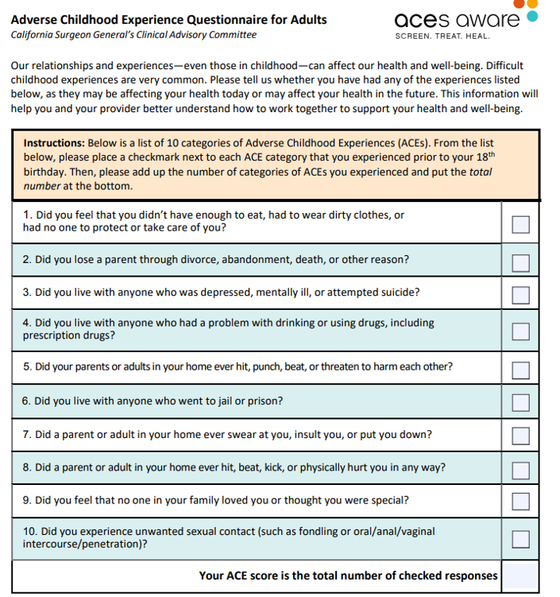
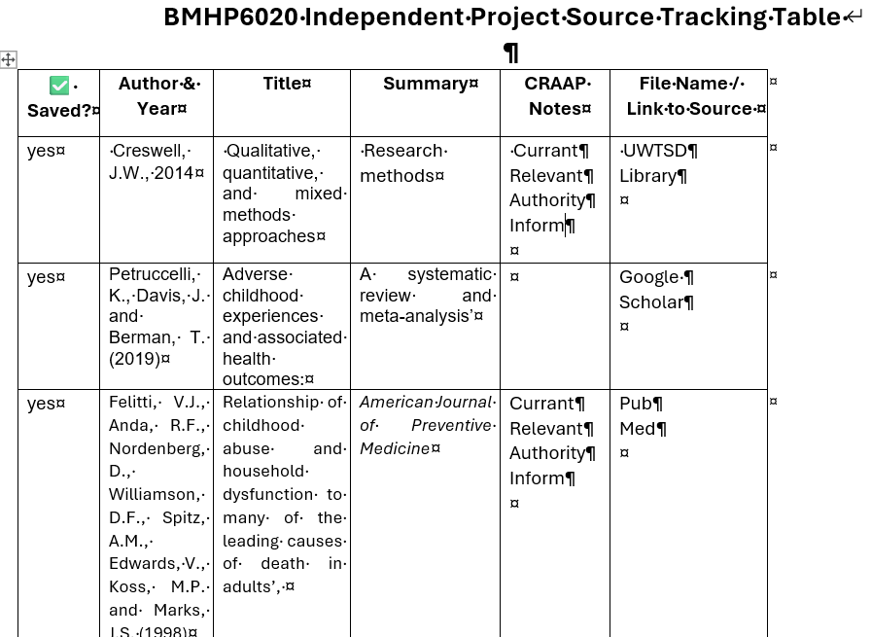
ACADEMIC METHODS RESEARCH POSTER
1.INTRODUCTION AND RESEARCH AIM; This chapter describes the methodology employed in this independent project. A desk-based, literature-focused approach was adopted to systematically examine existing academic evidence concerning adverse childhood experiences (ACEs) and their effects on mental health outcomes, including self-harm and suicidality. Creswell, J.W. (2014). Through the critical analysis and synthesis of relevant literature, the study aims to identify key trends, debates, and gaps in current knowledge. (Booth, A. 2016).
This questionnaire provides a structured framework for quantifying
childhood adversity, allowing researchers to explore links between early-life experiences and later mental health outcomes.
Keywords were chosen from the research title and question, focusing on adverse childhood experiences (ACEs), adolescents, and mental health. Both common and technical terms were included (e.g., “adverse childhood experiences” OR “childhood trauma”) to maximise sensitivity (Felitti et al. 1998). Searches were conducted in PubMed, the UWTSD library and Google Scholar. Boolean operators refined results: OR combined synonyms, AND linked key concepts (ACEs AND adolescents AND mental health), and NOT excluded adults to improve relevance. Filters limited results to peer-reviewed English studies published within the last 10–15 years, ensuring contemporary and high-quality evidence (Hughes et al., 2017).
3. SEARCHING FOR INFORMATION:
To maintain the currency and relevance
of the literature,
Several search filters were applied. Date
range filters focused on studies published in the last
10–15 years,
capturing recent evidence on ACEs and
adolescent
mental health, while the peer-reviewed
filter restricted
results to scholarly articles that had undergone rigorous
academic review, ensuring the reliability of the sources. (Lee, A. 2020). To organise and summarise the literature identified, a source tracking table was created. This table recorded key information from each source, including author, year, title, type of study, research methods, sample size, main findings, strengths and limitations, and relevant keywords or codes. SEE IMAGE;

Slide 3
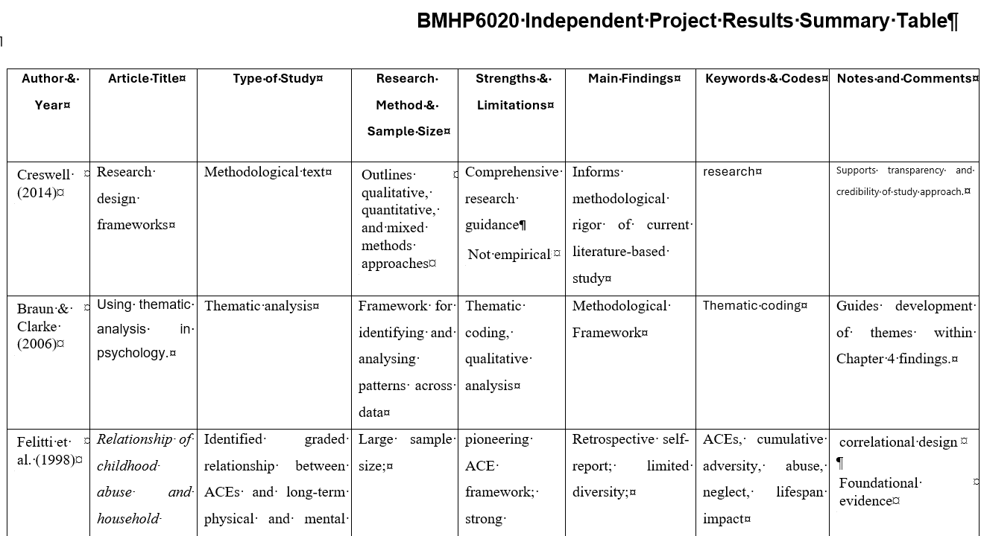

ACADEMIC METHODS RESEARCH POSTER
5. RESEARCH VALIDATION; To maintain the quality and reliability of the literature used in this dissertation, each source was systematically evaluated using the CRAAP test .(Bell, A.2010). The CRAAP test was systematically applied to each source. Currency was assessed by checking the publication date. Relevance was determined by evaluating whether the study directly addressed the research. Authoritywas considered by examining the credibility of the publishing journal or organisation. Accuracy was assessed by reviewing the research methodology, data sources, and whether findings were supported by evidence. Finally, Purpose was evaluated to identify any potential bias, recognising whether the source aimed to inform, educate, or promote a particular perspective. Not every source met all five CRAAP criteria fully; however, priority was given to those that strongly satisfied the most critical elements, particularly Currency, Relevance, and Authority. Summary tables make it straightforward to compare methodologies and outcomes across studies, which is essential for assessing reliability. This image shows an example of the table that was created for this independent project. It includes findings, codes, CRAAP test and notes and comments to help the user to skim the articles when it comes time to do research.
6.; INCLUSION CRITERIA; To ensure the literature included in this study was relevant and of high quality,
specific inclusion criteria were applied. Only peer-reviewed studies were
considered to guarantee methodological credibility.
(Booth, A.. 2016). Both quantitative and qualitative research designs were accepted to provide a comprehensive understanding of patterns, debates, and gaps within the field (Hart, C. 1998).
7. EXCLUSION CRITERIA; Non-scholarly
sources such as opinion articles, blogs, and
general websites were excluded due to their lack
of peer review and academic rigour (Booth, A. 2016).
Similarly, older studies, particularly those published over 10–15 years ago, were generally omitted unless they were seminal works that offered foundational insights into adverse childhood experiences (ACEs) or adolescent mental health. (Creswell, J.W. 2014)
8. ETHICAL CONSIDERATIONS;
SECONDARY RESEARCH ETHICS: All results, interpretations, and conclusions in this study were generated through the systematic review and thematic analysis of existing secondary sources. This methodological approach enabled a thorough examination of current evidence relating to adverse childhood experiences (ACEs) and adolescent mental health, while upholding ethical standards by eliminating the need for participant involvement or primary data collection. (Braun, V, and Clarke, V. 2006)..
ACADEMIC INTEGRITY: High standards of academic writing ethics were maintained throughout this dissertation to ensure transparency and uphold academic integrity. All sources used were properly credited through precise in-text citations and a comprehensive reference list, providing appropriate acknowledgement of the original authors. Consistency and clarity were achieved by applying a single referencing style, namely the Harvard system, across the entire dissertation. (University of Leeds. 2023).
TRANSPARENCY AND CREDIBILITY: A structured and transparent methodology was applied throughout this dissertation to strengthen the credibility and reliability of the literature review. Academic sources were chosen according to their relevance, scholarly quality, and credibility, rather than their consistency with specific viewpoints or expected outcomes. This strategy aimed to reduce potential bias and promote an objective and balanced consideration of the existing body of research, in line with established standards of rigorous academic practice. (Saunders, M. et al. 2019).

Slide 4
REFERENCES
Bell, A., 2010. Academic skills: Source evaluation and critical reading. London: Routledge.
Booth, A., Sutton, A. 2016. Systematic approaches to a successful literature review. 2nd ed. London.
Braun, V. and Clarke, V., 2006. Using thematic analysis in psychology. Qualitative Research in Psychology, 3(2), pp.77–101.
Creswell, J.W., 2014. Research design: Qualitative, quantitative, and mixed methods approaches. 4th ed. Thousand Oaks, CA: Sage.
Felitti, V.J. et al., 1998. American Journal of Preventive Medicine, 14(4), pp.245–258.
Hart, C., 1998. Doing a literature review: Releasing the social science research imagination. London: Sage
Hughes, K. et al., 2017. The Lancet Public Health, 2(8), pp.e356–e366.
Lee, A. and Thompson, K., 2020. Evaluating the quality of scholarly literature in psychology. Psychology Review, 33(2), pp.56–72.
University of Leeds, 2023. Referencing and plagiarism. Leeds: University of Leeds.
Saunders, M., Lewis, P. and Thornhill, A. 2019. Research methods for business students. 8th end. Harlow: Pearson Education.

