Slide 1
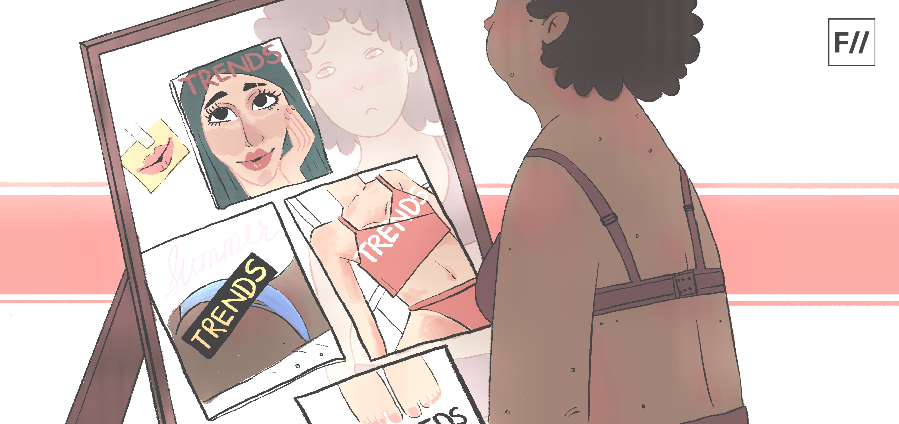
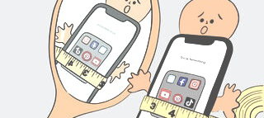
Media campaigns targeting healthy body image
Alisha Phillips | 2218529

Slide 2
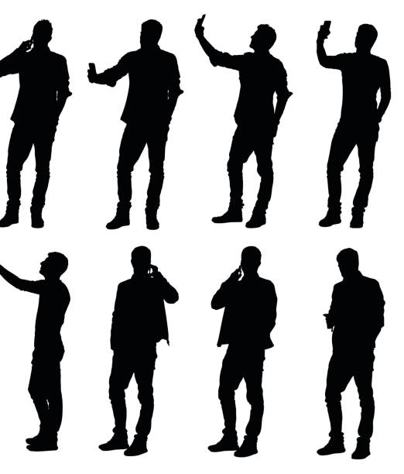
Contents of this presentation
What media is
Details about the dove self-esteem project
Details about the Roblox game and their accomplishments, goals for the future
Mental health foundation – Mind over body campaign
Mirror my mind comics
Reseach and tips gathered by the MHF
The Be real campaign
Aims of the campaign
Their reports and findings
Going forward what you can do to overcome/dodge body image issues
References

Slide 3
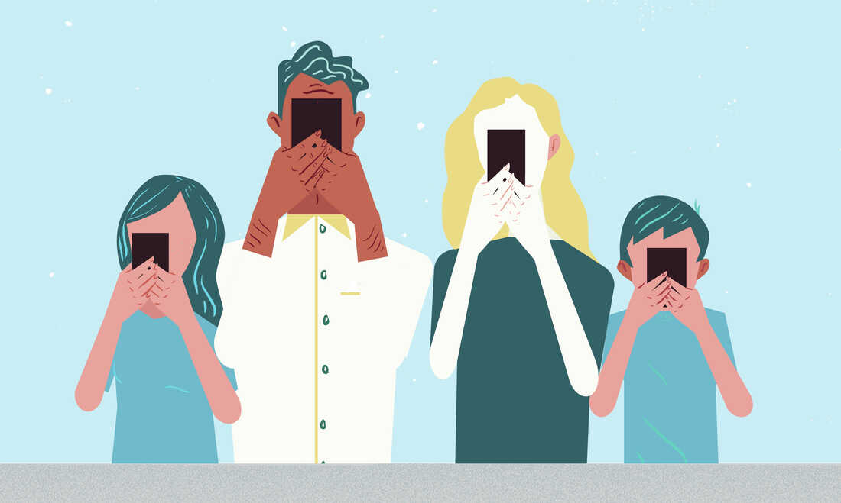
Media – What is it?

Slide 4
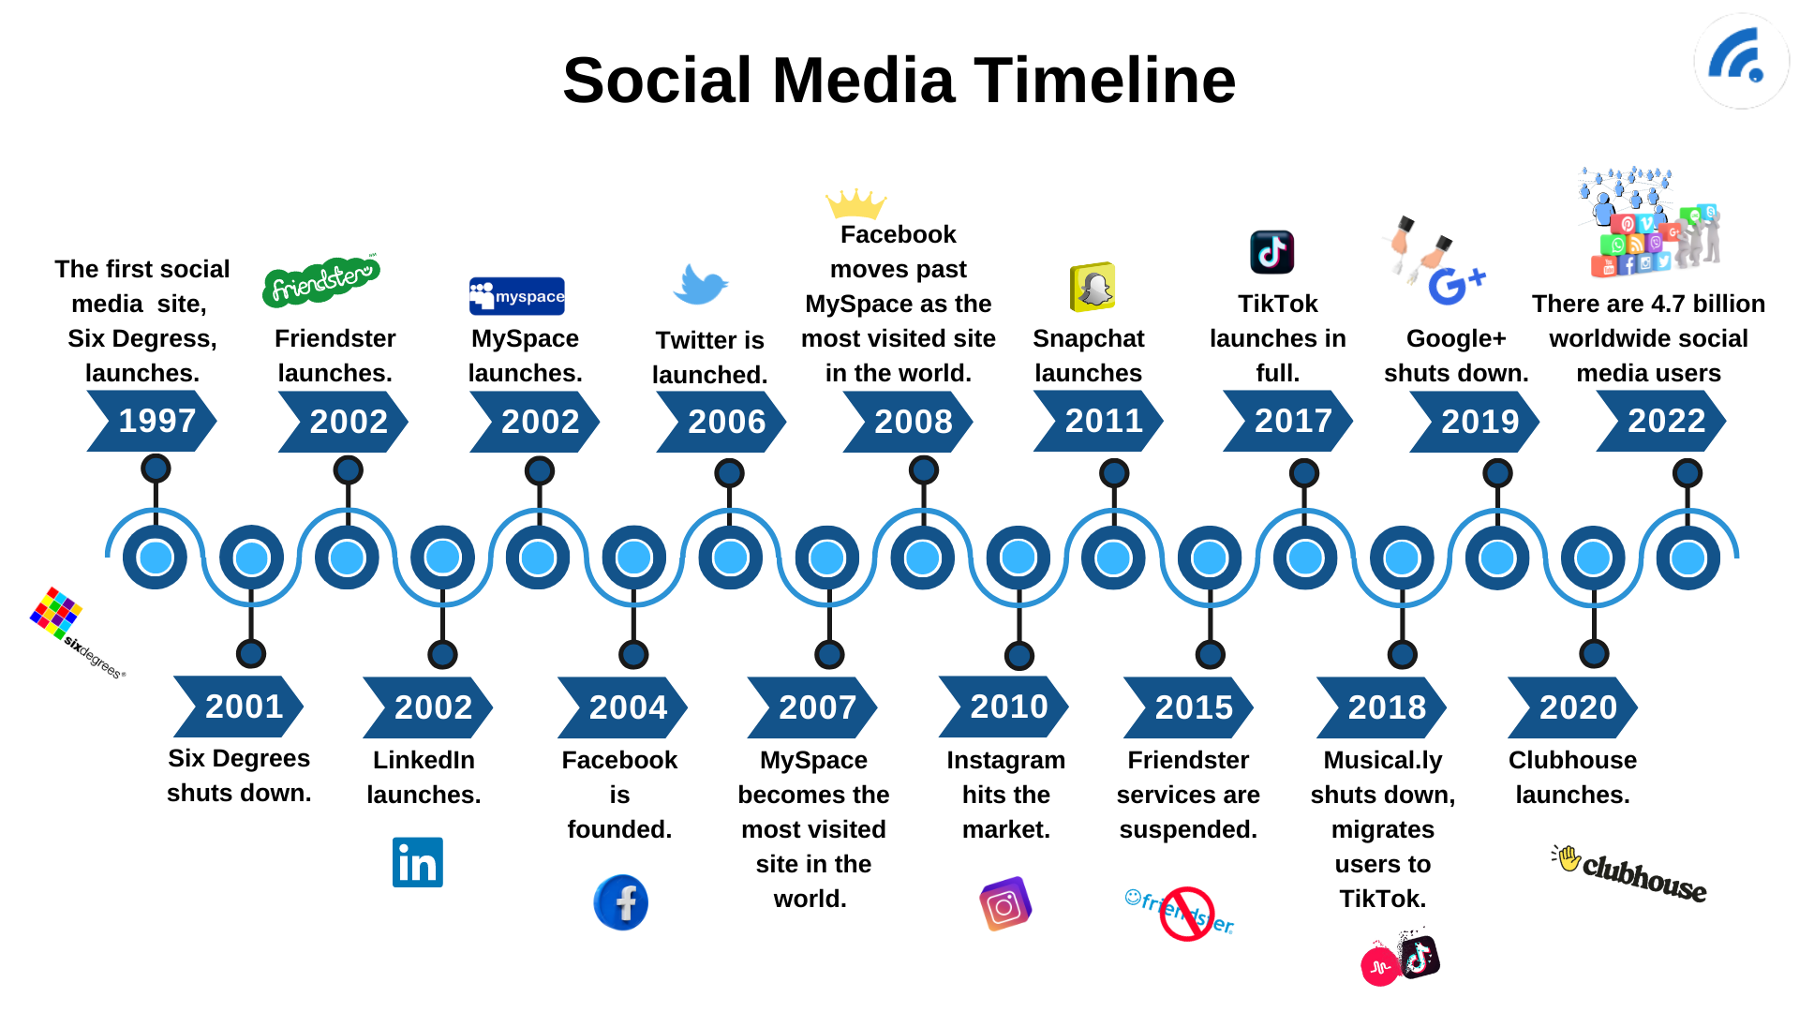
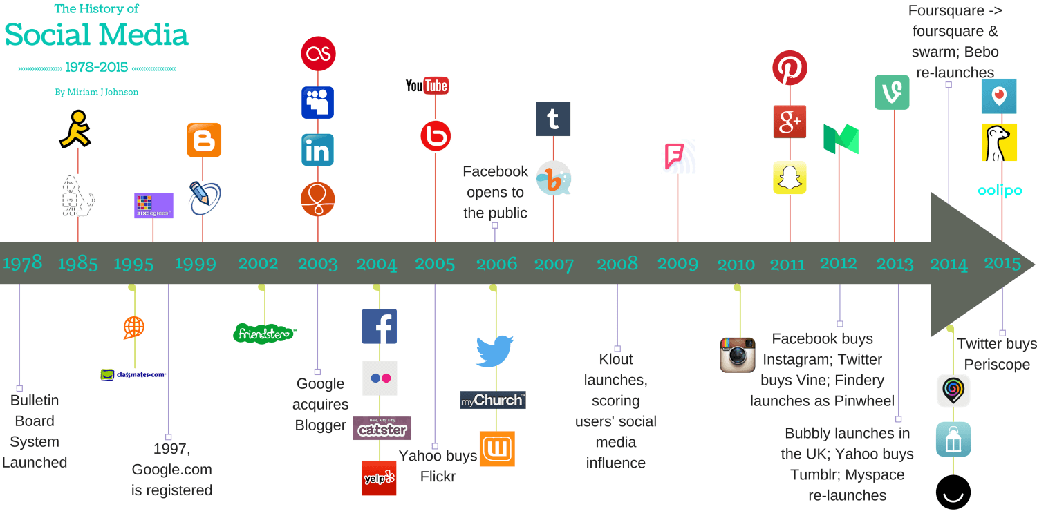

Slide 5
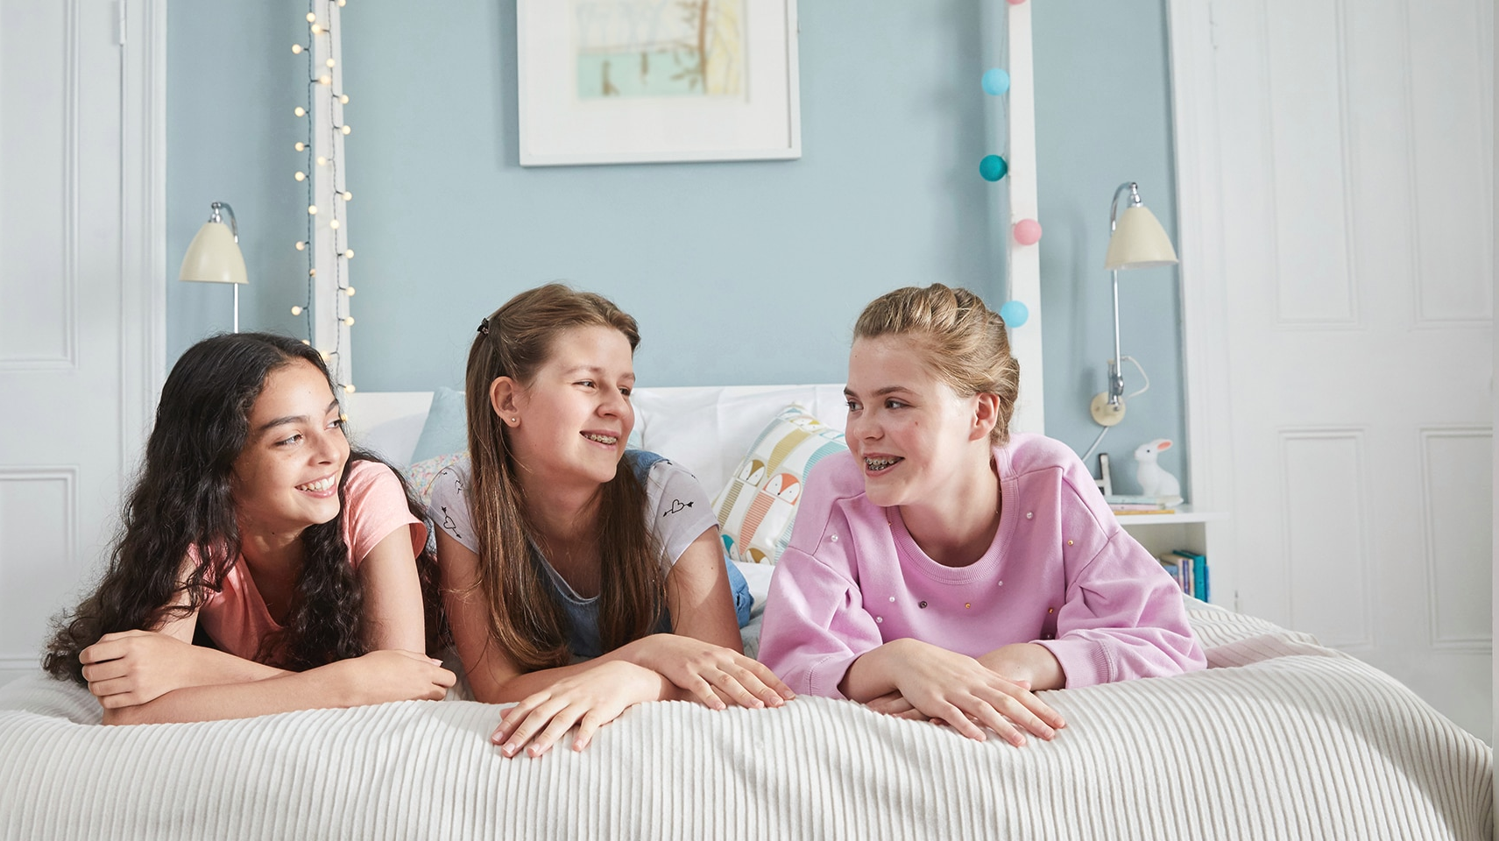
Dove – Self Esteem Project

Slide 6
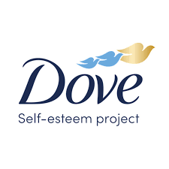
Details about the dove self-esteem project
In the UK 9 out of 10 girls with low body esteem put their health at risk by skipping meals or not seeking help
Dove has been building self-esteem in young children since 2004 and by 2030 it is predicted they would have helped ¼ billion people through their programmes
They supply a verse variety of different tools to help self-esteem in children and adults
RESOURCES
Parent and Mentors
Teachers
Youth leaders (groups)
TOPICS
Family, friends and relationships
Respecting and looking after yourself
Dealing with bullying
Talking about appearance

Slide 7
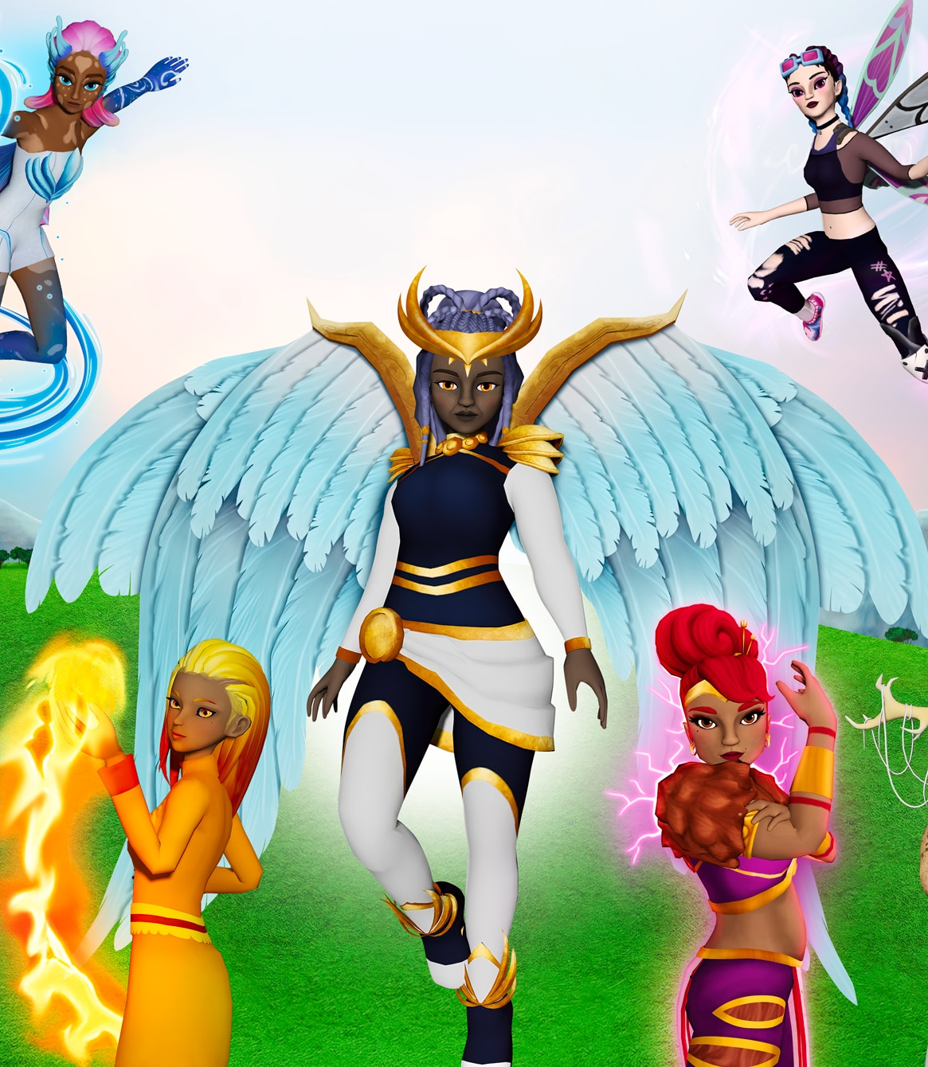
Dove Roblox game – The Academy
Details about the game
School for children with superpowers that’s under threat
Customise avatars
Team up with friends
Explore, earn power-ups and complete quests
Aim of the game
Help players find their unique superpower
Dodge and destroy negativity
The difference its making
New way of showcasing real life situations
First of its type
Making a change to beauty standards
Researchers targeted an aspect that they knew kids would play
The urge to win

Slide 8
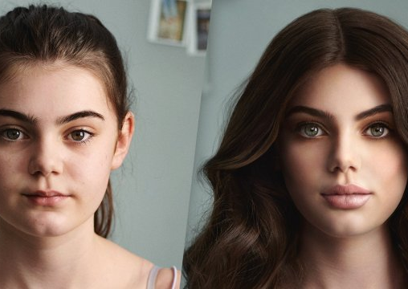
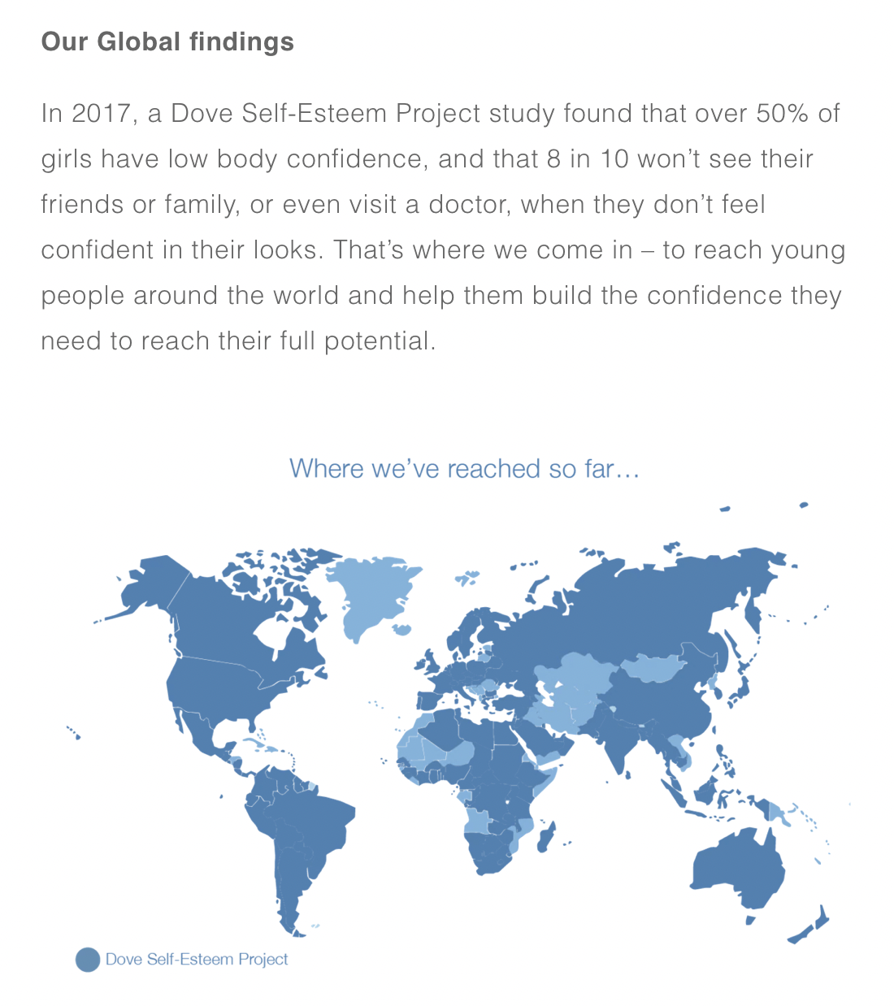
The mission for the future

Slide 9
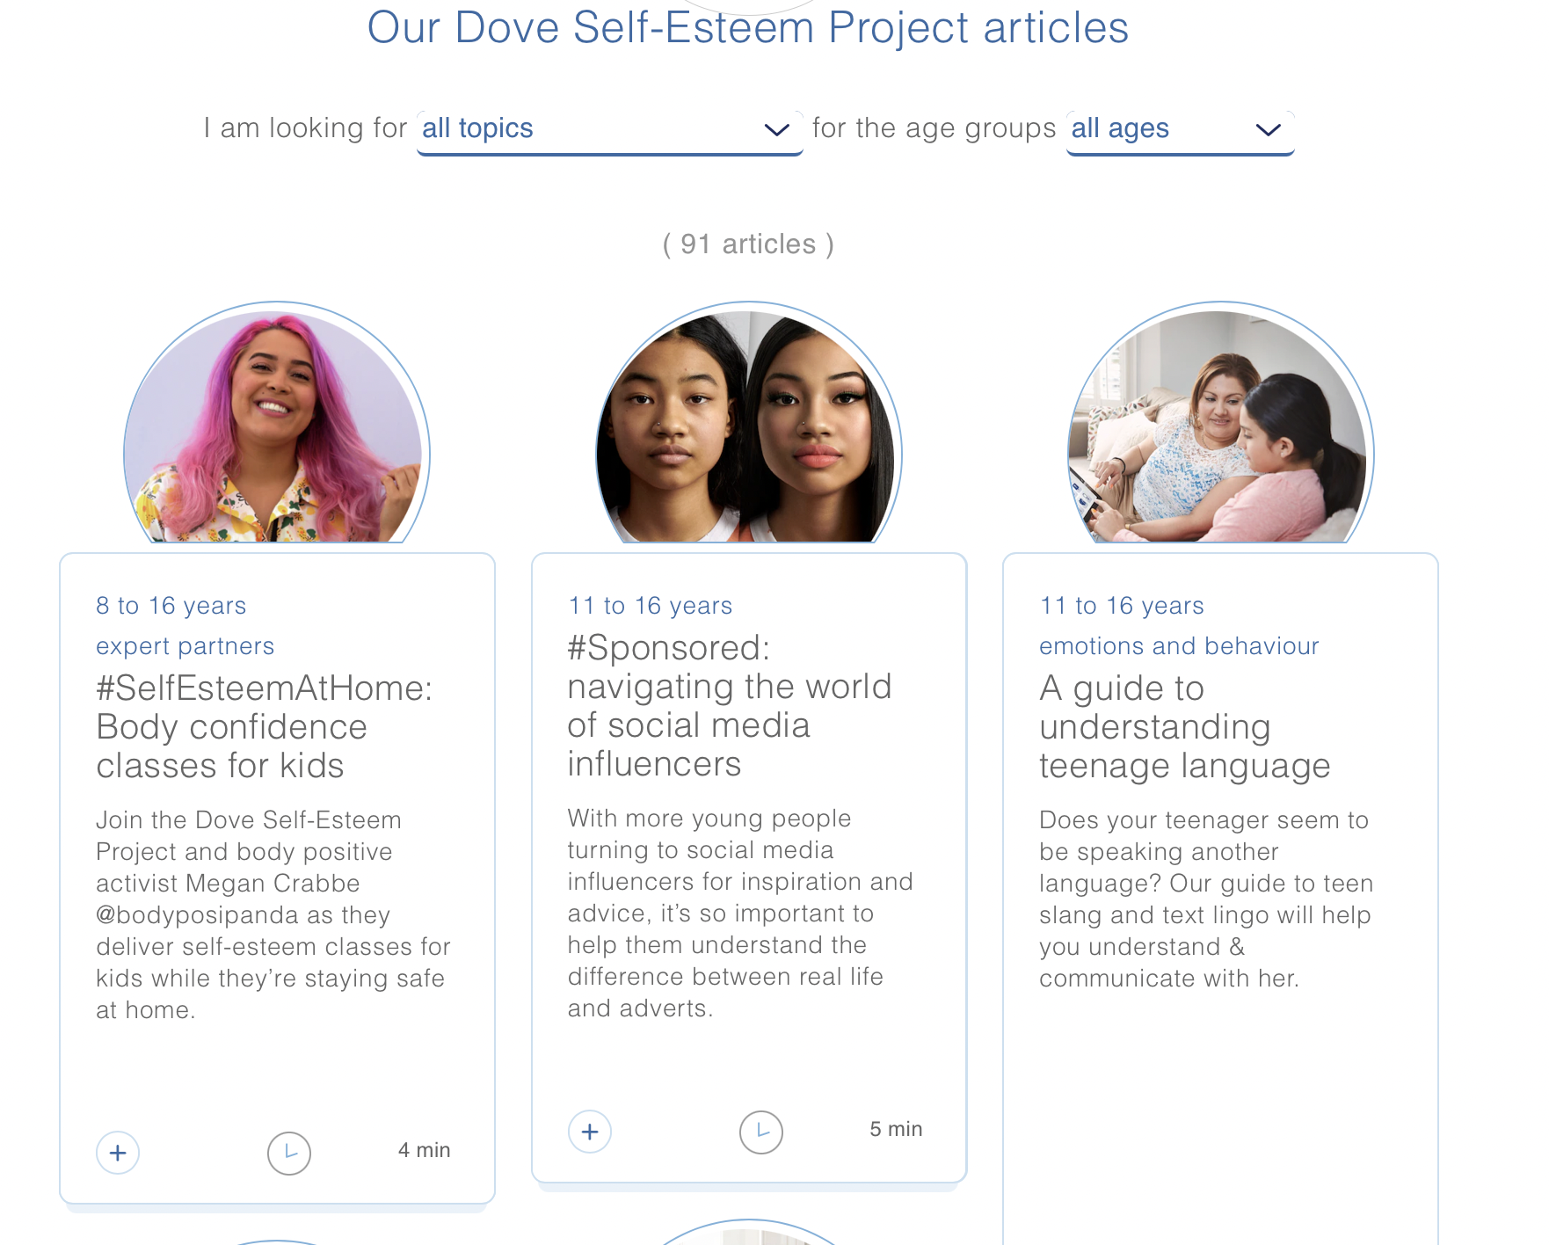
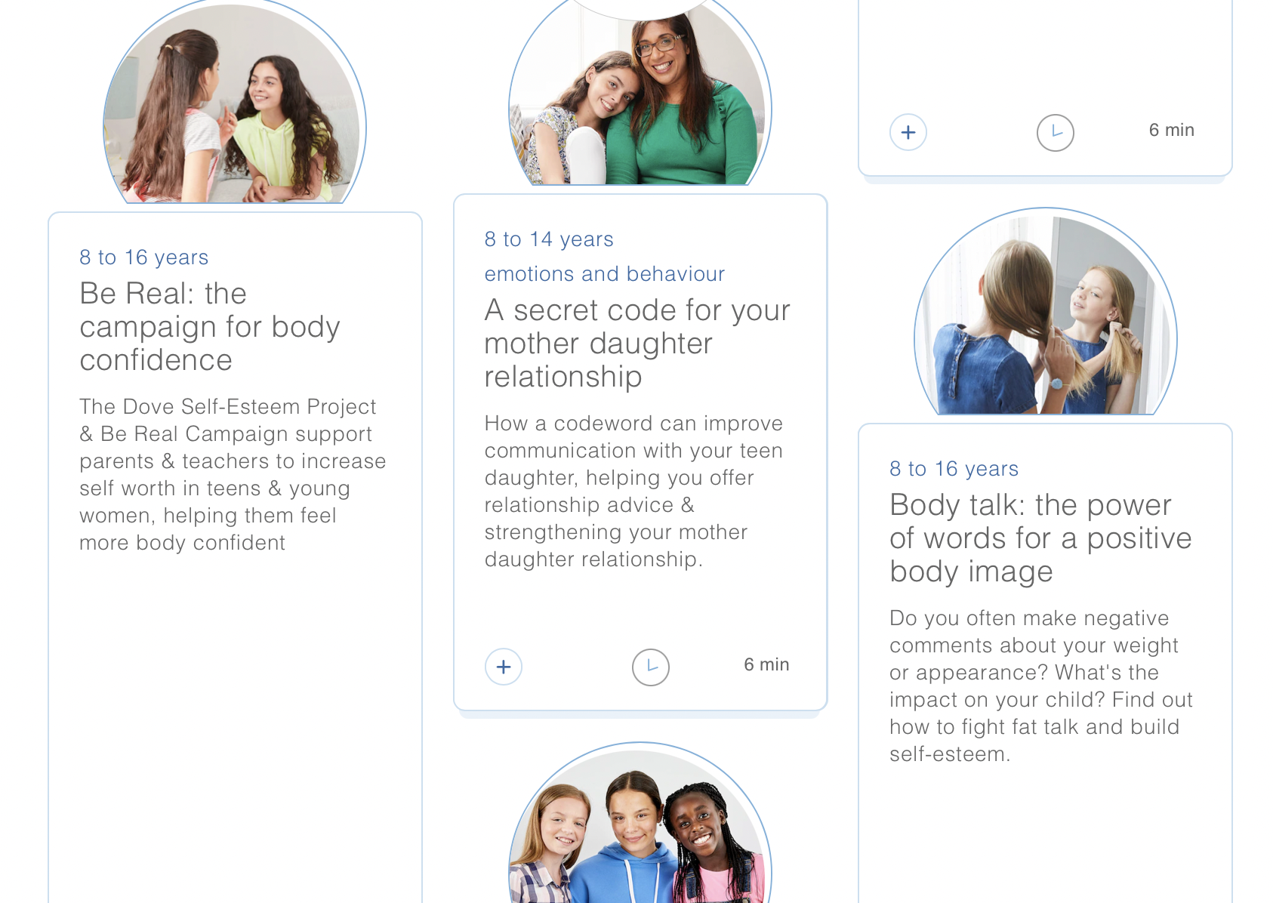

Slide 10
Mental Health Foundation
"body image and mental health"

Slide 11

Mind over body campaign
30% of all adults have felt stressed by body image and appearance causing them to feel overwhelmed
The mind over body campaign was created in 2021, focusing on the impact that body image can have on mental health and was co-created with young people, parents and adults from past experiences.
Mind over mirror report
Feeling my mind – tips for maintaining a positive body image
Parenting for healthy body image
Mirror my mind comics ( Comic strips about how you can talk about cosmetic treatments).

Slide 12
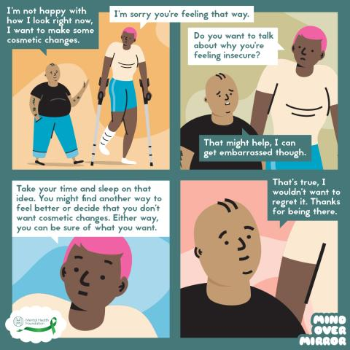
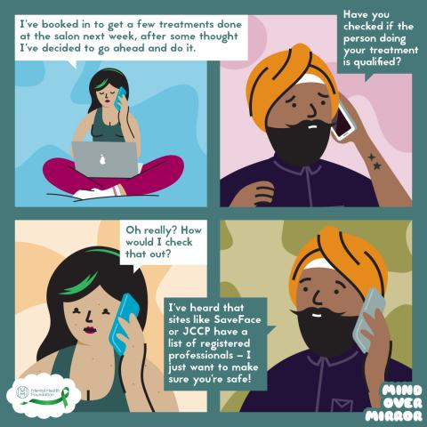
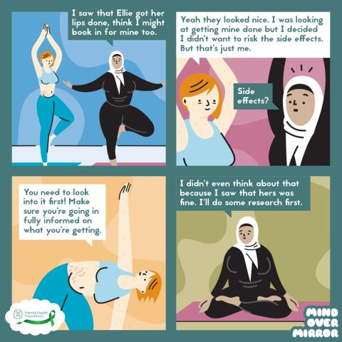
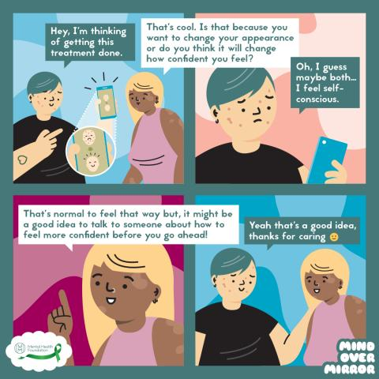
Mirror my mind comics
Series of comic strips
Based on real life situations
To know what to say in the real-life circumstances

Slide 13
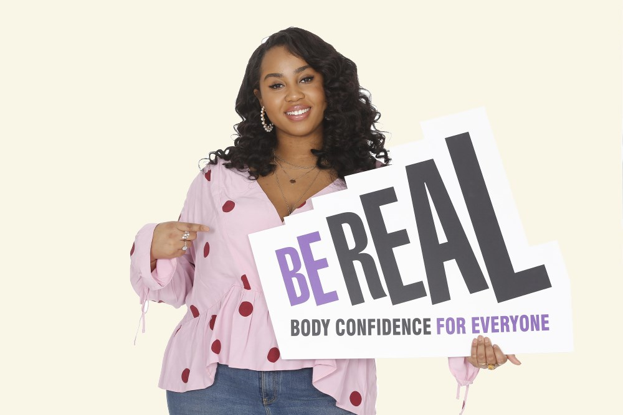
The Be real Campaign – Founded by YMCA and Dove
Real health​​
Focusing on the healthcare sector to promote long term healthy living​
Celebrating feeling good and being healthy
Real Diversity
Pushing fashion and media industries to sign up
Consumers buying from businesses that support body confidence
Real Education
Schools to take a whole school
Approach in promoting body
confidence
Parents to set a positive
example
Young individuals
support each other

Slide 14

Somebody like me : A report investigating the impact of body image anxiety on young people in the UK
52% of 11- to 16-year-olds regularly worry about how they look
30% of 11- to 16-year-olds isolate themselves because of body image anxiety
36% of 11- to 16-year-olds said they would do whatever it takes to look good, including surgery
48% of young people surveyed had learned about body confidence in school
76% said it made them feel more positive
Created due to the increasing pressures young individuals were having
They conducted major findings, conducted by Ed-coms
Involved 2,000 secondary schools and 501 teachers
YMCA also held focus groups in 12 locations in the UK

Slide 15
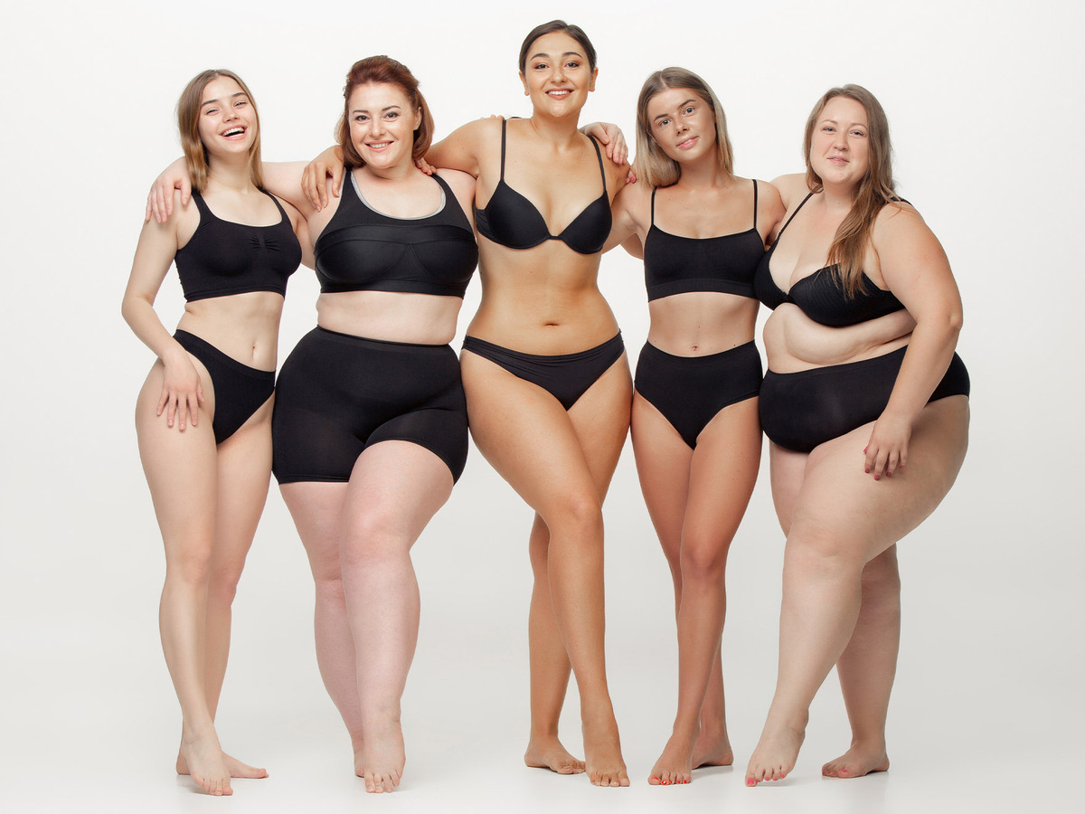
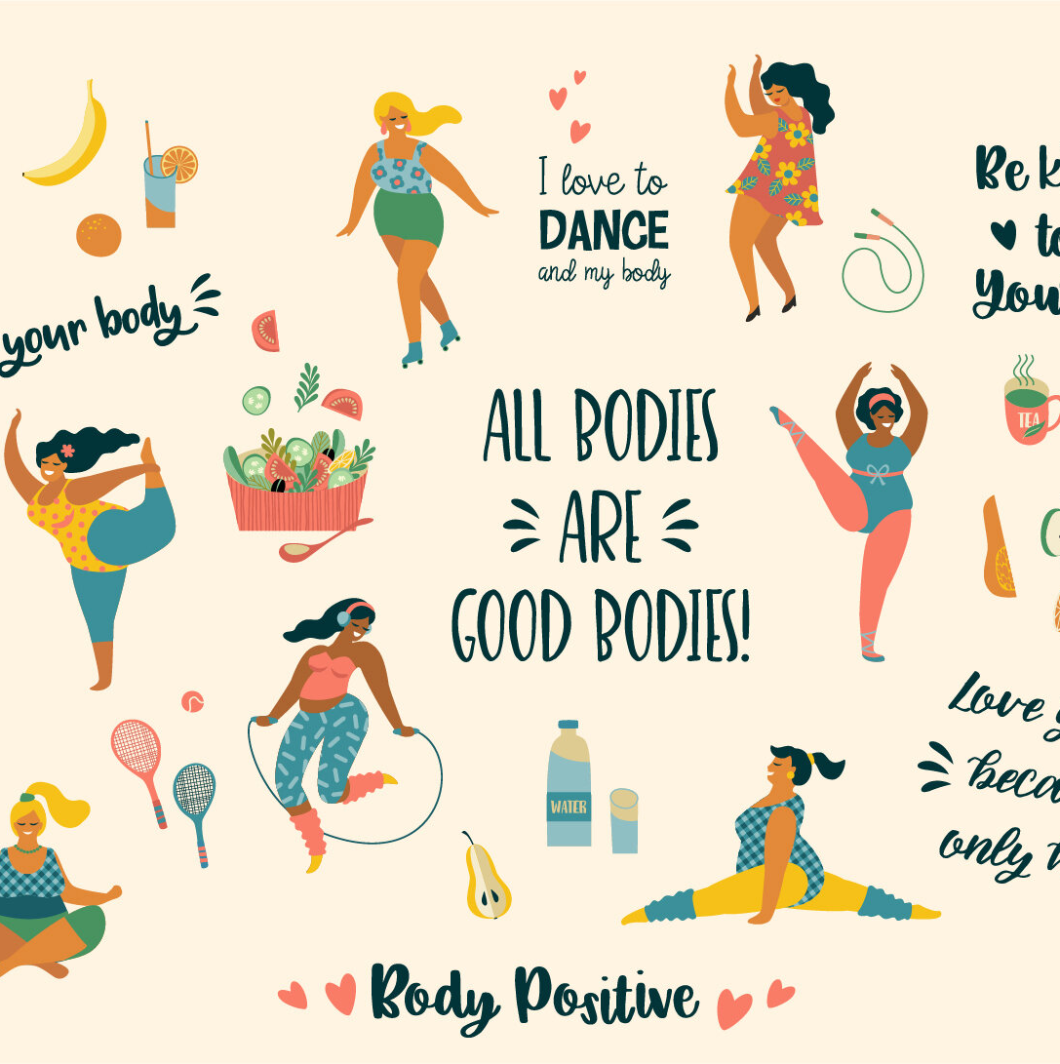
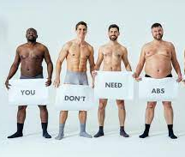
Going forward – things you can do to promote body image through reading campaigns
Follow given tips for a positive body image and image towards others
Pass on tips to others, with friends and family that may be struggling to spread awareness
Make notes
Listen to the stats, their REAL
Educate younger individuals online, that may be new to the media
Educate the older generation, that may be questioning why they feel a certain way
Notice what the triggers are that cause your low body image and take them out your life – deleting accounts that don’t bring you joy...

Slide 16
References
Dove. (n.d.). The Dove Self-Esteem Project | Dove. https://www.dove.com/uk/dove-self-esteem-project.html
The Be Real Campaign - Body Confidence for Everyone. (2019, October 24). The Be Real Campaign. https://www.berealcampaign.co.uk/
Body image and mental health. (n.d.). Mental Health Foundation. https://www.mentalhealth.org.uk/explore-mental-health/body-image
Oakes, K. (2022, February 24). The complicated truth about social media and body image. BBC Future. https://www.bbc.com/future/article/20190311-how-social-media-affects-body-image
Author, D. (2023, January 18). Super U Story on Roblox. Dove. https://www.dove.com/uk/dove-self-esteem-project/our-mission/roblox-super-u-story.html
Dove. (n.d.-b). Our Mission – The Dove Self-Esteem Project. https://www.dove.com/uk/dove-self-esteem-project/our-mission.html
Dove. (n.d.-c). Parenting teens: Dove Self-Esteem Project resources | Dove. https://www.dove.com/uk/dove-self-esteem-project/help-for-parents.html
Dove. (n.d.-a). Dove Self-Esteem Project workshops for schools – Dove. https://www.dove.com/uk/dove-self-esteem-project/school-workshops-on-body-image-confident-me.html
Dove. (n.d.-e). Self-esteem activities for youth leaders – Dove DSEP. https://www.dove.com/uk/dove-self-esteem-project/self-esteem-resources-for-youth-groups.html
Mind Over Mirror. (n.d.). Mental Health Foundation. https://www.mentalhealth.org.uk/explore-mental-health/body-image-and-mental-health/mind-over-mirror
Body Confidence Campaign Toolkit for Schools - The Be Real Campaign. (2018, July 4). The Be Real Campaign. https://www.berealcampaign.co.uk/resources/body-confidence-campaign-toolkit-for-schools
Preston, L. (2018, October 16). In Your Face: A report investigating young people's experiences of appearance-based bullying - The Be Real Campaign. The Be Real Campaign. https://www.berealcampaign.co.uk/research/in-your-face-a-report-investigating-young-peoples-experiences-of-appearance-based-bullying
Campaign, B. R. (2018, February 28). Somebody Like Me: A report investigating the impact of body image anxiety on young people in the UK - The Be Real Campaign. The Be Real Campaign. https://www.berealcampaign.co.uk/research/somebody-like-me

