Slide 1

Psychology in Health and Social Care
LCHS4010
Assessment 1: Individual Presentation
Programme: Certificate of Higher Education in Health and Social Care
Student name. Abdul wakabi
Student ID. 2333084
Lecturer: Miss Bianca sanfilippo

Slide 2
Acknowledgement of the use of AI
I confirm that I have not presented any AI generated text as my own work. I confirm I have copies of my drafts, notes, and other resources I used before, and after the use of AI tools which I may be asked to provide in evidence.

Slide 3
Overview
Introduction
Definition of the key terms
Human Lifespan
……………………..
……………………..
……………………..
……………………..

Slide 4
Definition of key terms
Lifespan perspective in psychology is a theoretical framework that emphasises the importance of studying human development across the entire lifespan
It helps us enhance empathy through fostering greater understanding and support of our own growth.
Builds better relationships by navigating awareness
It also enhances informed interventions in fields like education and healthcare.
Developmental psychology, is a branch of psychology studies and that that describes how people grow and change throughout their lifespan.

Slide 5
Human Lifespan
Infancy 0-2 -
Early childhood 3-5
Childhood 6-12
Adolescence 13-18
Early Adulthood 19-29
Adulthood 30-59
Late adulthood 60+

Slide 6
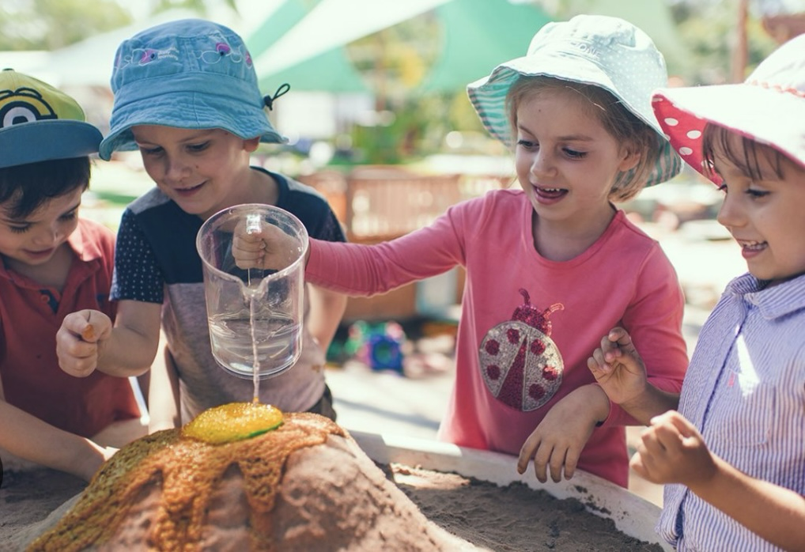
Life span stage : early childhood 3-5
Amiras stage. 3-5 early childhood.
The second stage of child development is early childhood which spans from birth to around a period from ages of 3-5. It’s a crucial stage in human development characterised by significant changes across physical, intellectual, and social domains.

Slide 7
Developmental changes in early childhood 3-5
Physical Development | Intellectual/Language
Children begin to develop the ability to use symbols, (words , images) to show experiences in there growth., although their thinking remains self centred. There by Amira would be supported with visual aids, picture books to assist her in managing her needs from anxiety. Piaget, J. (1952). | Children start being self-centred, in other words they view the growth and changes in their own perspective. Start to make social interactions with other children challenging, for example they might find it hard to understand others feelings. Amira would need to equipped with better engagement, to facilitate her emotions with others and be able to develop awareness of others emotions through guidance McLeod,S.(2018).
Emotional | Social
Children start to recognise, manage and express their emotions but still lean on carers for emotional support. Amira has to be equipped with hands on activities and emotional support that would help her to understand her environment . Piaget J. (1954). | Increased interactions with other children. Relationships starts to bond with other children and cooperative plays kick in Piaget J. (1952).

Slide 8
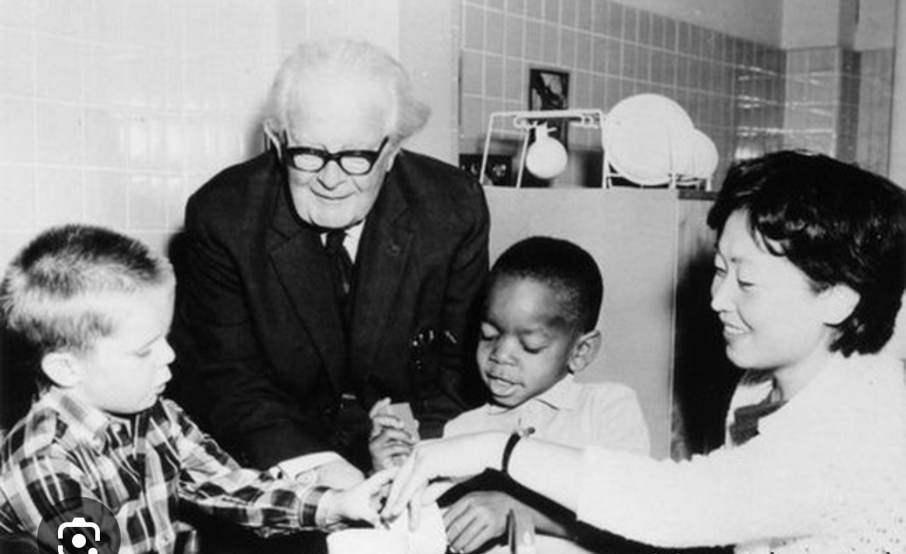
Jean Piaget
Jean Piaget was born in 1896 in Switzerland, and he died in 1980, originally trained as a biologist and later became a child psychologist. Jean Piagets theory of cognitive development is a framework that explains knowing how children thinking expands as they grow between the ages of 3-5 which falls under Piaget pre-operational stage (2-7)years.

Slide 9
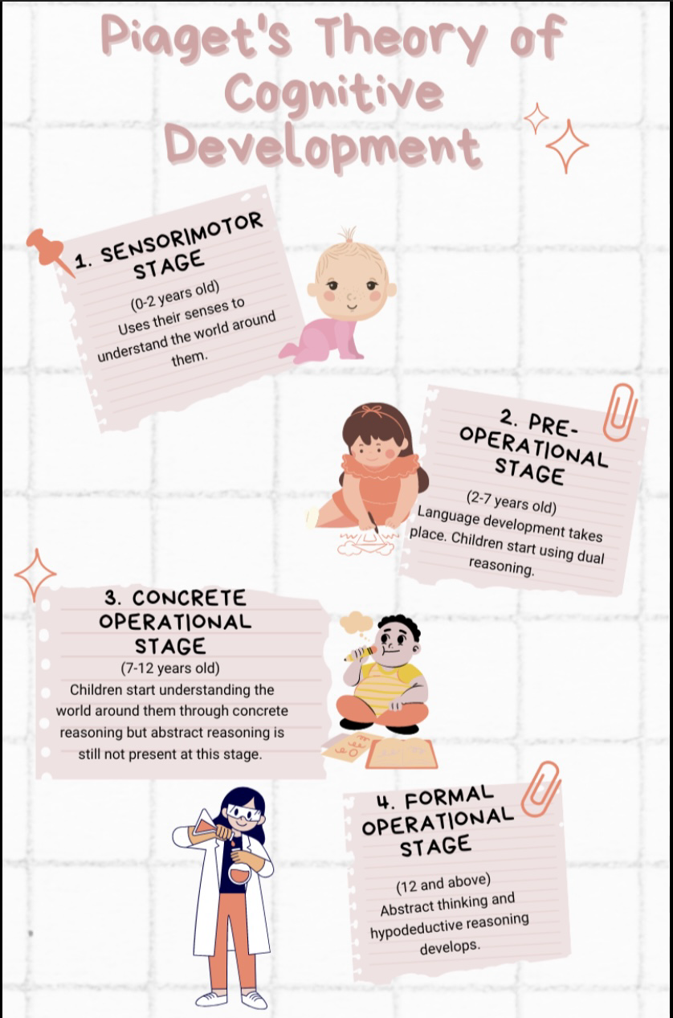
Piaget theory of cognitive development

Slide 10
Applying Piagets pre-operational stage to Amiras development.
The pre-operational stage.(Ages 2-7). During this period, the children develop basic language skills, imagination, and social interaction and still have limitations.
Early childhood.(Ages 2-4).
Rapid laugauge development.
Selfcentered thinking increases. Piaget,J.(1952).
Beginning of symbolic play, imagination.
Later childhood. (Ages 4-7).
Development of perspective taking of theory of mind, increased ability to engage in cooperative play, though still limited in reasoning.
Better understanding of rules and procedures. Piaget, J.(1954).

Slide 11
Practical strategies or interventions for Amira.
Providing emotional support and consistent care support to Amira that will provide reassurance to her through physical comfort, calm voice, and boost her attachment needs.(Woolf & Mareschal, 2007).
Providing Amira with visual and physical learning resources for example pictures, objects and gestures to facilitate her ability to communicate effectively.(Piaget,1952).
Engaging Amira in gentle social small groups to enable her build interactions with other fellow gentle children to build her confidence step by step.(McLeod, 2018).
Encouraging Amira to join imaginative plays through offering her activities that would promote independent lifestyle to her for example pretend plays.(Piaget, 1952).

Slide 12
Supporting Amira’s development:Nature and nurture influences.
Biological influences (nature): Amiras character make-up neurological development and growth processing capabilities play a big role in her capacity to regulate emotions, communicate and engage with her environment.(Guhn et al., 2016). For example her limited verbal communication may be likely to reflect in developing her maturation which is typical for her age but can vary among children.
Environmental influences (nurture): Amira’s nursery environment, caregivers, interactions and daily routine activities and social experiences can continuously shape Amira’s social and emotional skills(Bronfenbrenner, 1979). Her anxiety when separated from carers could be weakened with consistent routines and safety attachments encouraged through nurturing care. (Ainsworth, 1989).

Slide 13
Critical Evaluation of Piaget’s theory of cognitive development
Strengths | Limitations
Focusing on active learning., Piagets theory emphasises that children are active participants in their development, learning through interaction with their environment. ( Piaget, 1952). This also helps to build Amira’s confidence slowly by slowly through ending plays to increase her emotional strength. Increase in biological maturation and environmental influences.through encouraging a balanced broad platform that promotes nurturing and growth. Provides a developmental stage framework. This strength helps practitioners understand that children like Amira are in the pre-operational stage, where symbolic thinking and language start from. Recognising this helps to improve interventions such as using visual aids to support her limited verbal communication and reduce anxiety. (Piaget, 1952). | Limited consideration of cultural and Environmental influences. This can affect Amiras emotional wellbeing and social interactions in a nursery setting due to limited considerations caused by cultural factors and differences resulting from environmental influences.(Berk, 2018). Underestimates social and Emotional factors: Piagets theory focuses on cognitive development through individual self reflection and often minimises the importance of emotional and social influences. For example for a child like Amira, her anxiety and difficulty in social engagement explains the emotional factors that effectively influence her development. Inflexible periods may often ignore significant individual differences/details.for example Amira’s anxiety may indicate a delay or variation in her developmental timeline growth.(Schaffer, 2004).

Slide 14
Conclusion:
In summary of my conclusion, my presentation has been about Jean Piaget as my chosen theory of cognitive development describing Amira’s early childhood (ages 3-5) as her lifespan change development which describes a dynamic phase that involves development across multiple areas resulting into the foundation for future growth and learning.
Piaget theory offers enlightening perspectives into the cognitive stages of early childhood., it focuses more on individual developmental stages which may overlook critical emotional and social experiences that are essential for supporting children like Amira. A comprehensive broad approach that unites Piagets principles with emotional and social support strategies is necessary to effectively support Amira’s development. (Schaffer, 2004).

Slide 15
Reference list
Piaget, J. (1952) The Origins of Intelligence in Children. New York: International Universities Press.-(Accessed 12 November 2025).
Piaget, J. (1954) The Construction of Reality in the Child. London: Routledge & Kegan Paul.- (Accessed 12 November 2025).
McLeod, S. (2018) ‘Piaget’s Theory of Cognitive Development’, Simply Psychology. Available at: https://www.simplypsychology.org/piaget.html (Accessed 12 November 2025).
Woolf, K., & Mareschal, D. (2007) ‘The Development of Cognitive Abilities: Piaget’s Theory’, in Bowman, B. & Johnson, C. (eds) Child Development: (Accessed 12 November 2025 ).
Berk, L. E. (2018) Child Development. 9th edn. Boston: Pearson. (Accessed 12 November 2025).
Schaffer, H. R. (2004) Social Development. 4th edn. Malden, MA: Blackwell Publishing. (Accessed 12 November 2025 ).

