Slide 1
Strategic capabilities Part one– the Strengths and Weaknesses for your SWOT Analysis

Slide 2

Resources and capabilities
The resources and capabilities of an organisation contribute to its long-term survival and potentially to competitive advantage.
Resources are the assets that organisations have or can call upon (e.g. from partners or suppliers), that is ‘what we have’.
Capabilities (sometimes referred to as competences) are the ways those assets are used or deployed, that is ‘what we do well’ .
Notes:
An organization's resources are the tangible and intangible assets it possesses or can access, such as its finances, technology, knowledge, or physical facilities, while capabilities are the skills and processes used to deploy those resources effectively to achieve strategic goals, contributing to the firm's long-term survival and potential competitive advantage. The ability to effectively combine and leverage these resources and capabilities is central to the resource-based view (RBV) of competitive advantage.
Resources:
Definition: The assets an organization has or can call upon to achieve its objectives.
Examples:
Tangible: Financial assets, physical equipment, technology, raw materials, and infrastructure.
Intangible: Knowledge, organizational culture, patents, brand reputation, and information.
Capabilities:
Definition:
The organizational skills, processes, and activities that allow a firm to deploy its resources to create value.
Examples:
Human Capital: The collective skills, knowledge, and expertise of employees.
Processes: Efficient management systems, strategic planning processes, and methods for coordinating teams.
Strategic Management: The ability to manage and exploit resources effectively, such as Internationalization capabilities or dynamic capabilities.
Relationship to Competitive Advantage:
Foundation:
Resources and capabilities are the internal factors that a firm controls, forming the basis for a competitive advantage.
Strategic Advantage:
A company's ability to combine unique or valuable resources with effective capabilities allows it to achieve a competitive advantage over rivals.
Resource-Based View (RBV):
This strategic framework emphasizes that a firm's unique resources and capabilities are key to its superior performance and long-term success.

Slide 3
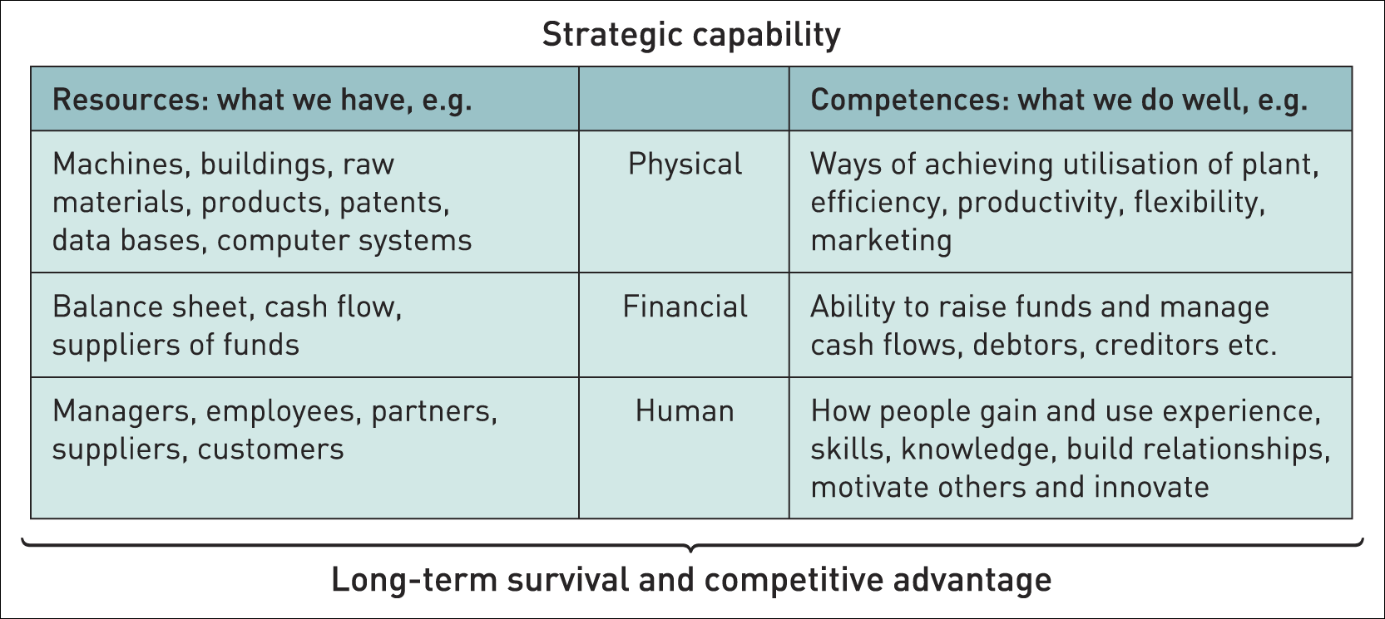
Strategic capabilities – resources & competences
Notes:
Strategic capabilities arise from a combination of an organization's resources (assets, tangible or intangible) and its competencies (the ability to deploy and coordinate these resources effectively). These capabilities form the foundation for competitive advantage when they are valuable, rare, difficult to imitate, and non-substitutable (VRIO attributes). Core competencies are unique, deeply integrated capabilities that provide a sustainable competitive edge by allowing a firm to consistently deliver superior value to customers.
Resources
Assets and Skills:
These are the "building blocks" of a company, including tangible assets like machinery and facilities, and intangible assets like patents, trademarks, brand reputation, and knowledge.
Types of Resources:
Tangible: Physical and financial assets.
Intangible: Non-physical assets, such as brand reputation, intellectual property, and organizational knowledge.
Competencies
Ability to Exploit Resources:
Competencies are the organizational processes and skills used to exploit resources effectively.
Examples:
A company's managerial, technical, or marketing skills are examples of competencies.
Strategic Capabilities
Integration of Resources and Competencies:
Strategic capabilities are the strategic deployment of an organization's unique resources and competencies.
Purpose:
They enable a firm to meet its strategic objectives and achieve a competitive advantage.
Core Competencies
Distinctive Capabilities:
A bundle of resources and capabilities that are especially valuable, rare, and difficult to imitate.
Source of Competitive Advantage:
These "crown jewels" of a company are the activities it performs particularly well compared to its competitors, providing unique value to customers over the long term.
VRIO Framework for Sustainability
For a strategic capability to provide a sustainable competitive advantage, it must be:
Valuable: It must enable the firm to exploit opportunities or neutralize threats.
Rare: It must be possessed by few, if any, current or potential competitors.
Inimitable: It must be difficult or costly for competitors to imitate.
Organized: The firm must have the appropriate organizational structure, processes, and culture to exploit the capability effectively.

Slide 4

Redundant capabilities
Capabilities, however effective in the past, can become less relevant as industries evolve and change.
Such ‘capabilities’ can become ‘rigidities’ that inhibit change and become a weakness.
It is important for an organisation to recognise such redundant capabilities and to eliminate them.
Notes:
Strategic capabilities are an organization's key strengths for competitive advantage, but redundant capabilities are those once-effective elements that have become outdated, rigid, or irrelevant to current industry conditions, thereby becoming a potential weakness rather than a source of advantage. These can include outdated processes, skills, knowledge, or tools that hinder adaptation to a changing market, as seen in Nokia's past struggles to adapt in the mobile phone industry.
What are strategic capabilities?
They are the unique combination of skills, processes, technologies, and behaviours that allow an organization to deliver on its business strategy and gain a competitive edge.
Effective strategic capabilities help an organization capitalize on opportunities, navigate threats, and sustain performance over time.
What makes a capability "redundant"?
Loss of Relevance:
The capability, while effective in the past, no longer aligns with the evolving needs of the industry or market.
Inhibition of Change:
Instead of supporting growth, the redundant capability becomes a rigid element that obstructs necessary innovation and adaptation.
Failure to Deliver Advantage:
What was once a source of competitive advantage can transform into a disadvantage, leading to a loss of market position, as seen with Nokia.
Examples of redundant capabilities
Outdated Technologies:
A company might still rely on old software or machinery that is no longer efficient or compatible with newer market demands.
Obsolete Skills:
A workforce with outdated technical skills may struggle to adapt to new digital tools or methodologies.
Rigid Processes:
Long-established workflows that are resistant to simplification or modernization can impede agility and responsiveness to market changes.
Why are redundant capabilities a problem?
Hindrance to Strategic Goals:
They prevent an organization from achieving its objectives and maintaining a competitive advantage.
Cost Inefficiency:
Maintaining outdated capabilities can be more expensive than adopting newer, more effective alternatives.
Missed Opportunities:
Resources allocated to redundant capabilities could be better used to develop or acquire new strategic capabilities needed for future success.

Slide 5

Core competencies / capabilities
Core competences¹ are the linked set of skills, activities and resources that together:
deliver customer value
differentiate a business from its competitors
potentially, can be extended and developed as markets change or new opportunities arise.
Notes:
Strategic capabilities are an organization's combined resources, skills, and processes that enable it to gain a competitive advantage and achieve long-term success, while core competencies are a type of strategic capability; they are unique and difficult for competitors to imitate, providing a sustained edge. Threshold capabilities are also necessary, meeting minimum standards to compete, but they don't offer a unique advantage.
What are Strategic Capabilities?
Definition:
The combination of knowledge, skills, tools, processes, and behaviors that allow an organization to achieve its objectives and gain a competitive edge.
Components:
They are built on two main components: resources (assets, infrastructure, etc.) and competencies (skills, knowledge, routines).
Purpose:
To enable the organization to meet its strategic goals and ensure its long-term survival and success.
What are Core Competencies?
Definition:
A unique set of strategic capabilities that an organization performs exceptionally well, providing a distinct and sustainable competitive advantage.
Characteristics:
They are difficult for competitors to imitate, contribute significantly to customer benefits, and provide access to diverse markets.
Origin:
The concept was popularized by Prahalad and Hamel in a 1990s Harvard Business Review article.
How they Relate:
Hierarchy:
Core competencies are a subset of strategic capabilities. A core competency is a specific type of strategic capability that delivers a strong, unique advantage.
Examples:
Threshold Capabilities: The minimum skills and resources required to enter a market, like the ability to manufacture a product to a certain quality standard.
Core Competencies: A unique combination of skills in product innovation, marketing, and manufacturing that allows a company like Apple to create and deliver highly successful products.
Why They Matter:
Competitive Advantage:
Core competencies are the foundation for sustainable competitive advantage because they are hard to replicate.
Growth and Differentiation:
Identifying and cultivating these competencies helps businesses differentiate themselves and drives growth.
Resource Allocation:
Understanding core competencies helps in making better strategic decisions about where to invest resources

Slide 6

Finding your company’s Core competencies
What are Core Competencies?
Watch this video and take notes:
  What are the key messages that you take away from this?
  We will discuss this together after the video.
https://youtu.be/Abl6b71H2Mc

Slide 7

benchmarking
Benchmarking is a means of understanding how an organisation compares with others – typically competitors.
Two approaches to benchmarking:
Industry/sector benchmarking – comparing performance against other organisations in the same industry/sector against a set of performance indicators.
Best-in-class benchmarking – comparing an organisation’s performance or capabilities against ‘best-in-class’ performance – wherever that is found even in a very different industry. (e.g. BA benchmarked its refuelling operations against Formula 1).
Notes:
Benchmarking is the process of comparing an organization's performance and practices against those of another organization to identify opportunities for improvement. The two main approaches are industry/sector benchmarking, which compares an organization against its direct competitors using specific performance indicators, and best-in-class benchmarking, which involves learning from the most effective practices of top performers, even if they are in completely different industries.
Benchmarking Explained
Purpose:
The primary goal of benchmarking is to understand current performance, identify weaknesses, and discover best practices to enhance efficiency, effectiveness, customer satisfaction, and overall competitiveness.
Process:
It's a systematic approach to measuring current performance and comparing it to leaders in a particular area to foster continuous improvement.
Outcomes:
By adopting insights from other organizations, businesses can set realistic improvement targets and develop strategic plans to achieve them, ultimately leading to future growth and success.
Approaches to Benchmarking
Industry/Sector Benchmarking (Competitive Benchmarking)
What it is: Comparing your organization's performance metrics against those of other companies within the same industry or sector.
Example: A car manufacturer might benchmark its production efficiency against another car manufacturer.
Best-in-Class Benchmarking (Generic or Functional Benchmarking)
What it is: Identifying and adopting best practices from any organization, regardless of its industry, that demonstrates superior performance in a particular process or function.
Example: As stated in the prompt, British Airways (BA) benchmarked its aircraft refuelling operations against the rapid pit stops and processes of Formula 1 racing teams, showcasing how a best-in-class practice from one industry can be applied to another.

Slide 8
The resource-based view (rbv) of strategy and
Achieving sustainable competitive advantage
The resource-based view (RBV) of strategy asserts that the competitive advantage and superior performance of an organisation is explained by the distinctiveness of its capabilities.
The four key criteria by which capabilities can be assessed in terms of providing a basis for achieving sustainable competitive advantage are:
V – value
R – rarity
I – inimitability and
O – organisational support
Notes:
The Resource-Based View (RBV) is a strategic framework suggesting that a firm's unique internal resources and capabilities are the key to achieving sustainable competitive advantage. To gain this advantage, resources must be valuable, rare, difficult to imitate, and well-organized (VRIO framework) or non-substitutable (VRIN framework). RBV emphasizes an "inside-out" perspective, focusing on a company's own strengths rather than solely on external market conditions, to maintain superior performance over time.
How RBV Achieves Sustainable Competitive Advantage
For a resource to confer a sustainable competitive advantage, it must meet the following criteria:
Valuable:
The resource must enable the firm to exploit opportunities or neutralize threats in the market, improving its efficiency.
Rare:
Competitors must not have access to the same resources, making them unique within the industry.
Inimitable:
The resources must be difficult or costly for competitors to acquire, develop, or copy.
Non-substitutable:
There should be no strategically equivalent resources available to competitors that can be used to replace the firm's valuable resources.
Organized:
The firm must have the necessary organizational structure, systems, and processes in place to effectively deploy, manage, and exploit these valuable, rare, and inimitable resources.
Internal vs. External Focus
The RBV contrasts with earlier external-focused approaches, such as Michael Porter's competitive positioning strategies. Instead of focusing on the external competitive environment, RBV advocates for an inward look to identify and leverage the firm's distinctive resources and capabilities.
Types of Resources
Firms possess various resources that can contribute to competitive advantage:
Tangible Resources: Physical assets like plant, equipment, and financial resources.
Intangible Resources: Less physical assets such as brand reputation, intellectual property, customer relationships, organizational culture, and skilled human capital.
Examples
BYD's Battery Technology:
BYD uses its advanced in-house battery technology and integrated supply chain to control costs and quality in the electric vehicle market, creating a competitive edge.
Nike's Brand and Innovation:
Nike's globally recognized brand, strong research and development, and high-profile marketing create a powerful sustainable advantage in the sports apparel industry.

Slide 9
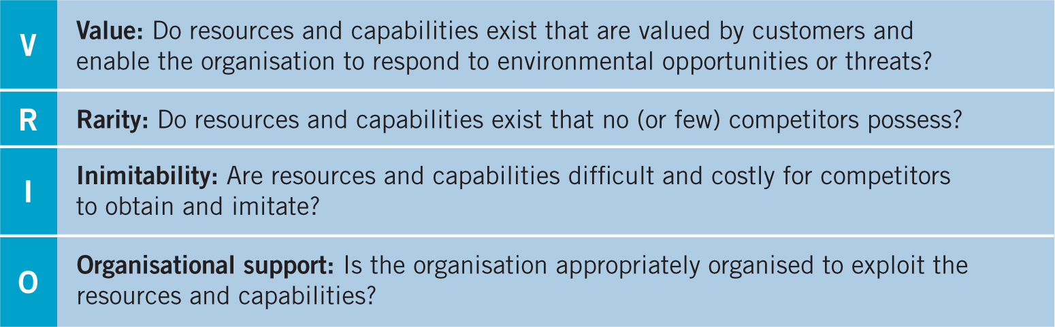
Achieving sustainable competitive advantage

Slide 10

V – Value
V – Value of resources and capabilities
Strategic capabilities are of value when they:
take advantage of opportunities and neutralise threats;
provide value to customers;
are provided at a cost that still allows an organisation to make an acceptable return.
Notes:
ccording to the concept of strategic capabilities, they are considered valuable when they all three of the following conditions are met: they take advantage of opportunities and neutralize threats, provide value to customers, and are provided at a cost that allows the organization to make an acceptable return.
Explanation:
Taking advantage of opportunities and neutralizing threats:
A valuable capability allows a company to capitalize on new market trends or effectively counter competitive actions by leveraging its unique strengths.
Providing value to customers:
The capability must deliver something that customers perceive as beneficial and are willing to pay for, ultimately impacting the company's competitiveness.
Being provided at an acceptable cost:
While delivering value is crucial, the capability needs to be produced or obtained at a cost that allows the company to maintain profitability.
Key points about valuable strategic capabilities:
VRIO framework:
This framework assesses capabilities based on their Value, Rareness, Inimitability, and Organizationability to determine their potential for sustained competitive advantage.
Unique and difficult to imitate:
Capabilities that are rare and difficult for competitors to replicate are considered more valuable.

Slide 11

R – rarity
R – Rarity
Rare capabilities are those possessed uniquely by one organisation or only by a few others.
(e.g. a company may have patented products, have supremely talented people or a powerful brand.)
Rarity could be temporary.
(e.g. patents expire, key individuals can leave or brands can be de-valued by adverse publicity.)
Notes:
Rare capabilities are resources or skills possessed uniquely by a single organization or a very small number of competitors, such as patented products, exceptionally talented individuals, or a powerful brand. However, rarity can be temporary, as patents expire, key employees leave, or a brand's value diminishes due to negative publicity.
Examples of Rare Capabilities
Patented Products: Exclusive technology that cannot be legally copied by competitors.
Supremely Talented People: Individuals with unique skills, knowledge, or experience that are difficult to replicate.
Powerful Brand: A strong, positive reputation and customer loyalty that differentiates a company from its rivals.
Why Rarity is Important
Competitive Advantage:
A rare capability can provide a significant advantage over competitors by offering something unique that others cannot easily access or replicate.
VRIO Framework:
In strategic management, rarity is a crucial component of the VRIO (Valuable, Rare, Inimitable, Organized) framework, which helps determine if a resource or capability can be a source of sustained competitive advantage.
The Temporary Nature of Rarity
It's important to recognize that rarity is not always permanent.
Patents: These have a limited lifespan and eventually enter the public domain.
Key Individuals: Highly skilled employees can leave the organization and join competitors.
Brands: A brand's prestige and value can be damaged by negative events or poor strategic decisions.
Market Evolution: Competitors can develop their own similar capabilities or find substitutes, eroding the rarity of a capability over tim

Slide 12

I – Inimitability
Inimitable capabilities are those that competitors find difficult and costly to imitate, to obtain or to substitute.
Competitive advantage can be built on unique resources (a key individual or IT system) but these may not always be sustainable (key people leave or others acquire the same systems).
Sustainable advantage is more often found in competences (the way resources are managed, developed and deployed) and the way competences are linked together and integrated.
I – inimitability
Notes:
Inimitable capabilities are strengths that are hard for competitors to copy, purchase, or replace, forming the basis for sustainable competitive advantage rather than easily replicable resources like a single person or IT system. True sustainable advantage arises from competences, which are the unique ways a firm manages, develops, and integrates its resources.
Inimitable Capabilities:
Difficulty in Imitation: These are capabilities that competitors cannot easily replicate.
Difficulty in Acquisition: They may also be difficult for other firms to obtain.
Difficulty in Substitution: Alternatives are hard to find or create.
Resources vs. Competences:
Resources:
These are the raw assets a company owns, like a unique IT system or a highly skilled individual.
Vulnerability: Resources often lack sustainability because key people can leave, or systems can be acquired by competitors.
Competences:
These refer to how a company uses its resources.
Sustainability: Competences are more likely to lead to a lasting competitive advantage.
Why Competences Lead to Sustainable Advantage:
Integrated Systems:
Competences involve the intricate linking and integration of various resources, making them complex to imitate as a whole.
Organizational Culture:
This integration often involves aspects of a company's culture and internal processes that are difficult to observe and replicate by outsiders.
Dynamic Capabilities:
The ability to manage, develop, and integrate resources over time, known as dynamic capabilities, is itself a form of inimitable competence that creates and renews competitive advantage.

Slide 13

O – organisational support
O – Organisational support
The organisation must be suitably organised to support the valuable, rare and inimitable capabilities that it has. This includes appropriate processes and systems.
Organisational knowledge is organisation-specific, collective intelligence, accumulated through both formal systems and people’s shared experience.
‘Explicit’ knowledge or ‘objective’ knowledge is transmitted in formal systematic ways, e.g. systems manuals or market research.
‘Tacit’ knowledge is more personal, context-specific, hard to formalise and communicate and is difficult to imitate, e.g. the knowledge and relationships in a top R&D team.
Notes:
Organizational support involves structuring an organization with processes and systems to nurture its unique, rare, and inimitable resources and capabilities. This includes fostering collective intelligence through the accumulation of explicit (documented) and tacit (experiential) knowledge to support valuable, inimitable capabilities. Proper organizational support leads to improved knowledge sharing, organizational learning, and a stronger competitive advantage through collective intelligence and effective knowledge management.
Key Aspects of Organizational Support
Resources and Capabilities:
Organizations must have appropriate systems and processes in place to support their most valuable, rare, and inimitable resources and capabilities.
Collective Intelligence:
This refers to the organization's ability to draw on the accumulated knowledge and experience of its people.
Explicit Knowledge:
This is objective, formal knowledge that can be documented and shared, such as in system manuals or market research reports.
Tacit Knowledge:
This is personal, context-specific knowledge that is difficult to formalize, communicate, or imitate, such as the expertise within a top R&D team.
How It Works
Support for Capabilities:
Organizations need the right structure, including suitable processes and systems, to support and develop their unique capabilities that are difficult for competitors to copy.
Knowledge Accumulation:
This support includes cultivating and managing organizational knowledge, which is a specific form of collective intelligence.
Balancing Knowledge Types:
Organizations leverage both explicit knowledge (easily codified) and tacit knowledge (hard to articulate, often gained through experience) to build organizational memory and foster learning.
Driving Organizational Learning:
By sharing and re-using knowledge through training, procedure changes, and technology, organizations can improve their effectiveness and efficiency.
Benefits
Competitive Advantage:
Harnessing internal knowledge drives innovation and helps an organization maintain a competitive edge.
Productivity and Efficiency:
Effective knowledge management and collective intelligence improve overall productivity and efficiency within the organization.
Adaptability and Innovation:
By leveraging its collective intelligence, an organization can become more dynamic and better equipped to adapt to changing business environments.

Slide 14
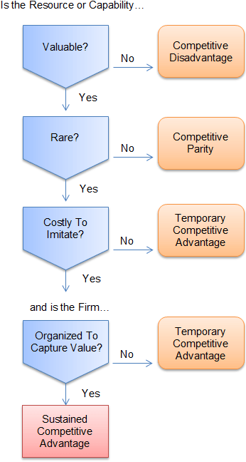
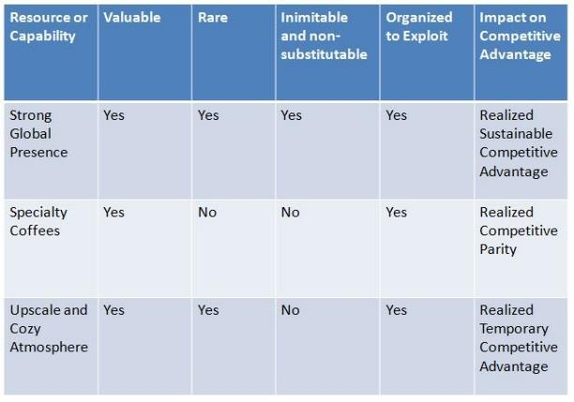
Vrio framework – levels of competitive advantage
Example of framework applied to Starbucks

Slide 15
summary
To be able to achieve sustained competitive advantage resources / capabilities need to be unique and distinctive.
To be distinctive and provide for sustainable competitive advantage, resources and capabilities need to fulfil the VRIO criteria of being Valuable, Rare, Inimitable and supported by the Organisation.
Ways of diagnosing organisational resources and capabilities include:
VRIO analysis of resources and capabilities to evaluate if they contribute to competitive advantage.
Analysing an organisation’s value chain and value system to understand how value to a customer is created and can be developed. WE will do this next week
Strategic analysis frameworks such as PESTEL, SWOT etc. drawing together an understanding of the strengths, weaknesses, opportunities and threats an organisation faces.
Benchmarking to understand the relative performance of organisations.
It is important for an organisation to recognise such redundant capabilities and to eliminate them.

