Slide 1
Early Language
Notes:
Introduce my self. Background info.
Ask the students where they want to be when they qualify.
Quiz
From birth on, children are programmed to develop speech and language. The first five years are most critical, but language development continues throughout early childhood and into adolescence. During the first five years, stimulation of language development is essential as the brain is developing new nerve cells as well as multiple connections between these cells to serve the function of expressive and receptive language. Lack of stimulation during this time could result in a child making slower progress or end up with poor communication skills. Later, we provide some tips for parents on how to help with language development, but some simple suggestions are to spend lots of time talking, singing, and reading to your child.In the early stages of language development, the brain is programmed to attend to speech sounds and begin to mimic them. Early on, babies like to make sounds up on their own. Later they attempt to repeat sounds and words they’re exposed to from their environment.Children usually say their first words between nine and 18 months old. The most common first words are either “mama” or “dada.” What’s interesting is no matter what language children are taught, the first words usually reference either mother or father.By about 18 months, a child usually has a vocabulary of 50 to 150 words. Children at this age begin to put a couple of words together to form a sentence sometimes referred to as “telegraphic speech,” such as “Mommy ball” or “Mommy throw ball.” By two-years-old, they can typically use over 300 words and understand about 1,000 words.Around three years of age, children begin to use language for all kinds of things. They’re not only trying to get what they want by asking, but they’re also talking about past experiences and even beginning to use it to pretend. By preschool (4 ½) they’re beginning to understand and use the rules of language to express possession of something, connect thoughts and quantify. Their language is becoming more like that of adults.

Slide 2

60% of all the energy a baby expends is concentrated in the brain.

Slide 3
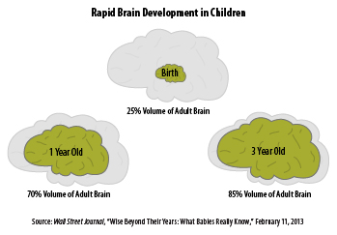
The birth-to-three period is the fastest rate of brain development across the entire human life span.

Slide 4
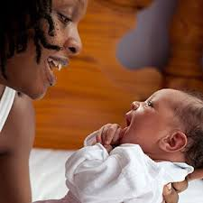
Babies whose parents frequently talk to them know 300 more words by age 2 than babies whose parents rarely speak to them

Slide 5

Social interaction enhances the speed and accuracy of learning at all ages.

Slide 6

ALL caregivers who are a part of a child’s life impact his/her brain development.

Slide 7

A strong parent-child bond in early childhood prepares children to better handle stress throughout life.

Slide 8
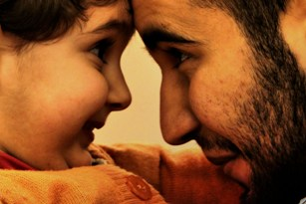
Babies learn what is important to pay attention to by following the eye gaze of adults.

Slide 9
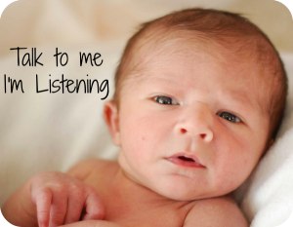
Humans are born with the ability to learn any language.

Slide 10

Learning more than one language improves cognitive development.

Slide 11

Children do not need special toys or videos to stimulate their brain development.

Slide 12
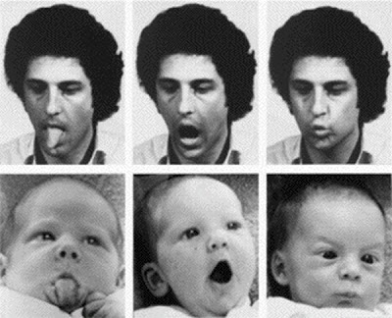
Babies use the facial expressions of adults to decide how they feel.

Slide 13

Holding and stroking an infant stimulates the brain to release important hormones that allow him to grow

Slide 14

If babies’ bodies grew at the same rapid pace as their brains, they would weigh 170 pounds by one month of age.

Slide 15
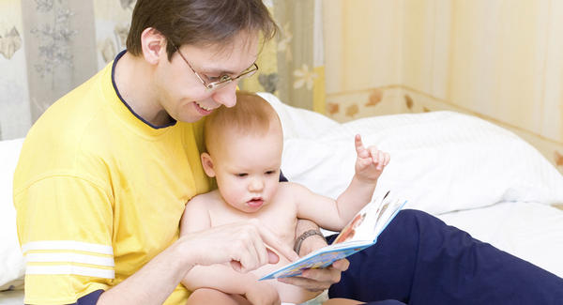
Reading aloud to children helps stimulate brain development, yet only 50% of infants and toddlers are routinely read to by their parents.

Slide 16
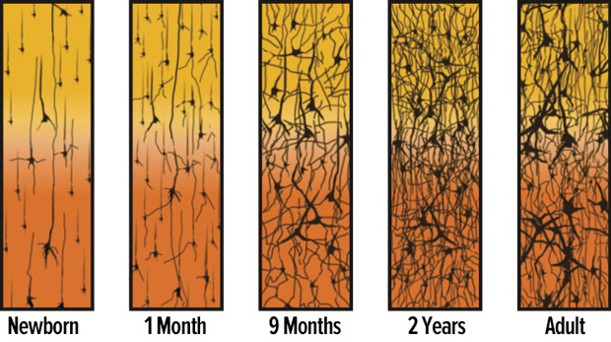
By the time they are 3, children’s brains have formed 1000 trillion connections between neurons.

Slide 17
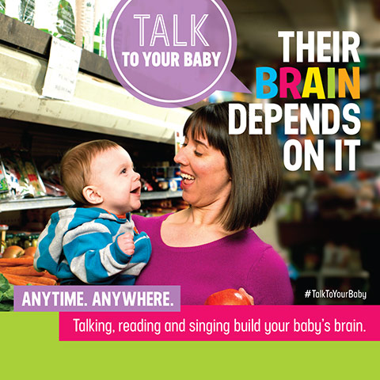
“Floor time” with a child including talking, singing, reading, playing, and exploring objects and physical space are the best ways to stimulate brain development.
Notes:
Video of Kathy Burke???

Slide 18
Adult/child interaction
Play
Understanding
Pronunciation
Looking and listening
Talking
Notes:
Triangloe sheet.
Where do these go on the triangle

Slide 19
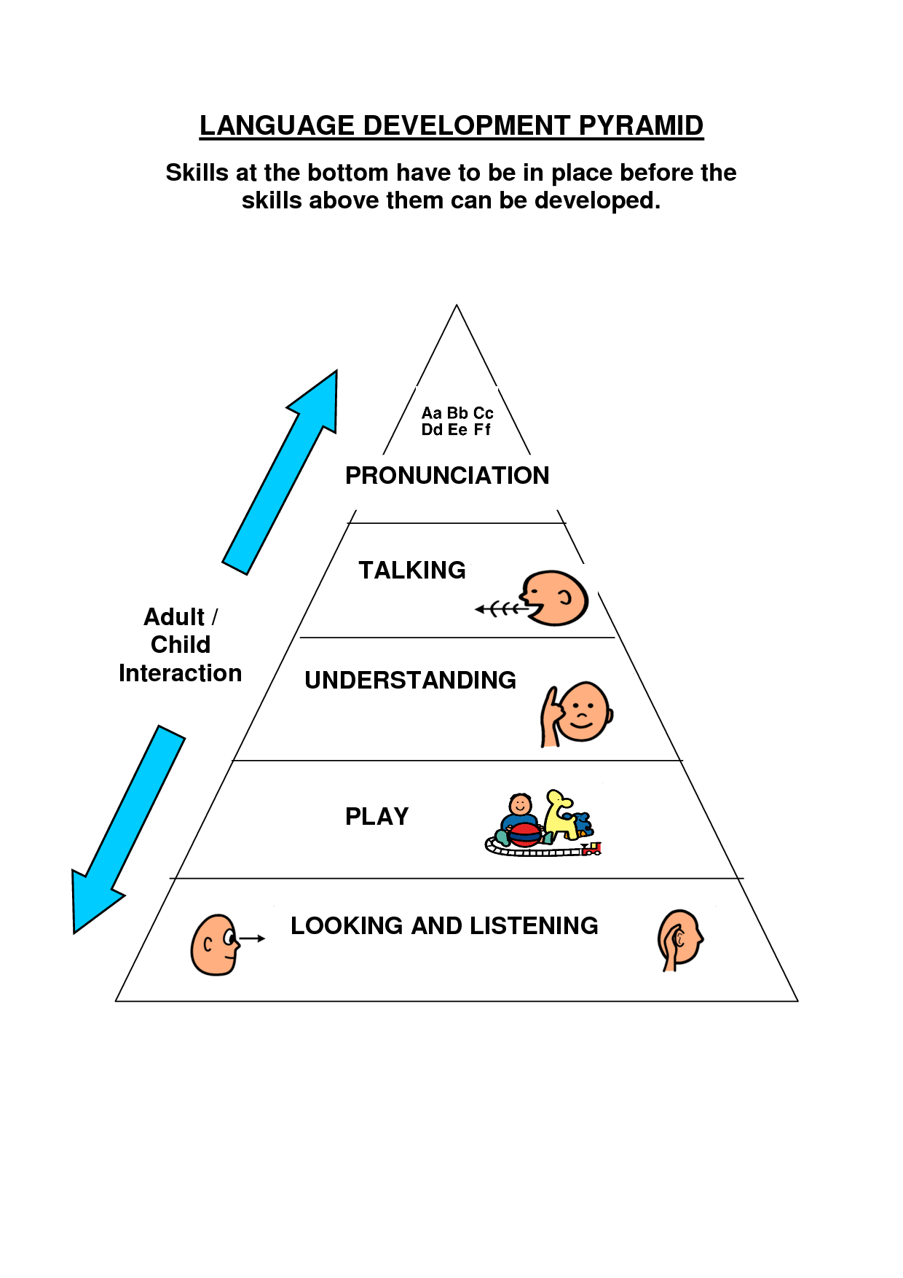
Chat and discussion
Notes:
Skills at the bottom have to be in place before the skills above them can be developed

Slide 20
Things that can influence a child's development
The first five years of a child’s life is a time of great promise and rapid change, when the developing brain is most open to the influence of relationships and experiences. However, millions of children across the world are at risk of not reaching their full potential because they do not get the care and early simulation they need.

Slide 21

Many factors can influence children's development
Family background
Different expectations for development, support, love, family makeup/background
Environment
Housing, pollution, available resources/opportunities, community safety structure and values
Gender
Different rates of growth for boys and girls and expectations
Health Status
Illness, SEN, diet, exercise, hygiene
Finances
Amount of money available for food, education, holidays clothing and resources/toys
Social class
Impact of poverty, attitudes
to educational development
Cultural background
Expectations of different
groups/ EAL
Genetics
Effects of inheritance

Slide 22

Many synapses are formed as a result of genes; this is how the basic brain becomes wired. However, the environment then plays a part in further development. Other synapses are formed as a result of a child’s senses reporting about his or her environment and experiences, and stimulating neural activity.
.
Notes:
For example, if a child hears speech sounds, this will stimulate activity in the area of the brain that focuses on language. If the level of speech heard increases, so will the activation between the synapses and neurons, and repeated use strengthens synapses.
There is no doubt that the influence of the environment and experiences of a baby and young child has a huge impact on the development of the brain, but this can be both positive and negative. For babies that experience very low levels of stimulation, trauma, violence or neglect, the negative impact on their brain development can be significant

Slide 23
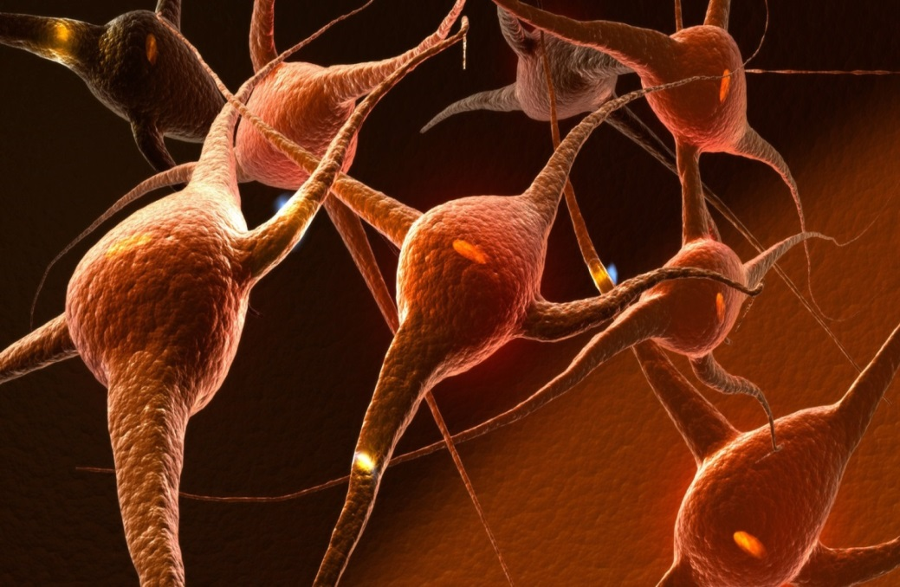
If synapses are rarely used, they stay weak and are more likely to be eliminated during the pruning process. Stronger synapses support the efficiency of the brain, supporting learning, memory and other cognitive skills.
Therefore, a child’s experiences have a great influence on how a child’s brain will process information for the rest of his or her life. This is why the first years of a baby’s life are critical.

Slide 24
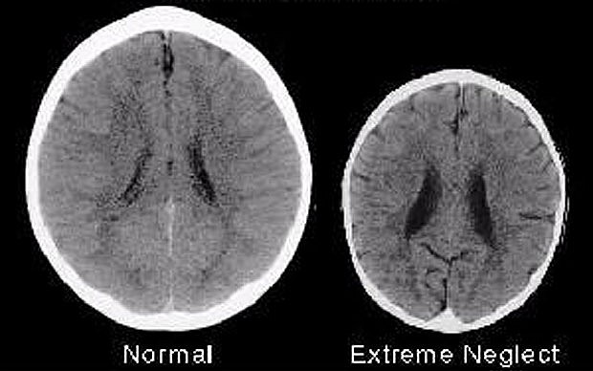
This image, from research conducted by Dr Bruce D Perry, Ph.D (PDF), illustrates the negative impact of neglect on the developing brain.
Notes:
Exteme cases
The CT scan on the left is from a healthy three-year-old with an average head size. The image on the right is from a three-year-old child suffering from severe sensory-deprivation neglect. This child’s brain is significantly smaller and Dr Perry’s research showed that, when a baby experiences severe trauma, the mid-brain part of the brain overdevelops. This results in children having overdeveloped safety and stress responses, resulting in them acting more impulsively.
When children experience neglect, the thinking/feeling parts of their brain do not develop. This results in an underdevelopment of the higher reasoning part of the brain.
If children experience both trauma and neglect, then this can result in anxiety, impulsive behaviour, poor affect regulation and motor hyperactivity, with poor empathy and problem-solving skills. Such as the Romenian orphans

Slide 25

Why Is It So Important?
Well, here’s a secret that will change the way you engage your child from now on…
The number of synapses in one’s brain depends on the positive engagement a child receives during the early years. So simply put, more positive experiences means more synapses
Notes:
Well, when you and I were young, we had a lot of games to play with, that were physical activities, had human interactions, made us think, and made us capable of handling a lot of real-life situations. Remember them? All these things impacted our Synapse growth.

Slide 26
In 1975, Edward Tronick and colleagues first presented the “still face experiment” to colleagues at the biennial meeting of the Society for Research in Child Development. He described a phenomenon in which an infant, after three minutes of “interaction” with a non-responsive expressionless mother, “rapidly sobers and grows wary. He makes repeated attempts to get the interaction into its usual reciprocal pattern. When these attempts fail, the infant withdraws [and] orients his face and body away from his mother with a withdrawn, hopeless facial expression.” It remains one of the most replicated findings in developmental psychology.
Notes:
Lack of a strong attachment in the first year can have a negative impact on a baby’s brain development. The Still Face Experiment was first presented in 1975 by Edward Tronick; since then it has become a heavily researched experiment to help researchers and scientists further understand how a child’s brain develops bonds of attachment and the impact of low interaction. It provides a powerful tool to demonstrate the importance of social interaction with children and is often used in speech and language training.
The negative impact of the environment and experiences within the first three years can result in a higher risk of the person developing depression in adulthood, dissociative disorders and memory impairments. There have also been links made to panic disorder, post-traumatic stress disorder, and attention deficit and hyperactivity disorder.

Slide 27
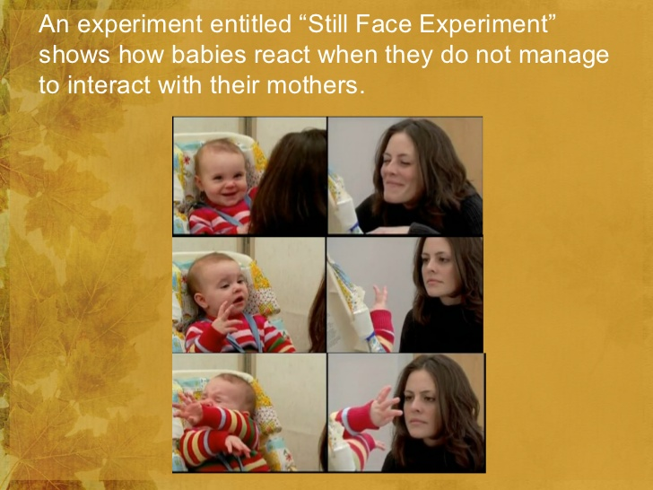
Notes:
Face to face video

Slide 28

Today, with the introduction of smartphones and TV, children have started engaging passively. Interactions with other human beings has reduced drastically. Children are seldom introduced to decision-making in real-life situations
Notes:
This is a worrying trend…
As per the latest study by American Academy of Pediatrics, it has been found that 75% of children use smartphones before they even turn 4!
Staffordshire University, UK, has found that even 15 minutes of TV time temporarily reduces the originality of ideas that children come up with.
In essence all these trends are impacting Synapse development in children

Slide 29
Discussion

Slide 30
Adverse Childhood Experiences (ACEs) are traumatic experiences that occur before the age of 18 and are remembered throughout adulthood.
These experiences range from suffering verbal, mental, sexual and physical abuse, to being raised in a household where domestic violence, alcohol abuse, parental separation or drug abuse is present.
Evidence shows children who experience stressful and poor quality childhoods are more likely to develop health-harming and anti-social behaviours, more likely to perform poorly in school, more likely to be involved in crime and ultimately less likely to be a productive member of society.
Cymru Well Wales has committed to addressing ACEs and their impact in Wales by; making all public services in Wales able to respond effectively to prevent and mitigate the harms from ACEs, and by building protective factors and resilience in the population to cope with ACEs that cannot be prevented.
.

Slide 31
Children who are exposed to abuse, domestic violence or other stresses are far more likely to develop long term health problems, says new research.
The Public Health Wales study looks at adverse experiences in childhood (ACEs) which include parents separating.
Children with four or more ACEs, around 14%, are three times more likely to get lung or heart disease later in life.
One senior health figure said instead of "mending broken adults" a focus was needed on "building stronger children".

Slide 32
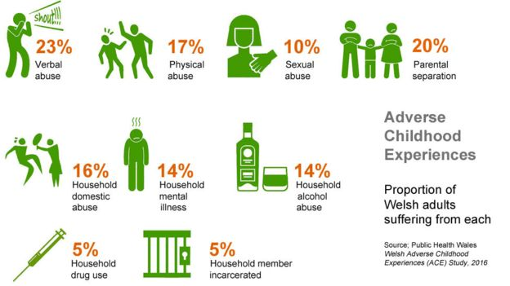
Notes:
Video of ACEs

Slide 33
For Prof Bellis it is crucial for the future to get it right.
The long term costs of leaving these things untreated are enormous," he said. "What we've got to focus on is instead of mending broken adults we must build stronger children.“
Prof Mark Bellis, director of policy and research at Public Health Wales
Notes:
Aces video

Slide 34
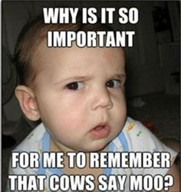
Impact on Early Language Development
Notes:
Discuss impact

Slide 35


School Readiness
Language Development at age 2 is a strong predictor of children’s school readiness at age 4
(Roulstone et al 2011)
Disadvantage Cycle
Children from low income families lag behind high income counterparts by 16 months in vocabulary at school entry
Vocabulary difficulties at 5 associated with poor literacy, mental health and employment outcomes at 34
(Law et al 2009)
Notes:
Learn to Talk, Talk to Learn,
Early speech, language and communication difficulties are a very significant predictor of later literacy difficulties (Snowling et al 2010).
Discuss

Slide 36

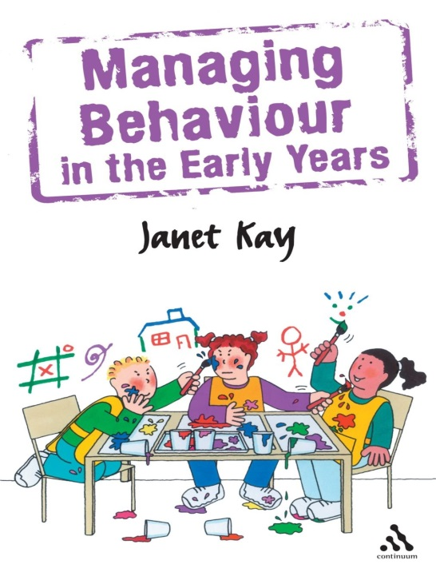
Criminality
65% of young people in young offenders institutions have communication difficulties
Mental Health
40% of 7 to 14 year olds referred to child psychiatric services had an undiagnosed language impairment
Behaviour/ vulnerability
2/3 of 7-14 year olds with serious behaviour problems have a language impairment
Notes:
Discuss

Slide 37
Information on the services that are involved within Early Intervention Service Jig-so
Early Language Development Team
Family Partnership team
Team around the family
Family Wellbeing Team

Slide 38
Early Language Development team
Supporting families to build and enhance skills that will better enable them to help their child to meet their developmental milestones. Encouraging families to engage and promote play and language skills through 1-2-1 home sessions and within group.
Talk, sing, read and playing with your child
We are Families First and Flying Start Funded and we cover the whole of Swansea
We are 9 ELDT project workers and 1 manager

Slide 39
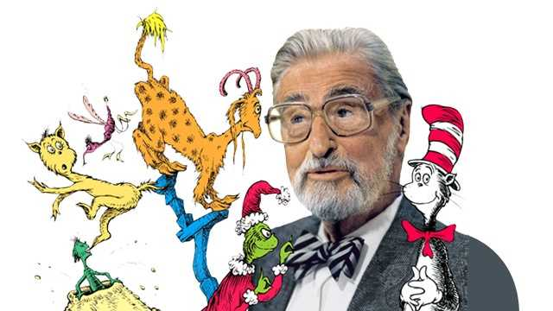
As Dr Seuss put it:
“The more that you read, the more things you will know. The more that you learn, the more places you’ll go.”
Notes:
Put down your phone video

