Slide 1
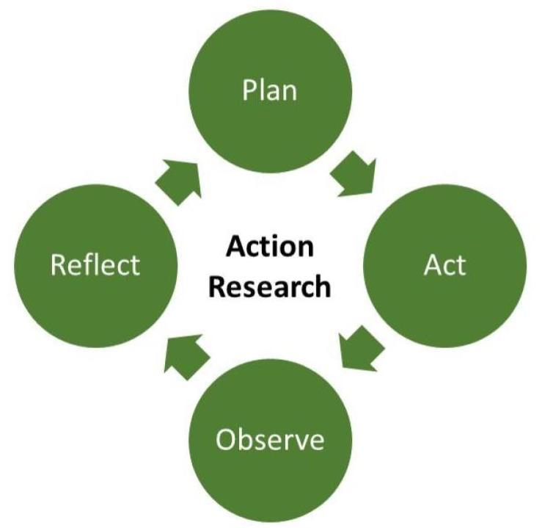



Methodology
Research techniques are instruments used for gathering data (Mchomes, 2019). There are many different research methodologies, including questionnaires, interviews, and action research. The method used to collect data for this study was not stated within the article which reduces the reliability of this article. However, it was clear that action research was the method that was used.
The sample size of three hundred and seventy-nine (379) pupils was chosen from eight primary schools in the North East of England. This sample size meant that more in-depth data was collected. non-probability sampling techniques were used to select the samples. Non-probability sampling is where samples are selected on the basis of their accessibility or the purpose of the researcher.
Not all the children were present on the days when the data was collected. The absence of participants means the absence of data which could have a negative impact on the study.
Getting more from getting out: increasing achievement in literacy and science through ecological fieldwork.
Journal Review
Ethical Implications
It is essential for researchers to conduct themselves in accordance with moral principles when conducting research. These moral principles are called ethics. In addition, ethical approval should be obtained from an ethical research committee before any studies begin. It is the responsibility of the ethics research committee to ensure that ethical guidelines are followed during the research proposal. According to Alderson and Morrow, (2011), the aims of the research committee are to prevent harmful or useless research, to respect participants, and to promote high standards of research. Ultimately the ethics committees have an important role to play in ensuring ethical standards are met by educational researchers, (Brown, Spio, and Quinton 2020).
Consent should have also been obtained from the participants. Thus, giving the participants an idea of the research and the right to withdraw from the study. Furthermore, Alderson et al, (2011) opined that gaining the participants’ informed consent is about building a relationship of trust between the researcher and the research participants.
The different ethical guidelines, that the researchers followed were not explicitly stated. This can therefore reduce the credibility and validity of this research. Also, not adhering to ethical guidelines can lead to serious consequences for both the researcher and the participants, thus researchers should explicitly state their ethical guidelines.
Introduction
The article was authored by Graham W. Scott, a principal fellow of the higher education academy and a bioscience educator, and Margret Boyd, a BSc holder in Agricultural Science. Having published numerous articles in scientific journals, both authors possess a wealth of knowledge, not just in Science but also in Research, which therefore makes their articles one of validity. It would have been beneficial to have had an author with Literacy Knowledge participate in this study in order to provide a fair assessment of the literacy achievement of the participants. The article has been peer-reviewed, which means it was reviewed and evaluated by scholars from the same discipline. Kelly, et al. (2014) further solidified the validity of the article by stating that peer reviews ensure only high-quality research is published by verifying its validity and originality.
Literature review
The researchers presented various literature to show that learning outdoors has a broader value. It is commendable that the researchers used literature to frame the context of their study. It is clear from this evidence that research was done even before the experiment was performed, as they said, “learning about the world and sharing one’s own discourse can be powerful motivators for learning to read, write and speak effectively” (Hapgoad and Palinscar, 2006).
Most of the sources were within the ten-year period of the article’s release date, except for three. While it is important to use up-to-date sources to ensure that research is current and valid, citing a few sources outside of the ten-year period did not affect the validity of the research. In fact, the information provided by these sources was very relevant to the research. Furthermore, Hayton 2018, argued that once the reference is appropriate to your study there is nothing wrong with including it in your article.
Research that was carried out on this same topic after this study was done, argued that although cognitive benefits are derived from fieldwork, the focus should also be on the development of the affective, social, and environmental education for students, without compromising the learning of the ecological fundamentals (Kervinen, 2018). This research demonstrated how the use of contradicting views can help to balance the research.
Data Analysis
The article used Analysis of Variance (ANOVA) to analyze the data collected, which according to Arthur, Hedges, et al (2012) is a method used to analyze data that includes comparing a control group and an intervention group with the use of a dependent variable. Burke (2001) stated that ANOVA is a powerful tool for determining if there is a statistically significant difference between two or more sets of data.
Amidst the appropriateness of this method, I believe that the article should have given its audience an overview of the method ANOVA which would have made the results better to understand.
Findings and Discussion
The findings from this research were presented appropriately since they represented each of the tests given. Furthermore, the researchers used graphs to represent the findings. However, even though the graphs were labeled they were difficult to understand.
The findings were reported in the context of what was already known about this phenomenon, in which the researchers used existing literature to report and discuss their findings. The original purpose of the study was adequately addressed throughout the discussion which further validates the research.
Conclusion: In conclusion, based on the findings and discussion presented, it is evident that the purpose of the research was achieved. In addition to the data collected from the participants and the use of other pieces of literature, it was made clear that ecological fieldwork, impacted students’ achievement positively in literacy and science. The failure to explicitly make mention the methodology used to collect the data as well as the ethical guidelines that were followed to carry out the research reduces the reliability of the article. the author’s failure to include contradictory literature within the research contributed to the study being one-sided. The study has enlightened me as a teacher of science about the benefits of ecological fieldwork for students. Therefore, the practice of ecological fieldwork would be part on my teaching methods when I return to the classroom.

Slide 2
Reference
Alderson, P. and Morrow, V. (2020). ETHICS OF RESEARCH WITH CHILDREN AND YOUNG PEOPLE : a practical handbook. S.L.: Sage Publications.
Amazonaws.com. (2022). [online] Available at: https://s3-us-west-2.amazonaws.com/courses-images/wp-content/uploads/sites/4056/2019/06/13210433/ethics-2991600_1920-1-350x247.jpg [Accessed 6 Nov. 2022].
Brown, C., Spiro, J. and Quinton, S. (2020). The role of research ethics committees: Friend or foe in educational research? An exploratory study. British Educational Research Journal, 46(4), pp.747–769. doi:10.1002/berj.3654.
Coe, R., Waring, M., Hedges, L.V. and Arthur, J. (2017). Research Methods & Methodologies in Education. 2nd ed. Los Angeles: Sage.
Hayton, J. (2018). An age limit on references? [online] Jameshaytonphd.com. Available at: https://jameshaytonphd.com/quick-tips/an-age-limit-on-references.

Slide 3
Reference Cont’d
Kelly, J., Sadeghieh, T. and Adeli, K. (2014). Peer Review in Scientific Publications: Benefits, Critiques, & A Survival Guide. EJIFCC, [online] 25(3), pp.227–43. Available at: https://www.ncbi.nlm.nih.gov/pmc/articles/PMC4975196/.
Kervinen, A. (2018). How fieldwork-oriented biology teachers establish formal outdoor education practices. Journal of Biological Education, 54(2), pp.115–128. doi:10.1080/00219266.2018.1546762.
Mrgscience.com. (2021). [online] Available at: https://www.mrgscience.com/uploads/2/0/7/9/20796234/editor/download_17.png?1573174475.
Pressbooks.pub. (2022). [online] Available at: https://cod.pressbooks.pub/app/uploads/sites/26/2020/04/Action-Research-Process1.jpg [Accessed 6 Nov. 2022].
Scott, G.W. and Boyd, M. (2014). Getting more from getting out: increasing achievement in literacy and science through ecological fieldwork. Education 3-13, 44(6), pp.661–670. doi:10.1080/03004279.2014.996242.
Wordpress.com. (2022). [online] Available at: https://cassandrajohn.files.wordpress.com/2016/07/data_analysis.jpg?w=1024 [Accessed 6 Nov. 2022].

