Slide 1
Bridging the Gap Between Research and Practice:
A Configurable Care Scheduling Prototype
Andrew Davies - 2213112

Slide 2


About Me
Early career in care (10+ years ago)
Joined Royal Marines → medical discharge
Self-taught coding, returned to care part-time
Rota managed in Excel → daily checks, fairness complaints
Little change in technology when returning
Moved into IT → inspired this project

Slide 3
Background & Rationale
Scheduling = balance of skills, compliance, shortages, preferences
Complex care model → residential, domiciliary, supported living, specialist services
Commercial systems = good at hard rules (coverage, rest breaks)
Weak on softer priorities → continuity, fairness, travel time
Result: heavy manual adjustments by coordinators
95% of providers still face rostering issues (Care Trends)

Slide 4


Literature Review Summary
Softer objectives can be integrated without losing efficiency
Clapper et al. (2024) → continuity +30% with stable carer-client pairings
Mansini et al. (2023) → step-by-step optimisation, fairness satisfaction ↑
Zhang et al. (2023) → flexible time-window preferences respected
Commercial tools (Access, Rotageek) → treat soft goals as extras
Gap: research potential vs practice reality

Slide 5
Aim & Objectives
Aim: Design and evaluate configurable scheduling prototype
Obj 1: Capture requirements → hard rules + soft goals
Obj 2: Build solver in Google OR-Tools
Obj 3: Create synthetic test data (realistic but anonymised)
Obj 4: Evaluate vs baselines: coverage-first & greedy approach
Obj 5: Assess explainability and usability with coordinators

Slide 6

Methodology
Positivist stance → measurable outcomes
Not interpretivist → less about feelings, more about data
Deductive approach → apply existing theory
Not inductive → not building theory from scratch
Strategy: software development + experimentation
KPIs: continuity, fairness, travel time, compliance
Agile FDD → build & test features iteratively

Slide 7
Project Design
Two main components → solver + simple UI
Workflow: upload data → set constraints → run solver → review KPIs → adjust
UI: lightweight calendar view + constraints options
Designed for non-technical coordinators

Slide 8
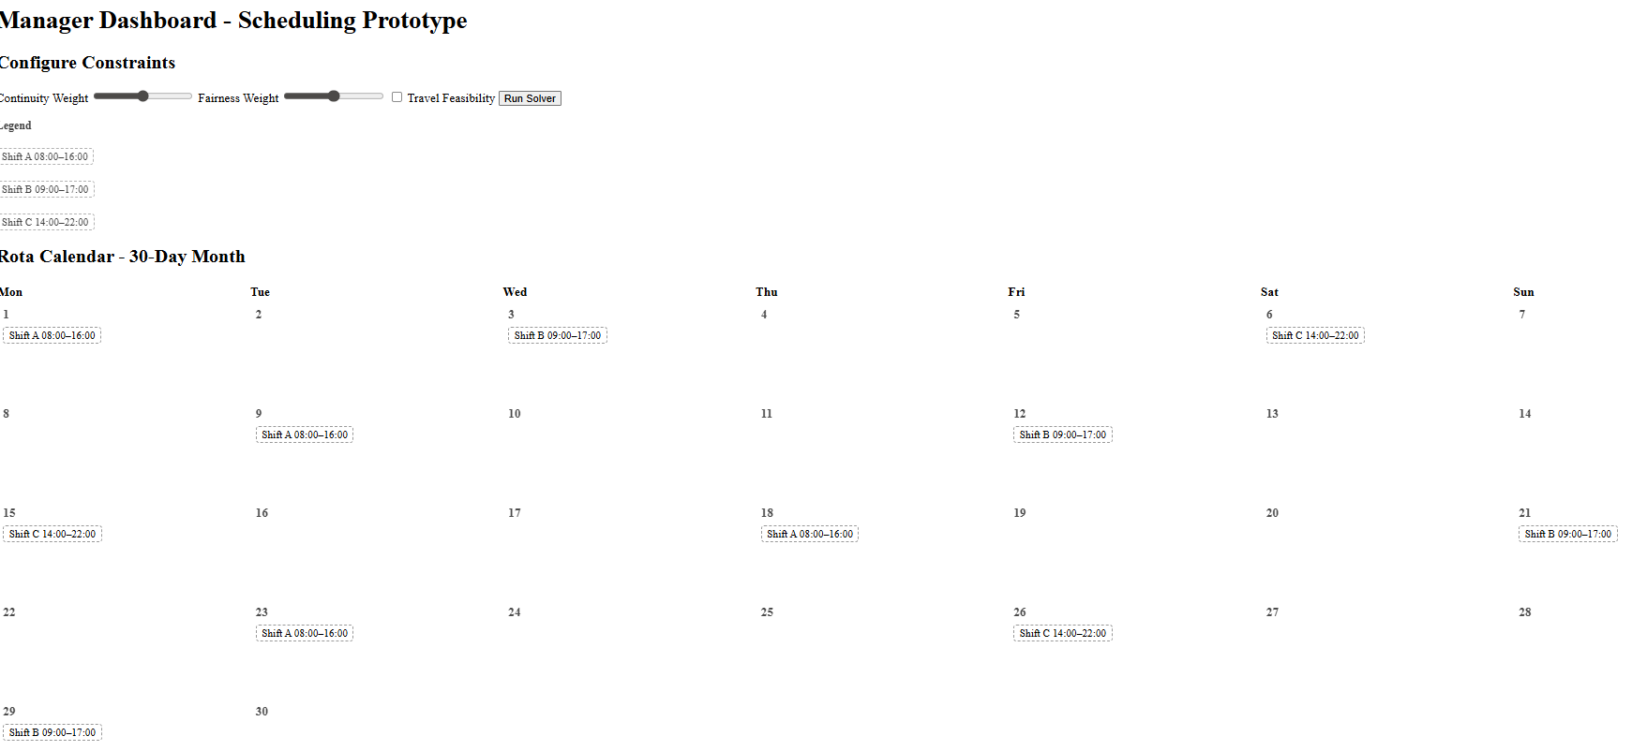
Design prototype

Slide 9
Project Planning & Resources
MoSCoW prioritisation → focus on MVP
MVP: solver + hard rules + 2 soft constraints + simple UI
Tasks tracked in Monday.com
Resources: OR-Tools, GitHub, VS Code (all free)
No financial costs → project is feasible

Slide 10

Project Impact
Reduce manual rota adjustments
Improve fairness in shift allocation
Strengthen continuity of care
Demonstrates research-led methods in practice

Slide 11

Limitations & Future Work
Limitations: synthetic data, short test scope, MVP only
Future: apply to live datasets
Add real-time re-rostering
Integrate fatigue management & infection-control

Slide 12
Conclusion
Project bridges gap between research & practice
Prototype embeds continuity + fairness alongside compliance
We don’t have to choose between efficiency & staff goals
Questions?

