Slide 1
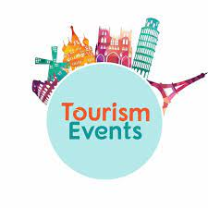
TELI
• Leisure and lifecycle, marketing factors , competition, created needs / trends in Tourism events industry

Slide 2
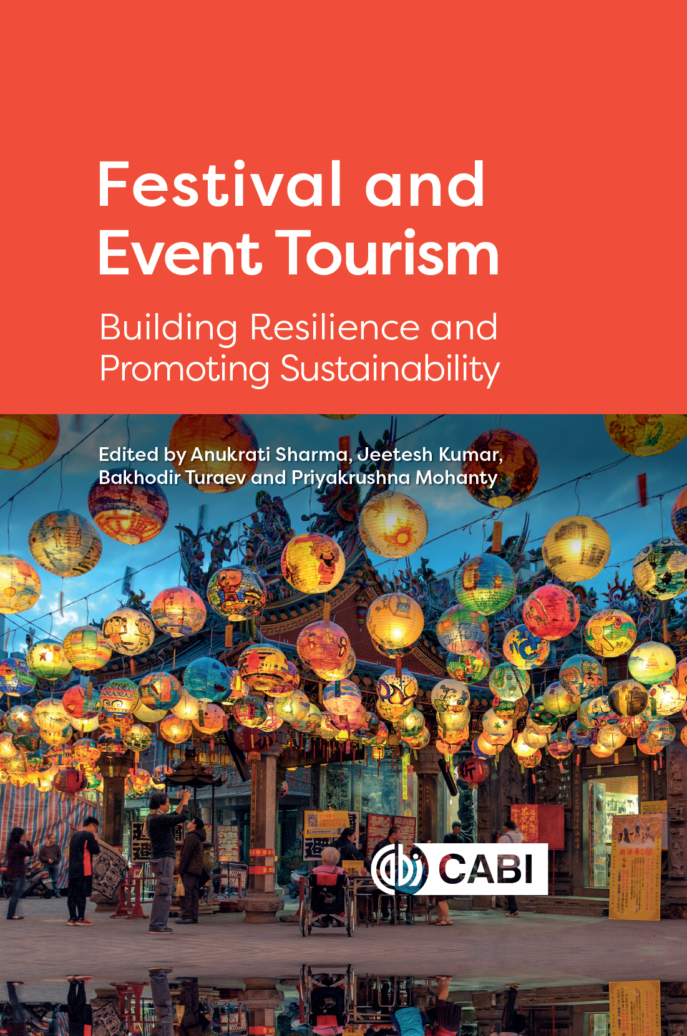
THIS WEEK
Changes in visitor typology for tourism events
Visitors' expectations
Visitor experiences

Slide 3
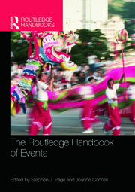
Event Typology
What do we mean by the term ‘typology’? Lewin and Somekh (2005: 349) suggest it is ‘the term used for a list or table which organises phenomena into categories and hierarchies. (Page & Connell, 2015)
Goldblatt (1997) describes how, in 1955, Disney’s Head of Public Relations Robert Jani created parades at the theme parks to prolong customer visit times into the evening. The parades were described by Jani as special events, ‘that which is different from a normal day of living’ .
Disney example is commercial profit and ‘for who?’ is contingent. One could argue that the parade was put on for the visitors to enjoy, but there is the commercial imperative, the increased profit, derived from prolonging the length of visits to the theme park. Early event literature focused on impacts, and in particular economic impacts, which focused on hallmark, special and mega-events.
The question of event typology as purpose or goal has been categorised by Goldblatt (2002: 8) as ‘celebration, education, marketing, and reunion’.
Matthews (2008: 3) develops Goldblatt’s categories and gives ‘the primary reasons for holding special events – ‘religious, political, social, educational and commercial’, going on to suggest ‘the primary reason for holding special events has now become almost completely commercial’.

Slide 4
Visitor typology
Virtual events - Since the pandemic, internet-based videoconferencing has undoubtedly become the norm, with Zoom alone growing from 10 million to 200 million users from December 2019 (Yung et al., 2022)
Sports events - like no other events in that they offer an authentic insight of a people at play. generating levels of passion and emotional investment. generate mass media interest and other positive outcomes related to health, regeneration and community cohesion.
Stadiums in which the events take place become attractions and can generate additional income for the organisations responsible for them. There is the darker and less positive sides to sports events associated with dysfunctional fan behaviour, and the over-optimistic estimates that promote failing local economies and social deprivation
Typology of cultural heritage tourists. Cultural heritage tourists are either compared with other types of tourists or are segmented based on cultural experience and activities.

Slide 5
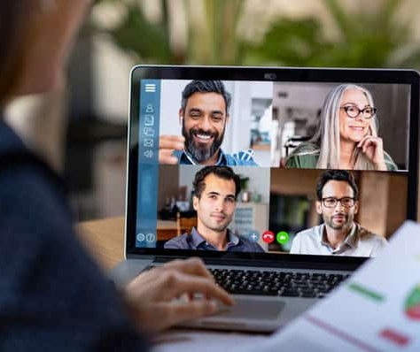
Virtual Events
When it comes to virtual events, there are various visitor typologies, or categories, that can help organisers and marketers better understand and engage with their audience. These typologies are similar to those for in-person events but are adapted for the virtual environment.
Passive Attendees:
These visitors watch or consume event content without actively participating.
They may tune in to keynote presentations, webinars, or panel discussions but do not engage in interactive elements or networking opportunities.
Active Participants:
Active participants are engaged attendees who interact with event content, speakers, and other attendees.
They may ask questions, participate in polls, and engage in chat discussions during sessions.
Networking Enthusiasts:
These visitors are primarily interested in networking and connecting with other attendees.
They participate in virtual meetups, discussion forums, and one-on-one video chats to expand their professional network.

Slide 6

Exhibitor Explorers:
Exhibitor explorers focus on exploring virtual booths and exhibitor content. They visit virtual exhibition halls, interact with exhibitors, and gather information about products and services.
Content Collectors:
Content collectors attend virtual events to access and collect valuable information and resources.
They may download presentations, documents, and other materials for future reference.
Multi-Session Participants:
These visitors attend multiple sessions or tracks throughout the event.
They are interested in a wide range of topics and engage in various sessions to gain a holistic experience.
Tech Enthusiasts:
Tech enthusiasts are fascinated by the virtual event platform itself.
They explore and experiment with the event technology, looking for new and innovative ways to engage with the content and features

Slide 7
Content Creators:
Content creators generate their content, such as live-tweeting sessions, writing blog posts, or creating video summaries of the event.
They contribute to the event's online presence and help extend its reach.
On-Demand Consumers:
On-demand consumers prefer flexibility and access event content at their convenience.
They watch recordings or access content post-event, ensuring they can fit the event into their schedules.
Understanding these visitor typologies can help event organizers tailor their virtual events to meet the diverse needs and interests of their audience. By creating engaging content, networking opportunities, and interactive features, organisers can cater to a wider range of virtual event attendees and enhance the overall experience.

Slide 8

Sports Tourism

Slide 9
Typology of cultural heritage tourists
Cultural heritage tourists are individuals who travel to explore and experience the cultural and historical aspects of a destination. These tourists have diverse motivations, interests, and preferences, leading to various typologies.
  History enthusiasts are passionate about the past and visit destinations primarily to learn about historical events, figures, and artifacts.
  They are drawn to museums, historical sites, and guided tours that offer insights into the history of the region.
Art and Architecture Enthusiasts:
  These tourists have a deep appreciation for art and architectural marvels.
  They visit destinations renowned for their art museums, galleries, and architectural landmarks, seeking to immerse themselves in the local art scene.
Cultural Immersion Seekers:
  Cultural immersion seekers prioritize experiencing the daily life, traditions, and customs of the local culture.
  They engage in activities like attending local festivals, trying traditional cuisine, and interacting with residents.

Slide 10
Typology of cultural heritage tourists
Religious and Pilgrimage Travelers:
  These tourists embark on journeys with strong spiritual or religious significance.
  They visit sacred sites, temples, churches, or pilgrimage destinations as part of their religious or spiritual practice.
Genealogy and Ancestry Explorers:
  Genealogy and ancestry explorers travel to trace their family roots and heritage.
  They often visit ancestral hometowns, cemeteries, and archives to connect with their family history.
Literary and Film Inspired Travelers:
  These tourists are inspired by literature, film, or other forms of media that depict a particular destination.
  They visit places featured in books, movies, or TV series that have a cultural or historical connection.
Museum and Gallery Patrons:
  Museum and gallery patrons are frequent visitors to cultural institutions.
  They prioritize exploring museums, art galleries, and cultural centres that house collections and exhibitions of historical and artistic significance.

Slide 11
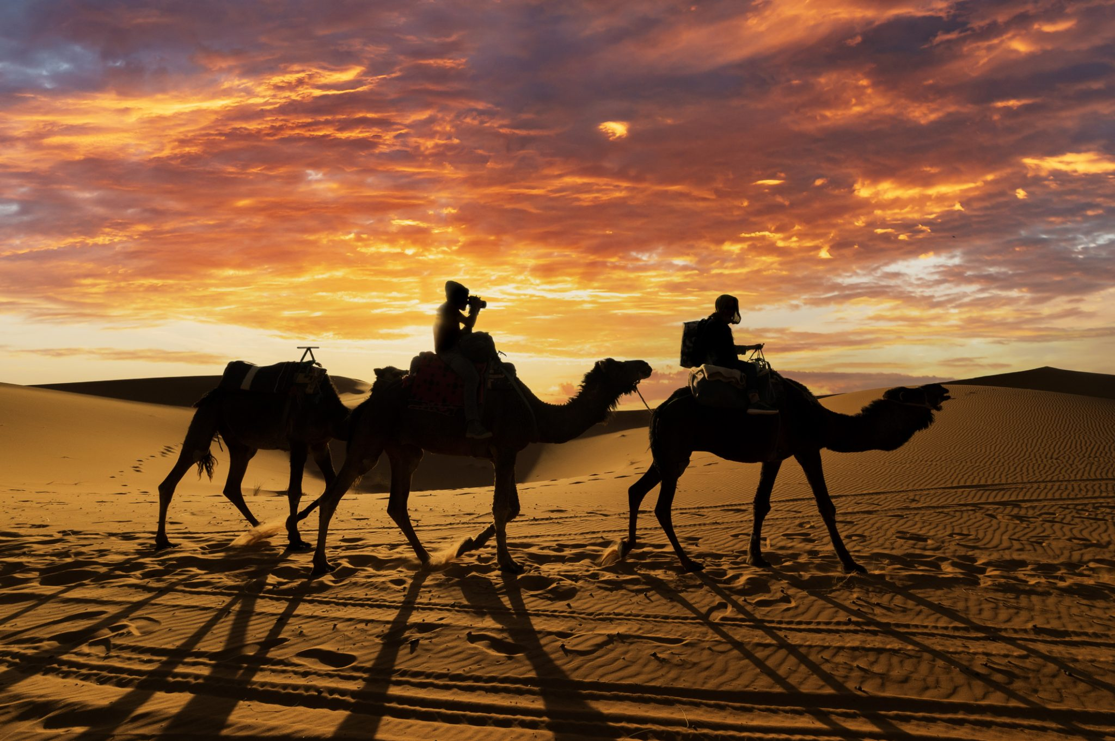
Typology of cultural heritage tourists
Conservation and Preservation Advocates:
  Conservation and preservation advocates are interested in efforts to protect and preserve cultural heritage sites and traditions.
  They may volunteer, donate, or support initiatives dedicated to cultural preservation.
Adventure Cultural Travellers:
  These tourists combine adventure activities with cultural exploration.
  They participate in activities like hiking, trekking, or wildlife safaris in areas with rich cultural heritage.
Understanding these typologies is crucial for destination marketing, as it allows tourism professionals to tailor their offerings to meet the diverse interests and motivations of cultural heritage tourists. By doing so, they can provide more meaningful and enriching experiences for these travellers.

Slide 12
Visitor Experiences
Cohen (1979) proposed a typology of tourist experiences that identified five modes of tourist type, that tourist experiences could be located on a continuum, with a desire for mere pleasure at one end of the spectrum and a search for meaningful experiences at the other.
He defined these tourist categories as ‘recreational’, ‘diversionary’, ‘experiential’, ‘experimental’ and ‘existential’, and argued that each holds different worldviews predicated on a relationship with the ‘centre’ of their own societies and the centre of ‘other’ societies (Cohen, 1979).
Global industry has developed to satisfy the perceived needs and expectations of tourists and tourism as types. For instance, tourism marketers have sought to ‘group tourists together based on their preference for vacation experiences : destinations, activities while on holiday, independent travel vs package holidays’ (Swarbrooke and Horner, 1999)
Strengthening the idea of tourism as an experience
Links to culture, authenticities, symbolic authenticity, real need, personalisation

Slide 13
TOURISM EVENTS LIFECYCLE AND LEISURE
Tourism events, such as festivals, conferences, and sporting events, play a significant role in the leisure and lifecycle of tourists. These events influence the decision-making process of travellers and contribute to overall tourism experience.
Tourism events can have a significant impact on the lifecycle of tourism, from inspiring initial travel plans to shaping tourists' experiences and influencing their future travel decisions. These events contribute to the diversity and vibrancy of the tourism industry, making them an essential component of the travel ecosystem.

Slide 14
Leisure and the lifecycle of tourism:
Tourism events often serve as the inspiration for travellers when they are planning their trips. People may choose their destinations and travel dates based on specific events they want to attend.
Event websites, social media, and marketing materials provide information that helps tourists plan their itineraries, accommodation, and transportation.
Tourists attending events need to secure suitable accommodation, which often leads to increased demand for hotels, vacation rentals, and other lodging options in the event area.
Transportation providers may experience increased demand as travelers seek convenient ways to reach the event location.
During the event itself, tourists can engage in a wide range of activities and experiences, depending on the nature of the event. For example, music festivals may include concerts, food vendors, and art installations, while conferences offer educational sessions and networking opportunities.
The event serves as the primary reason for the trip, and tourists allocate a significant portion of their time and resources to it.

Slide 15
Leisure and the lifecycle of tourism:
Tourism events often offer opportunities to interact with locals and other tourists. This can lead to cultural exchange and the formation of lasting memories.
Social interactions during events contribute to the overall leisure experience
Once tourists return home, they reflect on their experiences, including the event itself and the broader trip.
They may share their experiences through social media, word-of-mouth, or reviews, which can influence others' decisions to attend similar events or visit the destination
Positive experiences at tourism events and in the host destination can lead to repeat visits. Tourists may plan future trips specifically to attend the same event or explore the destination further.

Slide 16
Events experience and consumer satisfaction
Event organisers face a new competitive market where they will need to perform at their best for market share. Delivering high-quality experiences are essential for customers. Extending our knowledge about consumer experiences in how these influence value; satisfaction and behavioural outcomes are important.
Schmitt (1999) claims that experiences provide “sensory, emotional, cognitive, behavioural and relational values”.
Arnould and Price (1993) emphasise the “high levels of emotional intensity” during experiences
Havlena and Holbrook (1986) argue that experiential consumption is characterised by an emotional nature.

Slide 17
Events experience and consumer satisfaction
Walls et al. (2011) categorise consumer experiences as ordinary–extraordinary and emotive–cognitive.
Extraordinary relates to experiences that allow for “intensification that emotionally links people widely scattered and dissimilar in ordinary life” (Arnould & Price, 1993, p. 42) providing “meaning and perspective” (Walls et al., 2011, p. 18) to participants’ lives.
Experiential outcomes have been studied as being emotional, physical, cognitive or spiritual (Geus et al., 2016; Goolaup & Mossberg, 2017; Mossberg, 2007, 2008) and have been assessed by means of consumer perceptions (Kim, 2010; Mossberg, 2007).

Slide 18
When to evaluate events
it’s important to be aware that evaluation needs to be ongoing and be able to explore all stages, as each contributes significantly to the overall success of your event.
Pre-event: You can uncover a lot of useful information during event planning, making it one of your most important evaluation stages. From assessing general levels of interest and things that attendees most want to see and hear about, to more practical areas such as the most popular location and timings for your event.
Mid-event:, it’s important to be able to monitor what’s working, what might need more support to perform better and be able to keep abreast of any unforeseen circumstances that might arise and affect the progress of your event. Must have a method that will allow you to observe and collect feedback during your event, measure stakeholder satisfaction and help keep everything on track and performing well.
Post-event: event has finished, besides examining what your stakeholders thought about your event, evaluation methods will enable you to examine areas such as whether your budgets and timelines were realistic, how well your marketing efforts performed and what you need to improve on before your next event.

Slide 19

What are the types of event evaluation?
There are three types of surveys that you can use to gather feedback from your event:
self-evaluation,
direct-evaluation
organisational evaluation.
Self-evaluation surveys are made available for people who attend the event to record their comments and return the form.
Direct- evaluation – ask the attendees themselves
Organisational evaluation – debrief with team, sponsors, management

Slide 20
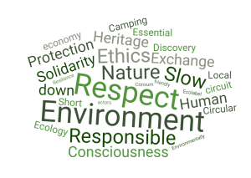

Needs / trends in Tourism events industry
The tourism events industry is constantly evolving, and new trends and created needs are emerging to meet the changing preferences and demands of tourists.
Sustainable and Responsible Tourism: Travellers are increasingly seeking eco-friendly and sustainable tourism options. They look for events and destinations that prioritise environmental conservation, support local communities, and promote responsible tourism practices.
https://ethik-and-trips.com/en/blog/what-is-sustainable-and-responsible-tourism
The Eden Project (Cornwall, UK)
Focus: Environmental education and regeneration
Practices: Built on a reclaimed clay pit; showcases biodiversity and sustainable living.
Social Impact: Employs locally, educates visitors, and reinvests in conservation.
Tourism as a driver of environmental awareness and regeneration.
Wellness and Health Tourism Events: Wellness and health-focused events have gained popularity. These events focus on physical and mental well-being, offering activities like yoga retreats, spa treatments, and mindfulness workshops.

Slide 21
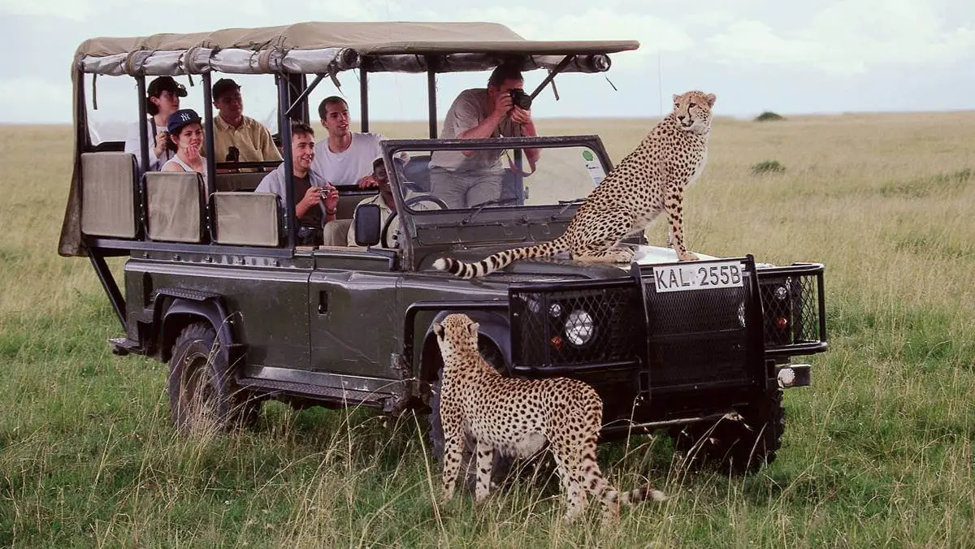
Needs / trends in Tourism events industry
Adventure and Outdoor Events: Adventure tourism is on the rise, with tourists seeking activities like hiking, trekking, wildlife safaris, and extreme sports. Events that cater to outdoor enthusiasts are in demand.
Food and Culinary Tourism: Culinary events, food festivals, and cooking classes have become significant attractions. Travellers are eager to explore the local cuisine and culinary traditions of a destination.
Pop-up and Limited-Time Events: Unique, time-limited, and pop-up events create a sense of exclusivity and urgency, attracting tourists who want to experience something special during their travels.

Slide 22
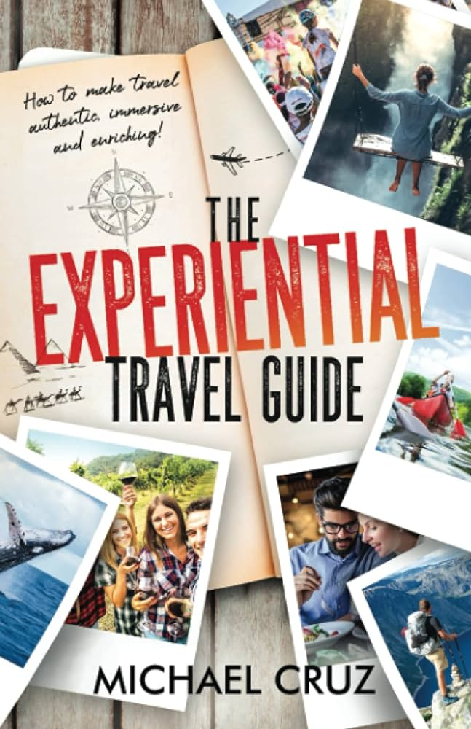
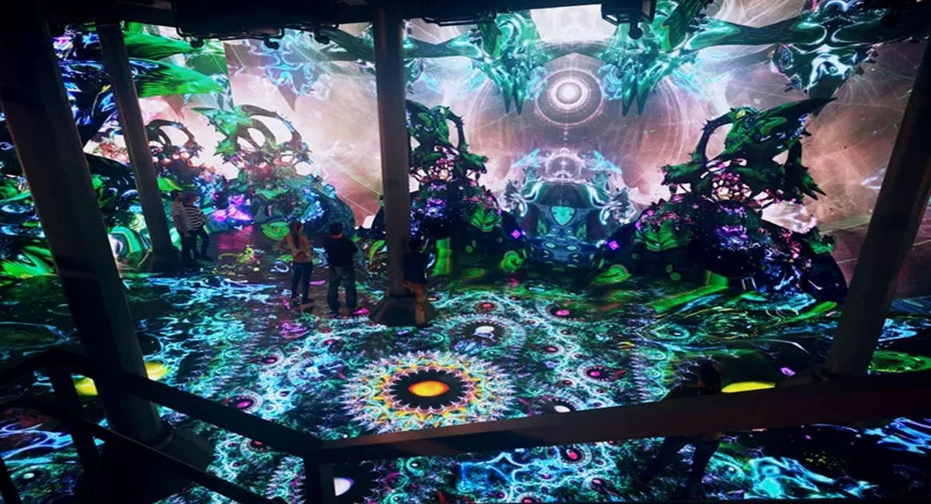
Needs / trends in Tourism events industry
Experiential Travel: Travellers are looking for immersive experiences. Events that allow tourists to engage with local culture, traditions, and activities are highly sought after.
Tech Integration: Integration of technology, such as augmented reality (AR), virtual reality (VR), and mobile apps, enhances the visitor experience, providing interactive and informative elements at events.
Use of 360°/VR/AR to create immersive event experiences, storytelling becomes core.
Socially Responsible Events: Events that support social causes, promote diversity and inclusion, and raise awareness of pressing issues are gaining attention. Tourists want to participate in events with a social impact.

Slide 23
Digital Nomad-Friendly Events: As remote work becomes more common, digital nomads seek events and destinations with reliable internet access, co-working spaces, and networking opportunities.
Cultural Exchange Programs: Tourists are increasingly interested in cultural exchange programs that allow them to live with and learn from local communities.
Solo Traveler-Friendly Events: Events and destinations that cater to solo travelers by providing social activities and community-building opportunities are in demand.
Fandom and Niche Events: Events targeting specific fan communities, hobbies, or niche interests are experiencing growth. These events create strong bonds among attendees who share common passions. driven by experience-seeking audiences, digital fan communities, and destination branding.
These trends and created needs reflect the evolving desires of tourists and the tourism events industry's efforts to adapt and offer unique and engaging experiences. Meeting these demands can lead to the success and sustainability of tourism events in an ever-changing landscape

Slide 24
Task
In your groups find examples of :
Socially responsible events
Fandom and Niche Events
Experiential travel
Wellness and Health Tourism Events

Slide 25
Socially responsible examples
Hay Festival (Wales)
Focus: Literacy, education & inclusivity
Practices: Promotes reading and creativity globally; includes projects for young people and marginalized communities.
Social Impact: Foundation supports educational access and creative learning.
Events as educational and cultural changemakers.
COP26 Glasgow (UK)
Focus: Climate and sustainability advocacy
Practices: Low-carbon event planning, local supply chain sourcing, waste reduction.
Social Responsibility: Empowered young climate activists and developing nations’ delegates.
Global conferences as platforms for policy change and social advocacy.

Slide 26
Fandom and Niche Events
Comic Con (London, San Diego, Dubai, etc.)
Focus: Popular culture fandom
Type: Pop culture, gaming, film, anime, and cosplay event
Social & Economic Impact: Attracts international visitors, boosting tourism and hospitality sectors.
Engagement: Hybrid content (panels, AR photo ops, digital meet-and-greets).
Teaching angle: Fan engagement, hybrid monetisation, destination tourism value.
UK Example: MCM London Comic Con draws 130k+ attendees to ExCeL London annually.
Eurovision Song Contest (Rotating host city)
Focus: Music fandom & cultural diplomacy
Type: Live international music competition with a dedicated global fan base.
Tourism Impact: Major destination promotion; host cities (e.g., Liverpool 2023) see hotel and hospitality surges.
Teaching angle: Events as soft power tools and fandom-driven tourism.
UK Example: Eurovision Liverpool 2023 generated ~£55 million local economic impact.

Slide 27
Experiential travel Events
Edinburgh Fringe Festival (Scotland)
Focus: Participatory cultural tourism
Experience: Audiences interact with performers in pop-up venues, streets, and digital spaces.
Why it’s experiential: Encourages co-creation, surprise, and emotional connection.
Immersion, participation, and event experience design.
Camino de Santiago Pilgrimage (Spain)
Focus: Transformational and spiritual travel
Experience: Pilgrims walk ancient routes, meeting others and reflecting.
Why it’s experiential: Deep personal meaning, self-reflection, community.
Spiritual tourism and slow travel as experiential frameworks.
https://santiagoways.com/

Slide 28
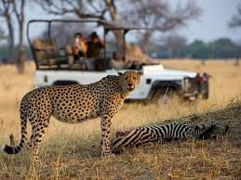
Sustainable & Responsible Tourism
Wilderness Safaris (Southern Africa)
Focus: Conservation through luxury ecotourism
Practices: Funds wildlife protection and community education via high-end safaris.
Impact: Protects over 2.3 million hectares of wilderness.
Teaching angle: Balancing conservation and commercial tourism.

Slide 29

Marketing Factors
Marketing plays a crucial role in the success of tourism events. Effective marketing strategies help attract attendees, create buzz, and build anticipation for the event.
Target Audience Segmentation: Identify and understand your target audience. Segment them based on demographics, interests, and behaviours to tailor marketing messages and strategies for specific groups.
Content Marketing: Create high-quality content related to the event, such as blog posts, articles, videos, and infographics, to engage potential attendees and provide valuable information.
Social Media Marketing: Use social media platforms to promote the event, engage with your audience, and create a sense of community. Leverage paid advertising on platforms like Facebook, Instagram, and Twitter.

Slide 30
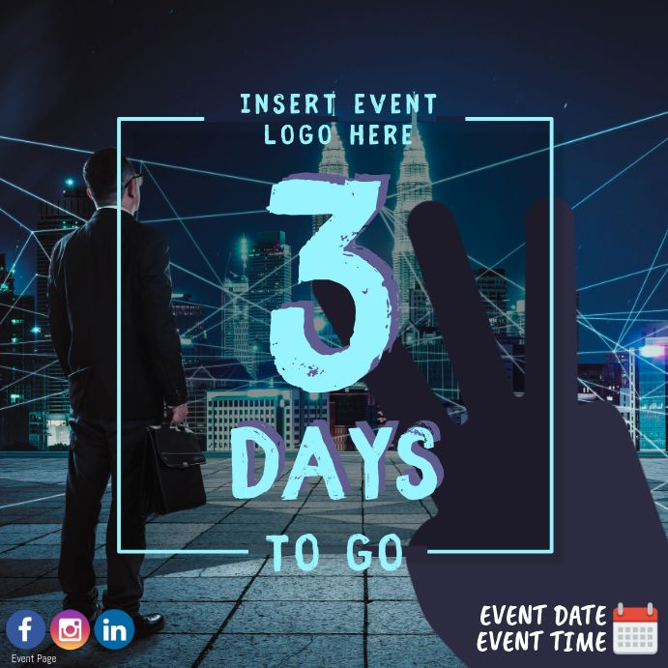
Marketing Factors
Influencer Marketing: Partner with influencers in your event's niche or industry. They can help promote the event to their followers, providing authenticity and credibility.
Event Partnerships: Collaborate with local businesses, tourism boards, and complementary events to cross-promote. Partnerships can expand your reach and attract a broader audience.
Event Teasers and Countdowns: Build excitement by releasing event teasers, countdowns, and sneak peeks. Create a sense of anticipation among your audience.
Early Bird and Discounted Tickets: Offer special pricing to incentivize early registrations and create a sense of urgency.

Slide 31
References
Goldblatt, J. (1997) Special Events Best Practices in Modern Event Management, New York: John Wiley.
Goldblatt, J. (2002) Special Events: Twenty-First Century Global Event Management, New York: Wiley.
Kim, J.-H. (2010). Determining the factors affecting the memorable nature of travel experiences. Journal of Travel & Tourism Marketing, 27(8), 780–796. https://doi.org/10.1080/10548408.2010.526897 [Taylor & Francis Online], [Web of Science ®], [Google Scholar]
Mossberg, L. (2008). Extraordinary experiences through storytelling. Scandinavian Journal of Hospitality and Tourism, 8(3), 195–210. https://doi.org/10.1080/15022250802532443 [Taylor & Francis Online].
Page, S.J. and Connell, J. (2015) The Routledge Handbook of Events. London: Routledge.
Schmitt, B. (1999). Experiential marketing. Journal of Marketing Management, 15(1-3), 53–67. https://doi.org/10.1362/026725799784870496 [Taylor & Francis Online], [Google Scholar]
Walls, A. R., Okumus, F., Wang, Y., & Kwun, D. J.-W. (2011). An epistemological view of consumer experiences. International Journal of Hospitality Management, 30(1), 10–21. https://doi.org/10.1016/j.ijhm.2010.03.008 [Crossref], [Web of Science ®], [Google Scholar]
Yung, R. et al. (2022) ‘Towards a typology of virtual events’, Tourism Management, 92, p. 104560. doi:10.1016/j.tourman.2022.104560.

