Slide 1

ECAD 6008 – Professional and Pedagogic Studies: Leading the Learning: what, how and why am I teaching?
Revisiting AfL: Feedback
PGCE Mathematics

Slide 2

Link to pedagogical principles:
Good teaching and learning uses assessment for learning to accelerate progress
Good teaching and learning sets tasks and selects resources that encourages learners to take responsibility for their own learning
Good teaching and learning challenges all learners by encouraging them to recognise the importance of sustained effort in meeting expectations that are high but achievable for them
Good teaching and learning means employing a blend of approaches including those that promote problem solving, creative and critical thinking
Good teaching and learning supports social and emotional development and positive relationships

Slide 3
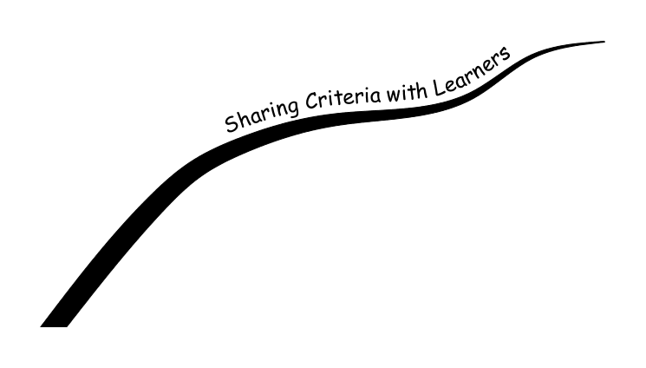
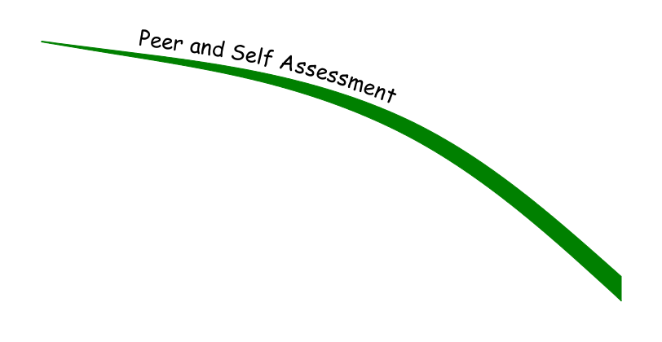

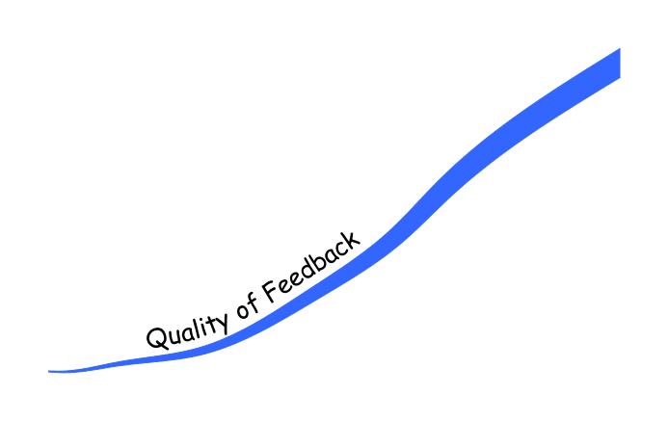
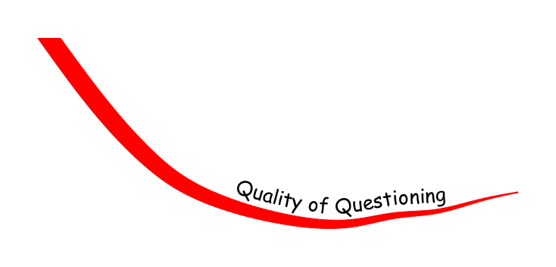
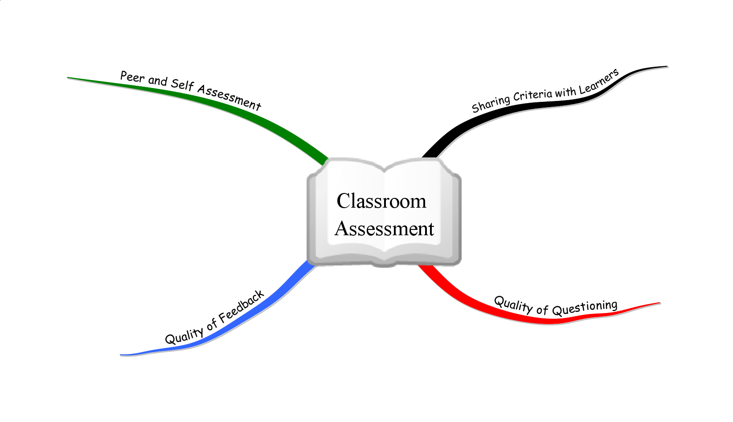
Aspects of Classroom Assessment
These are distinctive features of AfL

Slide 4


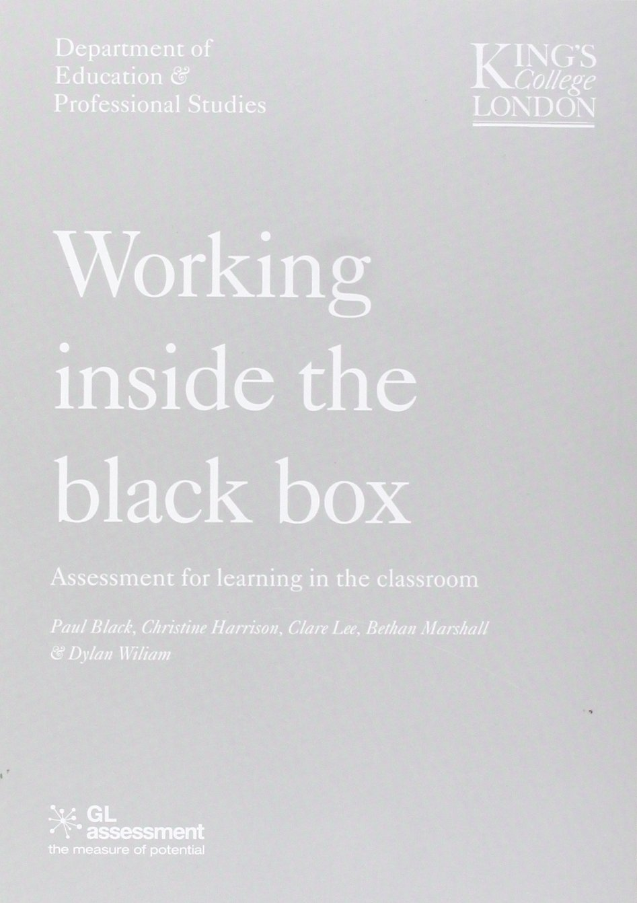
Formative Assessment
Formative Assessment’ refers to any form of activity undertaken by teachers (or by students-self and peer assessment) which provides information to the person receiving the feedback that enables refinement of the learning or teaching taking place. (Black and Wiliam 1998 pg )
Formative assessment is essentially a range of evidence-informed strategies that teachers can use to support learners to make progress (Jones, 2021 pg13)
Formative assessment takes place during the learning process as opposed to summative assessment which takes place at the end of the learning process.
Formative assessment helps the pupil and teacher understand what needs to be learned and how this can be achieved.
When carried out during the learning process, formative assessment can identify pupils' gaps in knowledge, misconceptions and progress steps
Formative assessment can offer opportunities for teachers to provide effective feedback that can move learning forward.
Pioneering research on formative assessment by Paul Black and Dylan Wiliam
published in the late 1990s, provides a wealth of information.

Slide 5
Formative assessment can be conducted through a variety of methods, and is effective when teachers are :-
  Using effective questioning
  open questions
  exposure of misconceptions and identifying errors
  discussing modelled answers
  Having a classroom where it is okay for students to be wrong
    provision of opportunities for pupils to discuss and share ideas with each other and the teacher
    Expectation that all learners must contribute and be engaged (eg using mini- whiteboards, random generator)
  Creating an environment that promotes a reflective culture and self regulation of learning
    Encouraging pupils to identify what they know and what they don’t know (metacognition) and be able articulate this to a peer or a teacher

Slide 6

Feedback

Slide 7
FEEDFORWARD…….

Slide 8
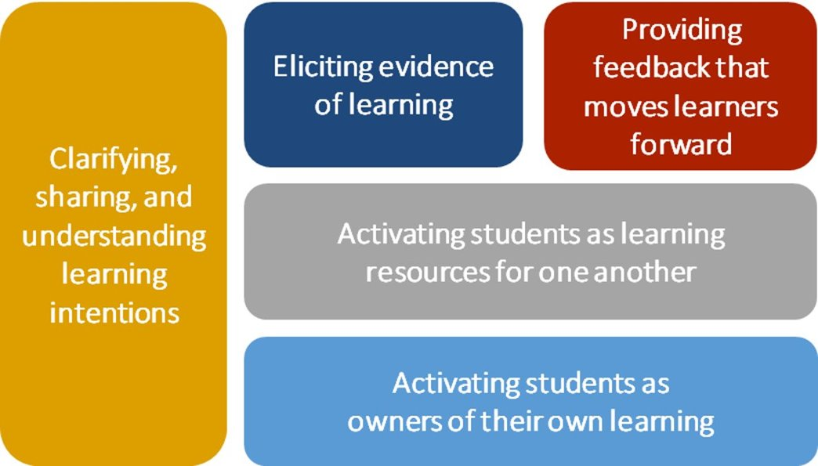
 | Where the learner is going | Where the learner is now | How to get the learner there
Teacher
Peer
Student

Slide 9
Verbal Feedback
Who gives verbal feedback?
What does verbal feedback ‘look like’?
What are the advantages or disadvantages of verbal feedback?

Slide 10
Providing feedback to learners.
What if the teacher’s written feedback has:-
1. only grades or marks, eg Grade achieved: B or Result: 76%
2. both grades and a lengthy comment.
3. comments that help learners focus on the learning issues rather than try to interpret a mark or grade
4. commentary relating only to effort, eg ‘’well done, a pleasing effort’’
5. every error circled (no explanation)
6. comments setting generic targets eg ‘’remember to set out your work systematically’
7. comments that bridge the gap between errors and next steps.
8. comments that clearly identify why the error has taken place.
9. comments that support learners identify key features of their understanding.
10. comments that relate to an improvement made from previous marking.
How much time do teachers give for learners to ‘act upon feedback’?
Written Feedback

Slide 11
Peer and self-assessment
Learners can only make steps towards achieving a learning objective if they understand the objective and can assess what they need to do.
The success criteria can be further understood if it is co-constructed. Examples of success could be used to model success criteria.
List some advantages and disadvantages of peer assessment
Advantages of peer assessment
Acceptance of criticism from a peer
Willingness to challenge the feedback
Oral or written feedback using language that learners would naturally use
Allows the teachers to be free to observe and listen and to provide helpful interventions
Disadvantages of peer assessment
Time required to model effective peer assessment- learners must be trained in the good practices of assessment.
Some learners feel ‘cheated’ if teachers do not ‘mark’ their work – this requires time to establish a culture of peer assessing.

Slide 12
‘Engaging in peer- and self-assessment is much more than just checking for errors or weaknesses. It involves making explicit what is normally implicit, and thus requires learners to be active in their learning. When learners reflect on their levels of understanding, it can be used in informing future teaching.’ (WG 2010, pg 27)

Slide 13


Why
How

Slide 14
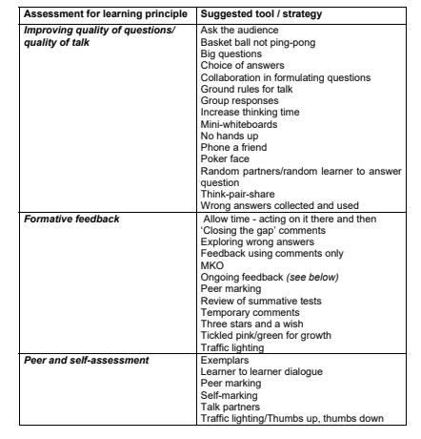
How
Visit the document to explore ideas on formative assessment

Slide 15


Deepening Practice

Slide 16
Modelling/Scaffolding
When we model the development of a solution
Can be used to “scaffold” learning

Slide 17


Worked examples…
What are the advantages and disadvantages of allocating time to worked examples?

Slide 18

Misconceptions

Slide 19

Why do misconceptions arise?

Slide 20


Task 1 (10 minutes): Read the blog by Jane Curell Understanding how children construct knowledge to develop learning
https://mathsnoproblem.com/how-children-construct-knowledge-to-develop-learning/
Also been added to the padlet

Slide 21

Misconceptions may arise in a number of ways
Through developing a conceptual structure which is flawed
By the overgeneralization of a rule, principle, or concept (the way addition of whole numbers applies to fractions)
Through systematic application of a flawed procedure (eg always subtracting the smaller digit from the larger within the subtraction algorithm
By misinterpreting notation
By misreading diagrams or tables (by assuming that angles which look equal in a sketch diagram are equal)
Notes:
Cited in Tanner and Jones, 2000, Becoming a successful teacher of Mathematics pg 88.

Slide 22
Expose and discuss common misconceptions
A misconception is a reasoned way of thinking which may only work in a limited set of circumstances. A simple example of this is the ‘rule’ of adding a zero to multiply a number by 10, which works for whole numbers but no other types of number.
Research has shown that teaching becomes more effective when common mistakes and misconceptions are systematically exposed, challenged and discussed (Tanner and Jones, 2000)

Slide 23
Expose and discuss common misconceptions
Cognitive conflicts occur when the learner recognises inconsistencies between existing beliefs and ideas. Research has shown that such conflicts, when resolved through reflective discussion, lead to more permanent learning than conventional, incremental teaching methods, which seek to avoid learners making mistakes.
Deciding to engage with learner misconceptions, rather than merely telling the learner a more appropriate strategy can feel quite challenging for some teachers, as you have no idea what direction the discussion will take, and it may well be outside your comfort zone.

Slide 24
Expose and discuss common misconceptions
The research studies have taught us that questions can be juxtaposed in ways that create a tension (sometimes called a ‘cognitive conflict’) that needs resolving. Contradictions arising from conflicting methods or opinions can create an awareness that something needs to be learned.
There are several ways of creating the conditions in which learners can feel able to discuss common mistakes and misconceptions without feeling threatened. Can you think of any?

Slide 25
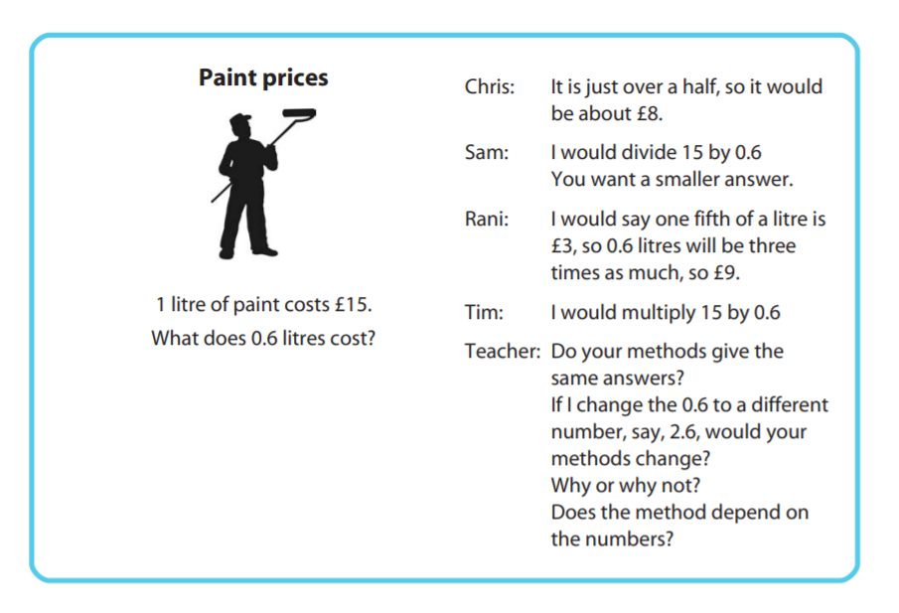
Notes:
Analysing reasoning and solutions. Example from the Standards Unit box https://www.stem.org.uk/elibrary/collection/2933
The activities suggested here are designed to shift the emphasis from ‘getting the answer’ towards a situation where learners are able to evaluate and compare different forms of reasoning.
Comparing different solution strategies in many mathematics sessions, learners apply a single taught method to a variety of questions. It is comparatively rare to find sessions that aim to compare a range of methods for tackling a few problems. Many learners are left feeling that if they do not know ‘the right method’ then they cannot even begin to attempt a problem. Others are stuck with methods that, while generating correct answers, are inefficient and inflexible. These activities are designed to allow learners to compare and discuss alternative solution strategies to problems, thus increasing their confidence and flexibility in using mathematics. When ‘stuck’, they become more inclined to ‘have a go’ and try something. They thus become more powerful problem solvers. In the following example, learners are asked to find as many different ways as they can of solving a simple proportion problem.

Slide 26
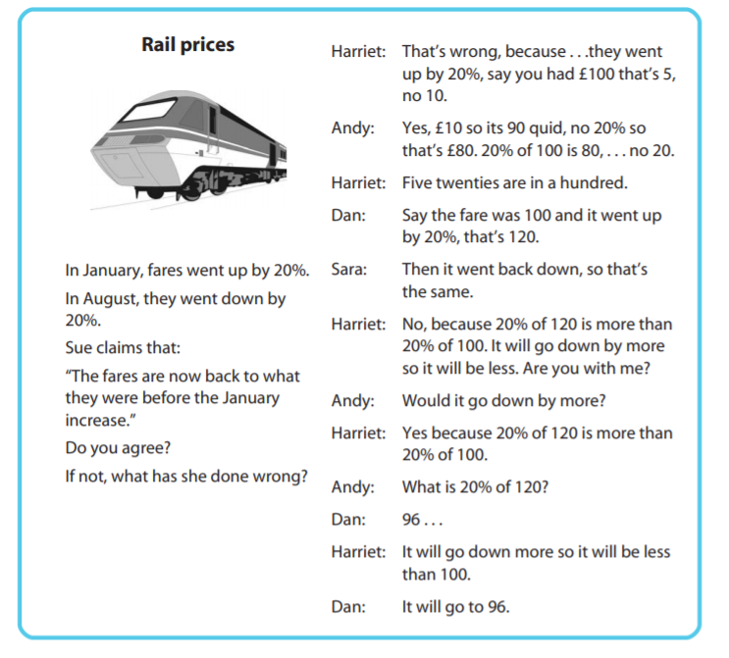
Notes:
Correcting mistakes in reasoning.
These activities require learners to examine a complete solution and identify and correct errors. The activity may also invite the learner to write advice to the person who made the error. This puts the learner in a critical, advisory role. Often the errors that are exhibited are symptomatic of common misconceptions. In correcting these, therefore, learners have to confront and comment on alternative ways of thinking. In the example below, four GCSE learners (Harriet, Andy, Sara and Dan) are discussing a common percentages misconception.
Example from Standards Unit Box https://www.stem.org.uk/elibrary/collection/2933

Slide 27
Problems which do not have a solution can also be productive as they allow learners think and reflect on their understanding.
Imagine you have done a series of questions with pupils on solving simultaneous equations algebraically using substitution or elimination and then ask them to solve
5 = 6y + 2x
2 = x + 3y
https://www.desmos.com/calculator
Notes:
Visit https://www.desmos.com/calculator
To support learners and your teaching with graphs

Slide 28
Expose and discuss common misconceptions
The research studies have taught us that questions can be juxtaposed in ways that create a tension (sometimes called a ‘cognitive conflict’) that needs resolving. Contradictions arising from conflicting methods or opinions can create an awareness that something needs to be learned.
There are several ways of creating the conditions in which learners can feel able to discuss common mistakes and misconceptions without feeling threatened. Can you think of any?
Classic mistakes https://classicmistake.nhost.uk/pdfs/cmallc.pdf
Notes:
48 ‘classic mistakes’ ideas

Slide 29
Two ways
Ask learners to solve a problem in pairs. Collect in some examples of different responses and write these on the board anonymously. Add a few extra ones that illustrate other interesting discussion points that you have already prepared. Then ask learners to discuss and debate these responses.
Give learners a completed past examination paper to mark. This should illustrate interesting and significant errors that show underlying misconceptions. It is often good to include responses that the learners themselves have made, but rewritten so that they become anonymous. Learners usually seem to enjoy the role shift when they are asked to become examiners. Encourage them to write comments indicating the source of the error and helpful advice to the ‘candidate’.

Slide 30

Table discussions
Open the document entitled 'Misconceptions' in the Files area/Day 6 folder to collate your ideas
Table | Members (1st person starts meeting)
1 | Sam | Glyn | Hannah | Alex | Sal | Becca | Phillipa
2 | Olivia | Rhun | Bron | James | Emilio | Ella

