Slide 1
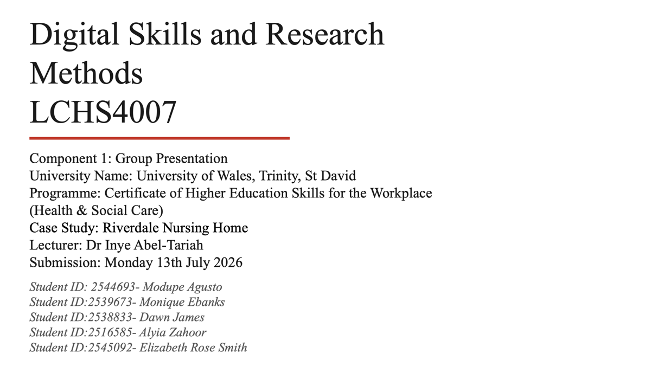

Slide 2
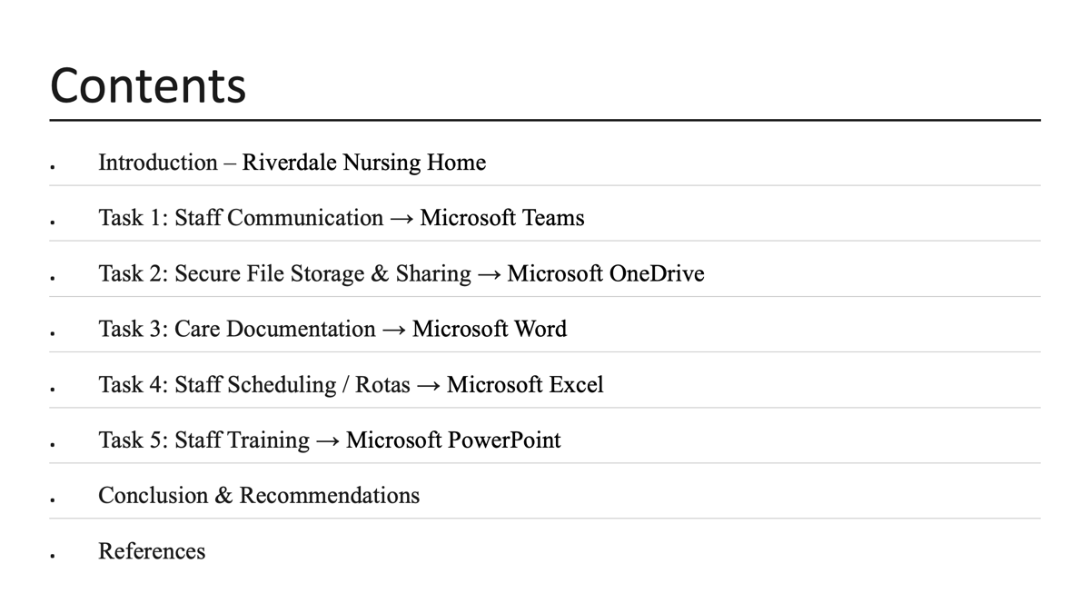

Slide 3
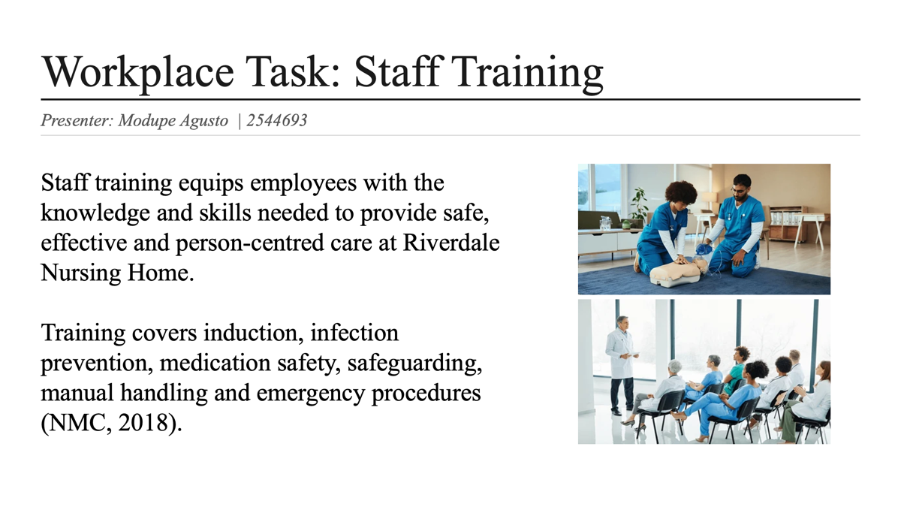

Slide 4
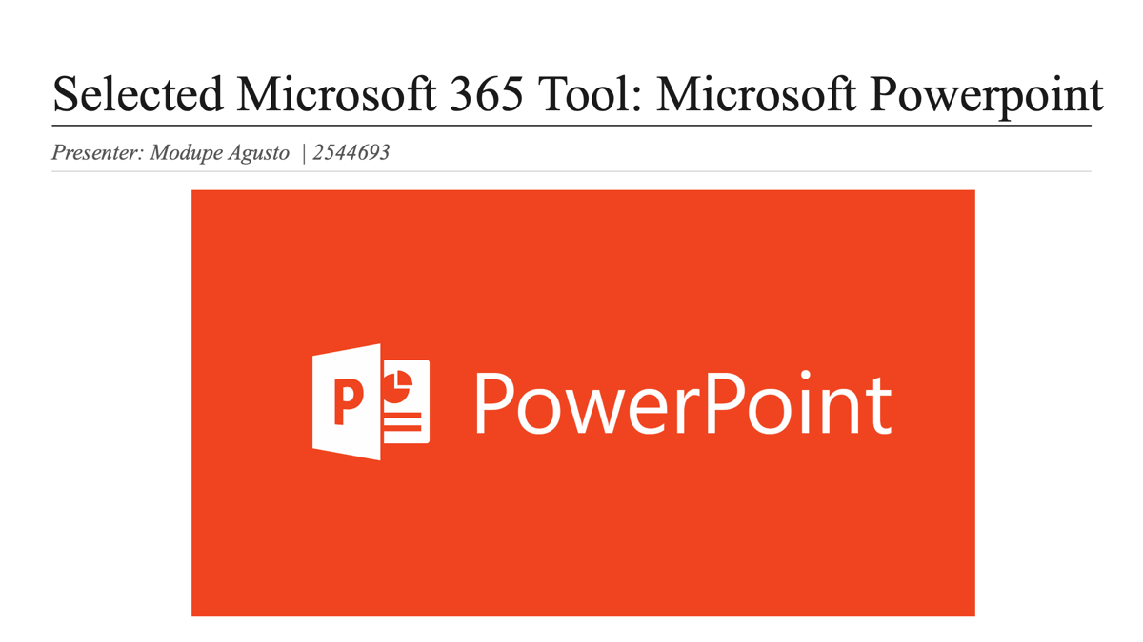

Slide 5
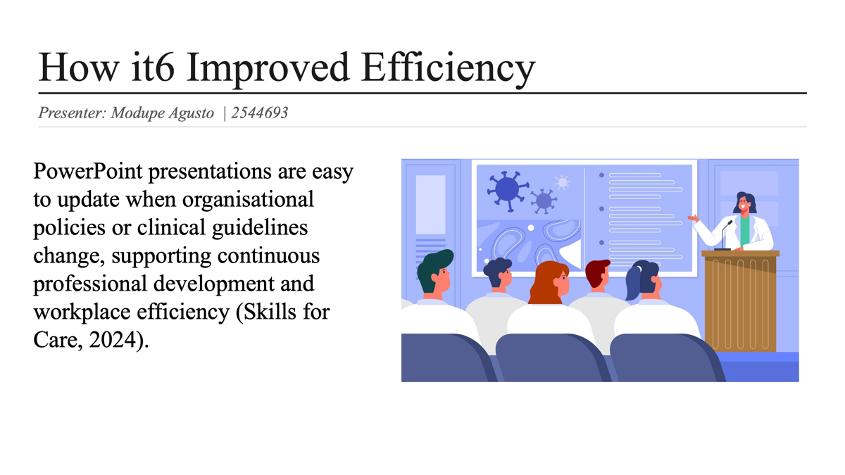
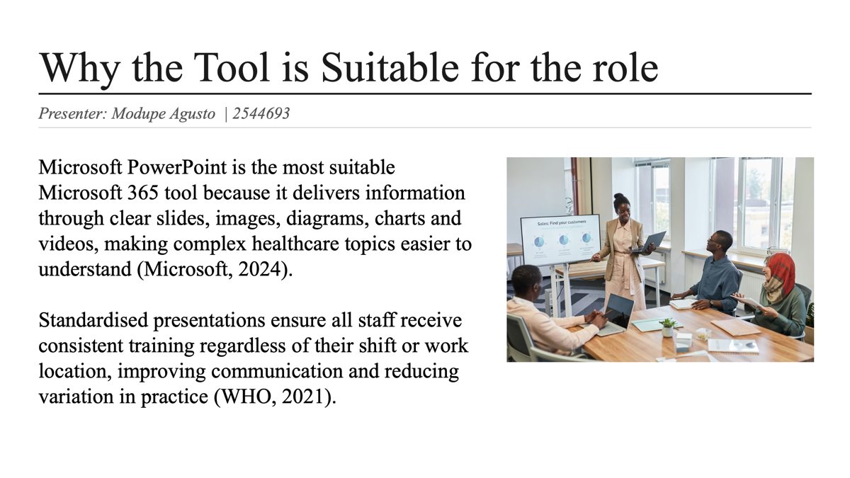

Slide 7
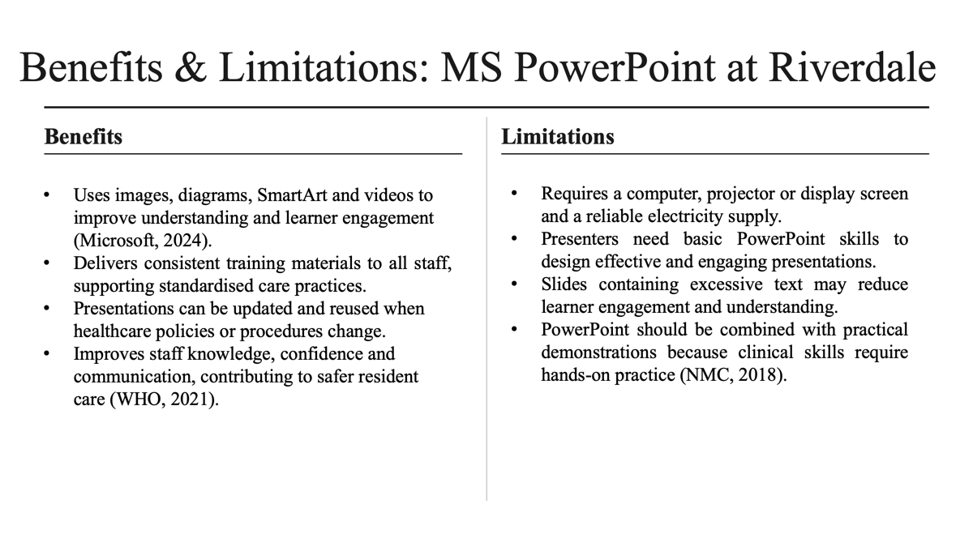

Slide 8
What is Microsoft Outlook?
Microsoft outlook is a communication and organisation app that is apart of the Microsoft 365 package. It is mainly used for sending and reciving emails, but it also includes features such as calendars, contacts, task and meeting scheduling. These tools help staff stay organised and communicate with each other more effectively. In a nursing home, outlook allows staff to quickly share important information about residents, organise work schedules and arrange meetings. Instead of relying on paper notes or verbal messages, staff can send emails that can be accessed at any time. This helps reduce mistakes and make sure everyone has the same information. Because outlook is connected to other microsoft 365 applications such as teams, word and Onedrive, staff can easily share documents, attend online meetings and work together even if they are in different parts of the building or work via computer
(Microsoft,2024) https://www.microsoft.com/en-gb/microsoft-365/outlook/email-and-calendar-software-microsoft-outlook#tabs-pill-bar-oc8375_tab1

Slide 9

Why communication matters
Communication plays a vital role in providing safe and high quality care for residents. Every member of staff needs to work together and share accurate information so that residents recive the correct care at the right time. If communication is poor, it can lead to mistakes and confusion. For example, if a nurse forgets to tell the next shift that. a resident has started a new medication, the resident might given the wrong medicine or wrong dose. Good communication helps prevent thes types of errors and makes sure everyone is good and aware of any changes to a resident's care.
https://careers-in-sport.co.uk/career-advice/effective-communication-skills/

Slide 10
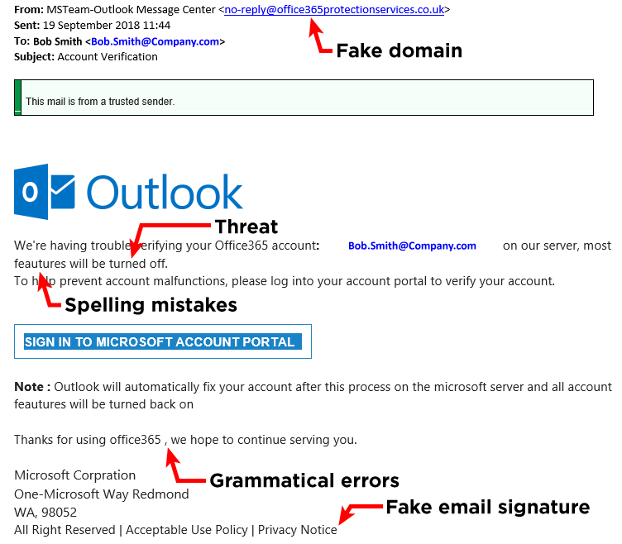
Keeping information safe with Microsoft outlook
When using Microsoft outlook in nursing homes, it is important that staff protect residents personal information. Emails often contain confidential details such as medical records, care plans and appointment information. This means staff must follow the UK general data protection regulations (UK GDPR). However, there are still risks when using email. For example, staff could accidently send information to the wrong person, click on scam emails or use weak password. Regular cybersecurity training and following workplace polices can help reduce these risks.
(information Commissioner's Office,2024: Microsoft,2024) https://ico.org.uk/for-organisations/advice-for-small-organisations/getting-started-with-gdpr/the-benefits-of-data-protection-laws/
https://affinitysmart.com/do-you-know-how-to-identify-a-sophisticated-email-scam/

Slide 11
Evaluations of Microsoft Outlook
Advantages | Limitations
Fast and realisable communication | Requires staff training
Shared calendars improves organisations | Depends on internet access
Helps reduce communication errors | Risk of phising and cyber attacks
Easy to share information securely | Staff may receive too many emails and feel overwhelmed
Works with Microsoft teams and other Microsoft 365 apps | Technical problems can interrupt communication
(Microsoft,2024:NHS England, 2025: Royal college of Nursing,2023) https://www.rcn.org.uk/Professional-Development/Nursing-Workforce-Standards#healthsafetyandwellbeing

Slide 12
Staff Scheduling & Rotas Using Microsoft Excel (Microsoft 365)
By Monique Mcpherson Ebanks
Student ID: 2539673

Slide 13
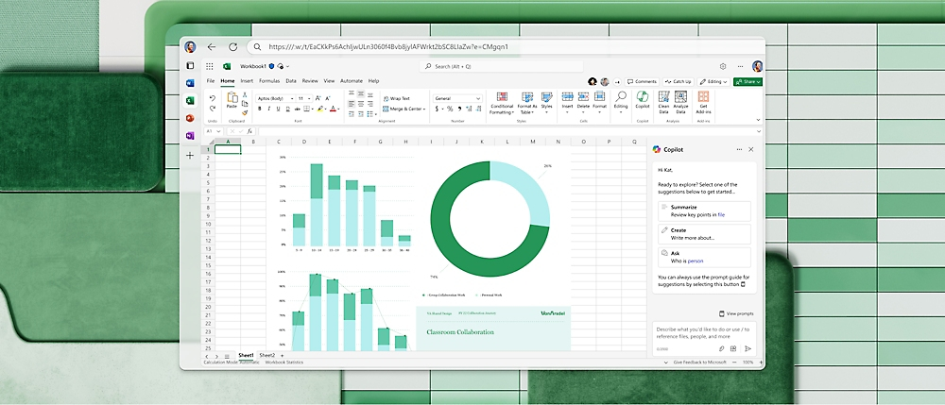
Microsoft 365 Excel
Microsoft 365 is a software that’s able to create spreadsheets, graphs, tables, generate formulas and calculations.
Sharing and collaborating with peers and colleagues
Very accessible by multiple users by desktop, laptop, IOS, Android and IpadOS anywhere with internet connections.
https://cdn-dynmedia-1.microsoft.com/is/image/microsoftcorp/341856-feature-apps-02-416x178-?resMode=sharp2&op_usm=1.5,0.65,15,0&wid=1000&hei=429&qlt=100&fit=constrain

Slide 14
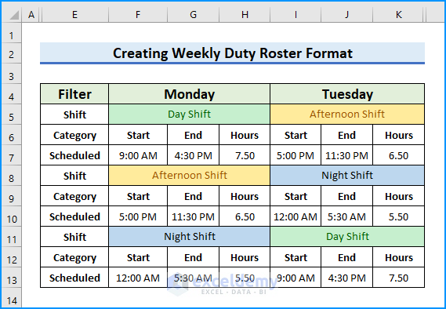
Staff Rota’s / Scheduling
Date
Building name
Staff Name
Star time
End time
Hours
https://www.exceldemy.com/weekly-duty-roster-format-excel/

Slide 15
Advantages | Limitations
Advanced Data Organization | Limited Collaboration
Built-In Formulas | cost
Third Party Support | Virus attack
Used anywhere | Difficult to learn
Free template | Slow processing
Sharing | Handling errors
Multiple templates

Slide 16

Effectiveness
Microsoft 365 Excel would work well with Riverdale nursing home has it can be an excellent tool with the right training to help staff with planning of shifts, allocating duties and adding structure to the nursing home.
It can improve the communication within the nursing home with both staff and clients as they would have a planned out shifts and is aware of who’s responsible for each task making it productive teamwork and better coordination.
https://www.linkedin.com/pulse/team-work-tips-ramy-ghaly

Slide 17
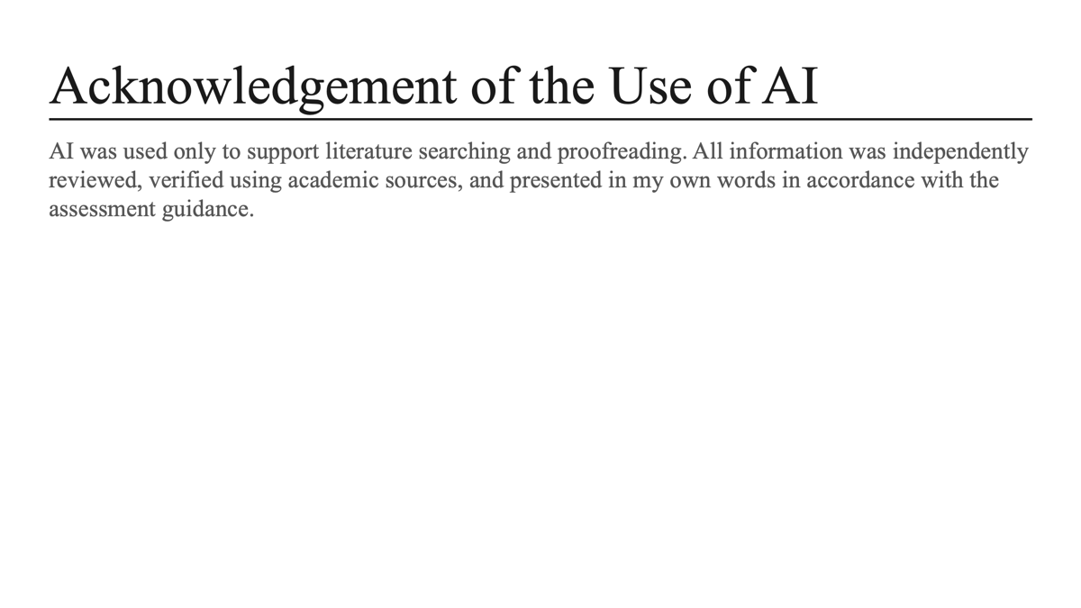

Slide 18
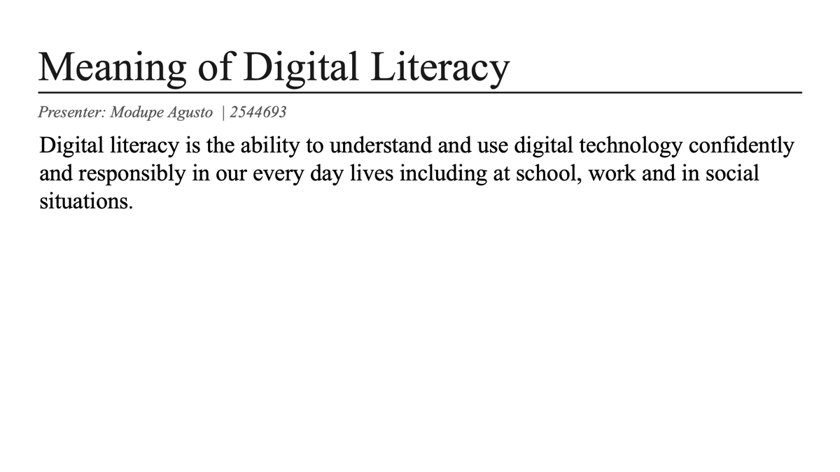

Slide 19
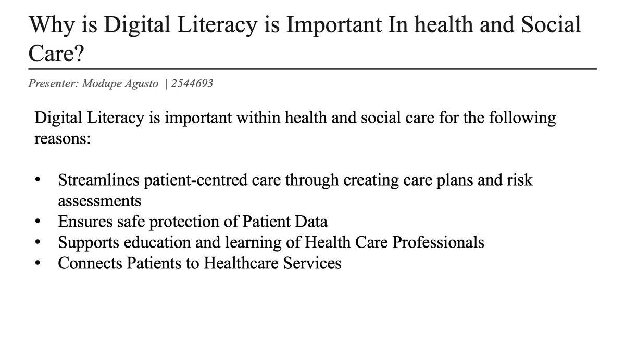

Slide 20
Digital Skills and Research Methods
Workplace task
My chosen Microsoft 365 tool to save and protect Data within Riverdale Nursing Home is Onedrive as it's a good tool to secure file, storage and protect digital assets from unauthorised people as they can use your data in different ways and other platforms.
Onedrive is for sharing documents such as staff policies, administrative files and training materials. This tool is most suitable because it provides staff within the nursing home to save files in a secure cloud storage where they access and share files from any authorised device.

Slide 21
Advantages
Any care home or business can use OneDrive has its sustainable, staff can work with some documents without creating multiple copies. To ensure everyone has access to the most up to date information which can be useful for instance if staff are in separate buildings, and most importantly it reduces data breaches by protecting the information put in with secure password and automatic back up that helps prevent data loss.
Onedrive has proven to show efficient communication as staff who have access can sync updated files so everyone has the latest version, built in version history allows the previous version of a file to be restored if mistakes are made.
Advantages further include support through collaboration by allowing staff to view and share documents easily, therefore very resourceful.

Slide 22
Limitations
Some may say there are limitations to onedrive because like most microsoft tools it requires a reliable internet connection for the best experience.
training is needed to know how to use the tool efficiently, incorrectly sharing permissions could give access to wrong people allowing confidential information to be breached.
It is mainly designed for storage and sharing not ideal for instant communication between staff.

Slide 23
Conclusion
Microsoft 365 Word, PowerPoint, Excel, OneDrive and Outlook
Is highly recommended by our group for overall running of the Riverdale nursing home and would all be excellent tools for staff to use.
It improves effiency by reducing duplicate files, making information easier to access, helping staff work with latest technology of documents, ultimately supporting better teamwork and resident care.

Slide 24

https://www.linkedin.com/pulse/art-asking-questions-bala-pitchandi

Slide 25
References List Harvard
Microsoft (2025) OneDrive cloud storage. Available at: https://www.microsoft.com/en-gb/microsoft-365/onedrive/online-cloud-storage (Accessed: 5 July 2026).
Microsoft (2025) OneDrive video training. Available at: https://support.microsoft.com/onedrive (Accessed: 5 July 2026).NHS England (2023) Records Management Code of Practice 2023. Available at: https://transform.england.nhs.uk/information-governance/guidance/records-management-code/ (Accessed: 5 July 2026).

Slide 26
Reference
(J Rehman, 2022) accessed on 6th July 2026
(Team work image) accessed on 9th July 2026
https://blog.suitebriar.com/advantages-and-disadvantages-of-ms-excel (M.Donovan, 2019) accessed on 6th July
https://cdn-dynmedia-1.microsoft.com/is/image/microsoftcorp/341856-feature-apps-02-416x178-?resMode=sharp2&op_usm=1.5,0.65,15,0&wid=1000&hei=429&qlt=100&fit=constrain (Microsoft graph) accessed on10th July 2026
https://itrelease.com/2022/01/what-are-advantages-and-disadvantages-of-microsoft-excel/
https://upload.wikimedia.org/wikipedia/commons/6/60/Microsoft_Office_Excel_%282025–present%29.svg (excel image) access on 4th July 2026
https://www.exceldemy.com/weekly-duty-roster-format-excel/ (Rotas image) access on 4th July 2026
https://www.linkedin.com/pulse/art-asking-questions-bala-pitchandi (question image) access on 4th July 2026
https://www.linkedin.com/pulse/team-work-tips-ramy-ghaly
https://www.microsoft.com/en-gb/microsoft-365/excel#Key-features accessed on 10th July
Affinity smart. Do you know how to identify a sophisticates email scam?. Available at:https://affinitysmart.com/do-you-know-how-to-identify-a-sophisticated-email-scam/(accessed:9th July)
Careers in sports. Effective communication skills Available at:https://careers-in-sport.co.uk/career-advice/effective-communication-skills/(accessed:)
Microsoft (2024) microsoft outlook email and calendar software. Available at:https://www.microsoft.com/en-gb/microsoft-365/outlook/email-and-calendar-software-microsoft-outlook#tabs-pill-bar-oc8375_tab1 (accessed:8th july)
Microsoft (2024) share calenders and contact in outlook. Available at: https://learn.microsoft.com/en-us/microsoft-365-apps/outlook/calendaring/share-calendar-and-contacts (accessed: 8th july)
NHS Englangd. (2025): Available at : HTTPS://ICO.ORG.UK/FOR-ORGANISATIONS/ADVICE-FOR-SMALL-ORGANISATIONS/GETTING-STARTED-WITH-GDPR/THE-BENEFITS-OF-DATA-PROTECTION-LAWS/ (accessed: 9th july)
Royal college of nursing.(2023) nursing workfoce standards: Available at: https://www.rcn.org.uk/Professional-Development/Nursing-Workforce-Standards#healthsafetyandwellbeing(accessed: 7 july)
Logo.wine. Microsoft outlook logo. Available at: https://www.logo.wine/logo/Microsoft_Outlook (accessed: 9th july)

Slide 27


