Slide 1
Health, Wellbeing and Sustainable Development
Heidi Ohanlon
2237628
BMHP6030

Slide 2
Introduction:
Introduction: Health is a state of complete physical, mental, and social well-being, influenced by biological, social, and environmental factors (WHO, 1948). Sustainable development aims to meet present needs without compromising future generations, integrating social, economic, and environmental goals to support long-term well-being. (United Nations, 2015). Addressing social determinants of health, such as education, income, and housing, reduces inequalities and promotes equitable access to care, linking health initiatives with the Sustainable Development Goals (Marmot, M. et al.2010).

Slide 3

Definitions and Key Concepts; Health;
Health is understood as a holistic state of physical, mental, and social well-being, rather than simply the absence of illness (WHO,1948).

Slide 4
Definitions and Key Concepts: Wellbeing: Wellbeing is a holistic concept that extends beyond physical health to include psychological, social and environmental factors. (WHO, 1948). Hettler’s wellness model highlights eight interconnected dimensions that support balanced living (Hettler, B. 1976). Objective indicators are often combined with subjective indicators, for example, “life satisfaction surveys”, to provide a comprehensive understanding of well-being. (OECD, 2013).
Emotional – Managing emotions and coping with stress
Physical – Exercise, nutrition and sleep
Social – Supportive relationships and belonging
Intellectual – Lifelong learning and creativity
Spiritual – Meaning, values and purpose
Occupational – Job satisfaction and work–life balance
Financial – Financial security and money management
Environmental – Safe, healthy surroundings
Balance across these dimensions promotes overall life satisfaction and flourishing (Diener, E. et al., 2010).
Notes:
8 DIMENSIONS WELLBEING AND SUBJECTIVE AND OBJECTIVE INDICATORS

Slide 5

Definitions and Key Concepts; Sustainable Development:
Sustainable development is a dynamic process that enables us to improve the quality of life while simultaneously protecting and enhancing earth,s life support systems. The three core areas (pillars) are: Environmental Sustainability, Social Sustainability, and Economic Sustainability. These pillars are interconnected and must be balanced for long-term global development (United Nations, 2015).
Notes:
3 AREAS – ENVIRONMENTAL, SOCIAL AND ECONOMIC

Slide 6
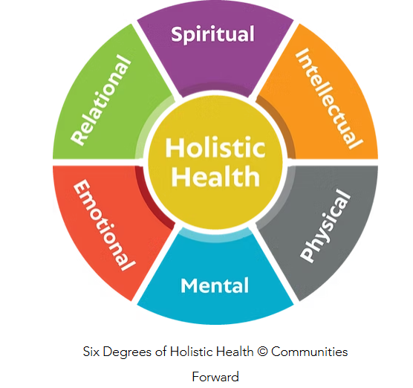
The holistic health model considers the physical, emotional, social, spiritual, and psychological needs of a person. (Engel, G.L. 1977). It is commonly used in: Chronic illness management, Palliative care, End-of-life care, Care homes, and long-term care settings. The model promotes whole-person care rather than focusing only on disease (WHO, 2020). According to the Nuffield Trust (2024), a holistic approach can combine clinical care with economic, social and environmental factors, which can reduce health inequalities, enhance quality of life and promote independence and overall well-being.
Theories/models; Holistic Health Model:
Notes:
WHEN IS IT USED – PALLIATIVE, END OF LIFE, CARE HOMES

Slide 7
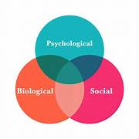
Theories/Models: Biopsychosocial Model:
The biopsychosocial model considers:
Biological factors
Psychological factors
Social influences
Health is influenced by lifestyle, emotions, relationships, and environment (Engel, G.L. 1977).
Used in:
Mental health services
Chronic illness management
Palliative and long-term care
(Socialworkportal. 2024)

Slide 8
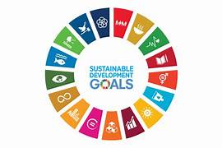
Sustainable development goals: SDGs:
The Sustainable Development Goals (SDGs) were adopted in 2015 by all United Nations Member States as part of the 2030 Agenda for Sustainable Development (United Nations, 2015a).
The SDGs aim to:
End poverty and hunger
Protect the planet
Promote health and wellbeing
Reduce inequalities
Achieve sustainable economic growth
There are 17 goals with 169 targets, designed to balance social, economic and environmental development (United Nations, 2015b).
(impact17.net.2015)

Slide 9
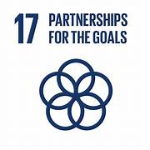
SDGs:
The SDGs apply to all countries and promote a global partnership approach (United Nations, 2015).
They:
Address climate change and environmental protection
Promote quality education and gender equality
Support decent work and economic growth
Improve global health and wellbeing (WHO, 2020a)
Goal 3 specifically focuses on ensuring healthy lives and promoting well-being for all at all ages (WHO, 2020b).
(pre-sustainability.com)

Slide 10
Policies and Governance:
The NHS Long Term Plan provides an example of a national policy framework that demonstrates how UK health policy can shape and influence social care practice. As the NHS in England continues to be restructured, a coherent, strategic and population-focused approach to commissioning must be maintained. In this context, governance and incentive mechanisms should be carefully evaluated to understand their effects on population health and overall well-being. (Marks. L. 2011).
The National Health Service (NHS), established under the National Health Service Act 1946, remains central to UK health governance, providing universal healthcare based on need rather than ability to pay (Department of Health and Social Care, 2022). More recently, the Health and Care Act 2022 introduced Integrated Care Systems (ICSs), designed to improve collaboration between NHS organisations, local authorities and community partners. These reforms aim to enhance population health management, reduce health inequalities and integrate health with social care and preventative services. (DHSC, 2022).

Slide 11
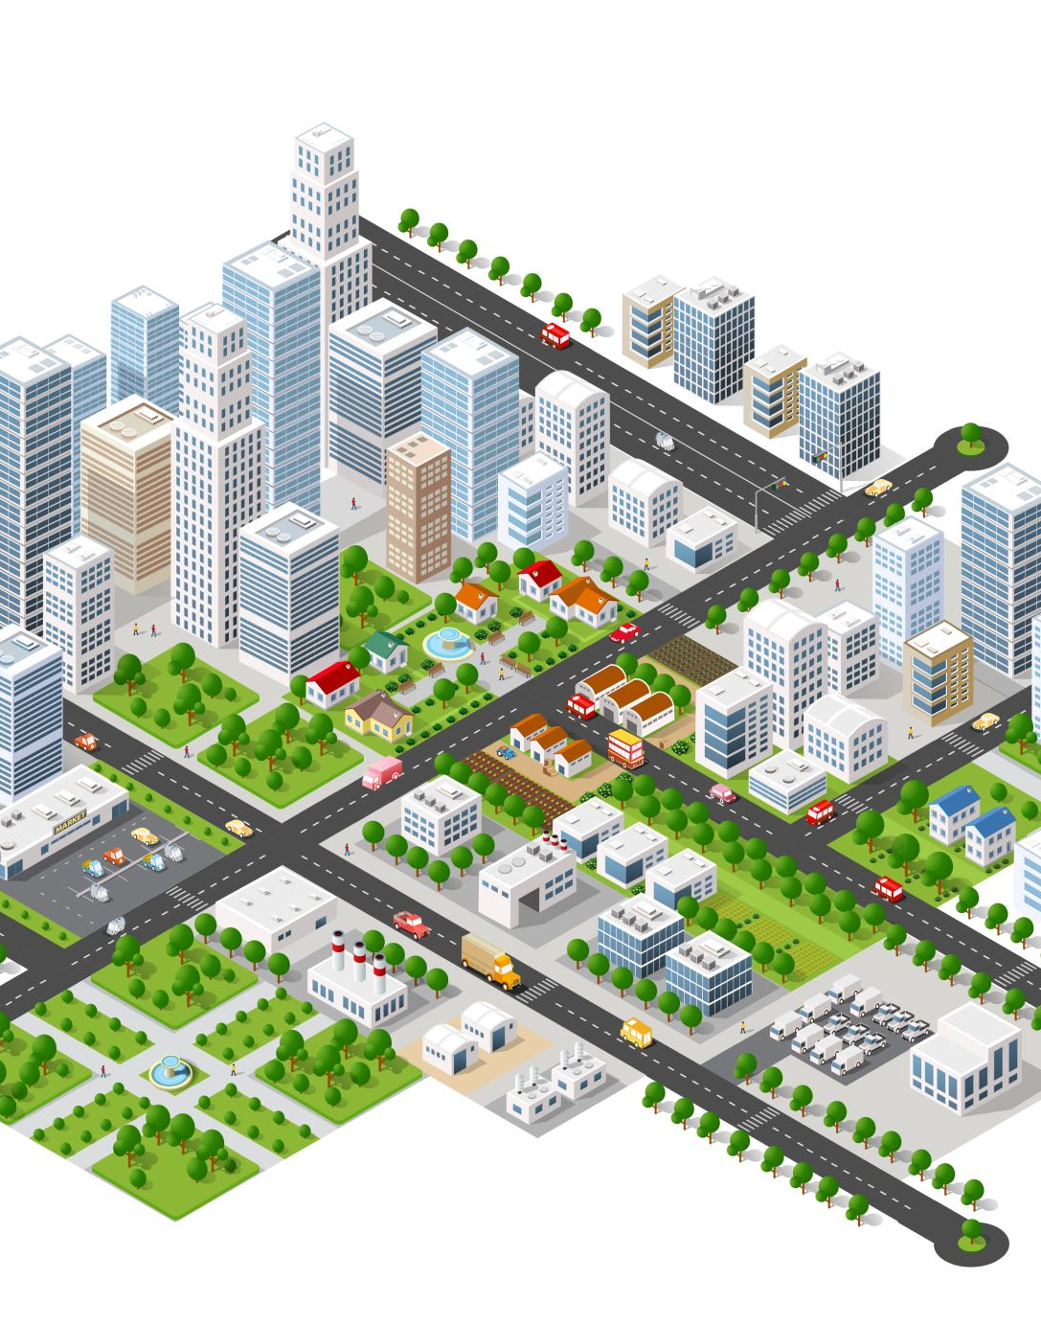
Examples and
Case Studies:
Example 1:
An example of promoting health, well-being, and sustainable development is the World Health Organisation’s Healthy Cities Initiative. By addressing both environmental and social determinants of health, the initiative aims to improve physical and mental well-being, strengthen community engagement, and foster sustainable, healthy urban environments. (WHO. 2020).

Slide 12
Examples and Case Studies: Seasonal Influenza Vaccination Programme:
Seasonal influenza (flu) is a recurring public health challenge that affects health and well-being globally. It has major implications for health systems, vulnerable populations, and economic stability.
Key statistics:
Seasonal influenza causes around 1 billion illnesses annually, including 3–5 million severe cases worldwide (World Health Organisation, 2025).
Seasonal influenza connects to Sustainable Development Goal 3 (Good Health and Well-being), which aims to ensure healthy lives and promote well-being for all.
Impact on SDG 3 outcomes:
Influenza increases healthcare demand, straining hospitals and workforce capacity.
Public health surveillance and immunisation contribute to disease prevention and health promotion, core to SDG 3.
Notes:
Add a bit more about what its achieved, and barriers

Slide 13
Equity and Access:
Equity and access are central to achieving health, well-being, and sustainable healthcare systems. Equity ensures that all individuals have a fair opportunity to reach their full health potential, regardless of factors such as socioeconomic status, ethnicity, or geographic location. (WHO. 2023). Access to healthcare encompasses not only the availability of services but also their affordability, acceptability, and cultural relevance. (NHS England. 2022). Addressing barriers to care and integrating social determinants into healthcare planning can reduce health inequalities, improve population well-being, and support sustainable health outcomes. (Marmot, M, et al. 2010).

Slide 14
INEQUALITIES:
People in lower socioeconomic groups experience worse health outcomes and shorter life expectancy
Health inequalities are largely driven by social determinants of health
These inequalities are avoidable and unfair (Marmot, M. et al., 2010)
The Marmot Review identified a social gradient in health – the lower a person’s social position, the worse their health (Marmot, M. et al. 2010).
It proposed six policy objectives:
Give every child the best start in life
Enable all children and adults to maximise their capabilities
Create fair employment and good work for all
Ensure a healthy standard of living
Create healthy and sustainable places and communities
Strengthen the prevention of ill health
The review links closely to SDG 3 (Good Health and Wellbeing) and SDG 10 (Reduced Inequalities) by addressing structural causes of poor health.
Notes:
Marmot review – 2010 got it worse by 32020

Slide 15
Recommendations:
To improve health and wellbeing sustainably, action is required at individual, community and policy levels.
1. Strengthen prevention and public health
Increase vaccination and screening programmes
Promote healthy lifestyles (diet, physical activity, mental wellbeing)
(WHO, 1948; United Nations, 2015)
2. Address social determinants of health
Reduce poverty and income inequality
Improve education, housing and employment conditions
(Marmot et al. 2010)

Slide 16
Reccomendations:
Promote
Promote environmental sustainability
Reduce
Reduce pollution and carbon emissions
Support
Support sustainable cities and communities
(United Nations, 2015)
Ensure
Ensure equitable access to healthcare
Improve
Improve universal health coverage
Target
Target vulnerable and disadvantaged groups
(United Nations, 2015)
Strengthen
Strengthen global partnerships
Collaborate across
Collaborate across governments and organisations
Align
Align national policies with the Sustainable Development Goals (SDGs)
(United Nations, 2015)

Slide 17
Recommendations: Addressing Social Determinants of Health:
Enhance community engagement: Involving local populations in planning and decision-making ensures services meet the needs of diverse groups. (OHID, 2022a).
01
Strengthen Preventive Health Services
Increase access to primary care, vaccination, and health promotion
Focus on vulnerable populations to reduce inequalities (Marmot, M. et al.2010)
02

Slide 18

Conclusion

Slide 19
Conclusion:
Tackling health inequalities is essential, by focusing on social determinants such as education, housing, employment, and access to healthcare.
The NHS can play a pivotal role in reducing disparities through its economic influence, serving as a major employer, purchaser, and local anchor institution to support inclusive growth and equitable service delivery.

Slide 20
Conclusion:
Health and well-being are shaped by biological, social, and environmental factors, and addressing social determinants such as education, income, and housing is essential to reduce inequalities (Marmot et al.2010; WHO, 2008). Integrating holistic health approaches with sustainable development goals ensures equitable access to care and long-term population health (Engel, G.L. 1977). Coordinated action across policy, environment, and healthcare systems is key to creating a fair, healthy, and sustainable future for all (WHO, 1948).

Slide 21

THE END.
THANKYOU FOR YOUR TIME.

Slide 22
References:
CDC (2024) 2023–2024 Influenza Season Summary: Influenza Severity Assessment, Burden and Burden Prevented. CDC. Available at: https://www.cdc.gov/flu/whats-new/flu-summary-addendum-2023-2024.html (Accessed: 11 Feb 2026).
Diener, E., Suh, E.M., Lucas, R.E. and Smith, H.L. (1999) ‘Subjective well-being: Three decades of progress’, Psychological Bulletin, 125(2), pp. 276–302.
Department of Health and Social Care (DHSC) (2022) Health and Care Act 2022. London: DHSC.
Department for Levelling Up, Housing & Communities. 2021. National Planning Policy Framework. London: UK Government
Engel, G.L. 1977 ‘The need for a new medical model: A challenge for biomedicine’, Science, 196(4286), pp. 129–136
Gov. UK. 2025. Available at; https://www.gov.uk/government/publications/health-inequalities-in-health-protection-report/health-inequalities-in-health-protection-report-2025. (Accessed: 26 January 2026)
Hettler, B. (1976) The six dimensions of wellness model. National Wellness Institute.
HM Government (2021) Net Zero Strategy: Build Back Greener. London: HM Government.
Holistic image. 2019. Available at: https://www.communitiesforward.org/post/what-is-holistic-health. [Accessed: 09 jan /2026].
Image. 2024.Available at; https://www.tes.com/teaching-resource/medical-or-biomedical-model-and-social-model-of-health-and-well-being-12060624. [Accessed: 09 Jan 2026].
Image. Available at: https://impact17.net/sdgs. [Accessed: 11 Feb 2026].
Image. Available at: https://pre-sustainability.com/articles/the-sdg-series-evaluating-sustainable-development-goals-13-17/. [Accessed: 11 Feb 2026].

Slide 23
References:
Image. Available at: https://uk.images.search.yahoo.com/search. [Accessed 11 Jan 2026].
Image. Available at: https://www.socialworkportal.com/bps-model/. [Accessed: 11 Jan 2026]
Journal of Market Access & Health Policy. 2015. Journal of Market Access & Health Policy,
Largeron, N. et al. 2015. ‘Role of vaccination in the sustainability of healthcare systems’, Journal of Market Access & Health Policy, 3(1).
Marks L, Cave S, Hunter D, Mason J, Peckham S, Wallace A. 2011.Governance for health and wellbeing in the English NHS. Journal of Health Services Research & Policy.
Marmot, M., Allen, J., Goldblatt, P., Boyce, T., McNeish, D., Grady, M. and Geddes, I. 2010. Fair society, healthy lives: The Marmot Review. London: The Marmot Review.
NHS.England. 2024. Available at: https://www.england.nhs.uk/about/equality/equality-hub/national-healthcare-inequalities-improvement-programme/our-approach-to-reducing-healthcare-inequalities/. [Accessed: 05 Feb 2026].
NHS England .2019. The NHS Long Term Plan. London: NHS England.
Nuffeild+trust+health+wellbeing+and+sustainability. Available at: https://www.google.com/search. Accessed; [26 Jan 202].6
OECD (2013) OECD Guidelines on Measuring Subjective Well-being. Paris: OECD Publishing
Office for Health Improvement and Disparities. OHID. (2022) Health disparities: Improving health outcomes. London: Department of Health and Social Care.

Slide 24
References:
UK Government (2026). Influenza in the UK, annual epidemiological report: winter 2024 to 2025. GOV.UK.
UK H.S.A.2025. Available at: https://www.gov.uk/government/publications/health-inequalities-in-health-protection-report. [Accessed; 05 Jan 2026].
United Nations. 2015. Transforming our world: the 2030 Agenda for Sustainable Development. New York: United Nations.
World Commission on Environment and Development (WCED). (1987). Our common future. Oxford University Press.
WHO, 2024. Available at; https://iris.who.int/server/api/core/bitstreams/9b11ca87-a64b-4646-8baa-bbfcba488dfc/content. [Accessed; 09 Jan 2026].
World Health Organisation. WHO. 1948. Constitution of the World Health Organisation. Geneva.
World Health Organisation. WHO. 1986. Ottawa Charter for Health Promotion. Geneva.
World Health Organisation. WHO. 2022. WHO Global Strategy on Health, Environment and Climate Change. Geneva.
World Health Organisation. (WHO) (2025) Influenza (seasonal). WHO. Available at: https://www.who.int/news-room/fact-sheets/detail/influenza-%28seasonal%29 (Accessed: 11 Feb 2026).
Yuill, C., Crinson, I. and Duncan, E. 2010. The Biomedical Model of Health. In: Key Concepts in Health Studies. London: SAGE Publications Ltd. pp. 7-10. Available at: <https://doi.org/10.4135/9781446251676.n2> [Accessed 26 Jan 2026].

Slide 25
World Health Organisation.WHO. 2024. European Region roadmap. Copenhagen: WHO Regional Office for Europe
World Health Organisation. WHO. 2023. Health equity and inequalities. Geneva: WHO.

