Slide 1

Boundaries
Notes:
Welcome to a quick overview of boundaries within my future studies.

Slide 2
INTRODUCTION
The roll Boundaries play in my path to studying
Notes:
A look at the path I hope to follow and the roll of boundaries.

Slide 3
Boundaries
Racial
Religious
Ethical
Political
Moral
Financial
Notes:
Six key boundaries I see that will be prominent in my studies.

Slide 4
Relationship with My future Studies
Philosophical Thinking
As a group
Personal actions
Political Decision making
Trade
Notes:
Looking within the boundaries.

Slide 5
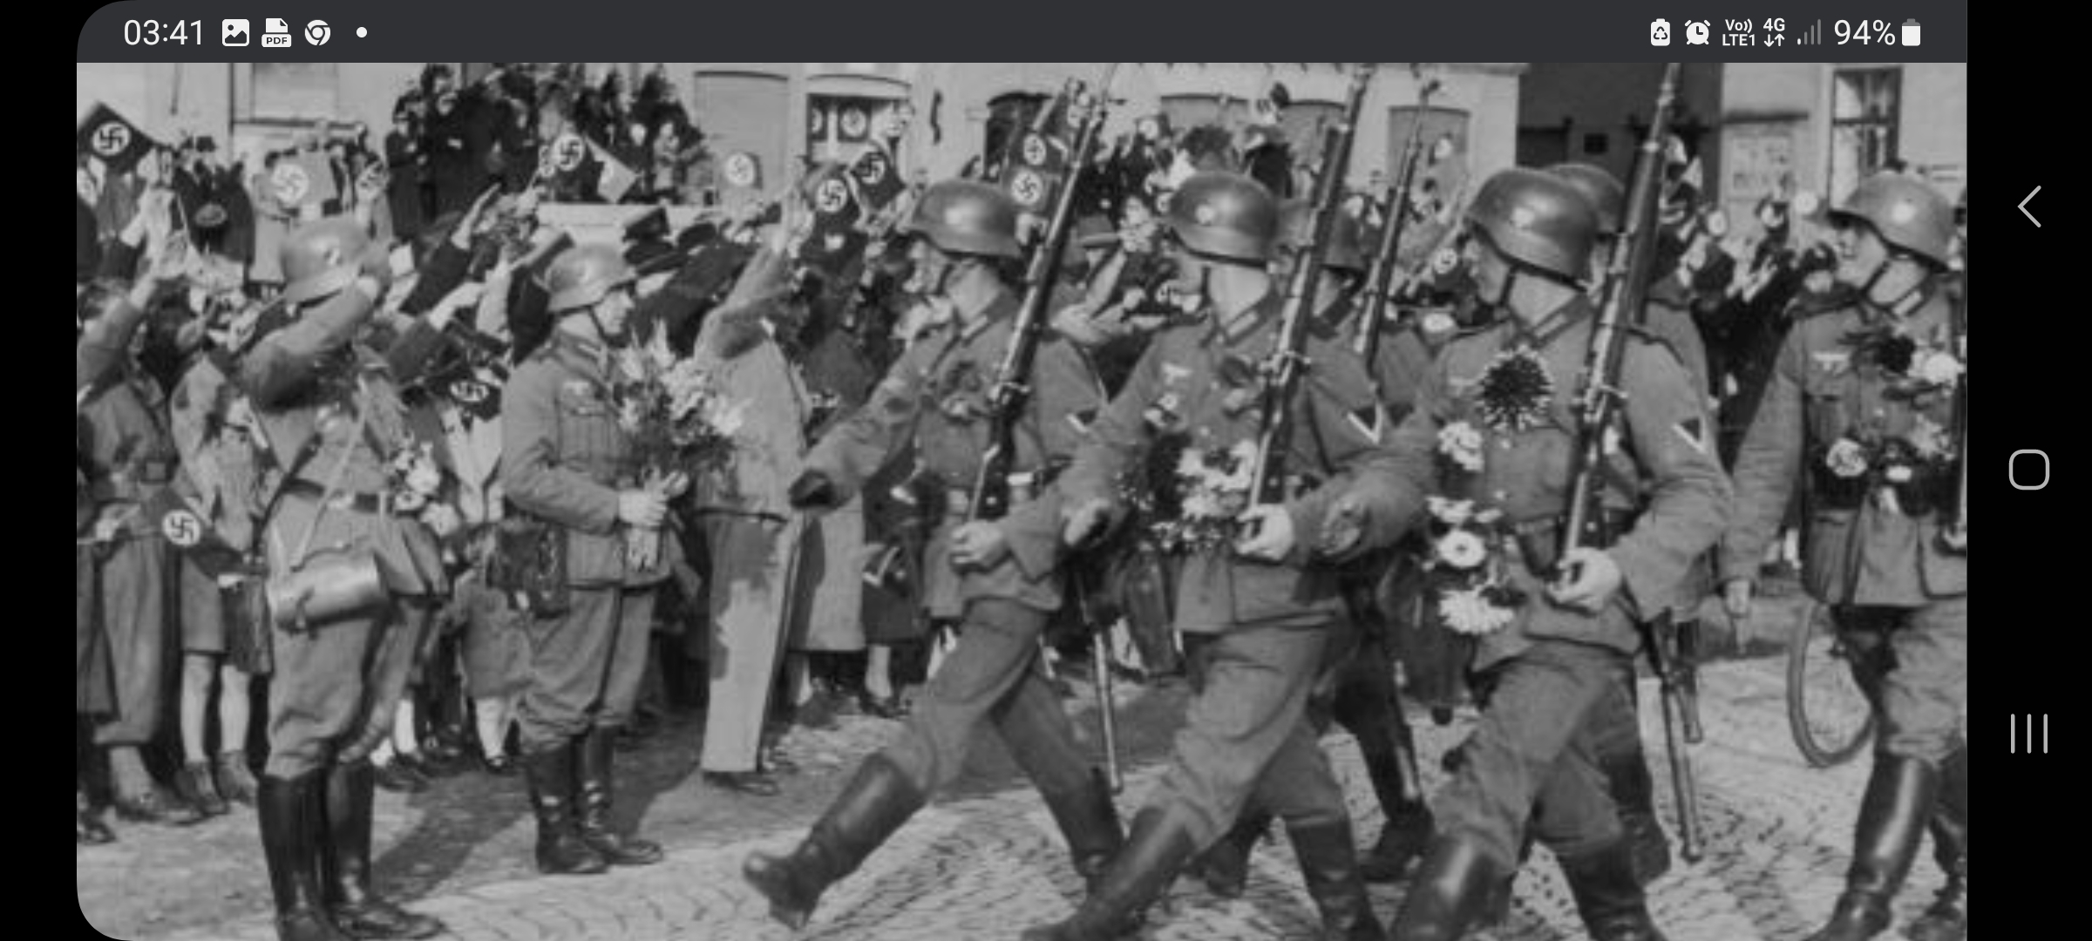
How we think about Boundaries
Compartmentalising
When Interviewed, Speer, Hitlers Architect, replied that
“Hitler required us not only to compartmentalise our activities but also our thinking. He insisted that each man should only think about his task and not be concerned with that of his neighbour.”
1b1b1b1b1b1b
1a
Notes:
Forming of boundaries , Compartmentalising.

Slide 6
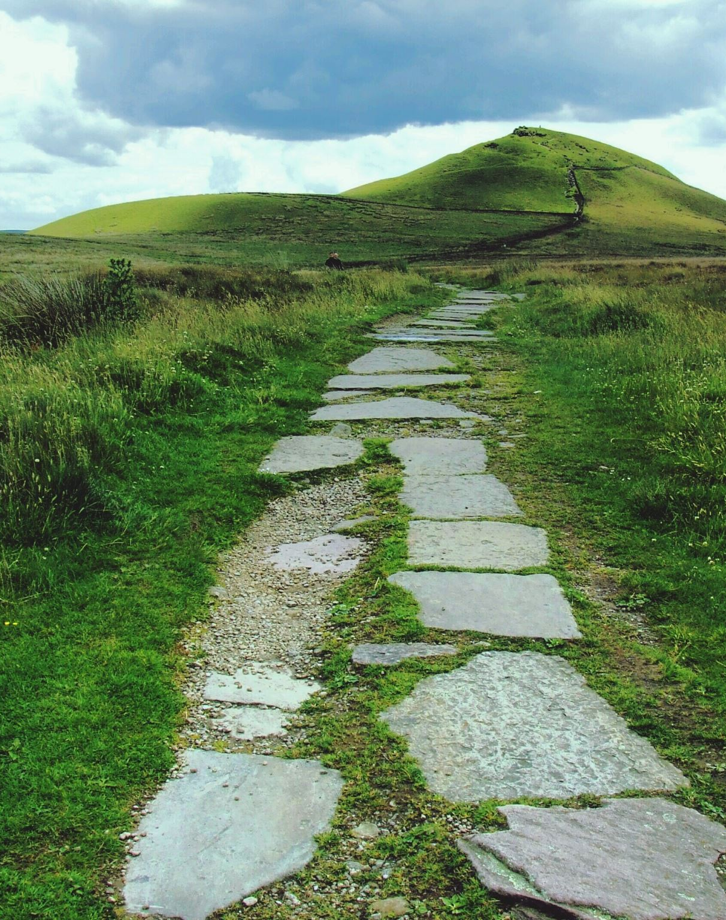
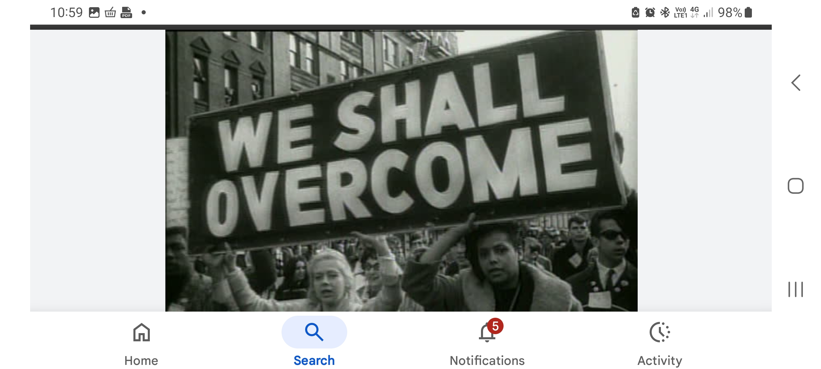
Conclusion
Tracing the path laid by time.
History has laid us a path that if we look carefully can lead you to a greater understanding of why we act in ways we find hard to understand. 1b
Notes:
How history has laid path through time and into our future.

Slide 7
Bibliography
1, Graton Dan, 2019 I YOU WE THEM Penguin, p 499
1a, Holocaust Museum. https://www.bing.com/search?pglt=299&q=HOLLICAST+MUSEUM+IMAGE&cvid (date accessed 15/11/2025)
1b Getty Images. https://www.bing.com/images/search?q=we+shall+overcome+image+martin+ ( date accessed 15/11/2025 )
Image of Path. Microsoft Word.
Notes:
Anyone wishing to have more information regarding references mentioned above feel free to ask.

