Slide 1


Program of study: Certificate in Higher Education Business Skills for the Workplace
Module Title: Enterprise & Entrepreneurship
Module Code: LCLM40006
Assessment: Component 2 – Individual Presentation Pitch
Student Name: Chante Fleary-Young
Student Number: 2441293
Lecturer’s Name: Dr Chung Lai Johnny Wan

Slide 2
Table of contents
Business Overview……………………………………..3
Legal Format…………………………………………….4
External Business Factors…………………………......5
Key Marketing Strategies…………………………........6
Our Services……………………………………………..7
Funding Requirements………………….…………..….8
Cash In & Fund allocation.……………………………..9

Slide 3


Location & Market
Warwickshire-based cleaning service operating within the £66.9bn UK cleaning industry
Target Clients
Corporate offices, private residences, and short-term rental properties
Service Focus
Specialist cleaning designed for inspection readiness, compliance, and high guest/ property standards.
Unique Selling Point
A premium, quality-controlled cleaning system designed to deliver consistent, inspection ready results. Ensuring every task is completed to the same high standard each time.
Many independent cleaning providers offer general cleaning services but do not follow a structured quality-control system. Their work may vary depending on the cleaner or the day.
Business structure
Sole trader model which offers flexibility, low administration, and direct quality control.
Growth Plan
Owner-led service delivery initially, with staff recruitment as demand increases for scalability
Business Overview

Slide 4
Why Choose a Sole Trader Business Structure?
Simplicity – Easy and fast setup with fewer forms and lower administrative costs
Full Control – Owner has 100% control over business decisions and operations
Flexibility & Tax Benefits – Eligible for tax incentives, with freedom to hire and adjust operations as the business grows
Lower costs & Quick Start – More affordable, quicker, and less paperwork compared to limited companies
Ideal for start-ups seeking flexibility, control, and cost efficiency
Legal format

Slide 5




Economic Strong & Stable Demand | Social Increased Hygiene Awareness | Environmental Competitive Differentiation
Cleaning services are recession-resilient because hygiene and maintenance remain essential. Growth in dual-income households make up about 48% of households and business outsourcing continues to increase demand for professional cleaning services. | Post-pandemic behaviour has significantly raised expectations for cleanliness in homes and workplaces. Busy lifestyles and an ageing population also increase demand for reliable outsourced cleaning services. | Growing consumer preference for eco-friendly and non-toxic cleaning products creates an opportunity for the business to stand out. A green cleaning approach supports brand differentiation and potential premium pricing.
Key External Factors Supporting the Business
Understanding external factors helps a business anticipate market changes, adapt strategies, and remain competitive in a continuing changing environment.

Slide 6
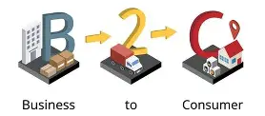





Key Marketing Strategies
Digital Strategy (B2C) | Partnership Strategy (B2B)
Use Instagram and TikTok to showcase before-and-after cleaning results, testimonials, and behind-the-scenes content Maintain a professional website with service details, pricing, and online booking Optimise Google Business Profile to improve local search visibility and encourage customer reviews Builds trust, credibility, and engagement with local residential customers | Build partnerships with estate agents, property managers, moving companies, and short-term rental hosts Promote reliability, compliance, and long-term service value for businesses Introduce a referral programme offering discounts or service upgrades Encourage repeat business through follow-ups, service reminders, and review requests

Slide 7

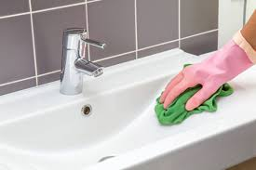
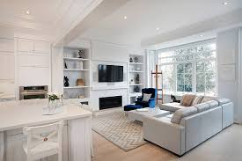
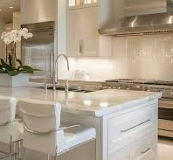
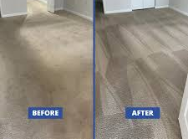
Our Services
Standard Home Cleaning
Regular cleaning to keep your home fresh and tidy.
Deep Cleaning
A more detailed clean for areas that need extra attention.
Move-In / Move-Out Cleaning
Thorough cleaning to prepare a property for new occupants or leave it spotless when moving out.
Kitchen Cleaning
Bathroom Cleaning
Surface & Detail Cleaning
Dusting furniture, wiping skirting boards, polishing surfaces, and cleaning mirrors.
Flexible Cleaning Plans
Weekly, bi-weekly, or one-time cleaning tailored to your needs.

Slide 8
Diversified funding reduces financial risk
Supports stable cash flow and sustainable business growth
Government Start-Up Loan Scheme
Friends & Family Contributions
Expense Category | Purpose
Cleaning Equipment | Ensures efficient, high-quality service delivery
Eco-Friendly Products | Supports sustainable and safe cleaning practices
Uniform and Insurance | Professional image and legal protection
Marketing | Brand visibility and early customer acquisition
Transportation | Needed to travel to client locations
Funding Requirements
Start-up £10,000
Friends & Family £2,000
Sales & Service £6,000

Slide 9

Cash In & Fund allocation

Slide 10

Thank you for listening!
Chante Luxe Cleaning Co aims to deliver premium, reliable cleaning services while building strong relationships with local clients.
With a clear market demand and a structured service model, Chante Luxe Cleaning Co has strong potential for sustainable growth.
Thank you, I'm happy to take any questions.

