Slide 1

MODULE NAME
Problem Solving and Decision Making
MODULE CODE
LCLM4004-LON
STUDENT NAME
Hazel Javiera Robleto Lacayo
STUDENT ID
2439869
LECTURER
Toyin Adisa
Assignment 1: Presentation

Slide 2
OVERVIEW
Introduction
Company background
Problem: nature and scope
PESTLE ANALYSIS: Green Haven Florists
Cause and effect analysis: Fishbone diagram
Conclusion
References

Slide 3

Introduction
I will be presenting an analysis of Green Haven Florists, an small independent flower shop based in Norwich, UK. The purpose of this presentation is to explore the main challenges the business is currently facing, particularly the recent 30% decline in sales the impact of online competition on its performance.
I will begin by identifying the core problems affecting the company using the 5W2H method. Then I will discuss the external factors influencing the business through a PESTEL analysis.
Finally, I will present a cause and effect diagram to highlight the root causes of these issues and propose strategies that could help Green Haven Florists adapt and remain sustainable in a rapidly changing retail environment.

Slide 4

Company background
Green Haven Florists is an independent flower shop founded in 2016 in Norwich, United Kingdom, by owners Liam and Priya Patel. Since its establishment, the company has built a strong reputation for its focus on bespoke floral arrangements, sustainable materials and environmentally friendly practices.
The business is recognised for its close customer relationships and community engagement, providing services for individual clients and events. Its value proposition is based on craftsmanship, locally sourced flowers, and strong environmental commitment.
In its early years, Green Haven Florists consolidated its position within the local market; however shifting economic conditions, market digitalisation and intensifying online competition have progressively challenged its traditional business model resulting in a 30% decline in sales.

Slide 5
5W2H ANALYSIS
What ? | Green Haven Florists is experiencing a 30 % decline in store sales over the past year. The shop is also struggling to maintain profitability due to rising operational costs and strong competition from online flower retailers and new local competitors.
Who? | It affects the owners, Liam and Priya Patel, their employees and their customers, who are now turning to competitors with more modern and convenient online services.
When? | The issues have become evident over the last 12 months, coinciding with broader market changes in the retail and floral industries, specially the rise of online delivery services and inflation pressures.
Where? | The problem is taking place in Norwich, United Kingdom, specially affecting the physical store operations and its local customer base.
Why? | The decline is mainly caused by a shift in customer behaviour towards online shopping, the closure of nearby businesses reducing foot traffic.
How? | The business has failed to adapt its strategies; it relies mainly on traditional marketing, has limited online visibility and faces higher supplier costs.
How much? | The store has suffered a 30% drop in sales, and operational expenses have increased due to higher flower prices and the cost of maintening sustainable packaging. As a result, profitability has decreased.

Slide 6
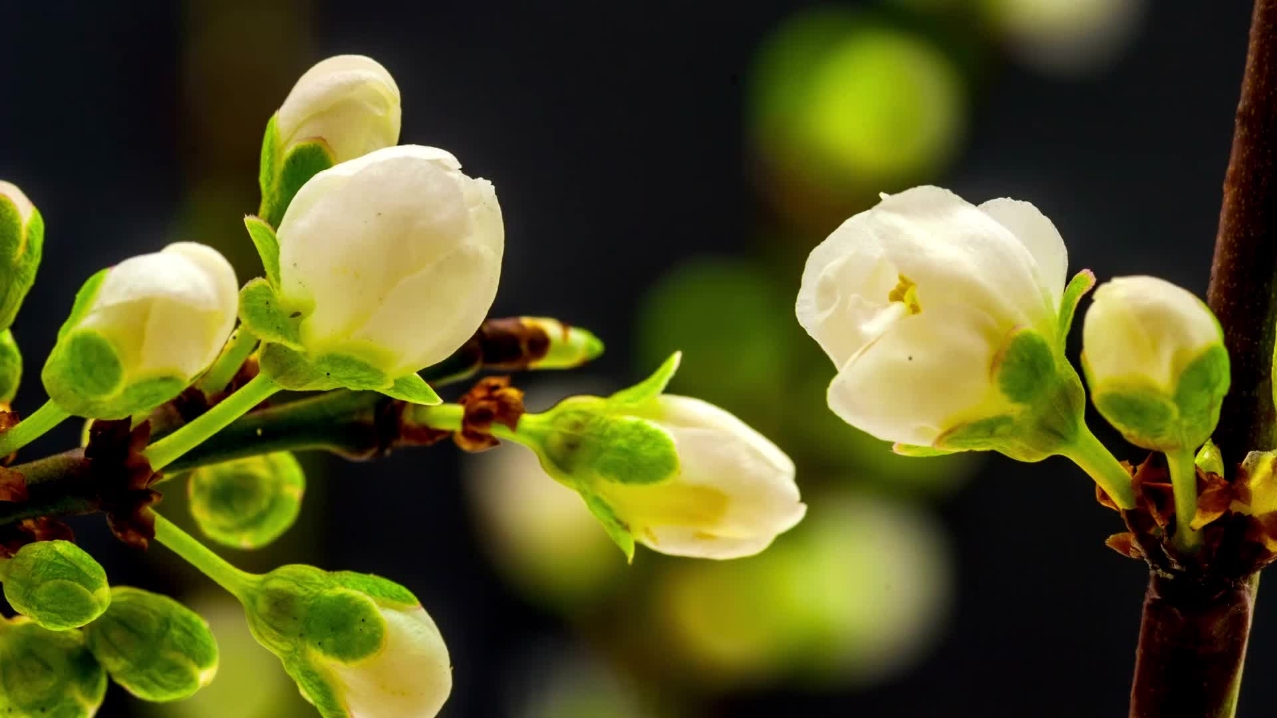
PESTLE ANALYSIS: Green Haven Florists
POLITICAL
Government policies promote eco-friendly materials, increasing costs.
Post-Brexit import rules make flower supplies more expensive.
ECONOMIC
Inflation raises energy and product costs.
Consumers spend less due to the cost of living crisis.
SOCIAL
Customers prefer online shopping and quick delivery.
Social media influences younger buyers more than traditional advertising.

Slide 7
PESTLE ANALYSIS: Green Haven Florists
TECHNOLOGICAL
Outdated website limits online sales opportunities.
Competitors use digital platforms for marketing and delivery .
LEGAL
Must follow consumer protection and employment regulations.
Import and safety laws raise administrative and compliance costs.
ENVIRONMENTAL
High demand for sustainable products increases sourcing costs.
Supply issues affect availability of eco-friendly materials.

Slide 8

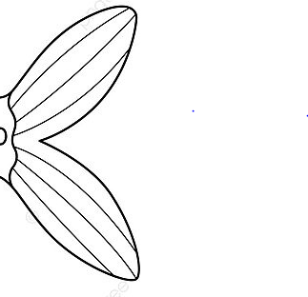
Cause and effect analysis: Fishbone diagram
Market
Economic
Technological
Decline in sales
Inflation, increases operational costs
Outdated website without online ordering
Strong online competition
Reduced consumer spending power limits sales
Customers prefer convenience
Weak social media and digital marketing
Dependence on walk-in customers only
Lack of online promotions
Delays in imported flower deliveries
High costs due to sustainable materials and packaging
Website viewed as old-fashioned and slow
Increased prices for eco- friendly products
Operational
Customer
Supply chain

Slide 9

Conclusion
In conclusion, Green Haven Florists is currently facing a decline in sales due to economic pressures, growing online competition, and limited digital presence factors such as inflation, higher supply costs, and changing customer habits have affected its profitability. To overcome these challenges, the company should modernize its website, strengthen online marketing, and collaborate with local suppliers to reduce costs while maintaining its sustainable values .

Slide 10
References
• Reading on the need to identify the ‘right’ business problem: Spradlin, D. (2012). Are you solving the right problem? Harvard Business Review
• https://hbr.org/2012/09/are-you-solving-the-right-problem
• CIPD (2025) PESTLE ANALYSIS Available at: https://www.cipd.org/en/knowledge/factsheets/pestle-analysis-factsheet/ (Accessed: 8 November 2025)
• https://uk.practicallaw.thomsonreuters.com/w-006-4835?transitionType=Default&contextData=(sc.Default)&firstPage=true
•BGMC(2024) Exploring the Fishbone Diagram: Types, Advantages, Drawbacks, and Revealing the Six M’s of Change Available at: https://bgmcgroup.com/exploring-the-fishbone-diagram-types-advantages-drawbacks-and-revealing-the-six-ms-of-change/ (Accessed: 9 November 2025)

Slide 11

Questions ?

