Slide 1

Research Methods & Communication
5: Interviews

Slide 2
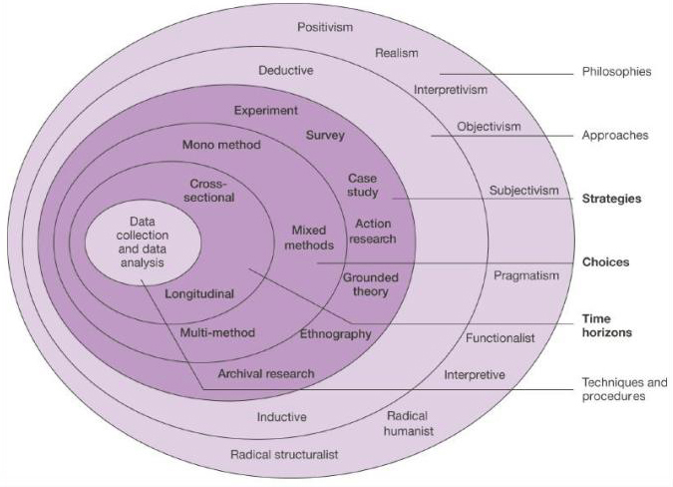
Research Onion
From: Saunders, Lewis & Thornhill (2007) Research Methods in Business. Pearson Education

Slide 3
Surveys
"Surveys gather data at a particular point in time with the intention of describing the nature of existing conditions, or identifying standards against which existing conditions can be compared, or determining the relationships that exist between specific events" (Cohen et al 2011: 256).

Slide 4
Interviews
An interview is:
A data collection method which facilitates direct communication between two people (F2F, telephone, Internet), and which
Enables the interviewer to elicit information, feelings, and opinions from the interviewee using questions and *interactive* dialogue.

Slide 5
Interviews
Why?
"The expressive power of language provides an important resource for the researcher. A crucial feature of language is its capacity to present descriptions, explanations, and evaluations of almost infinite variety about any aspect of the world, including itself".
[Adapted from Hammersley & Atkinson 1995, cited in Matthews & Ross 2010: 219]

Slide 6
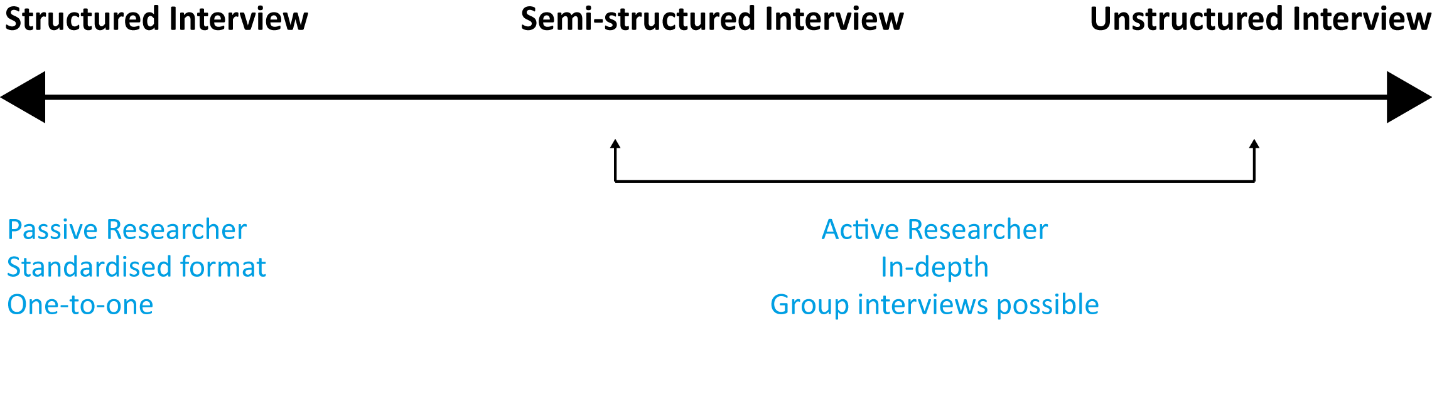

Slide 7
Structured Interviews
Follow a common set of questions.
Ask the questions exactly the same way, in the same order, using exactly the same words.
Scripted from beginning to end.
Presents the participants with a fixed set of answers to choose from.
It's a questionnaire, but in person.

Slide 8
Semi-structured Interviews
Follow a common set of topics.
May introduce topics in different ways as appropriate for each interviewee.
Probably only have an introductory script.
Allows the participants to answer questions or discuss the topic in their own way and using their own words.

Slide 9
Unstructured Interviews
Simply focuses on a broad subject area.
Probably only have an introductory script.
Allows the participants to discuss the topic in their own way and using their own words: there may not be any "questions" as such.

Slide 10
Benefits: Structured Interviews
Consistency.
Standardised outputs.
Quantitative data.
High-volume/large samples possible because they do not require trained interviewer.

Slide 11
Benefits: Semi- and unstructured Interviews
Allows participant to talk freely about a subject.
However, the use of an "interview guide" allows contextualization of discussions and provides a framework for analysis.
Allows unforseen/novel/unanticipated aspects of the research to emerge.
Allows in-depth exploration.
Allows the interviewer to "probe" areas of interest.
Allows interviewer to broach sensitive or difficult personal issues.
Allows group interviews (e.g. focus/Delphi groups).

Slide 12
The Interview Guide Format
Introduction. Possibly scripted.
Topic 1: Vinyl
Points to cover
  Sound quality
  Scratches and surface noise
  Covers
  Collectibility.
Topic 2: CD
Points to cover
  Sound quality
  Price
  Playing time
  Durability
Topic 3: Blu-ray Disc (etc.)

Slide 13
Problems: Semi- and unstructured Interviews
Needs an expert interviewer.
Time-consuming.
Will inevitably need recording technology of some sort.
Generates huge amounts of data.
Data may be difficult to interpret.
Data may be difficult to generalize.

Slide 14
Good Practice
All interviews need:
A private, secure, and comfortable environment.
Preparation by the researcher, including piloting the whole interview apparatus.
A robust ethical framework. TBC.

Slide 15
Links
http://www.scribd.com/doc/15426750/Interview-Script
https://www.wiki.ed.ac.uk/display/UX2/Interview+Script+-+Master+%28Unflow%29

Slide 16
References
Cohen, L., Manion, L. & Morrison, K. (2011) Research Methods in Education. London, New York: Routledge.
Matthews, B. & Ross, L. (2010) Research Methods. Harlow: Pearson Education

