Slide 1
Digital Transformation in the Health and Care Professions (BMHP6026)
Component 2 Assessment
Student name: Delia Munteanu
Student ID: 2314055

Slide 2
Use of AI Acknowledgement
I confirm that I have not used any AI tools during the research and creation of this assignment. I also confirm that I have not presented any AI-generated materials as my own work. Additionally, I affirm that I have copies of my drafts, notes, and other resources used, which I may be asked to provide as evidence.

Slide 3

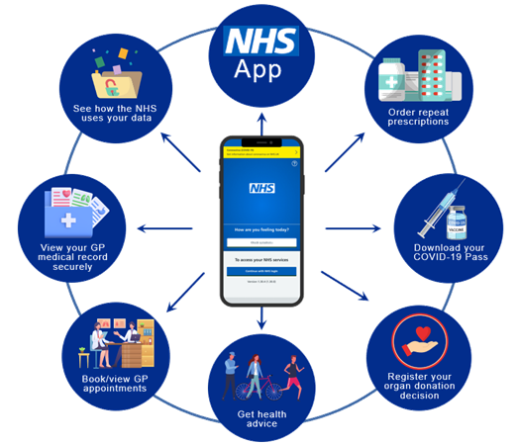
NHS App
The NHS App is a secure, free app available on any device, introduced in 2019 as part of the NHS Long Term Plan.
Key factors:
Book or cancel GP and hospital appointments
Request ongoing prescriptions
View medical records
Hospital referrals
Register for organ donation
NHS COVID Pass, which enabled digital proof of vaccination and supported broader public health efforts (KC et al., 2023).
https://www.youtube.com/watch?v=zh4reyziG8w
(Digital Health Devon, 2023)
(NHS, 2025).
(Swan Surgery, 2025)

Slide 4
Impact on Workforce
POSITIVE IMPACT | NEGATIVE IMPACT
Reduced Administrative Tasks: Digital functions minimise routine staff workload, enabling more time for patient-focused activities (NHS, 2024). Improved Workflow Efficiency: Integrated systems support smoother coordination and faster information exchange (Beaney et al., 2019). Enhanced Digital Skills: Staff gain greater confidence and competence in using digital tools and guiding patients (Reidy et al., 2025). Greater Flexibility and Collaboration: Automation and digital access promote adaptable working practices and stronger inter-team communication. | Rising Demand for Digital Skills: Staff must rapidly adapt to new technologies, which can be difficult for those with limited IT experience. Increased Patient Support Needs: Supporting users who struggle with the app adds to staff workload and highlights gaps in patient digital literacy. Cultural and Language Barriers: Staff must tailor communication for patients with limited English or differing cultural expectations to ensure equitable access. More Complex Workflows: Providing alternative pathways and additional guidance can increase workload and reduce operational efficiency. (Reidy et. al., 2025)

Slide 5
Impact on service delivery
POSITIVE IMPACT | NEGATIVE IMPACT
Reduces administrative workload by allowing patients to book appointments, request prescriptions, and access results independently (Beaney et al., 2019). Provides 24/7 access to records and results, improving convenience and engagement (Reidy, 2025). Supports informed decision-making and encourages proactive health management (Reidy, 2025). Simplifies digital prescription management and reduces errors (NHS, 2024). Strengthens communication and care coordination across services through digital integration. App-generated data helps organisations plan services and manage demand. | Digital exclusion limits access for patients without devices, internet access, or digital skills (Reidy et al., 2025). Differences in digital literacy affect patients’ ability to use the app effectively (Reidy et al., 2025). Increased short-term workload for staff who must support or train patients in using the app. Some patient groups may struggle more, risking widening inequalities in access to services.

Slide 6
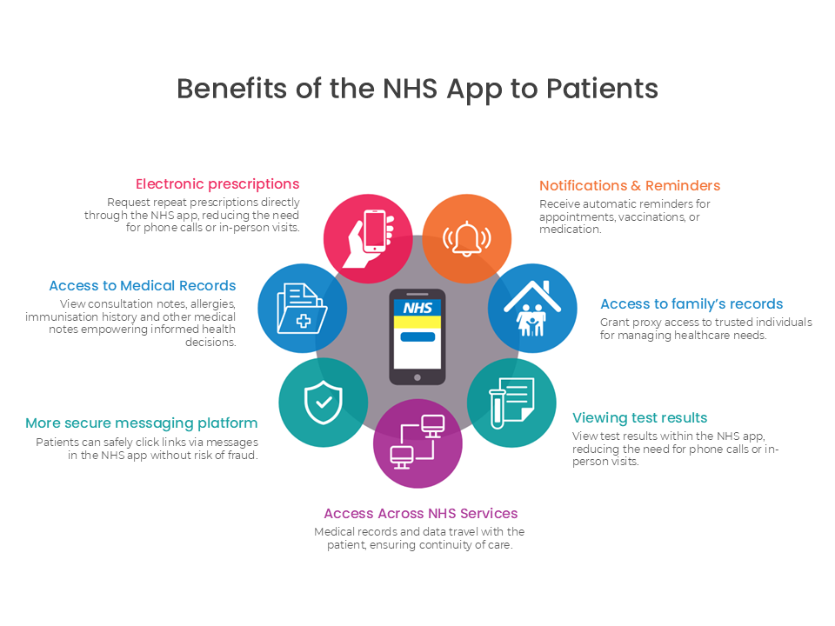
Impact on patients
Challenges
Digital inequality: (KC et al., 2024).
Risk of widening health inequalities: Socioeconomic factors affect who can fully benefit, reflecting broader inequalities highlighted in the Marmot Review (Marmot et al., 2012)
Inconsistent user experience: Patients in deprived areas may perceive the service as less accessible or supportive.
(Whiteladies Medical Group, 2023)

Slide 7
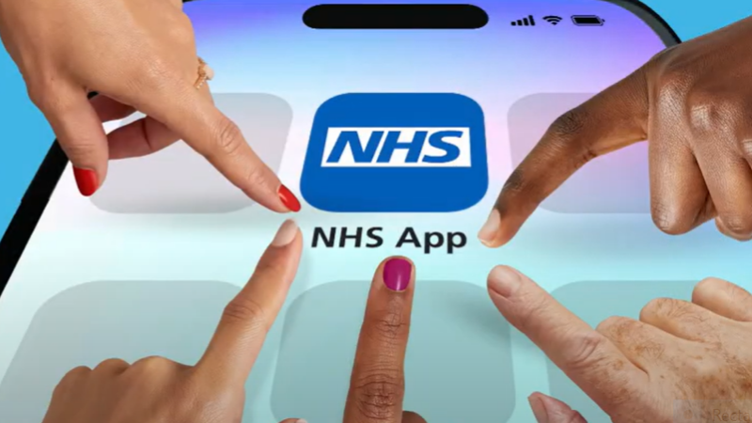
Impact on community
For patients and services, the NHS App has broadened access to primary care by allowing individuals to manage appointments, prescriptions, and health records digitally, reducing geographical barriers and alleviating administrative workload for healthcare providers.
Families and carers benefit from improved oversight of health needs through shared access features, which support more coordinated involvement in patient care and promote greater autonomy for those receiving support.
For public health, the app has strengthened system-wide responsiveness, particularly during the COVID-19 pandemic, where features such as the COVID Pass enhanced engagement, supported efficient communication, and facilitated large-scale public health efforts.
(NHS South West London, 2025)
KC, et al. (2023),

Slide 8
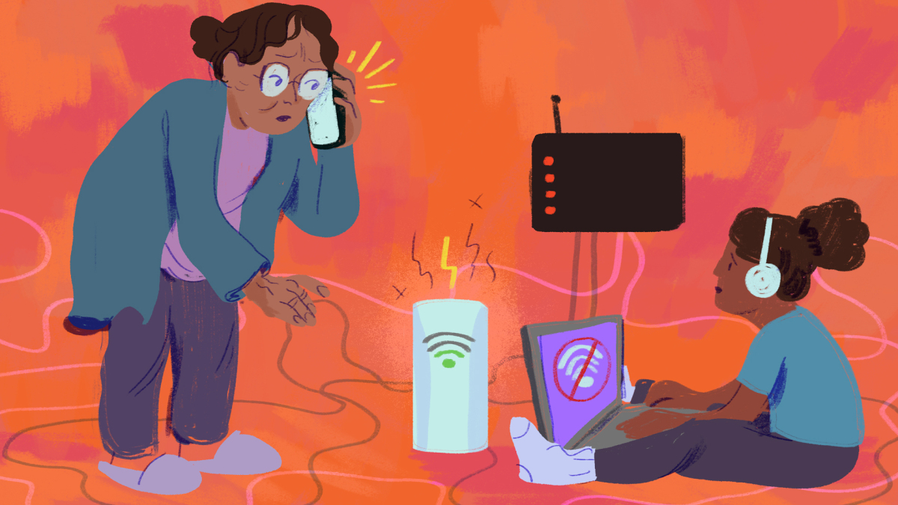
Challenges of the innovation
Digital Exclusion Challenges
Limited access to devices or reliable internet.
Low digital literacy or confidence using online tools.
Language barriers.
Financial constraints restrict access to technology and support.
Groups Most Affected
Older adults.
People in socio-economically deprived areas.
Minority ethnic groups.
People experiencing homelessness.
Disabled individuals.
NHS App Usability Challenges
Difficulty locating information or services within the app.
Need for clearer interface design and simpler language.
(Ruiz, 2021)
(NHS, 2025)

Slide 9

Recommendations
Introduce more convenient login options, such as secure features that keep users signed in.
Inform users that the NHS App can be accessed across multiple devices to encourage flexible use.
Refine the app by simplifying its wording and improving its navigation clarity.
Provide translated content in the most widely used languages in the UK to support users with limited English proficiency.
(Patient Information Forum, 2025)
(MarTech, 2025)

Slide 10

Conclusion
The NHS App represents a significant step in the digital transformation of health and care services, offering patients greater autonomy and more efficient access to appointments, prescriptions, and health records. Its adoption has supported workforce capacity and improved service delivery, especially during periods of high demand. However, the app’s full potential can only be realised if barriers such as digital exclusion, usability challenges, and inconsistent access across population groups are addressed. By refining navigation, improving accessibility, and promoting equitable digital participation, the NHS App can become a more inclusive and effective tool that supports better health outcomes for all users.

Slide 11
References
Beaney, P. et al. (2019). ‘GP Online: turning expectations into reality with the new NHS app’, British Journal of General Practice, 69(681), pp. 172–173. Available at: https://doi.org/10.3399/bjgp19X701333.
Digital Health Devon (2023). NHS App - Introduction. Available at: https://www.youtube.com/watch?v=zh4reyziG8w [Accessed 4 Dec. 2025].
KC, S. et al. (2024). ‘Differences in Use of a Patient Portal Across Sociodemographic Groups: Observational Study of the NHS App in England’, Journal of Medical Internet Research, 26(2), p. e56320. Available at: https://doi.org/10.2196/56320.
KC, S. et al. (2023), ‘Uptake and adoption of the NHS App in England: an observational study’, British Journal of General Practice, 73(737), pp. e932-e940. Available at: https://doi.org/10.3399/BJGP.2022.0150.
Marmot, M. & Bell, R. (2012). ‘Fair society, healthy lives’, Public health (London), 126(supplement 1), pp. S4–S10. Available at: https://doi.org/10.1016/j.puhe.2012.05.014.
NHS (2024), Transformation and innovation delivery update. Available at: https://www.england.nhs.uk/long-read/transformation-and-innovation-delivery-update/#:~:text=At%20the%20end%20of%20November%202023%2C%2024%25,access%20(where%20their%20GP%20has%20granted%20access). (Accessed: 13 October 2025).

Slide 12
NHS (2025), Co-creating the digital front door to the NHS. Available at: https://digital.nhs.uk/blog/design-matters/2025/co-creating-the-digital-front-door-to-the-nhs#:~:text=Research%20shows%20that%20while%20most,needed%20to%20use%20digital%20services. (Accessed: 03 December 2025).
NHS (2025), About the NHS App. Available at: https://www.nhs.uk/nhs-app/about-the-nhs-app/#:~:text=The%20NHS%20App%20gives%20you,can%20use%20the%20NHS%20App. (Accessed: 28 November 2025).
Patient Information Forum (2025), Public and Patient Experience of the NHS App. Available at: https://pifonline.org.uk/news/public-patient-experience-nhs-app/#:~:text=Increasing%20awareness%20and%20promoting%20benefits,and%20when%20they%20are%20used (Accessed: 01 December 2025).
Reidy, C. et al. (2025). ‘Qualitative evaluation of the implementation and national roll-out of the NHS App in England’, BMC Medicine, 23(1). Available at: https://doi.org/10.1186/s12916-024-03842-w.
Whiteladies Medical Group (2023). The NHS App. Available at: https://www.whiteladiesmedical.nhs.uk/nhs-app. (Accessed: 01 December 2025).

