Slide 1
Adult Learners and Learning
Barriers, Enablers, Policy and Practice.

Slide 2
Recap
What have we covered so far?
Do you have any questions around the assignment?

Slide 3
Asynchronous Learning
Having read chapter two 'Curriculum' of 'Learning For Life: The foundations for lifelong learning' by David Hargreaves ​
Discuss;​
How does the chapter link to the concepts discussed in this session?​
In your opinion what impact will the Curriculum for Wales have on the arguments discussed in the chapter?​

Slide 4
Objectives
By the end of this session you will be able to;
  Discuss the key barriers and enablers to adult education
  Recall Key policy documents from England and Wales relating to adult education
  Evaluate key adult learning practices

Slide 5
Definitions
Barriers
Enablers

Slide 6
Barriers to Adult education –
Key Terms
Situational barriers
Institutional barriers
Dispositional barriers
Notes:
Situational barriers: arising from an adult’s personal and family situation, such as time pressures and financial constraints; •
Institutional barriers: arising from the unresponsiveness of educational institutions or a lack of flexibility in the provision on offer, such as inappropriate scheduling or content of provision; and •
Dispositional barriers: relating to the attitudes, perceptions and expectations of adults, such as believing that they are too old to learn or lacking confidence or interest.

Slide 7
Global Barriers
Open the Excel file Adult Education and Learning found in the resources folder in the week 2 tile in moodle.
Discuss what are the largest barriers to adults participating in education among the OECD countries?
Are there any that you find particularly surprising?
Notes:
The statistical estimates presented in this table are based on samples of adults, rather than values that could be calculated if every person in the target population in every country had answered every question. Therefore, each estimate has a degree of uncertainty associated with sampling and measurement error, which can be expressed as a standard error.
The use of confidence intervals provides a way to make inferences about the population means and proportions in a manner that reflects the uncertainty associated with the sample estimates.
In this table, there is one column with the heading “Value”, which indicates the average percentage or mean, and a column with the heading “SE”, which indicates the standard error.
Given the survey method, there is a sampling uncertainty in the percentages or means of twice the standard error. For example, for the values: % = 10 and S.E. = 2.6, 10% has an uncertainty zone of twice (1.96) the standard error of 2.6, assuming an error risk of 5%.
Thus, the true percentage would probably (error risk of 5%) be somewhere between 5% and 15% (“confidence interval”). The confidence interval is calculated as: % +/– 1.96 * S.E., i.e. for the previous example, 5% = 10% – 1.96 * 2.6 and 15% = 10% + 1.96 * 2.6.

Slide 8

Barriers to
Watch the video and consider;
To what degree do you think these barriers apply to a UK context?

Slide 9
Barriers and enablers to Adult education in the UK
From the report - Barriers to learning for disadvantaged groups, found in the week 2 tile in Moodle read the sub-chapters
  Barriers to learning
  Facilitators to learning
What are the main barriers being discussed?
What are the main facilitators being discussed?
What other barriers have you considered in other modules?
What additional barriers or enabling factors may have been added in the following 4 years?

Slide 10
What else?
Parental experiences of learning
Initial experiences of education
Age
Social Class
Connection to the labour market
Gender
Ethnicity
Disability or learning difficulty
Being a ‘slower adapter to technological advances’
Notes:
Parental experiences of learning: Those, whose parents have not shown interest in their earlier educational experience are less likely to engage in learning later in life; overall development and reading improvement are also impacted. This affect becomes cross-generational
Initial experiences of education: Adults who have not had previous successes in education are not likely to continue or return to education.
Age: Results in the 2017 Participation Survey show that learning declines with age, even though we are generally living and working longer. There was a report in a 9 percentage point decline in those of 45 years or above taking up learning from the same survey conducted two years previously (2015).
Social Class: Continues to be the strongest measure of participating in learning (Savage 2015).
Factors such as occupation, parental education level, income and level of qualification, all sit within the social class group, and demonstrate a correlation between socio-economic status and engagement in learning; those in the higher levels being twice as likely to engage in learning than those in the lower levels of socio-economic status.
Connection to the labour market: Those who are employed, even in low-skilled, or being registered as unemployed but looking for work, are more likely to be able to access learning opportunities than those who those who are not connected to the job market at all according to Schuller and Watson (2009). Work is important as it offers opportunities and motivation for learning to take place.
Gender: Schuller and Watson (2009) also found that both men and women who do well in formal education, are more likely to become adult learners. Although more young women engage in adult learning than men, there is more of an equal rate by the time we reach 50 years of age. The 2017 Participation Survey reported that 39% of women and 35% of men were engaged in learning.
Ethnicity: The NIACE (2008) Briefing on participation in learning by adults from minority ethnic groups highlighted the significant difference between those learners from White or Black, Asian and Minority Ethnic (BAME) backgrounds. The 2017 Participation Survey also found this to be the case; BAME backgrounds were more likely to engage in learning (48%) than White backgrounds (35%). It must be acknowledged though that mixing ethnicities together in BAME did not separate out the higher rates of engagement from Black African backgrounds than those of Pakistani and Bangladeshi backgrounds.
Disability or learning difficulty: People with a disability are not only less likely to engage in education, they are less likely to have a place in the labour market. Mobility issues and lack of understanding can create access barriers in learning environments, as well as possible negative experiences in compulsory education. Those who experience these factors are less likely to re-engage in adult education according to NIACE. (2012). Adult Participation in Learning Survey.
Being a ‘slower adapter to technological advances’: Many mature learners are slower at adapting to new technology and this holds them back in learning. However, it isn’t just mature learners who are disadvantaged in the technological world. Younger learners, people living in social housing, with lower income, or those unemployed sit alongside those with disabilities who struggle to access the benefits of technology. Those who live rurally or in travelling communities, homeless, those young people who are not in education, employment or training, and those who have no access to public funding are also amongst those individuals for whom technology is a barrier to learning according to NIACE. (2012) and Tuckett & Field. (2016).

Slide 11
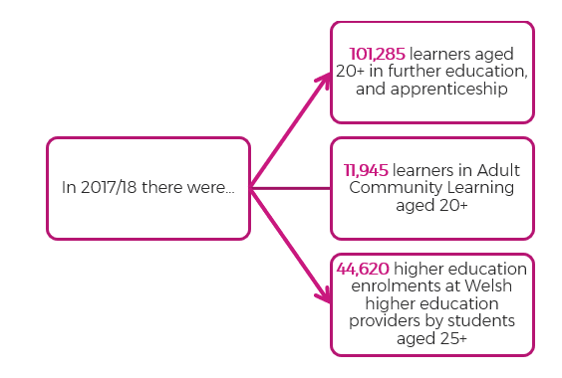
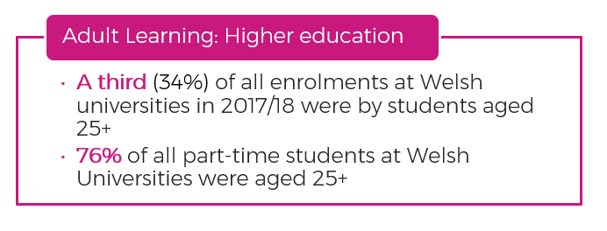
Key Figures from Welsh adult Education.
Notes:
https://research.senedd.wales/research-articles/a-lesson-on-adult-learning-in-wales/
https://statswales.gov.wales/Catalogue/Education-and-Skills/Post-16-Education-and-Training/Further-Education-and-Work-Based-Learning/Learners/Further-Education/uniquelearnersenrolledfurthereducationinstitutions-by-age-modeoflearning-gender

Slide 12
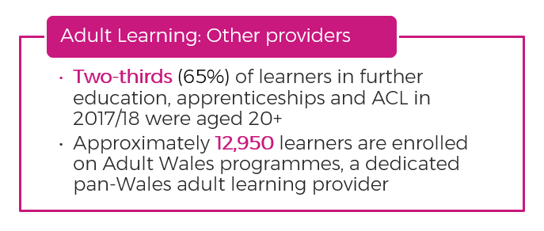
Key Figures from Welsh adult Education.

Slide 13
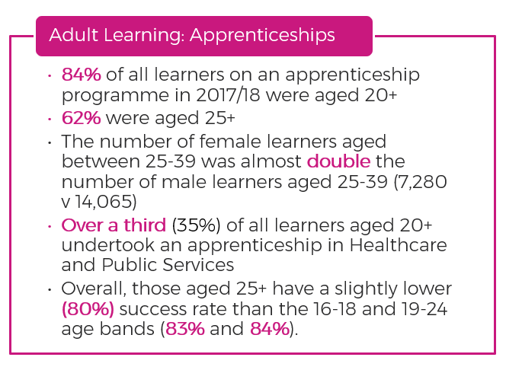
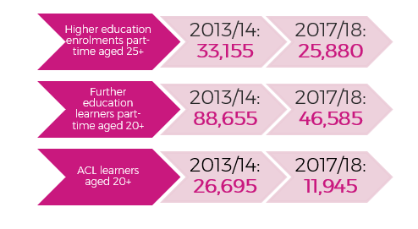
Key Figures from Welsh adult Education.

Slide 14
Key Figures from Welsh adult Education.
From the document - Further Education, Work-based Learning and Adult Learning in Wales, 2021/22 found in the resources folder in the week 2 tile on moodle.
Compare the number of adult learners with the 2017/18 figures.
Apart from the pandemic what other factors may have caused these differences?

Slide 15

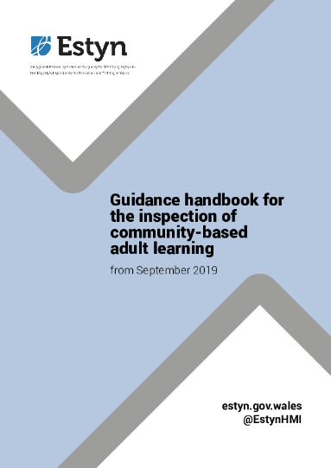


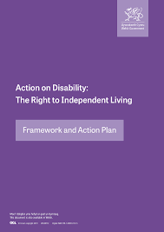





Adult learning policy Documents

Slide 16
Debate the statement:
Government policy Effectively enables adult learning.
Notes:
In pairs you have 45 minutes to research the statement.
One pair will be arguing for and one against, you will need to develop counter arguments so ensure you research both sides of the argument.
You will need to include specific legislation and policy guidance to support your arguments.
The debate will be structured –
Opening statements – 5 minutes each
Counter statements – 5 minutes each
Q&A – 15 minutes each

Slide 17
Adult learning In Practice

Slide 18
Task
In pairs research the following:
  Definitions of
    Community based learning
    Employer Led Training
    Further and Higher Education
  Specific examples of these adult learning programs
  The benefits and disadvantages of each type
Consider how does each type of provision remove barriers to participation.

Slide 19
Objectives
Are you able to;
  Discuss the key barriers and enablers to adult education
  Recall Key policy documents from England and Wales relating to adult education
  Evaluate key adult learning practices

Slide 20

Questions?

