Slide 1
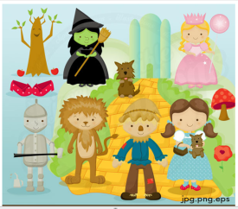
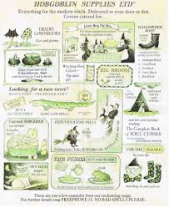
Developing Children’s Non-Fiction Writing
ECAD5004
Notes:
Warm-up activity:

Slide 2
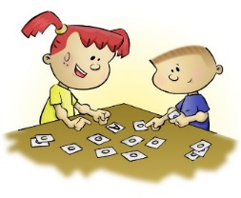
Warm-up activities
Warming up the word games work on the same principle as the practise that musicians or sports people put in daily in order to play at their peak
expanding an idea. This is one of the key skills of a writer. To take the seed of an idea and to expand it. So often children find this challenging and write what is basically a list of events with a few details added in. These games help children to build upon an idea.
developing vocabulary – usually tapping into dormant vocabulary. We use only a small proportion of the words that we know daily. In order to tap into the words that children know but don’t use we need games that help them to do this.
usual words in unusual combinations. Great writing is not about the most unusual, biggest words being used but putting usual words together in unusual combinations. These games help children to combine words in different ways.
developing imagination and imaging. It is frequently said that if children haven’t had any experience of something that they can’t write about it. Although children do need first-hand experiences, they also need to learn how to imagine how something might be drawing on what they do know. It also helps if they can see images in their head and describe these.
Notes:
Student to try out some games

Slide 3
Aims of the session
 | Aim | Link to QTS
1 | For you to become familiar with the programme of study for writing at FP & KS2; | 2.1, 2.2, 2.3
2 | For you to develop an understanding of the importance of stories in children’s development; | 2.4
3 | For you to think about how you can use oracy and reading to develop students writing skills. | 3.3.2, 3.3.3 & 3.3.4

Slide 4
What do you think of this statement?
Oracy
Writing
Reading
“Shared reading is an essential step in the effective teaching of writing. In the course of reading a shared text with a class, you can, as well as focusing on teaching them how to read this text, also teach a deal about how the text is structured. A highly developed familiarity with the structure of a text is necessary if children are subsequently to write texts like this themselves.”
Medwell et al.(2014)
Notes:
Elicit responses
State that I would take it even further and use known texts for all aspects of literacy teaching … then move quickly to the next slide to make the point

Slide 5

Children internalise…
Using stories in the classroom is important because storytelling …..
involves the learning and repeating of oral stories
basic plot structures
builds children’s confidence in storytelling
the building blocks of narrative (common characters, settings, events narrative patterning)
extends storytelling into writing
the flow of language/sentences
results in new stories being prepared and rehearsed prior to writing
the vocabulary – especially connectives e.g. so, next, but, then
Notes:
Talk through this slide and provide the following background information.
Story-making is based upon how children learn language – through imitation, innovation and invention of language.
It draws upon international research that universally highlights the importance of stories as the key mode in which the human mind thinks.
Stories are essential to cognitive development. They are not just a frivolity to end the day – they are central.
Research shows that are important because they develop:
composition/writing
comprehension
abstract, critical and logical thought
memory and concentration
a sense of belonging, confidence and motivation
the ability to learn information that is communicated in story form
language (listening, speaking, writing and reading)
More information…
Neuroscientists and psychologists agree that the mind actually uses story architecture to help us to understand the world.
Our brains operate as neural story maps, using story as a template to explain and cope with experience.
Story is the key method of internal processing used by the mind.

Slide 6


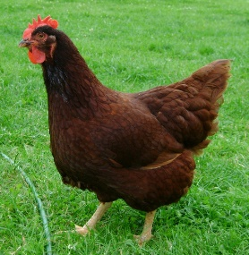
The teaching model
Imitate
This is the ability to retell so that the child has a bank of tales by heart…they have become part of the long term working memory, embedded into their linguistic competence
Innovate
This is the ability to adapt a well-known story in order to create a new story.
Invent
This is the ability to draw upon the full range of stories, and one’s life, to create something new.
https://www.youtube.com/watch?v=JdvJZD-cplg
imitate
innovate
invent
Notes:
We often start story writing with this model and it forms the basis of Talk4writing
But this model is how children initially develop language – give students time to think about this
SECURING SUBJECT MATTER – ensuring children become experts and enthusiasts in the topic
IMITATION - using a strong shared text as a model from which children internalize the key language features
INNOVATION –using the structure and language patterns of the model text for shared planning and writing in a new, but closely related, context,
INDEPENDENT APPLICATION – children independently writing that text type in literacy lessons and across the
curriculum

Slide 7
Smith’s influential view of writing
Writing is not one unified process. The act of writing can be divided into two distinct parts:
1. composition (the actual creation of a text);
and
2. transcription (the writing down of the text)
Frank Smith in Writing and the Writer (2013) formulated this distinction. He broke the writing process down into the different jobs which come under these two headings:
Smith, F. (2013). Writing and the writer. Routledge.
Writing
Writing accurately
Organizing ideas and information
Meaning, purposes, readers
Language
Handwriting Punctuation Grammar Spelling
Structure and organization

Slide 8
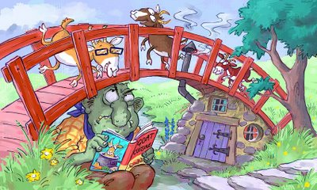
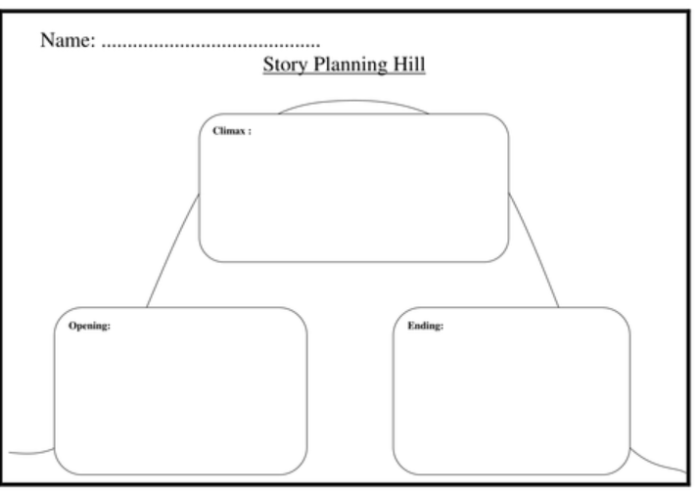
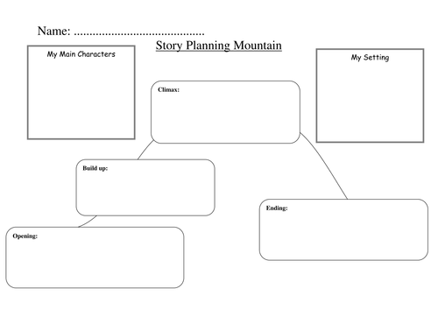

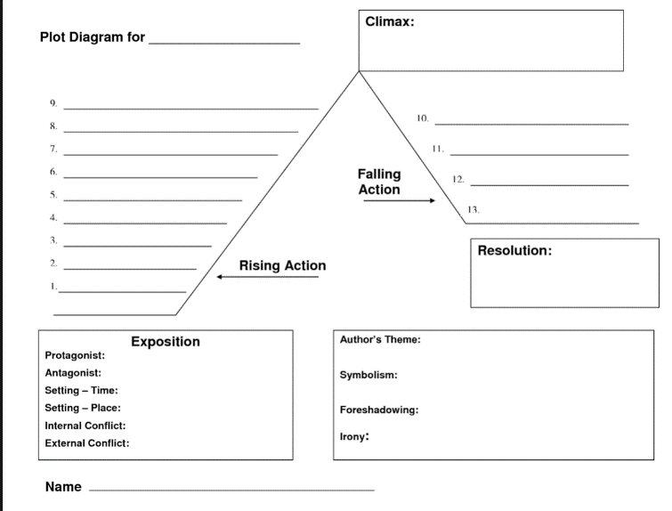
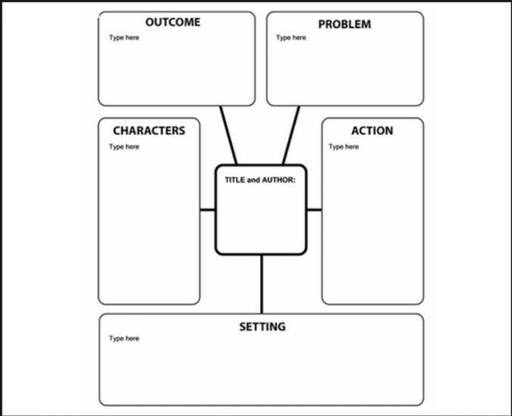
Planning a story
Notes:
Activity: Quiz
Opening / Climax / Resolution
Give an example of one part of a story, e.g., the girl runs away from the ball, and the group have to work out the story. Then they have to come up with 5 similar question of their own to ask the rest of the group.
Question: are these templates easy to use? Is it easy to break stories down into these parts?

Slide 9
The writing process
1
Plan
3
Revise
2
Draft
4
Edit
Notes:
Drafting can overcome the problem the children have in trying to compose and transcribe at the same time

Slide 10

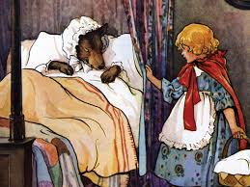
How could this work in the classroom?
Writing
Oracy
Story
Reading
Cross-curricular
links?
Notes:
Model how you would use “Little Red Riding Hood” over a week to teach literacy, include learning objectives
WHAT ABOUT CROSS_CURRICULAR LINKS???
Activity:
Each group to choose a fairy story and plan for a week using their imaginations and the curriculum documents.

Slide 11

When we write we consider…
Word Level
Range of vocabulary
WOW! Words
Spelling
Sentence Level
Accurate sentence structure
Complexity of sentence structure
Range of sentence structures
Text Level
Fiction or non-fiction
Features of text types and genres

Slide 12

Writing non-fiction texts
poster
?
commentary
interview
e-mail
questionnaire
notes
express opinion
information
speech
slogan
instructions
article
blog
argument
rules
letter
review
blurb
report
message
script
invitation
bulletin
diary
Notes:
Activity: make a list of as many forms of non-fiction writing as you can
Children should be encouraged to use the writing skills that they learn in Literacy lessons across the curriculum.
Any curriculum subject can offer opportunities to practise writing one of the text types .
What types of writing can we practise across the curriculum? Thematic work provides great opportunities for children to develop their understanding of the topic.
Children are also able to practise writing different text types in contexts that engage them.
They will also have lots of content fresh in their minds and reinforced by resources and displays.

Slide 13
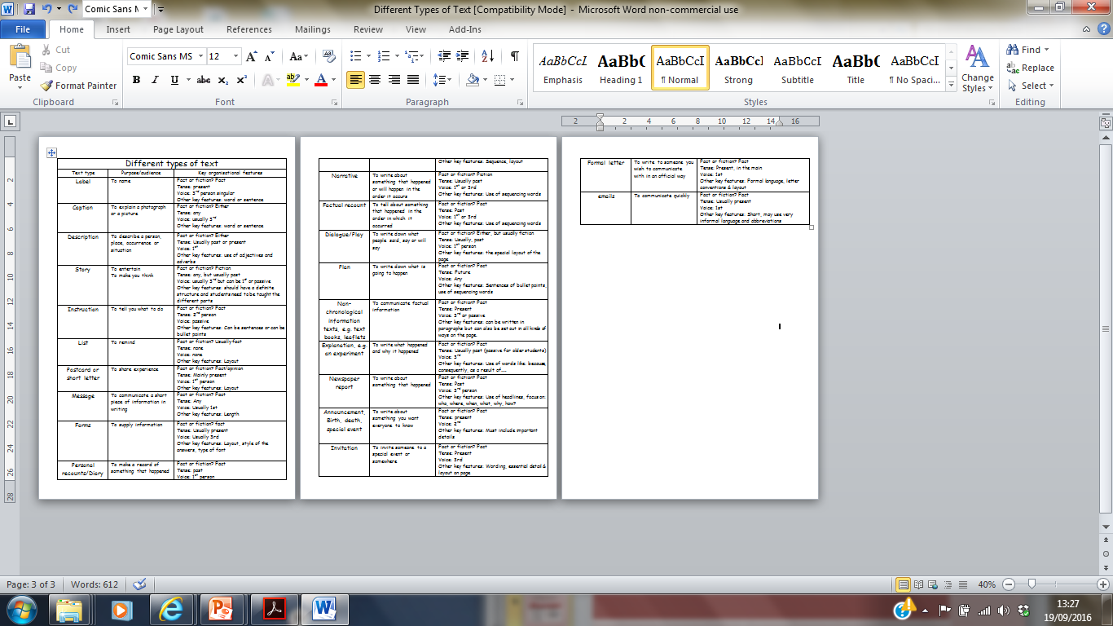

Key organizational features
Text organization refers to the way a text is laid out and the order in which the information is presented.
Most texts start with an introduction of some kind. However this will vary according to the text type.
Text Forms or Types
Text Structure
Text Organisation
Language Features
Purpose
The structure refers to the way ideas, feelings and information are linked within a text. Types of patters that are used to link and organize information include:
Compare and contrast
Problem and solution
Listing things logically or chronologically
Language features refers to the type of vocabulary and grammatical structures used in a text. Each text type or form has specific language features that are appropriate to that form
Children need to understand the purpose of what they are doing.:
They need to have something worth saying;
Decide that writing is the most important medium for saying it, and
Have an audience in mind for what is written.
Text Features.pptx
Different Types of Text.doc
Notes:
“What is the writing process like? We tend to focus on the ideas when we talk about this but the transfer of ideas via writing to other people is the main process”
Medwell et al. (2014)

Slide 14
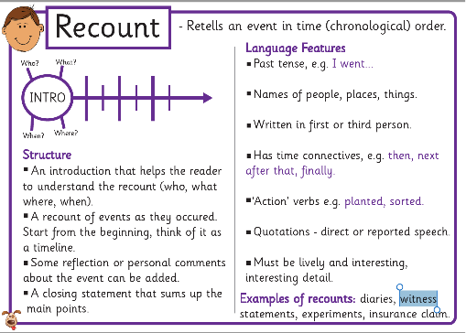
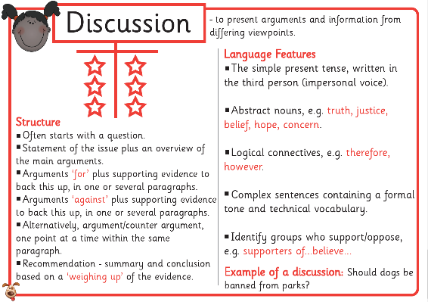
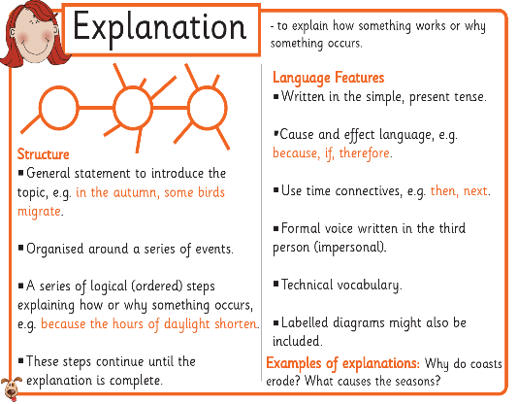
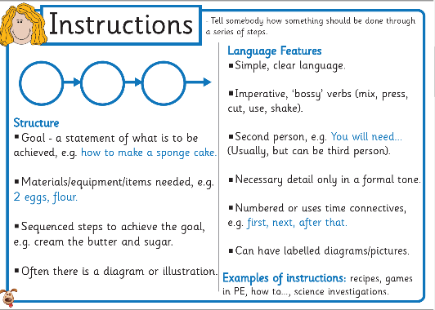
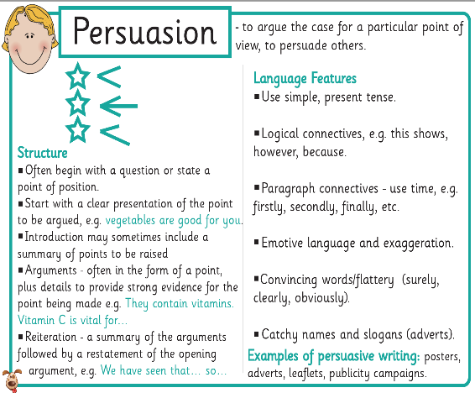
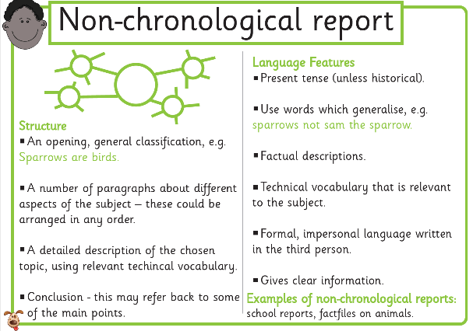
Useful resource
nonfictionmats.pdf
Notes:
Explain that this useful resource has been provided in the folder.

Slide 15
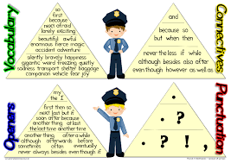
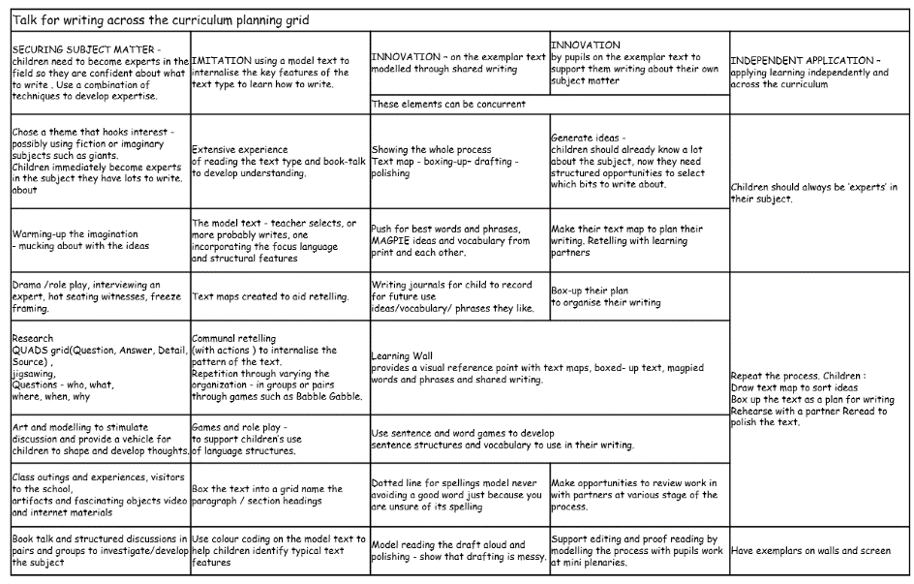
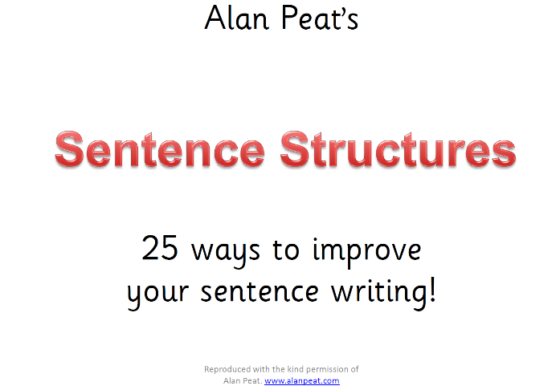
Other useful resources for you to look at
VCOP.pdf
Writing using 3Is.docx
Another version of Alan Peat's Ideas.pdf
handout

Slide 16
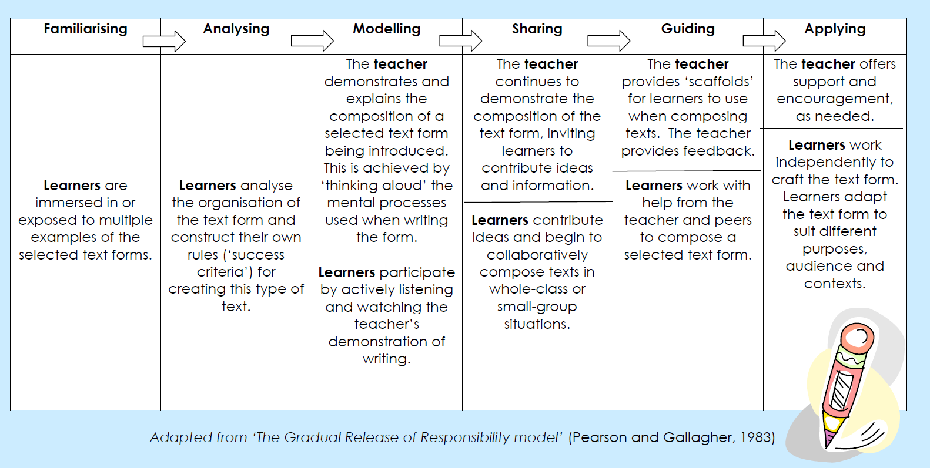
An alternative to the 3Is - Gradual Release Model
Notes:
Compare with the Pie Corbett handout from last week
This is actually easier to follor

Slide 17

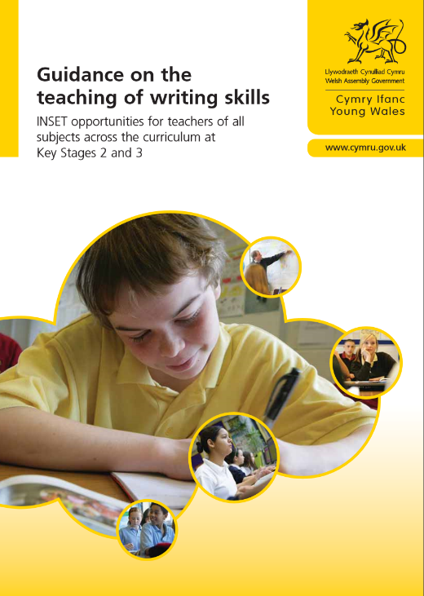
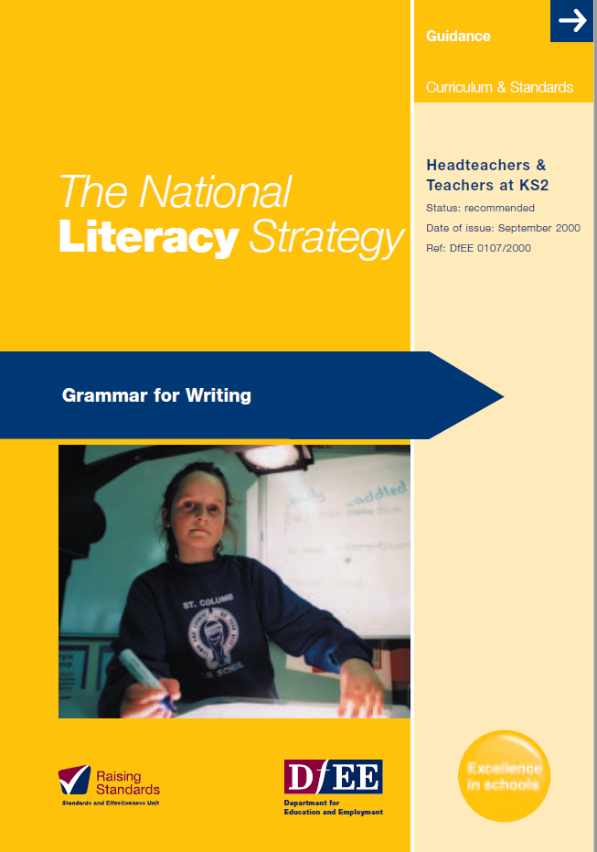
Directed study
Look at these 2 documents by our next lecture.
Guidance on the teaching of writing
NLS Grammar for Writing

Slide 18
References
DfES (2000) The National Literacy Strategy: Grammar for Writing London: DfES
Medwell, J.A., Wray, D. and Minns, H. (2014) Primary English: Teaching theory and practice. United Kingdom: SAGE Publications.
Pearson, P.D. & Gallagher, M.C. (1983) The Instruction of Reading Comprehension. University of Illinois at Urbana-Champaign.
Welsh Assembly Government (2008) English Guidance for Key Stages 2 and 3 Cardiff: Welsh Assembly Government
Welsh Government, (2015). Curriculum for Wales Programme of Study for English Key Stages. Cardiff: Welsh Government.
Welsh Assembly Government (2010) Guidance on the teaching of writing skills. Cardiff: Welsh Government.
www.longeaton.derbyshire.sch.uk/assets/Year_Teams/Sentence_Types.pdf Accessed 28.11.17

