Slide 1
BSc (Hons) Cloud Computing
Module Code : ACCA4023 - Introduction to Web and Database Concepts
Week 05: Front-End Development: Key Technologies and Concepts

Slide 2
Objectives
front-end development
HTML: the key front-end technology
CSS: Styling your façade
CSS frameworks

Slide 3
What is front-end development? Front end vs back end
The website’s front end is everything you see and can interact with using a browser. So, creating this visual part is called front-end development.
You could even say that designers creating user interfaces and planning experiences are also front-end developers, as they are working in collaboration on the same part of the project.

Slide 4
What is front-end development? Front end vs back end
To create the front end, engineers use the combination of HTML (for basic page structure and content), CSS (for visual editing), and JavaScript (for making websites interactive).
The same set of tools is used to create progressive web apps –mobile apps that look and feel like a native one but are created with the use of front-end technologies.

Slide 5
What is front-end development? Front end vs back end
On the other hand, the back end is everything that happens, well, backstage. It contains servers where your web pages are located and the underlying logic that governs the website’s functions and processes.
The back end is built using a different set of technologies, including Java, PHP, Ruby, C#, and sometimes JavaScript, which we’ll explain in a corresponding section.

Slide 6
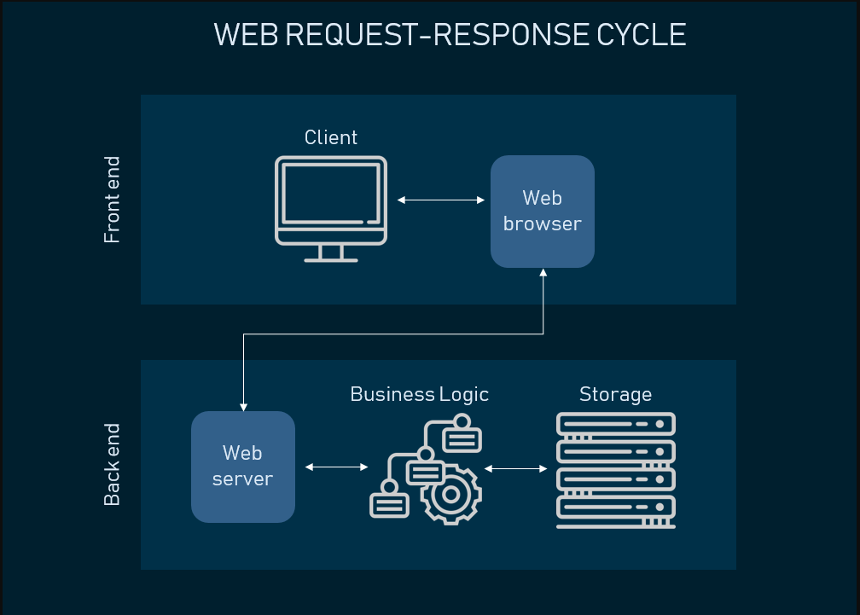
What is front-end development? Front end vs back end

Slide 7
What is front-end development? Front end vs back end
The basic toolset for a front-end is well-defined: HTML, CSS, and JavaScript. The frontend development technologies may be however extended with package managers, CSS preprocessors, frameworks, and many more.

Slide 8
What is front-end development? Front end vs back end
HTML: the key front-end technology
HTML (or Hypertext Markup Language) is a computer language designed to create websites that later can be explored by anybody who accesses the Internet.
HTML is normally employed to structure a web document. It defines such elements as headlines or paragraphs and enables embedding images, video, and other media.

Slide 9
What is front-end development? Front end vs back end
How HTML works
HTML is composed of a series of shortcodes called tags, normalized into a text-file by a site creator. The text is then stored as an HTML file and observed through a browser.
The browser scans the file and interprets the text into a visible form, and in the best case, renders the page as the designer had planned.

Slide 10
What is front-end development? Front end vs back end
HyperText is the way by which we travel across the web by clicking hyperlinks – specific texts taking you to other pages. Hyper means it’s non-linear, which allows for moving to any other place, as there is no predefined order to do so.
Markup determines the qualities that HTML tags apply to the text inside them. Tags mark it as a particular type of text.
As a Language, it holds code words and syntax like any other language.

Slide 11
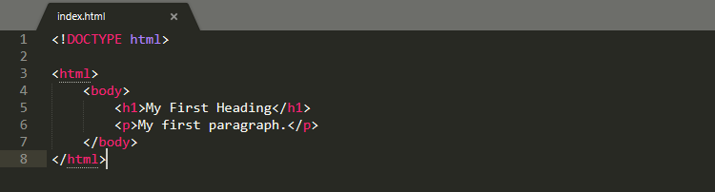
What is front-end development? Front end vs back end
HTML Tutorial: https://www.w3schools.com/html/default.asp

Slide 12
CSS: Styling your facade
CSS (or Cascading Style Sheets) is a style sheet language. It’s applied to define how HTML elements are supposed to be presented on a webpage in terms of design, layout, and variations for diverse devices with different screen sizes.
CSS masters the layout of numerous different web pages at a time.

Slide 13
CSS: Styling your facade
How it works. CSS interacts with HTML elements, the components of a web page.
To communicate with HTML, CSS uses selectors. A selector is the part of CSS code defining which HTML piece the CSS styling will impact.
A declaration contains properties and values that are employed by the selector.
Properties define font size, color, and margins. Values are the settings for these properties.

Slide 14
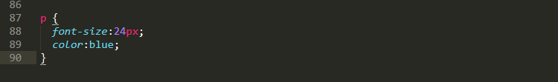
CSS: Styling your facade
P (for paragraph) is selector, { font-size:24px; color:blue; } is a declaration, font-size: and color: are properties, while 24px; and blue; are values.
CSS is written in plain text over a text editor or word processor on a computer. If you were to examine how the CSS code is implemented to HTML content, there are three ways to do so:

Slide 15
CSS: Styling your facade
External style sheets are stored as .css files and can be applied to define the appearance of a whole website via a single file, instead of putting extra instances of CSS code to every HTML element which has to be modified. To use an external style sheet,. html files need to contain a header section that connects to the external style sheet.
Internal style sheets are CSS directions put straight into the header of a particular .html page.
Inline styles are snippets of CSS recorded into HTML code itself.
CSS Tutorials : https://www.w3schools.com/css/default.asp

Slide 16
CSS: Styling your facade
CSS frameworks. A CSS framework is a set of default CSS and HTML files. It extends a front-end developer’s capabilities for website design.
In addition to assisting while building a responsive design, CSS frameworks also present distinct and symmetric layouts, saving developers from writing code from ground zero at every occasion.
They are usually considered a good choice to fit diverse platforms and screen sizes. With common user interface components, grid systems, layouts, and many other features, CSS frameworks considerably accelerate development workflow.

Slide 17
CSS: Styling your facade
Many frameworks exist in the CSS Universe:
Full featured (Bootstrap, Foundation, Semantic UI, and more),
Aimed at Material Design: (Materialize and Material Design Lite), and
Lightweight (Pure).

Slide 18
JavaScript: making the Web alive
JavaScript (JS) is one of the most popular scripting languages. It’s mostly renowned for providing a full stack of technologies for both front-end and back-end development.
As we are talking about the first one, it’s applied to make web pages dynamic.

Slide 19
Main frameworks and libraries to know
Angular is a front-end framework powered by Google that is compatible with most of the common code editors.
Angular is intended to create dynamic, single-page web applications (SPAs), and progressive web-apps. Upon its initial release, the framework was most appreciated for its ability to convert HTML-based documents into dynamic content.
Angular is among the most popular front-end frameworks.

Slide 20
Main frameworks and libraries to know
Vue.js is yet another open-source framework for SPAs. It employs a component-based development model and enables attaching components to a project.
Vue.js is an example of a library that is more of a framework. To utilize Vue.js, knowledge of HTML and CSS is an absolute requirement.

Slide 21
Main frameworks and libraries to know
Ember.js is a framework for SPAs, mobile, and desktop applications. It uses the model-view-view-model (MVVM) pattern.
Ember tools enable designing a development environment, while its command-line interface gives tools for script automation.
Activity: Difference between angular.js, vue.js and ember.js

Slide 22
Main frameworks and libraries to know
JavaScript for the back end
Speaking of JavaScript as an end-to-end development environment, we must mention its back-end implementation.
Since JavaScript is so popular, the software engineering world adapted JS to back-end specifics.
For web server-side development with JavaScript, Node.js has probably become one of the most prominent tools.

Slide 23
Questions & Answers
Reference :
https://www.altexsoft.com/blog/front-end-development-technologies-concepts/
https://www.w3schools.com/css/default.asp
https://www.w3schools.com/html/default.asp

