Slide 1

Revision
Putting it all together.

Slide 2
Blood can you answer the following?
What are erythrocytes ?
What are lymphocytes?

Slide 3
Can you answer the following ?
What is the primary function of blood?
How much blood is in the human body?
What is plasma and what percentage of it is in the blood?

Slide 4
Blood
The average human has 5 litres of blood
It is a transporting fluid
It carries vital substances to all parts of the body

Slide 5
Plasma
Liquid portion of blood
55 % of the blood is plasma
90-92 % water and a range of dissolves substances such as enzymes, hormones, gases, plasma proteins, waste products. All of which have a vital part to pay in maintaining the internal environment or homeostasis.

Slide 6
Questions
Where are plasma proteins formed?
What is the function of Albumin, Fibrinogen and prothrombin and globulins?

Slide 7
Plasma proteins are formed in the liver.
Three types
Function
Albumin
Fibrinogen and prothrombin
Globulins
Increasing osmatic pressure drawing fluid back into the capillaries.
Involved in blood clotting.
Formed in liver or lymph tissue responsible for immunity and fighting infection.
Notes:
Fibrinogen ( factor 1) - is a glycoprotein made in the liver. During tissue injury such as a cut it is converted by thrombin to fibrin and then to a fibrin based blood clot. This is what stops you from bleeding after cutting yourself.

Slide 8
What are the following?
Erythrocytes
Lymphocytes
Thrombocytes

Slide 9
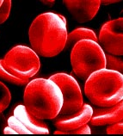
Erythrocytes (Red blood cells)
1) biconcave shape
2) no nucleus
→ extra space inside made in red bone marrow
3) contain haemoglobin
→ the oxygen carrying molecule
→ 250million molecules / cell most abundant
increases the surface area so more oxygen can be carried
Notes:
Erythrocytes are the most abundant blood cells. They are formed in the red bone marrow in the Centre of bones. The biconcave shape increase the surface area, thus allowing for greater absorption of gases such as oxygen and carbon dioxide ( CO2) . Red blood cells contain the pigment haemoglobin this transports oxygen and Carbon dioxide to all the cells of the body. Haemoglobin consists of globlin a protein and complex called haem oxygen attaches itself to the haem portion of the red blood cell. Red blood cells have a limited life of about 120 days after which they are broken down and recycled. If oxygen levels become low due to anaemia, blood loss the body needs to respond to this loss and makes new blood cells Erthropoiesis formation of red blood cells is stimulated. Low oxygen stimulates the production of erythropoietin (EPO) from the kidneys this stimulates the red bone marrow to produce more erythrocytes or red blood cells thus increasing the amount of oxygen in the blood. It is essential that the body has sufficient iron, B12 and folic acid in order to produce red blood cells,

Slide 10
How to remember?
Never – Neutrophils most prevalent so bacterial infections first responders!
Let – Lymphocytes B and T cells produce antibodies
Monkeys – Monocytes- remember munch ) phagocytosis eat the bacteria
Eat – Eosinophils- parasites and allergic responses inflammatory.
Bananas – Basophils Allergic and antigen response release histamine.

Slide 11
Erythropoiesis
Kidneys detect hypoxia
Erythropoietin released by kidneys into the blood.
Bone marrow increase erythropoiesis
Increases amount of erythrocytes in blood with capacity to carry O2
Reduction in tissue hypoxia due to increased
Notes:
Hypoxia is when your are suffering from low levels of oxygen

Slide 12
Can you answer the following?
What are arteries
What are veins

Slide 13
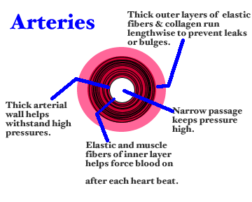
Arteries
Carry blood away from the heart at high pressure.
Arteries require elastic walls to cope with the pressure caused when the ventricles contract and muscle to provide a further contraction to help move the blood. The muscles also help dilate (open) the artery to increase blood flow.

Slide 14
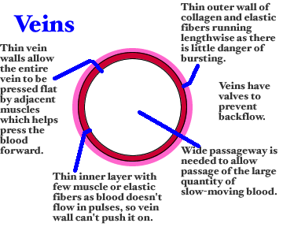
Veins
Provide the tubing to take blood back to the heart.
Veins have a thinner wall because they do not have to deal with constant changes in blood pressure with heart contractions, and the blood moves more slowly through them.
They contain valves, which help to prevent blood flowing in the wrong direction. This is needed especially in veins that are bringing blood up-wards against gravity

Slide 15

What is the flow of blood through the arteries on leaving the heart

Slide 16
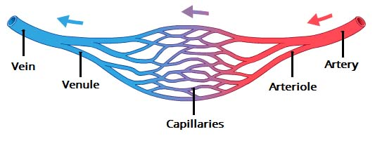
Venules
venules are minute vessels that drain blood from capillaries into veins.
Many venules unite to form a vein.
Drains blood from capillaries into veins, for return to the heart.

Slide 17
Can you answer the following?
What are DVT’s
What increases risks of DVT
How can we prevent DVT

Slide 18
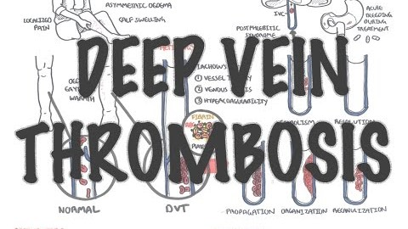
DVT

Slide 19
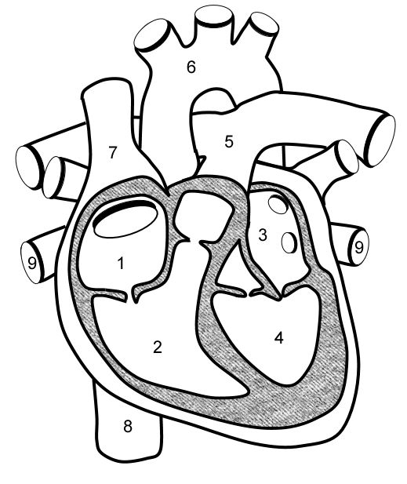
Can you label the following

Slide 20
Can you answer the following?
What is blood pressure
What is the systolic
What is the diastolic
What is hypertension
What is hypotension
What is the pace maker of the heart called
What is mean arterial pressure
What is blood pressure determined by
What factors affect venous return.

Slide 21
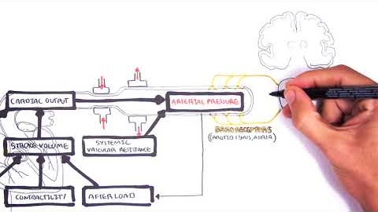
Factors which influence blood pressure
Cardiac output (CO)
Total Peripheral Resistance (TPR)
Or BP = CO x TPR
Notes:
Factors affecting peripheral resistance
The length of the vessel the blood
The diameter of the lumen of the vessel
The viscosity of the blood

Slide 22
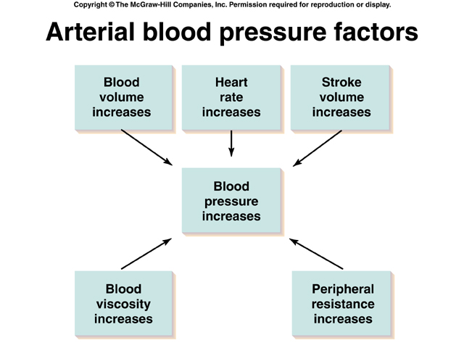

Slide 23
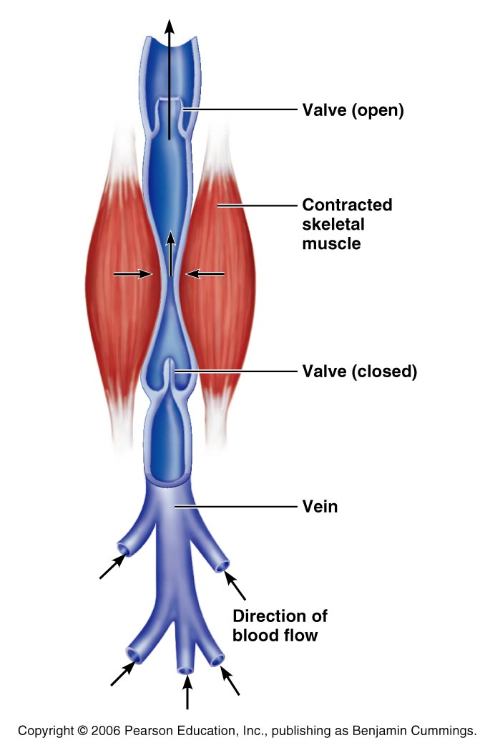
Factors Aiding Venous Return
Venous blood pressure alone is too low to promote adequate blood return and is aided by the:
  Respiratory “pump” – pressure
  changes created during breathing suck blood toward the heart by
  squeezing local veins
  Muscular “pump” – contraction
  of skeletal muscles moves blood
  toward heart
  Valves prevent backflow during venous return
Notes:
More information or for more visual learners
https://www.youtube.com/watch?v=i6mIBpHs-aE respiratory pump
https://www.youtube.com/watch?v=FKJr5uqPv5s

Slide 24
Can you answer the following?
What are the consequences of a high blood pressure
What are the consequences of a low blood pressure
What are the modifiable causes of high blood pressure
What are the non modifiable causes of high blood pressure
What is the rennin aldosterone system
What readings are associated with high blood pressure and low blood pressure

Slide 25
An adult’s blood pressure is considered high when the readings are greater than 140 mm Hg systolic or 90 mm Hg diastolic (BHS, 2004)
Non-modifiable Risk Factors:
Age
male sex
family history
Primary cause of raised cholesterol (genetic)
diabetes mellitus (autoimmune)
Modifiable Risk Factors
Excess alcohol (43 units/day)
Excess salt intake
Lack of exercise
Environmental stress
smoking
Overweight (obesity)
Type II -Diabetes
(Type II can often coexists with obesity, dyslipidaemia, hypertension)
Notes:
Modifiable means you can change it non modifiable means you can’t change it.
For more information please watch the following
https://www.youtube.com/watch?v=RrXJsf9x_sY

Slide 26
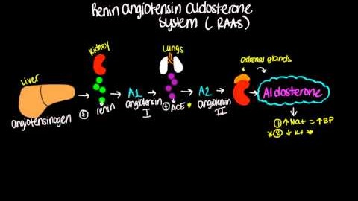
Renin aldosterone system

Slide 27
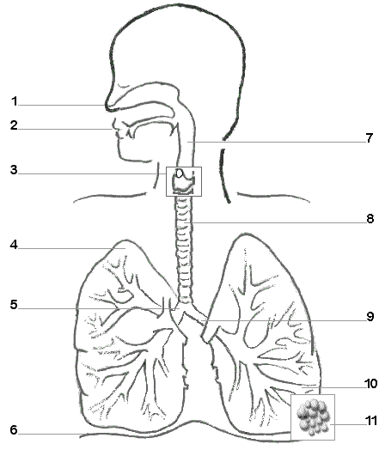
Can you label the following?

Slide 28
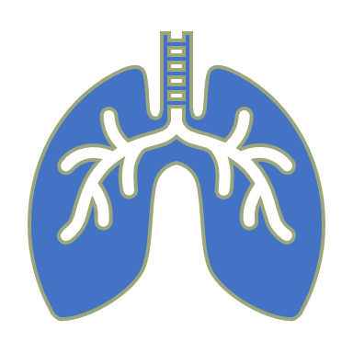
How do we breath in and out?
What is the formula for cellular respiration
Where does the exchange of oxygen and Carbon dioxide take place ?

Slide 29
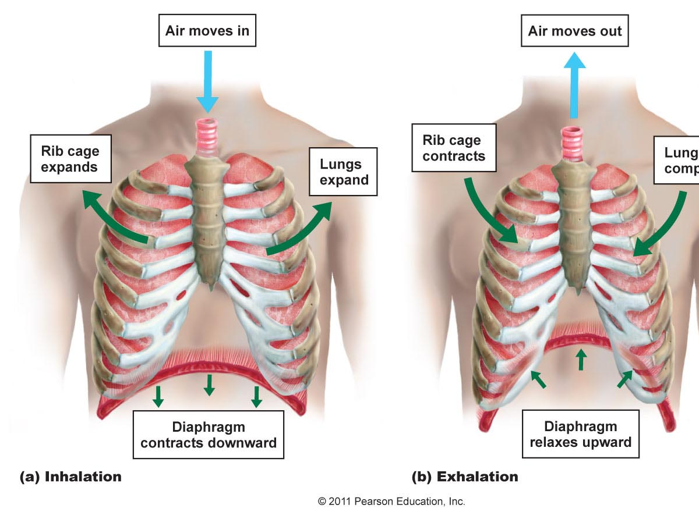
Moving air in and out
During inspiration (inhalation), the diaphragm and intercostal muscles contract.
During exhalation, these muscles relax. The diaphragm domes upwards.

Slide 30
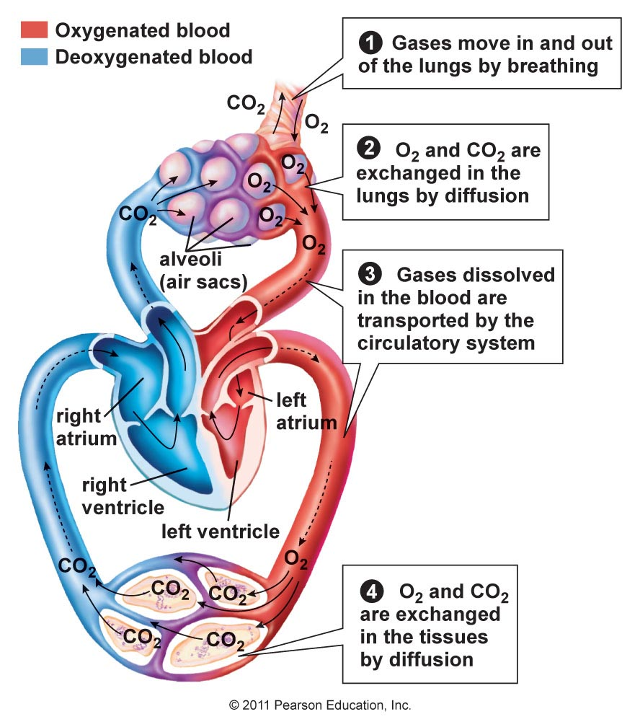
Circulation and Gas Exchange
Recall the interconnection between circulation and the respiratory system.
Gas exchange at the lungs and in the body cells moves oxygen into cells and carbon dioxide out.

Slide 31
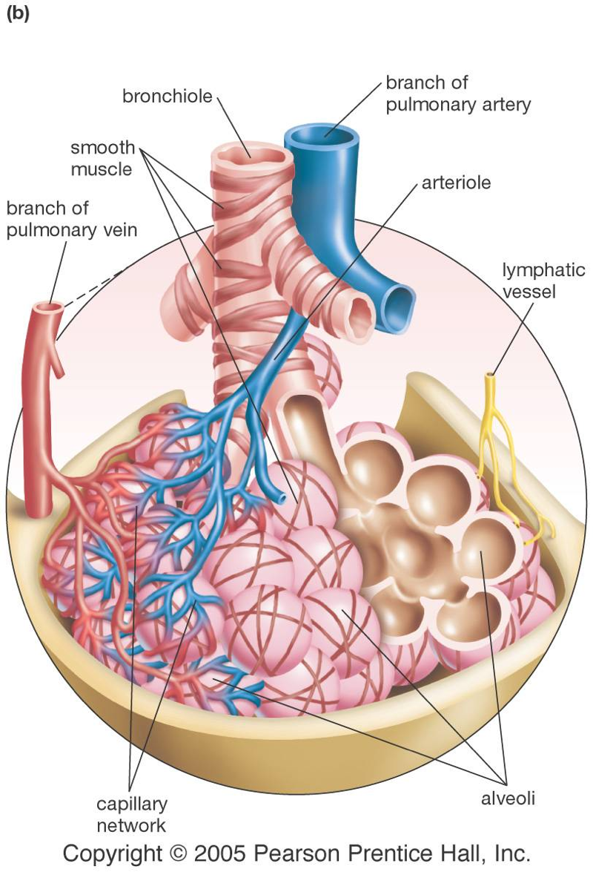
Alveoli
The alveoli are moist, thin-walled pockets which are the site of gas exchange.
A slightly oily surfactant prevents the alveolar walls from collapsing and sticking together.

Slide 32
Formula for cellular respiration
Oxygen + Glucose = CO2 + H20 + ATP

Slide 33
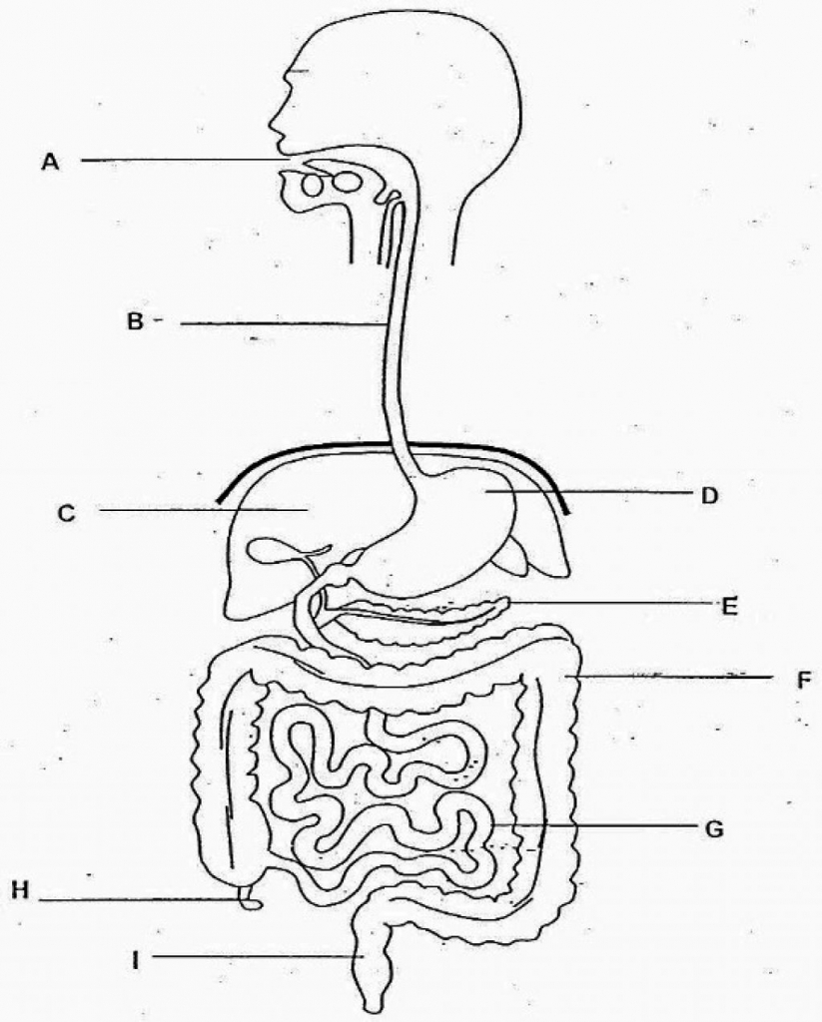
Digestion can you label the diagram?

Slide 34
What are the following
Egestion
Digestion
Ingestion
Absorption

Slide 35
Processing food
Ingestion- process of taking food into the digestive system so that it may be hydrolised or digested.
Digestion- the breakdown of food (either chemically or mechanically) in order to utilise nutrients
Absorption- nutrients pass from the guts to the blood stream
Egestion- elimination of indigested food

Slide 36
What happens where
Mouth
Epiglottis
Stomach
Small intestines
Large intestines

Slide 37
What are the functions of the following?
Bile
Liver
Protease
Lipase
Amylase

Slide 38
Can you answer the following?
What are the accessory organs and what is their function?
What are villi and what are their function ?
What is peristalsis ?

Slide 39
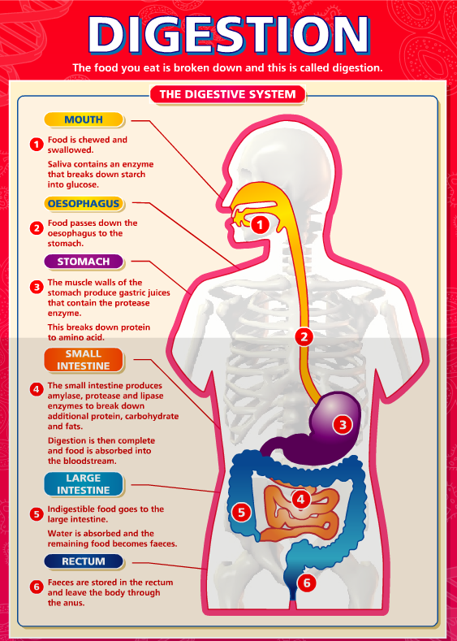

Slide 40
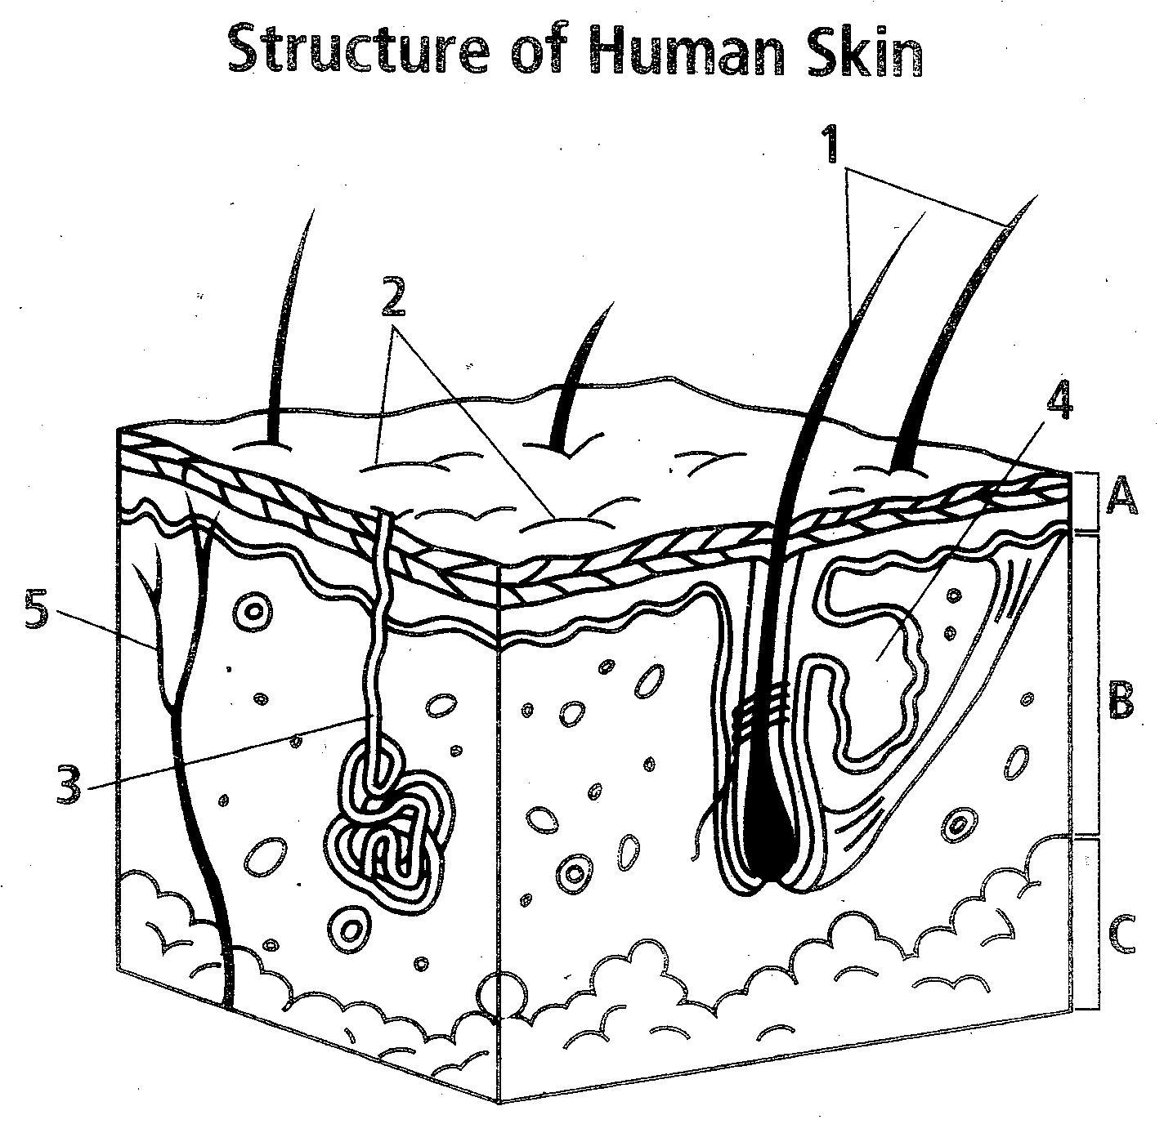
Can you label this?

Slide 41
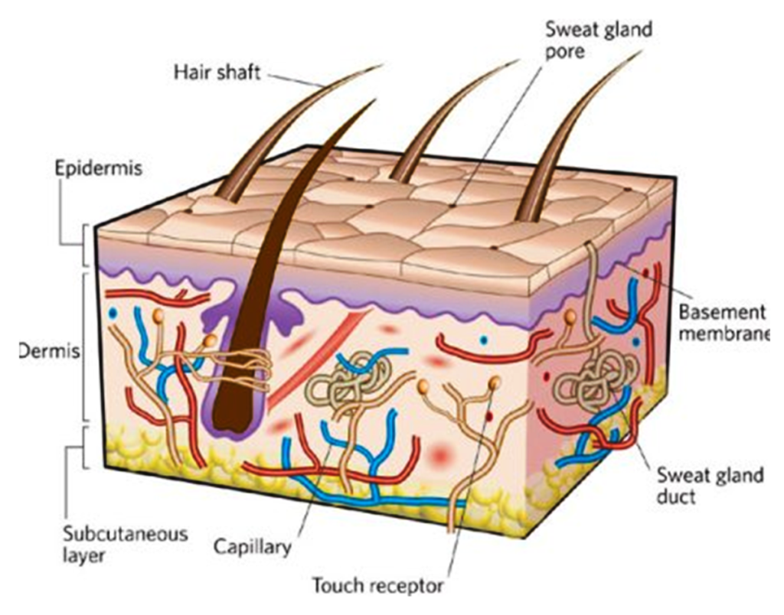
Skin cross section.

Slide 42
Can you answer the following.
What are the functions of the skin?
What is thermoregulation?
Can you describe thermoregulation?

Slide 43
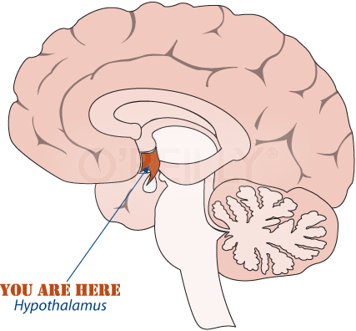
The thermoregulatory centre in the hypothalamus senses the temperature of the blood flowing through the hypothalamus
The hypothalamus also receives information via sensory neurones from heat receptors in the skin
If the core body temperature starts to rise the hypothalamus triggers responses which increase heat losses
Hypothalamus
If the core body temperature starts to fall the hypothalamus triggers responses which either reduce heat losses OR generate more heat

Slide 44
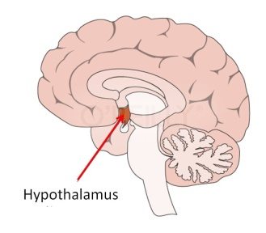
Change detected by hypothalamus
Vasodilation
Sweating
Triggers responses
Blood Temperature Rises
Temperature falls again
Normal Body Temperature 37˚C
Blood Temperature Falls
Temperature rises again
Triggers responses
Change detected by hypothalamus
Vasoconstriction
Goosebumps
Shivering

Slide 45
Can you answer the following?
How does skin heal?
What is proliferation?
What is hemostasis ?
What are phagocytes?

Slide 46
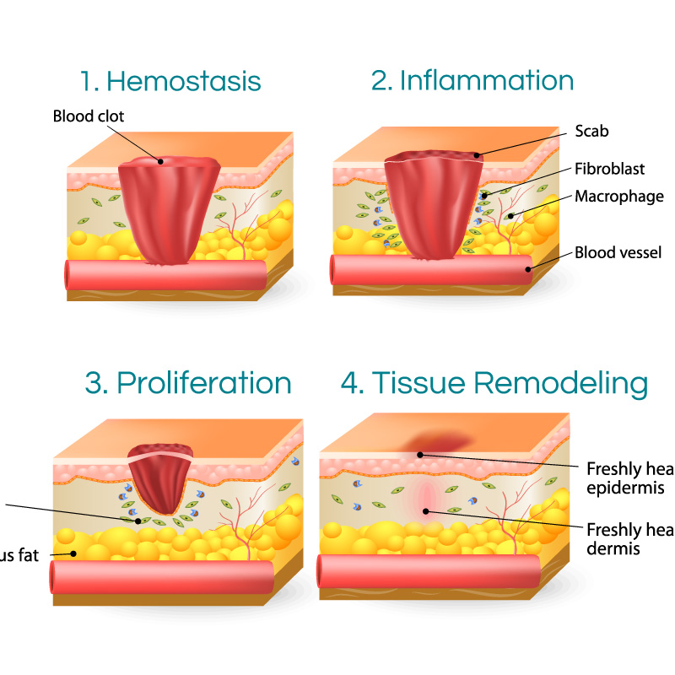
How the skin heals

Slide 47
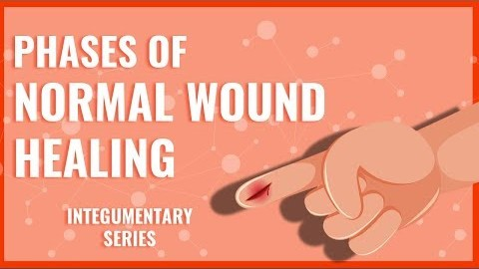

Slide 48
Lymphatic system.
Lymph - a fluid that contains white blood cells that defend against germs
Lymph vessels - vessels that carry lymph throughout your body. They are different from blood vessels.
Lymph nodes - glands found throughout the lymph vessels. Along with your spleen, these nodes are where white blood cells fight infection.

Slide 49
Functions of the lymphatic system
Protects body against foreign material
Assists in circulation of body fluids between cells and bloodstream
Transports dietary fats

Slide 50
Consists of;
Lymph
Network of vessels
Lymph nodes and nodules
Tonsils
Spleen
Thymus gland
Bone marrow

Slide 51
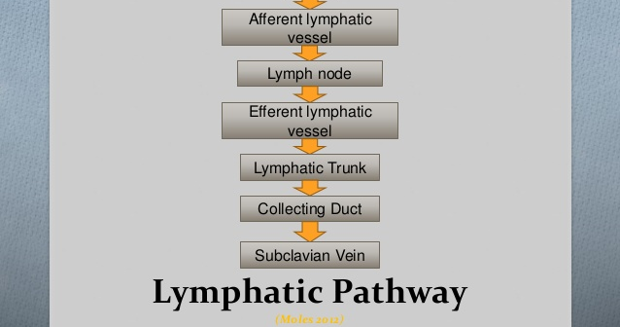

Slide 52
Lymph a clear fluid
Derived from tissue fluid
Contains more white blood cells than plasma
Enters node through afferent lymphatic vessels
Flows through node in one direction

Slide 53
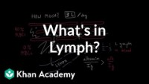
Lymph

Slide 54
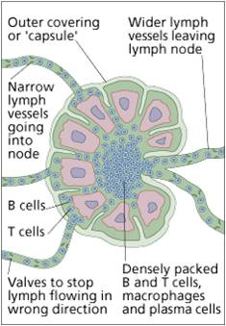

Slide 55
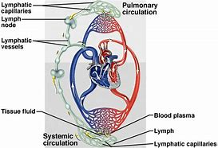

Slide 56
Lymph Capillaries
Microscopic closed-ended vessels
Located next to blood capillaries in tissue spaces
Larger diameter than blood capillaries
Are very permeable and collect tissue fluid and proteins
Lymph capillaries merge to form larger lymph vessels

Slide 57
Lymph Vessels
Resemble veins but have thinner walls and more valves
Ends of endothelial cells overlap - Act as one-way valves allowing interstitial fluid to flow in but not out
Attached to surrounding tissue by anchoring filaments

Slide 58
Lymph vessels
No pump for lymph
Lymph is kept moving by: - Constriction of vessels - Skeletal muscle pump - Respiratory pump
At intervals along vessels lymph flows into lymph nodes
Lymphatic vessels unite to form lymph trunks

Slide 59
Lymph Trunks
formed by lymphatic vessels uniting
large tubes
Empty their lymph into lymphatic ducts

Slide 60
Lymphatic ducts
Lymph empties into two conducting ducts:
the thoracic duct (left lymphatic duct) - the right lymphatic duct
Lymph from these ducts enters the blood stream via the left subclavian vein and the right subclavian vein

Slide 61
Lymph nodes
Oval or bean-shaped
Masses of lymphatic tissue
Aid in defense and white blood cell formation
Located along length of lymphatic vessels
Scattered throughout the body usually in clusters

Slide 62
Two main regions of a lymph node: Cortex and Medulla
Cortex -outer region directly beneath the capsule
Contains densely packed lymphocytes arranged in masses called follicles - outer rim of follicle contains T cells, macrophages, and follicular dendritic cells (aid in T cell activation).
Medulla-Inner region • lymphocytes are arranged in strands called medullary cords - contain macrophages and plasma cells.

Slide 63
BIOLOGICAL FILTRATION
As lymph passes through a node bacteria and other foreign materials are trapped by reticular fibers within the node - bacteria are then phagocytized by macrophages.
plasma cells produce antibodies to antigens in the lymph • antibodies, lymphocytes, and monocytes are eventually returned to the blood via subclavian veins

Slide 64
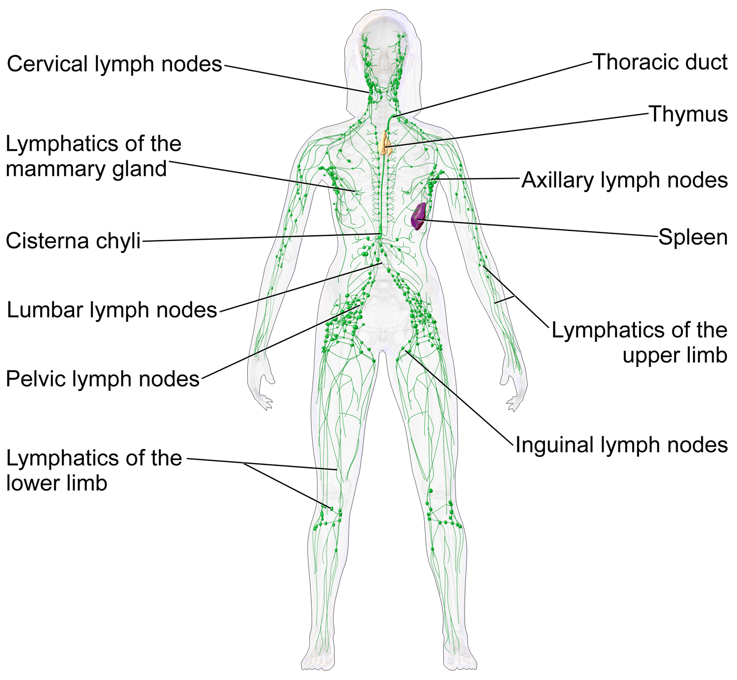

Slide 65
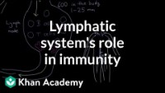
Lymphatic system role in immunity

Slide 66
Lymph Organs
As well as the Lymph Nodes, there are specific organs that are part of the lymphatic system
Thymus
Spleen
Tonsils

Slide 67
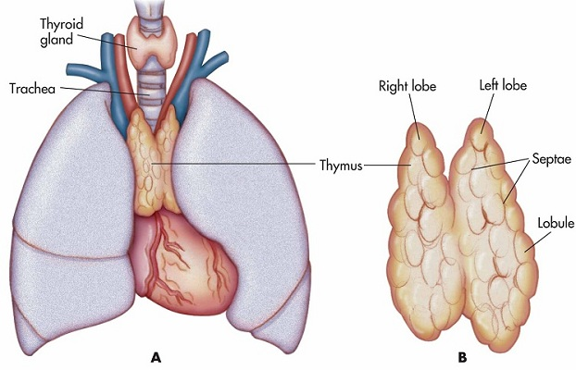
Thymus
In the neck . Produces T-lymphocytes for the immune system. The human thymus becomes much smaller at the approach of puberty.
You make most of your T Cells in childhood.

Slide 68
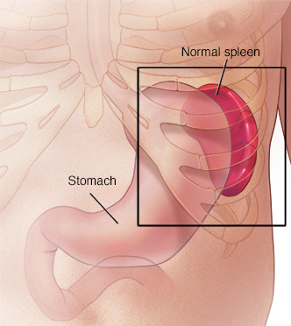
Spleen
A life-threatening condition that results when you lose more than 20 percent (one-fifth) of your body's blood or fluid supply
Found behind the stomach
Largest lymphatic organ in the body
Similar in structure to a large lymph node, it acts primarily as a blood filter.
The spleen plays important roles in regard to red blood cells and the immune system. It removes old red blood cells and holds a reserve of blood, which can be valuable in case of haemorrhagic shock, and also recycles iron.

Slide 69
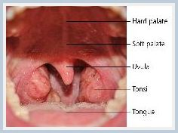
Tonsils
Most people have five tonsils. These include a single pharyngeal tonsil, often referred to as the adenoid, located in the posterior wall of the upper part of the throat. A pair of palatine tonsils is found at the back of the mouth; a pair of lingual tonsils is located at the base of the tongue.
The tonsils combat bacteria and viruses that enter your body through your mouth. However, tonsils are also vulnerable to infection from these invaders.

Slide 70


