Slide 1

Change and Stability
Management
mergers and acquisitions

Slide 2
Last time we…
Examined the different roles played by leaders in the change management process
Explored the skills and qualities required by leaders of change to ensure success
Understood the need for leaders to be proactive in the change process
Identified how leader of change can adapt their style and focus to different phases of the change process
Identified the range of choices facing leaders and their organisations when considering change

Slide 3
What is the difference between Change Leadership and Change Management
Change Management vs. Change Leadership — What's the Difference? - YouTube

Slide 4

Today’s Objectives
To examine the reasons for restructuring and the process involved
To examine BPR and lean techniques
To assess how teams can best address organisational change
To examine the purpose of merger and acquisition activity
To review the research into successful/unsuccessful M&As
To apply change theory to M&As with a focus on guidelines for leaders
To consider the impact of the above on your case study
To review the assignments key objectives

Slide 5

Restructuring
We trained hard. But is seemed that every time we were beginning to form into teams, we would be reorganised. I was to learn later in life that we tend to meet any new situation by reorganising. And what a wonderful method it can be for creating the illusion of progress while producing confusion, inefficiency, and demoralisation.
Gaius Petronius, Arbiter, The Satyricon, 1 A.D

Slide 6


Slide 7
Activity
Identify an organisation in the news currently undergoing corporate restructuring
What are the reasons for this?

Slide 8
Should we be discussing restructuring as a theme for change at all?
Or be examining the reasons behind the change instead?
Is it the solution to organisational issues?
It impacts on many people’s lives, so often
What are the dynamics involved?
What can go wrong?
What does a ‘good’ process of restructuring look like?

Slide 9
Or
Should it be the last option to be considered by management rather than the first?
Does it really address the organisational issues it seeks to resolve?
Are there any other tools available?

Slide 10
Reasons for Restructuring
• Downsizing or rightsizing • Internal market realignment
• Rationalisation or cost-cutting • Cultural change
• Change of senior manager • Efficiency or effectiveness
• Decentralisation or centralisation • Flatten the hierarchy
• Change in strategy • Crisis – internal or external
• Change of senior manager • Merger or acquisition
• New product or service……..

Slide 11
Restructuring should only take place……
Due to a change in strategy
Clear rationale
Occur in conjunction with other changes such as process change and culture change
Cameron & Green (2015)

Slide 12
Possible other reasons in reality
• New boss
• Process/product failure
• An argument
• Dissatisfied customer
• Underperforming person/department

Slide 13
The Machine Metaphor
• One line manager per employee.
• Division of labour into specific roles.
• Each individual should have key objectives.
Team is simply the sum of the individual’s efforts.
• Managers should monitor, control, report, maintain and discipline their people.
• Those running the organisation, such as senior management, can change it at will.
• Change can be designed, planned – and will work if well executed and controlled.
• There will be resistance and this needs to be managed – changes need to be driven through the organisation.

Slide 15

Types of combination
Mergers
Acquisitions
Joint ventures
Strategic alliances
In terms of “relatedness” combinations can be:
➢Horizontal
➢Vertical
➢Concentric
➢Conglomerate

Slide 16
Integration for economic gain
Horizontal integration
• Acquire a competitor – why?
• Public sector – cost savings / partnerships
Vertical integration:
• Dependable supply
• Lower costs
• Improved competitive position

Slide 17

Why Restructure?
M&S boss: 'We must do better' - YouTube
2019 01 10 JLR JOB LOSSES, CHRISTMAS RETAIL
M&S, TESCO, DEBENHAMS, JOHN LEWIS RESULTS – YouTube
Why Companies Restructure and What They Should Be Doing – YouTube
Tata Steel puts its UK arm up for sale - YouTube

Slide 18

Merger
Why merge?

Slide 19

Growth
• Quick way of growing
• Avoids pain of internally generated growth BUT There are risks and challenges -can management run a larger company

Slide 20
Synergy
• More successful together than apart
• Growth in revenues/ new or better products
• Cost reductions via economies of scale
• Cheaper finance
• Better governance
• Better management?
More profits? Success

Slide 21
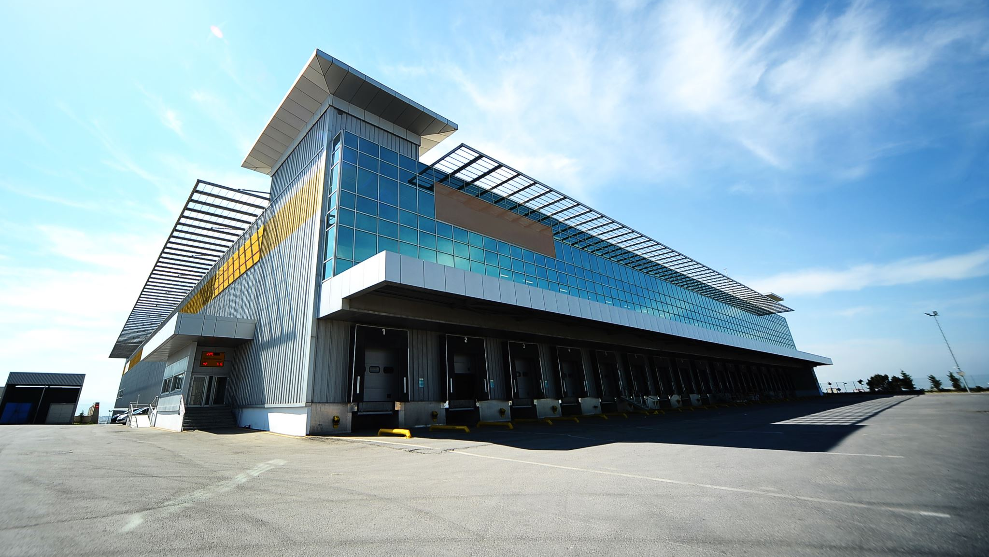
Diversification
Growing business outside the traditional industry/sector
Develop a portfolio of products
Examples?

Slide 22
Successful and failed Mergers
Successful
Exon and Mobil
Failed
AOL and TimeWarner

Slide 23

Acquisition success depends on strategic fit & organisation fit

Slide 24

The Acquisition Process
1. Reacquisition and Planning
Acquisition Objectives – Acquisition Overview – Acquisition Blueprint (Implementation Plan)
2. Communication
3. Acquisition Implementation
4. Stabilisation Monitoring
Based on Hubbard (1999)

Slide 25
Acquisition objectives & strategic fit
Value creation can be based on:
• Financial synergies • Market protection
• Market penetration • Market entry
• Product extension • Technical expertise
• Access to resources • Operational synergies
• Managerial expertise • Economies of scale
Acquisitions can fail because the buy-team misjudge the added value or overestimate the extent to which potential added value will be captured. Value capture often depends on the quality of organization fit

Slide 26

Assessing organisation fit
A number of factors often deflect attention away from organisation fit. These include the:
➢ Range and complexity of the issues that have to be investigated,
➢ pressure to complete the due diligence review as quickly as possible,
➢ relative ease of assessing strategic rather than organization fit, and
➢ mindset of the buy-team.

Slide 27
Acquisition overview & degree of integration
Degree of integration chosen
 | Financial controls | Change with controls | Functional integration | Total integration
Financial synergies | LIKELY | POSSIBLE | UNLIKELY | UNLIKELY
Market Entry | LIKELY | POSSIBLE | UNLIKELY | UNLIKELY
Vertical integration | POSSIBLE | LIKELY | POSSIBLE | UNLIKELY
Asset Potential | POSSIBLE | LIKELY | POSSIBLE | UNLIKELY
Market penetration | POSSIBLE | POSSIBLE | LIKELY | POSSIBLE
Economies of scale | UNLIKELY | UNLIKELY | POSSIBLE | LIKELY
Reason for acquisition
John Hayes, The Theory and
Practice of Change Management, 3rd Ed. Palgrave 2010
Figure 22.1 Acquisition objective and required degree of integration
Adapted from Hubbard, N. (1999), Acquisition: Strategy and Implementation. p.59

Slide 28
Implementation
Post merger integration tasks
 | Coordination | Control | Conflict resolution
Procedural | Design accounting systems and procedures | Design management control systems | Eliminate contradictory rules and procedures Rationalize systems
Physical | Facilitate sharing of resources | Measure and manage the productivity of resources | Allocate resources Redeploy assets
Managerial and Sociocultural | Establish integrator roles Introduce new organisation structures Develop a consistent corporate culture and frame of reference to guide decision making | Design compensation and reward systems Allocate authority and responsibility | Stabilise power sharing Eliminate incompatible frames of reference and conflicting priorities
Adapted from Shrivastava, P. (1986) Postmerger Integration, Journal of Business Strategy, 7, 1, p. 67.
John Hayes, The Theory and
Practice of Change Management, 3rd Ed. Palgrave 2010

Slide 29

Implementation & people synergies
Pressure to deliver quick wins can promote “heavy handed” approaches to integrating the acquired organisation and can lead to resistance to the merger.
Many of the anticipated benefits from acquisitions depend on employees’ commitment and their willingness to work together to deliver high performance.
John Hayes, The Theory and
Practice of Change Management, 3rd Ed. Palgrave 2010

Slide 30
Lessons from research
70-80% of acquisitions fail / create no wealth for the acquirer’s owners (Selden & Colvin, 2003)
They destroy wealth
Overly focused on profits not the balance sheet
Problems in public sector also (HMRC)
Why? NAO – ‘leadership vacuum’ results between the decision makers and implementers

Slide 31
Successful and failed Acquisitions
Successful
Disney – Pixar and Marvel
Google and Android
Failed
Ebay and Skype

Slide 32

Rules for successful M&As (Cameron & Green, 2015)
Communicate constantly
Get the structure right
Tackle the cultural issues
Keep customers on board
Use a clear overall process

Slide 33
Managers should manage themselves….
Get involved
Get informed
Get to know people
Deal with your feelings
Actively manage your career
Identify success criteria
Be positive

Slide 34

Keeping the change on track: monitoring and reviewing change plans

Slide 35
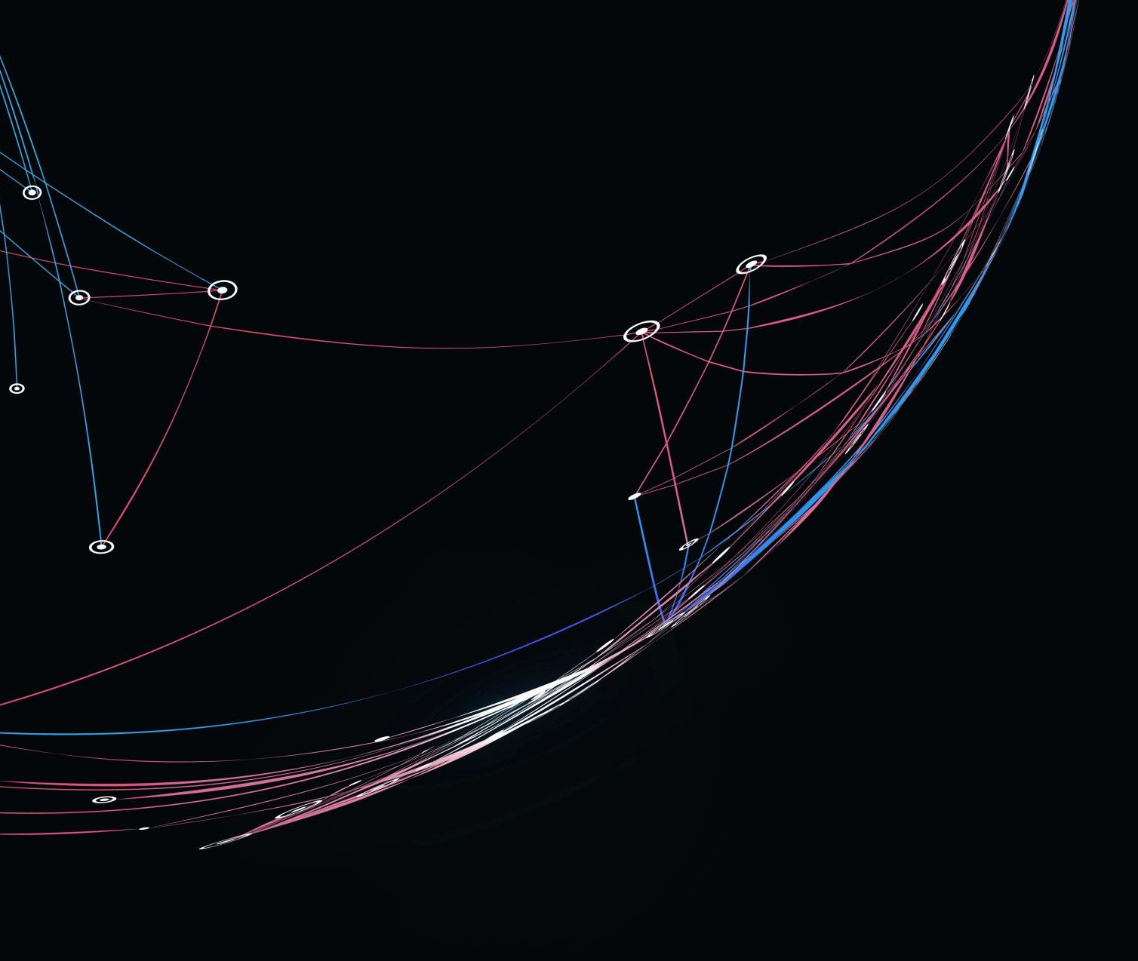
Every plan for change is based on a cause-and- effect hypothesis that needs to be kept under constant review and revised as necessary
John Hayes, The Theory and
Practice of Change Management, 3rd Ed. Palgrave 2010

Slide 36
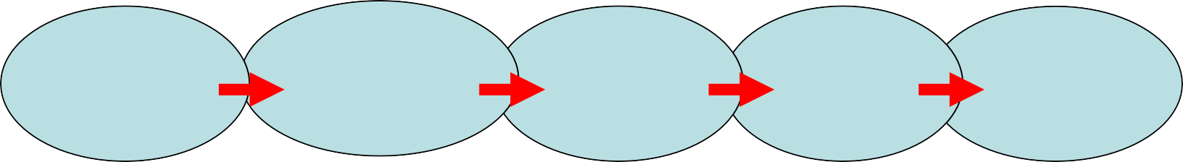
The service-profit cause-and-effect hypothesis
Employee satisfaction
Customer satisfaction
Customer loyalty
Profit & Revenue growth
Commitment
Based on the service-profit chain it might be hypothesised that reduced revenue growth is caused by low customer satisfaction which, in turn, is the result of poor employee satisfaction and commitment
John Hayes, The Theory and
Practice of Change Management, 3rd Ed. Palgrave 2010

Slide 37
The cause-and-effect hypothesis informs the target for change and choice of intervention
Target for change:
In this case the immediate target for change might be to improve employee satisfaction and commitment
Choice of intervention:
Redesign jobs to provide employees with greater autonomy, challenge and sense of achievement, and improve customer focus by encouraging employees to voice their views about opportunities and threats that could affect customer satisfaction.
John Hayes, The Theory and
Practice of Change Management, 3rd Ed. Palgrave 2010

Slide 38

Module Recap

Slide 39
Reviewing the effectiveness of the change plan involves:
Monitoring whether the selected interventions are being implemented as intended
Implementation may be hindered by factors such as:
  Resistance from those immediately affected by the intervention
  Lack of political support from other important stakeholders
John H•ayes, TheLTahecorykandof time and other resources

Slide 40
Reviewing the change plan
Monitoring whether the interventions are having the desired effect on employee satisfaction and commitment
  In this example we assume there is a significant improvement
(If the interventions had failed to produce this desired change the change manager might have tried an alternative intervention at this point)

Slide 41
Reviewing the change plan
Monitoring whether improvements in employee satisfaction and commitment are having a positive effect on customer satisfaction
  In this example customer satisfaction is improving
Monitoring whether improved customer satisfaction is leading to greater customer retention and improved revenue growth.
  In this example let us assume that (in due course) there is evidence of greater customer retention and revenue growth.
(No improvement would challenge the validity of the cause-effect hypothesis and
prompt a revision to the change plan)
rd Ed. Palgrave
96
2010

Slide 42


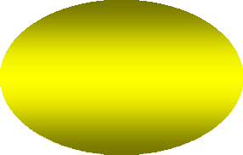



Developing tools to help with monitoring the change plan
Profit & revenue growth
Employee satisfaction
Vision & strategy
Customer retention
Employee commitment
Customer
satisfaction
Translating the change strategy into a set of operational goals and related measures

Slide 43

Peter Senge’s Systemic Model PRINCIPLES:
• Start small.
• Grow steadily.
• Don’t plan the whole thing.
• Expect challenges – it will not go smoothly! GUIDELINES:
• Use pilot groups – ideas, innovations in infrastructure, theories methods and tools.
• Stick to the basic rules – start small, grow steadily, be clear about intentions, declare your approach – but don’t plan the whole thing.
• Expect challenges – it will not go smoothly! Challenges require understanding and counterintuitive strategies.

Slide 44
Stacey and Shaw – Complex Change, the Leader’s Role?
• To decide what business the organisation is in and stretch people’s thinking on how to get there.
• To ensure that there is a high level of connectivity between different parts of the organisation.
• To focus peoples’ attention on important differences: between current and desired performance, between style of working, between past and present results.

Slide 45

Next Session
Drop- in session to discuss your assignment approach

