Slide 1
Skills for life: Employability
Job application for a leader in a Cylch Meithrin.

Slide 2
Job Description.
Make sure the Cylch Meithrin’s policies and procedures are followed by every member of staff.
Implement the principals and aims of the Foundation Phase in all activities.
Make sure the room and facilities, including the outdoor area are attractive, welcoming and comply with health and safety requirements.
Ensure there is a variety of resources to promote linguistic, physical, creative and social skills.
Make sure there are areas that reflect the Foundation Phase to promote the children’s development.
Every staff member should promote the welsh language at all times.
Work as a team to plan activities.
Ensure that every child is welcomed and receives equal care and attention.
Prepare welcome packs and registration documents for new children and ensure they are completed correctly.
Make sure all equipment is stored tidily after every session.
Keep records of the children’s development including examples of their work.
Make the parents feel welcome.
Make opportunities to discuss the child’s development with the parents.
Encourage the parents to support the Cylch Meithrin’s activities.
Comply with the regulations of the Care Inspectorate Wales.
(Mudiad Meithrin, No Date)

Slide 3
Suitable Qualifications.
A suitable recognised level 3 or above is needed, such as:
Diploma or degree in Early years and education
NNEB Diploma
CACHE Diploma in childcare and education
NVQ in early years care and education
(mudiad meithrin, no date)

Slide 4
Job Requirements.
Suitable qualifications
Training
DBS
Understanding of health and safety
Experience of working in a Cylch Meithrin
Understanding of the Foundation Phase
Understanding of the Care Inspectorate Wales regulations
(Mudiad Meithrin, No Date. UCAS, 2019)

Slide 5
The Foundation Phase.
The seven areas of learning in the Foundation Phase are:
Personal and social development
Language, literacy and communication skills
Mathematical development
Welsh language development
Knowledge and understanding of the world
Physical development
Creative development
(Welsh Government, 2015)

Slide 6
CIW Regulations.
Child care providers must:
Give parents the information so they can decide on what childcare they require
Have a written contract with the parents
Meet the child’s individual needs
Keep a full range of records
Work in partnership with the parents
Provide opportunities for play and learning
Manage the children’s and the staff’s behaviour
Healthcare and medication
Food and drink
Organisation
Staffing ratios
Equal opportunities
Complaints procedure
Child protection
Environment and equipment (Welsh Government, 2016)

Slide 7
Professional competencies
Communication and the ability to speak welsh
Team work
Time management
Listening- active listener
Problem solving
Creativity
Organisation
Motivation
Conflict resolution
Leadership
Decision making
Planning.
(Mudiad meithrin, No Date. UCAS, 2019)

Slide 8
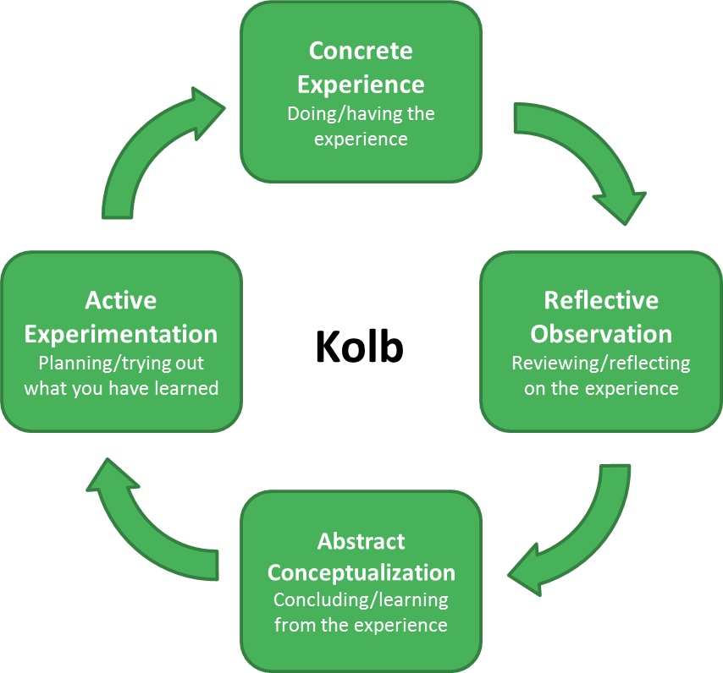
Reflection of my development
(Cambridge Community, No Date)

Slide 9
References
Cambridge Community. (No Date) Getting started with Reflective Practice. Available at: https://www.bing.com/images/search?view=detailV2&ccid=Vhzsyur7&id=67DDB1AEF7C11A066EF1B7AD973D6110AE8D6C8B&thid=OIP.Vhzsyur7V0iCnmxMhv2gnwHaG5&mediaurl=https%3a%2f%2fwww.cambridge-community.org.uk%2fprofessional-development%2fgswrp%2fmedia%2frefp_m3_aw_001_cp0rhm3.png&exph=796&expw=854&q=reflective+framework+kolb&simid=608024054037414884&selectedIndex=30&ajaxhist=0 (Accessed: 17th January 2020).
Dinkel, D. et al. (2019) ‘An exploration of infant and toddler unstructured outdoor play’, European Early Childhood Education Research Journal, 27(2), pp. 257-271.
GOV.UK. (2019) DBS checks for childminders and childcare workers. Available at: https://www.gov.uk/guidance/criminal-record-checks-for-childminders-and-childcare-workers#history (Accessed: 15th January 2020)
GOV.UK. (No Date) Legislation: Role of the employee. Available at: https://www.resources.hwb.wales.gov.uk/VTC/ngfl/nln_materials/nln_health_and_social_care/Health%20and%20safety%20legislation%20relevant%20to%20an%20early%20years%20setting/access/reference.html (Accessed:17th January 2020).

Slide 10
References
Kinsner, K. (2019) ‘Fresh Air, Fun, and Exploration: Why Outdoor Play Is Essential for Healthy Development’, YC: Young Children, 74(2), pp. 90-92.
Mudiad Meithri. (No Date) Job Description- Cylch meithrin Leader. Available at: https://www.meithrin.cymru/creo_files/upload/downloads/job_description_cylch_leader_english_.pdf (Accessed: 6th January 2020).
Pacey. (No Date) Food safety and hygiene training. Available at: https://www.pacey.org.uk/training-and-qualifications/training-from-pacey/online-training/food-safety-hygiene-training/ (Accessed: 15th January 2020).
Pacey. (No Date) Safeguarding. Available at: https://www.pacey.org.uk/working-in-childcare/spotlight-on/safeguarding/ (Accessed: 16th January 2020).

Slide 11
References.
Tovey, H. (2007) Playing Outdoors: Spaces and Places, Risk and Challenge. Berkshire: Open University Press.
UCAS. (2019) Explore Jobs. Nursery Manager. Available at: https://www.ucas.com/ucas/after-gcse/find-career-ideas/explore-jobs/job-profile/nursery-manager (Accessed: 10th January 2020).
Welsh Government. (2015) Foundation Phase Framework. Available at: https://hwb.gov.wales/storage/d5d8e39c-b534-40cb-a3f5-7e2e126d80077/foundation-phase-framework.pdf (Acceseed: 9th January 2020).
Welsh Government. (2015) Successful Futures: Looking at the Curriculum snd Assessment Arrangements in Wales. Available at: https://gov.wales/sites/default/files/publications/2018-03/successful-futures-a-summary-of-professor-graham-donaldsons-report.pdf (Accessed: 14th January 2020).

Slide 12
References.
Welsh Government. (2016) National Minimum Standards for aregulated Childcare for children up to the age of 12 years. Available at: https://careinspectorate.wales/sites/default/files/2018-01/160411regchildcareen.pdf (Accessed: 9th January 2020).
Welsh Government. (2019) New School Curriculum: Overview. Available at: https://gov.wales/new-school-curriculum-overview (Accessed: 14th January 2020)

