Slide 1
Cyflwyniad Sgrinio
Gwasanaeth Cymorth Dysgu PCYDDS
UWTSD Learning Support Screening

Slide 2
Introduction to Screening
Cyflwyniad i Sgrinio
Cyfle:
I’n hysbysu os oes gennych anabledd o gyflwr iechyd corfforol neu feddyliol hirdymor
Am gyflwyniad i gymorth drwy Lwfansau Myfyrwyr Anabl (DSA)
I gwblhau holiadur amlddewis am sut rydych chi’n ymdopi gyda gwahanol dasgau
Pam cymryd rhan?
Er mwyn ein galluogi i roi addasiadau neu gymorth ar waith sydd eu hangen arnoch
Nodi unrhyw anghenion cymorth heb eu diagnosio a allai nodi Gwahaniaeth Dysgu Penodol fel dyslecsia neu ADCaG
An opportunity to:
Inform us if you have a disability of long-term physical or mental health condition
Have an introduction to support available via Disabled Students Allowances (DSA)
Complete a multiple-choice questionnaire about how you find different tasks
Why participate?
To enable us to put in place adjustments or support you require
To identify any undiagnosed support needs that may indicate a Specific Learning Difference such as dyslexia or ADHD
Who reviews your responses?
A learning support specialists and disability adviser for the purpose of identifying support needs and arranging support and adjustments
Notes:
Cyflwyniad i Sgrinio
Cyfle:
I’n hysbysu os oes gennych anabledd o gyflwr iechyd corfforol neu feddyliol hirdymor
Am gyflwyniad i gymorth drwy Lwfansau Myfyrwyr Anabl (DSA)
I gwblhau holiadur amlddewis am sut rydych chi’n ymdopi gyda gwahanol dasgau
Pam cymryd rhan?
Er mwyn ein galluogi i roi addasiadau neu gymorth ar waith sydd eu hangen arnoch
Nodi unrhyw anghenion cymorth heb eu diagnosio a allai nodi Gwahaniaeth Dysgu Penodol fel dyslecsia neu ADCaG
Introduction to Screening
Screening is an opportunity to:
Inform us if you have a disability of long-term physical or mental health condition
Have an introduction to support available via Disabled Students Allowances (DSA)
Complete a multiple-choice questionnaire about how you find different tasks
Why participate?
To enable us to put in place adjustments or support you require
To identify any undiagnosed support needs that may indicate a Specific Learning Difference such as dyslexia or ADHD
Who are your responses shared with?
Learning support staff for the purpose of identifying support needs and arranging support and adjustments

Slide 3
Pwy sy'n adolygu eich ymatebion?
Arbenigwr cymorth dysgu a chynghorydd anabledd at ddibenion nodi anghenion cymorth a threfnu cymorth ac addasiadau
Who reviews your responses?
A learning support specialist and disability adviser for the purpose of identifying support needs and arranging support and adjustments
Notes:
Pwy sy'n adolygu eich ymatebion?
Arbenigwr cymorth dysgu a chynghorydd anabledd at ddibenion nodi anghenion cymorth a threfnu cymorth ac addasiadau
Who reviews your responses?
Learning support staff for the purpose of identifying support needs and arranging support and adjustments

Slide 4
Disabled Students’ Allowance (DSA) via Student Finance
Lwfans Myfyrwyr Anabl (DSA)
trwy Gyllid Myfyrwyr
Mae DSA yn cwmpasu costau sy'n gysylltiedig ag astudiaethau a allai fod gennych oherwydd anabledd, cyflwr iechyd corfforol neu feddyliol hirdymor.
Nid thelir cyllid uniongyrchol i chi, ond yn hytrach cewch lwfans i ariannu unrhyw gymorth ac offer arbenigol y gallai fod ei angen arnoch i sicrhau bod eich astudiaethau yn hygyrch.
Gall hyn gynnwys:
Gliniadur gyda meddalwedd cynorthwyol ​
Offer arbenigol e.e. gweithfan ergonomig
Cymorth 1:1 e.e. tiwtor sgiliau astudio, mentor, cyfieithydd BSL.
Cymorth i gostau teithio sy'n gysylltiedig ag anabledd
I wneud cais, mae angen i chi lenwi ffurflen gais, darparu tystiolaeth o'ch anabledd ac yna cael asesiad anghenion – bydd eich cynghorydd anabledd yn eich cefnogi drwy'r broses hon.
DSA covers study-related costs you may have because of a disability, long-term physical or mental health condition.
It is not direct funding paid to you but instead is an allowance which funds any specialist support and equipment you might need to ensure your studies are accessible.
This may include:
A laptop assistive software ​
Specialist equipment e.g. ergonomic workstation ​
1:1 support e.g. study skills tutor, mentor, BSL interpreter.
Support for disability-related travel costs
To apply you need to complete an application form, provide evidence of your disability and then have a needs assessment – your disability adviser will support you through this process.
Notes:
Lwfans Myfyrwyr Anabl(DSA) trwy Gyllid Myfyrwyr
Mae DSA yn cwmpasu costau sy'n gysylltiedig ag astudiaethau a allai fod gennych oherwydd anabledd, cyflwr iechyd corfforol neu feddyliol hirdymor.
Nid thelir cyllid uniongyrchol i chi, ond yn hytrach cewch lwfans i ariannu unrhyw gymorth ac offer arbenigol y gallai fod ei angen arnoch i sicrhau bod eich astudiaethau yn hygyrch.
Gall hyn gynnwys:
Gliniadur gyda meddalwedd cynorthwyol ​
Offer arbenigol e.e. gweithfan ergonomig
Cymorth 1:1 e.e. tiwtor sgiliau astudio, mentor, cyfieithydd BSL.
Cymorth i gostau teithio sy'n gysylltiedig ag anabledd
If you have a disability or long-term-physical or mental health condition you may be eligible for Disabeld Students’ Allowances.
DSA covers study-related costs you may have because of a disability, long-term physical or mental health condition.
It is not direct funding paid to you but instead is an allowance which funds any specialist support and equipment you might need to ensure your studies are accessible.
This may include:
A laptop with assistive software ​
Specialist equipment e.g. ergonomic workstation ​
1:1 support e.g. study skills tutor, mentor, BSL interpreter.
Support for disability-related travel costs
To apply you need to complete an application form, provide evidence of your disability and then have a needs assessment – your disability adviser will support you through this process.

Slide 5
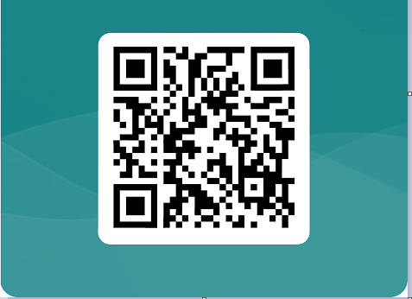
Scan the QR code below with your phone to access the screening form:
Sganiwch y cod QR isod gyda'ch ffôn i gael mynediad i'r ffurflen sgrinio:
Notes:
Sganiwch y cod QR isod gyda'ch ffôn i gael mynediad i'r ffurflen sgrinio:
To participate in screening please scan the below QR code with your phone and it will open up the digital form for you to complete.
https://forms.office.com/e/ax0dSJMJ4B

Slide 6
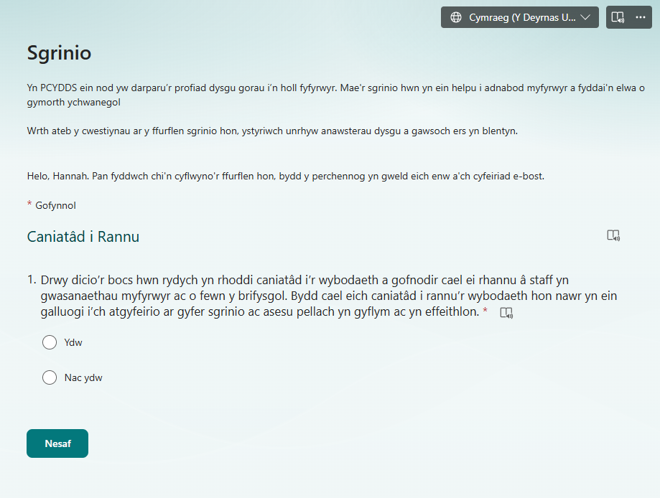
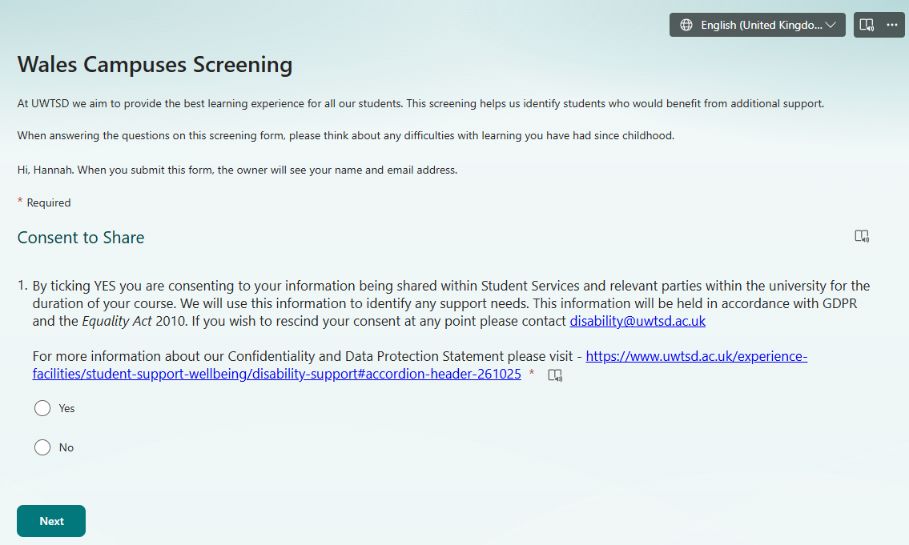
Notes:
Yma gallwch weld y dudalen gyntaf a fydd yn ymddangos pan fydd y ffurflen yn agor gyda'r teitl 'Wales Campuses Screening'. Yng nghornel dde uchaf y ffurflen gallwch newid yr iaith i'r Gymraeg.
Mae Cwestiwn 1 yn gofyn am eich caniatâd i'ch gwybodaeth gael ei rhannu â Gwasanaethau Myfyrwyr a phartïon perthnasol yn y brifysgol. I gael rhagor o wybodaeth am ein Datganiad Cyfrinachedd a Diogelu Data, ewch i- https://www.uwtsd.ac.uk/experience-facilities/student-support-wellbeing/disability-support#accordion-header-261025
Gallwch ddileu eich caniatâd ar unrhyw adeg trwy e-bostio anabledd @uwtsd.ac.uk.
Here you can see the first page that will appear when the form opens with the title ‘Wales Campuses Screening’. In the top right-hand corner of the form you can change the language to Welsh.
Question 1 asks for your consent for your information to be shared with Student Services and relevant parties within the university.
For more information about our Confidentiality and Data Protection Statement please visit - https://www.uwtsd.ac.uk/experience-facilities/student-support-wellbeing/disability-support#accordion-header-261025
You can remove your consent at any point by emailing disability @uwtsd.ac.uk.

Slide 7
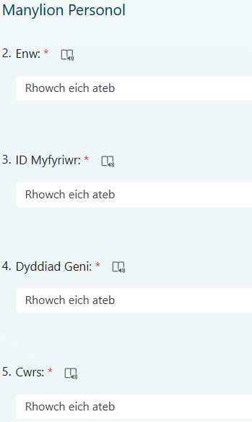
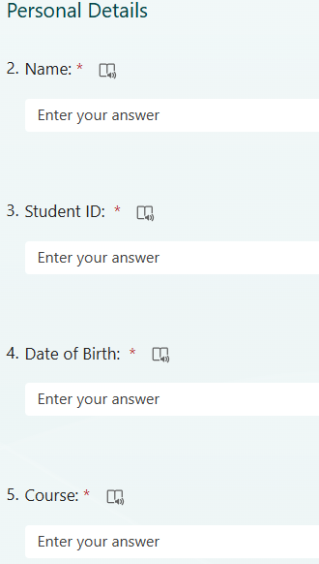
Notes:
Nesaf, gofynnir i chi fewnbynnu eich manylion personol.
Enw
ID Myfyriwr
Dyddiad geni
Cwrs
Next you will be asked to input your personal details.
Name
Student ID
Date of Birth
Course

Slide 8
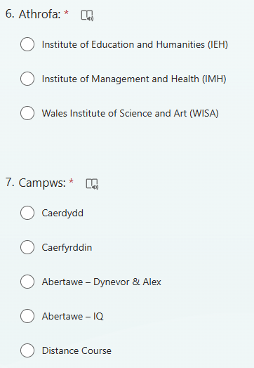
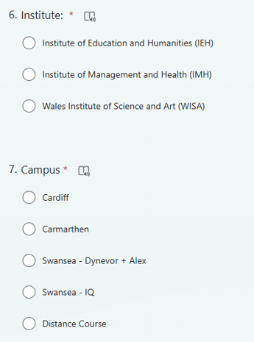
Notes:
6. Dewiswch yr athrofa perthnasol y daw i’ch cwrs, os nad ydych chi'n siŵr gofynnwch i'ch tiwtor.
7. Dewiswch y campws rydych chi'n astudio ynddo.
6. Select the relevant institute your course comes under, if you are not sure ask your tutor.
7. Select the campus you are studying at.

Slide 9
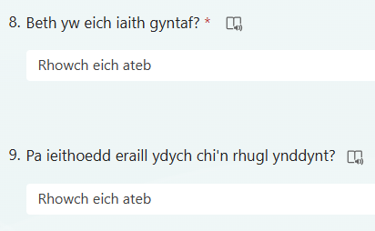
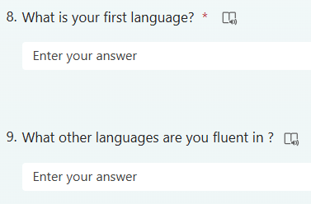
Notes:
Cwestiwn wyth – Nodwch eich iaith gyntaf
Cwestiwn 9 – Rhestrwch unrhyw ieithoedd eraill rydych chi'n rhugl ynddynt
Question 8 – State your first language
Question 9 – List any other languages you are fluent in

Slide 10
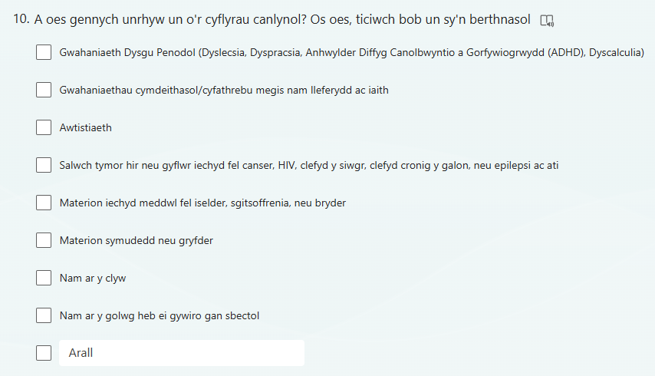
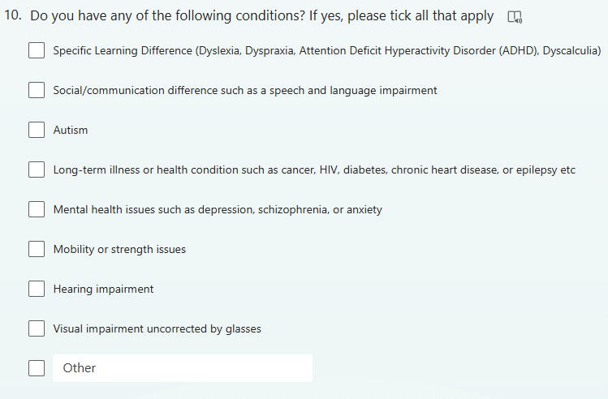
Notes:
Cwestiwn 10 - Ticiwch y blychau ar gyfer unrhyw gyflyrau sydd gennych, os nad yw'ch anabledd wedi'i restru, dewiswch 'arall'. Byddwch yn ymwybodol:
- Nad yw anawsterau iaith a brofir oherwydd nad Saesneg neu Gymraeg yw’r hiaith gyntaf yn berthnasol
- Mai Ystyr 'nam ar y golwg heb ei gywiro gan sbectol' yw nam ar y golwg nad yw'n cael ei gywiro'n gyfan gwbl trwy wisgo sbectol.
Question 10 - Tick the boxes for any conditions you have, if your disability is not listed, please select ‘other’. Please be aware that:
Language difficulties you may experience because English or Welsh is not your first language do no apply
‘Visual impairment uncorrected by glasses’ means a visual impairment that is not entirely corrected by wearing classes.

Slide 11
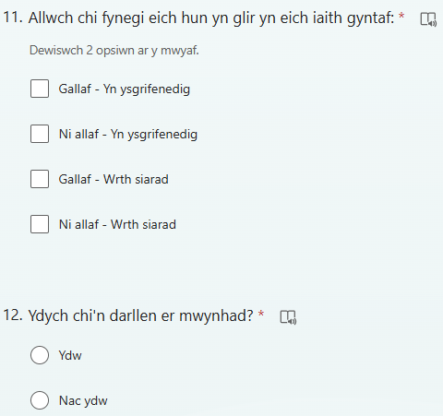
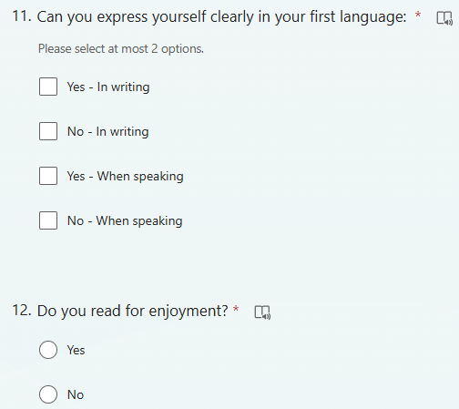
Notes:
Mae'r cwestiynau sy'n weddill yn gofyn am eich profiad gyda thasgau gwahanol, nodwch nad prawf yw hwn ac nid oes atebion cywir neu anghywir i'r cwestiynau hyn; Y nod yw cael cynrychiolaeth onest a chywir o'ch profiad
Rydym yn gofyn i chi am eich profiad yn eich iaith gyntaf fel y gallwn wahaniaethu rhwng anghenion cymorth a allai fod yn gysylltiedig â gwahaniaeth dysgu penodol fel dyslecsia neu ADCaG ac anghenion cymorth sy'n ymwneud â Saesneg neu Gymraeg nad yw’n iaith gyntaf person.
Cwestiwn 11 Allwch chi fynegi eich hun yn glir yn eich iaith gyntaf? Dewiswch ddau ateb – un ar gyfer ysgrifennu ac un ar gyfer siarad.
Cwestiwn 12 Ydych chi'n darllen er mwynhad? Ydw / Nac ydw
The remaining questions ask how you find different tasks, please note this is not a test and there are no right or wrong answers to these questions; the aim is to get an honest and accurate representation of your experience
We ask you about your experience in your first language so that we can distinguish between support needs that could relate to a specific learning difference such as dyslexia or ADHD and support needs relating to English or Welsh not being a person’s first language.
Question 11 Can you express yourself clearly in your first language? please select two answers – one for writing and one for speaking.
Question 12 Do you read for enjoyment? Yes/No

Slide 12
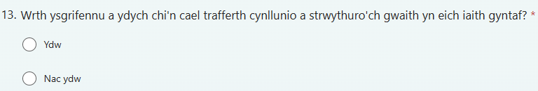
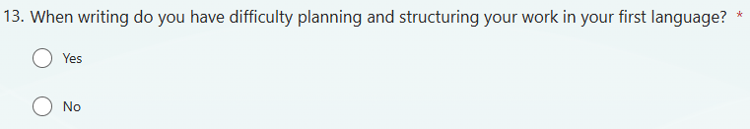
Notes:
Cwestiwn 13: Pan fyddwch yn ysgrifennu, a ydych chi'n cael trafferth cynllunio a strwythuro eich gwaith yn eich iaith gyntaf? Ydw/Nac ydw
Question 13: When Writing do you have difficulty planning and structuring your work in your first language? Yes/NO

Slide 13
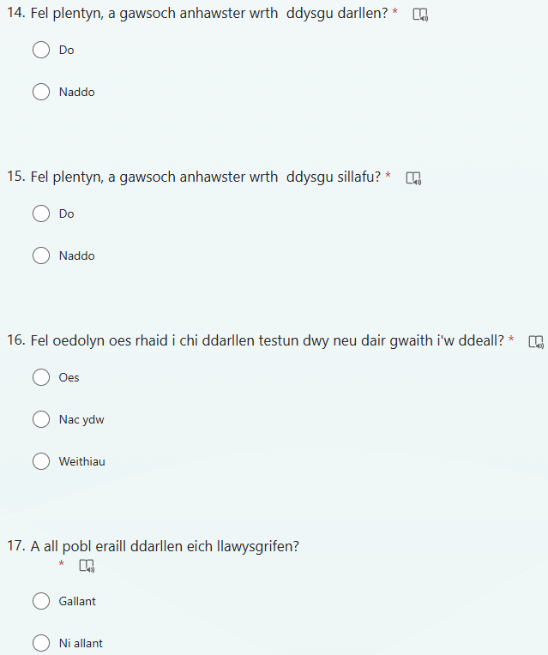
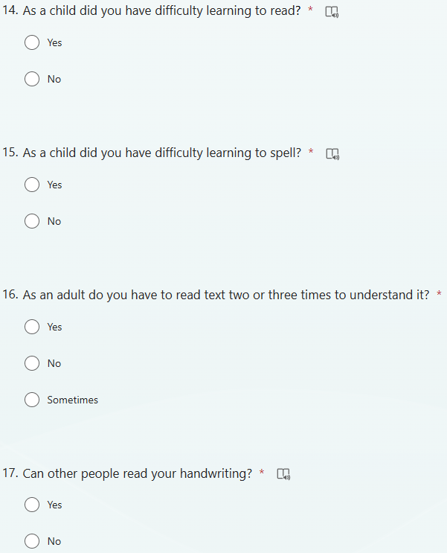
Notes:
14. Fel plentyn a gawsoch chi anhawster dysgu darllen? Do / Naddo
15. Fel plentyn a gawsoch chi anhawster dysgu sillafu? Do / Naddo
16. Fel oedolyn a oes rhaid i chi ddarllen testun ddwy neu dair gwaith i'w ddeall? Oes / Nac oes/ Weithiau
17. A all pobl eraill ddarllen eich llawysgrifen? Gallant / Ni allant
14. As a child did you have difficulty learning to read? Yes/No
15. As a child did you have difficulty learning to spell? Yes/No
16. As an adult do you have to read text two or three times to understand it? Yes/No/Sometimes
17. Can other people read your handwriting? Yes/No

Slide 14
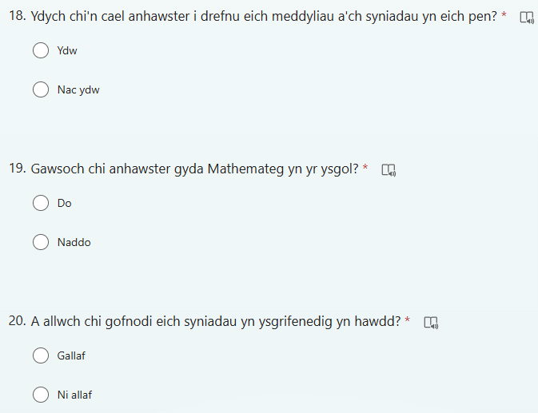
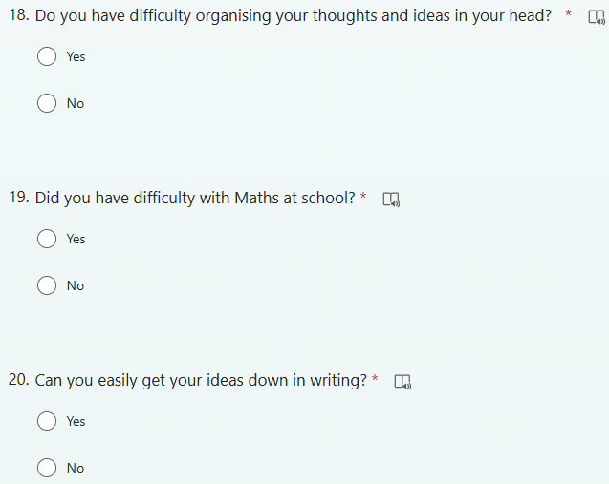
Notes:
18. Ydych chi'n cael trafferth trefnu eich meddyliau a'ch syniadau yn eich pen? Ydw / Nac ydw
19. A gawsoch chi anhawster gyda Mathemateg yn yr ysgol? Do / Naddo
20. Allwch chi gael eich syniadau i lawr yn ysgrifenedig yn hawdd? Gallaf / Ni allaf
18. Do you have difficulty organising your thoughts and ideas in your head? Yes/No
19. Did you have difficulty with Maths at school? Yes/No
20. Can you easily get your ideas down in writing? Yes/No

Slide 15
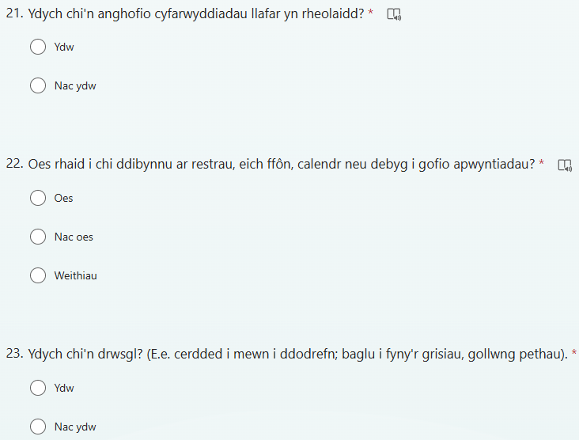
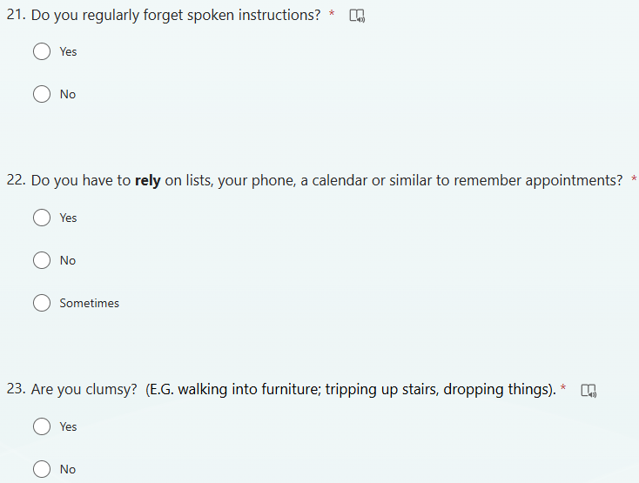
Notes:
21. Ydych chi'n anghofio cyfarwyddiadau llafar yn rheolaidd? Ydw / Nac ydw
22. A oes rhaid i chi ddibynnu ar restrau, ar eich ffôn, calendr neu debyg, i gofio apwyntiadau? Oes / Nac oes/ Weithiau
23. Ydych chi'n lletchwith (E.e., cerdded i mewn i ddodrefn, baglu i fyny grisiau, gollwng pethau)? Ydw / Nac ydw
21. Do you regularly forget spoken instructions? Yes/No
22. Do you have to rely on lists, on your phone, a calendar or similar, to remember appointments? Yes/No
23. Are you clumsy (E.G, walking into furniture, tripping up stairs, dropping things) Yes/No

Slide 16
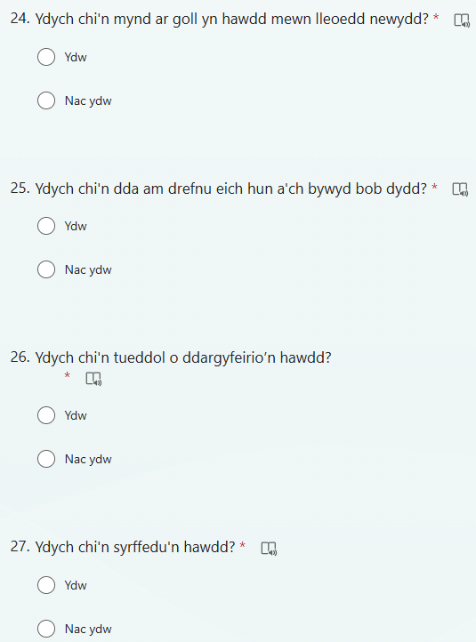
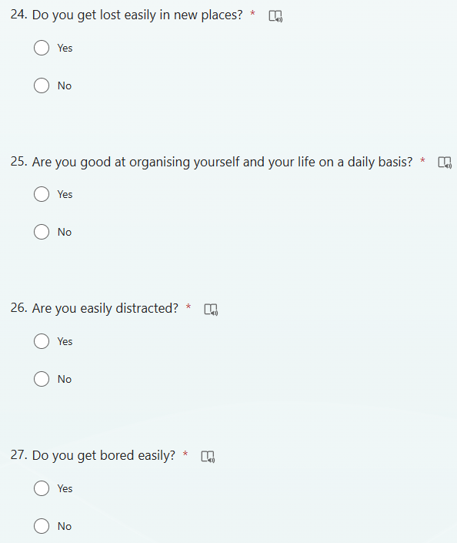
Notes:
24. Ydych chi'n mynd ar goll yn hawdd mewn lleoedd newydd? Ydw / Nac ydw
25. Ydych chi'n dda am drefnu eich hun a'ch bywyd bob dydd? Ydw / Nac ydw
26. Ydych chi’n dueddol o ddargyfeirio’n hawdd? Ydw / Nac ydw
27. Ydych chi'n diflasu'n hawdd? Ydw / Nac ydw
24. Do you get lost easily in new places? Yes/No
25. Are you good at organising yourself and your life on a daily basis? Yes/No
26. Are you easily distracted? Yes/No
27. Do you get bored easily? Yes/No

Slide 17
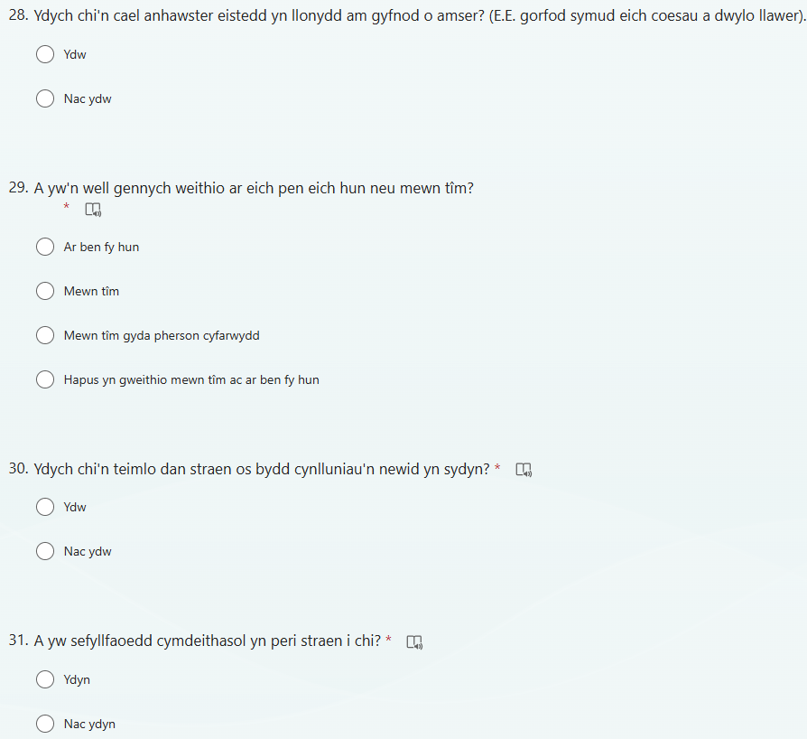
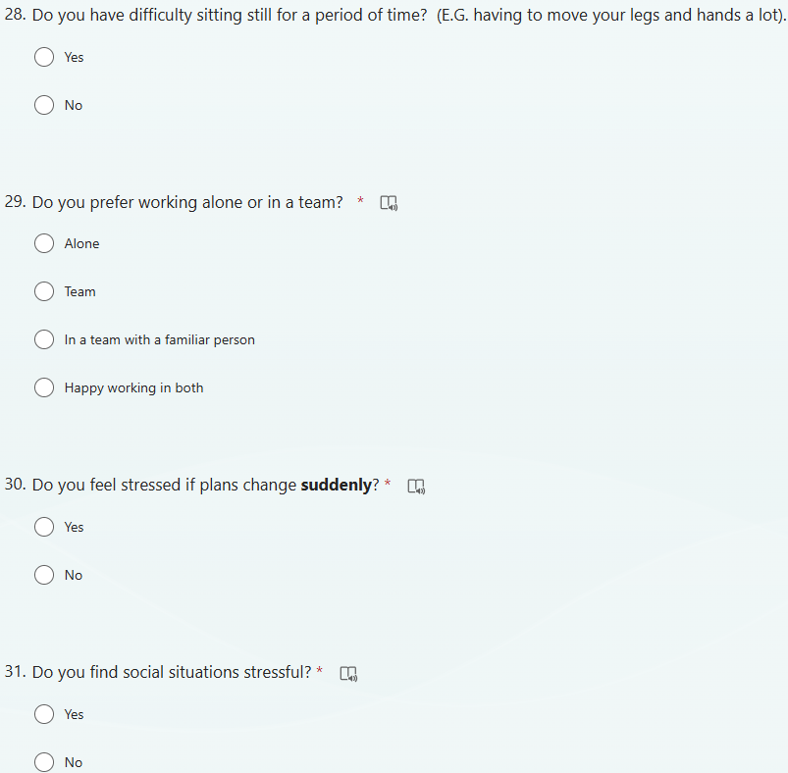
Notes:
28. Ydych chi'n cael trafferth eistedd yn llonydd am gyfnod o amser (e.e. gorfod symud eich coesau a'ch dwylo llawer). Ydw / Nac ydw
29. A yw’n well gennych weithio ar eich pen eich hun neu mewn tîm? Ar ben fy hun, mewn tîm, mewn tîm gyda pherson cyfarwydd, yn hapus yn gweithio ar ben fy hun ac mewn tim
30. Ydych chi'n teimlo dan straen os bydd cynlluniau'n newid yn sydyn? Ydw / Nac ydw
31. Ydych chi'n gweld sefyllfaoedd cymdeithasol yn straen? Ydw / Nac ydw
28. Do you have difficulty sitting still for a period of time (E.G having to move your legs and hands a lot)? Yes/No
29. Do you prefer working alone or in a team? Alone, in a team/ in a team with a familiar person/happy working in both.
30. Do you feel stressed if plans change suddenly? Yes/No
31. Do you find social situations stressful? Yes/No

Slide 18
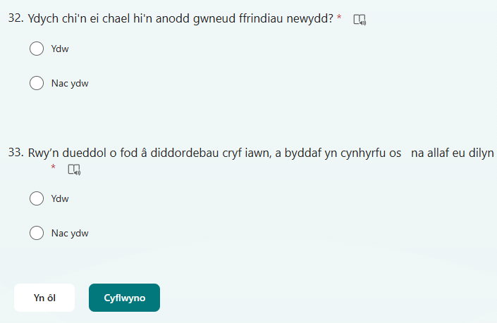
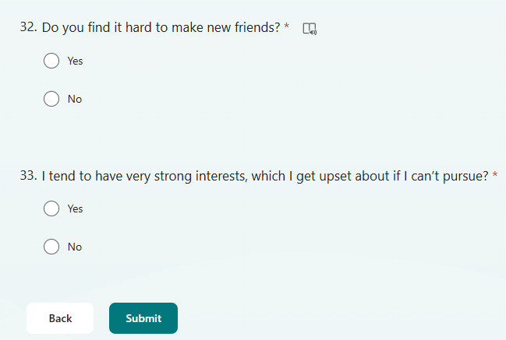
Notes:
32. Ydych chi'n ei chael hi'n anodd gwneud ffrindiau newydd? Ydw / Nac ydw
33. Rwy’n dueddol o fod a diddordebau cryf iawn, a byddaf yn cynhyrfu os na allaf eu ddilyn? Ydw / Nac ydw
Pan fyddwch wedi cwblhau'r holl gwestiynau, cliciwch 'cyflwyno’.
32. Do you find it hard to make new friends? Yes/No
33. Intend to have very strong interests, which I get upset about if I can’t pursue? Yes/No
When you have completed all questions please click ‘submit’.

Slide 19
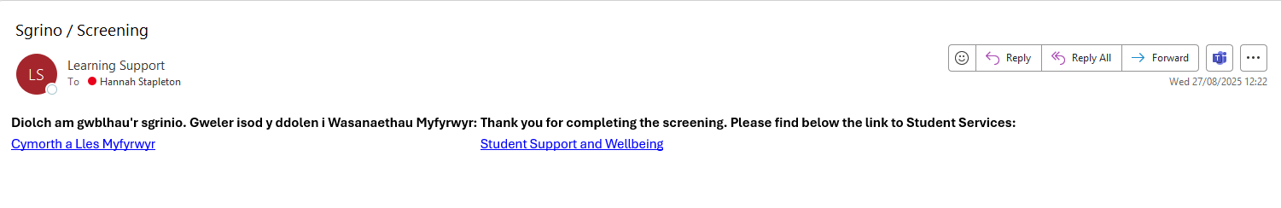
E-bost y byddwch yn ei dderbyn ar ôl i chi gyflwyno eich holiadur:
Email you will receive once you have submitted your questionnaire:
Notes:
Dyma’r e-bost y byddwch yn ei dderbyn ar ôl i chi gyflwyno eich holiadur sy’n cynnwys dolen i wybodaeth am gymorth a lles myfyrwyr.
This is the email you will receive once you have submitted your screening questionnaire which includes a link to information about student support and wellbeing.

Slide 20
Beth sy'n digwydd nesaf?
Byddwn yn cysylltu â chi trwy gyfeiriad e-bost eich prifysgol os:
Rydych wedi rhannu bod gennych anabledd neu gyflwr iechyd hirdymor
Ydy’r atebion i'r holiadur yn dangos y byddech yn elwa o sgrinio pellach
Os nad ydych yn clywed gennym ni, mae hyn yn golygu nad oes angen sgrinio pellach arnoch ond gallwch e-bostio disability@uwtsd.ac.uk ar unrhyw adeg yn eich cwrs i drafod eich anghenion cymorth.
What happens next?
We will contact you via your university email address if:
You have shared that you have a disability or long-term health condition
Answers you have given to the questionnaire indicate you would benefit from further screening
If you do not hear from us, this means you do not require further screening however you can email disability@uwtsd.ac.uk at any point in your course to discuss your support needs.
Notes:
What happens next?
We will contact you via your university email address if:
You have shared that you have a disability or long-term health condition
Answers you have given to the questionnaire indicate you would benefit from further screening
If you do not hear from us, this means you do not require further screening however you can email disability@uwtsd.ac.uk at any point in your course to discuss your support needs.

Slide 21
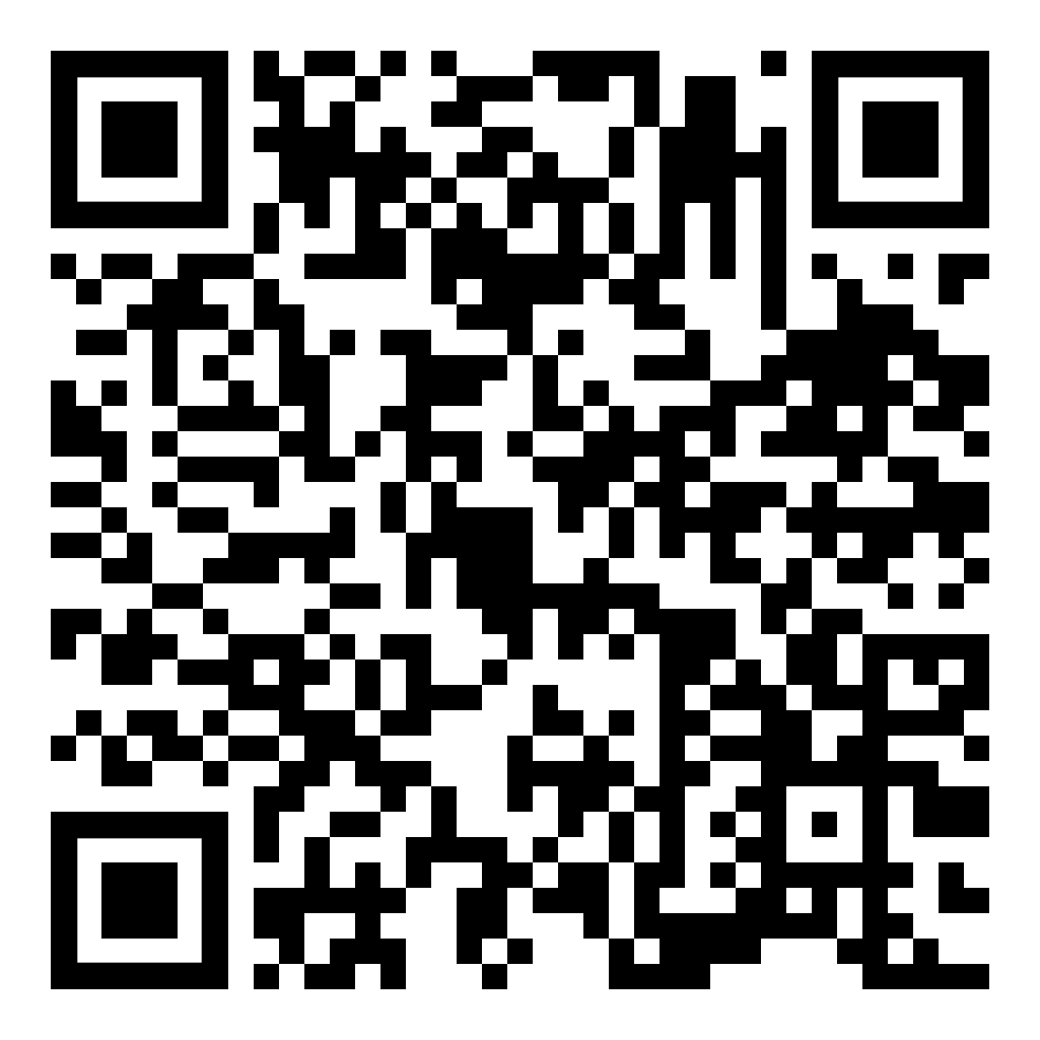
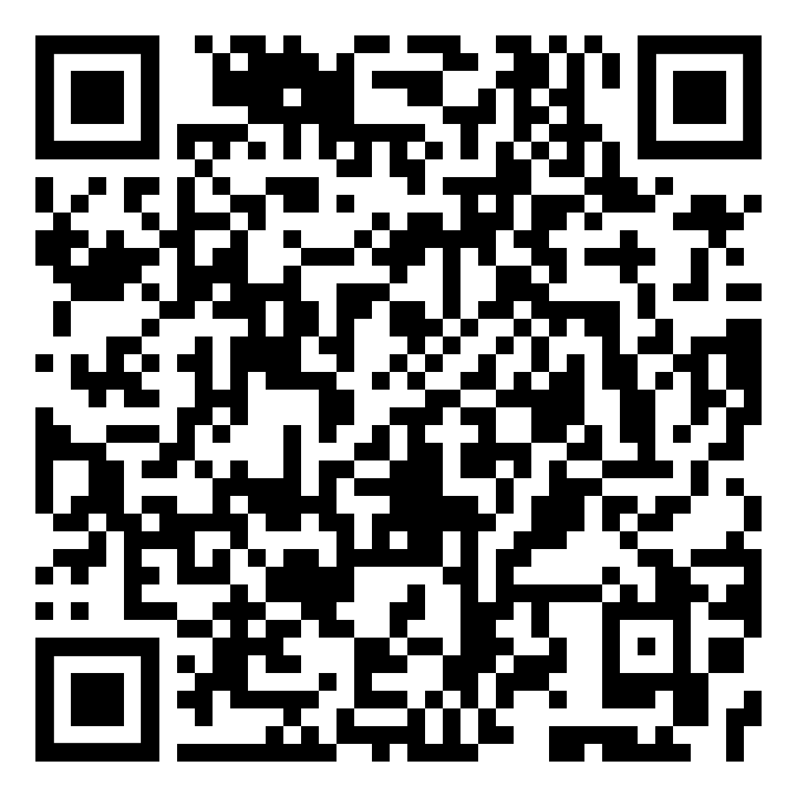
Cymorth Sgiliau Astudio
1-1 Ar-lein ar gael i bob myfyriwr
1-1 Online Study Skills Support is available for all students
Gofynnir am hyn drwy e-bostio: studyskillsdistance@uwtsd.ac.uk gydag amlinelliad byr o’r cymorth sydd angen arnoch a’r diwrnod a’r amser sydd orau gennych.
Mae argaeledd sesiynau i’w gael drwy:
Requested by emailing: studyskillsdistance@uwtsd.ac.uk with a brief outline of the support you require and your preferred day and time
Session availability found via:
Notes:
Waeth a oes angen sgrinio pellach arnoch, mae yna lawer o resymau pam y gallech elwa o gael mynediad at gymorth astudio ar lefel prifysgol am y tro cyntaf, boed hynny oherwydd trafferth deall beth sy'n ddisgwyliedig ohonoch gan diwtoriaid, eich bod yn dychwelyd i addysg ffurfiol ar ôl amser hir o fod allan o addysg, neu oherwydd nad Cymraeg/ Saesneg yw eich iaith gyntaf.
Mae cymorth sgiliau astudio 1-1 trwy Microsoft Teams ar gael i bob myfyriwr.
Gofynnir am hyn drwy e-bostio: studyskillsdistance@uwtsd.ac.uk gydag amlinelliad byr o’r cymorth sydd angen arnoch a’r diwrnod a’r amser sydd orau gennych.
Mae argaeledd sesiynau i’w gael drwy:
Regardless of whether you require further screening, there are many reasons why you may benefit from accessing support such as studying at university level for the first time, struggling to understand what is expected of you, returning to formal education after a long time of being out of education, or English not being your first language.
1-1 study skills support via Microsoft Teams is available for to all students.
You can scan the QR code with your phone for more information. When requesting support include a brief outline of the support you require and your preferred day and time

