Slide 1
Presentation- Strategies for Effective communication in a business settings
BMSW4002 Effective team working and communication
Stanciu Radu Mihai
Student ID:2111825

Slide 2
Table of content
Slide 3 Introduction
Slide 4 Benefits of effective Communication
Slide 5 Model of Communication
Slide 6 Continue Model of Communication
Slide 7 Barriers of communication
Slide 8 Channels of Communication
Slide 9 Conclusion And Recommendation
Slide 10 References

Slide 3



Introduction
This presentation is about effective communication and how to implement it in to an organization.
For that, this presentation will show what are the benefits of effective communication and how to implement in order to chose the most appropriate channel and communication theory for Apple Inc.
Apple Inc. is a globally organization well known for they strong relationship with they external stakeholders-Customers.
(Levy, 2022)

Slide 4
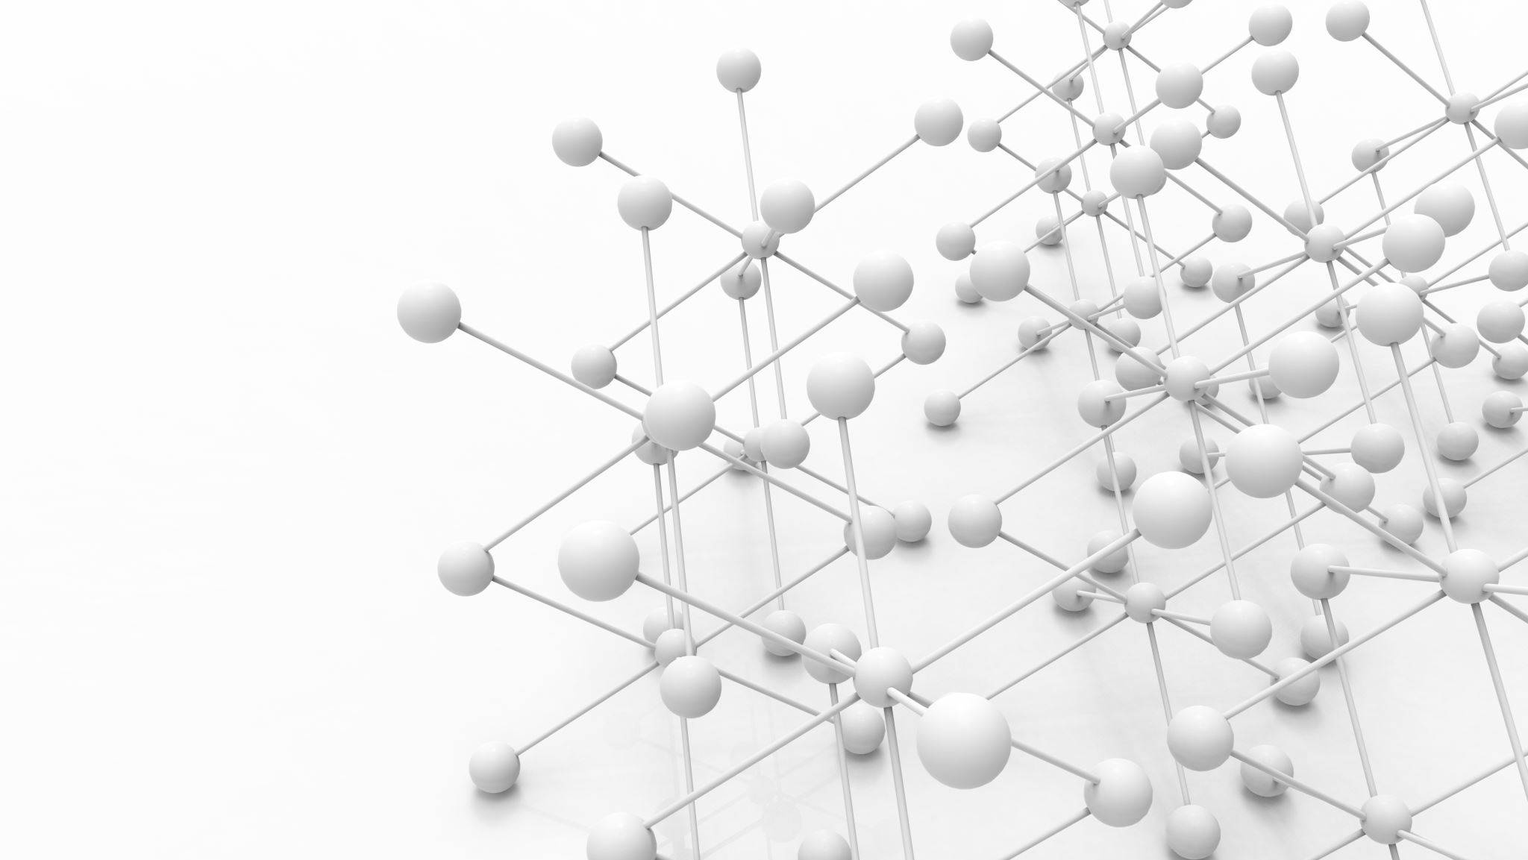
The benefits of effective communication Apple Inc.
As an organization Apple had a very well know experience in effective communication which bring to the organization a lot of benefits like:
It promote trust:
Apple Inc. know how to benefit from communication and make it effective which had as result the customers to trust them.
Promote Loyalty:
An another benefit from the organization effective communication is that Apple Inc. had loyal customers who will always come back for a new product.
Solve issues:
Apple has providing good customer support which and because of them effective communication the issues are solve faster and easier.
(Trivedi, 2019) (Forbes, 2019)

Slide 5
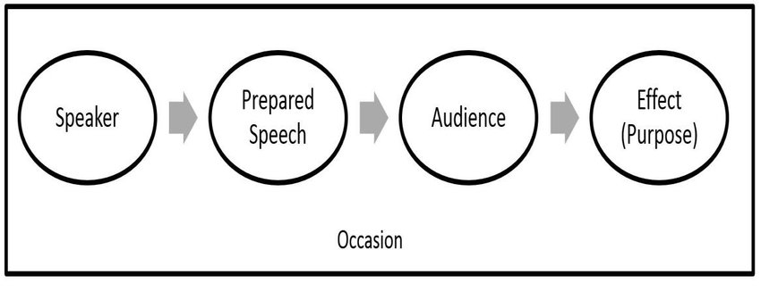
Apple Model of Communication
Analysing Apple Inc. , and seen how they benefit from the effective communication and also having some research about the organization, the best model that it represent the organization is Aristotle’s Model of Communication:
( ResearchGate GmbH, 2022) (MANAGEMENT STUDY GUIDE, 2022)

Slide 6
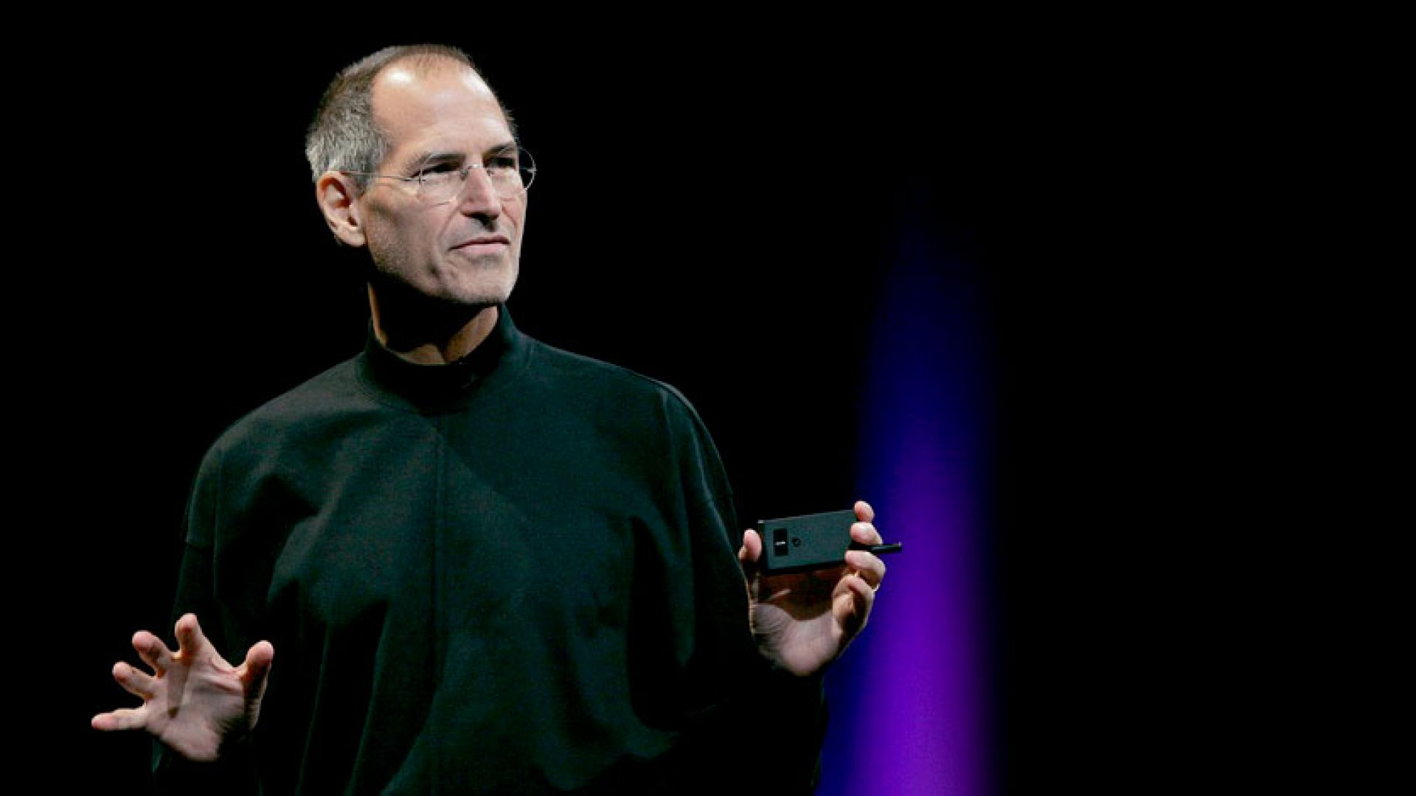
Continue
Applying the model to the organization it result that :
Steve Jobs ( Apple fonder ) in order to communicate with the customers and how him self say “keep them hungry” had always create events for the new apple product and present to the audience which had as effect to make the customers to feel important and up to date with the newest apple products . Doing that Steve Jobs not only achieve the customers loyalty but also bult trust for Apple products and reach the audience building strong relationship between the customers and the company.
Steve Jobs (Speaker)
Speech about the product
Customers
Build Customer Relationship
iPhone Launch Event
(Apple Inc., 2021) (Gallo, 2010)

Slide 7
Types of barriers
The meaning of communication barriers are characterized as a noise or a disruption of the message sender by the messenger to the receiver. In the Apple case a barrier that could be identify according with the previous showed model:
While the speaker (Steve Jobs) send his speech (the announcement of a new iPhone and details regarding the product) to the audience via online event, an barrier could be a low network signal which will disrupt the speech while is listen by the audience (customer).
In order to avoid that the audience (customers) need to be sure that they have a good signal network before to join the event.
(Skills You Need, 2022)

Slide 8

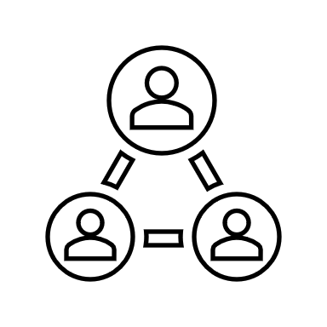


Apple Inc. Communication Channels
In short words : Communication Channel are characterized as “the place” where the communication is happen
The Apple Organization use multiple channel in order to communicate with they External Stakeholders- customers. Some of the Apple Inc. communication channels are:
Face to face:
Via Apple stores
Written Communication : Apple Website
Via Email
Social Media :
YouTube - Video online platform
Facebook Video Advertising
(Project-Management, 2020)

Slide 9
Conclusion and Recommendation
In conclusion an effective communication can be the key of success even for a global company such as Apple Inc. . The Aristotle’s Model help as to analyse how Apple Inc. had achieve they communication effectiveness by applying to the organization .
Even if the organization is doing so well and is doing a great job in order to communicate with they customers, there will always be plenty of room for improvements:
Even if Apple is still doing events in order to keep the customers informed regarding any type of changes in the organization, they can also go further with that and create reminders via emails in order to alert the customers when an event will be in order to help the customer by giving time to prepper himself to make sure that before to enter for the event the customer will have a good network signal.

Slide 10
Referances
ResearchGate GmbH, 2022. Aristotle's model of communication (Eisenberg and Gamble, 1991 p. 25). [Online]
Available at: https://www.researchgate.net/figure/Aristotles-model-of-communication-Eisenberg-and-Gamble-1991-p-25_fig1_309311997
[Accessed 16 03 2022].
Apple Inc., 2021. Apple Event. [Online]
Available at: https://www.apple.com/uk/apple-events/
[Accessed 18 03 2022].
Forbes, 2019. Apple CEO Tim Cook Applies Three Persuasive Communication Techniques To Answer Tough Questions. [Online]
Available at: https://www.forbes.com/sites/carminegallo/2019/01/09/apple-ceo-tim-cook-applies-three-persuasive-communication-techniques-to-answer-tough-questions/?sh=7f8d8b9c2e40
[Accessed 11 03 2022].
Gallo, C., 2010. The Presentation Secrets of Steve Jobs. 1 ed. New York: Columnist, Businessweek.
Levy, S., 2022. Apple Inc.. [Online]
Available at: https://www.britannica.com/topic/Apple-Inc
[Accessed 09 03 2022].
MANAGEMENT STUDY GUIDE, 2022. Aristotle Model of Communication. [Online]
Available at: https://www.managementstudyguide.com/aristotle-model-of-communication.htm
[Accessed 15 03 2022].
Project-Management, 2020. Number of Communication Channels (+ PMP® Formula & Calculator). [Online]
Available at: https://project-management.info/number-of-communication-channels-pmp-formula-calculator/
[Accessed 20 03 2022].
Skills You Need, 2022. Barriers to Effective Communication. [Online]
Available at: https://www.skillsyouneed.com/ips/barriers-communication.html
[Accessed 19 03 2022].
Trivedi, D. S., 2019. A Study on Development of Personal and. International Journal of Human Resource Development and Management, 9(1), pp. 1-9.

