Slide 1

DIGITAL TRANSFORMATION IN HOSPITALITY AND TOURISM
Student Name: Cristina Paulina Mitu
Student ID: 2120015
Module : BMIH6001
Lecturer: Ernest Balutie Wavei

Slide 2
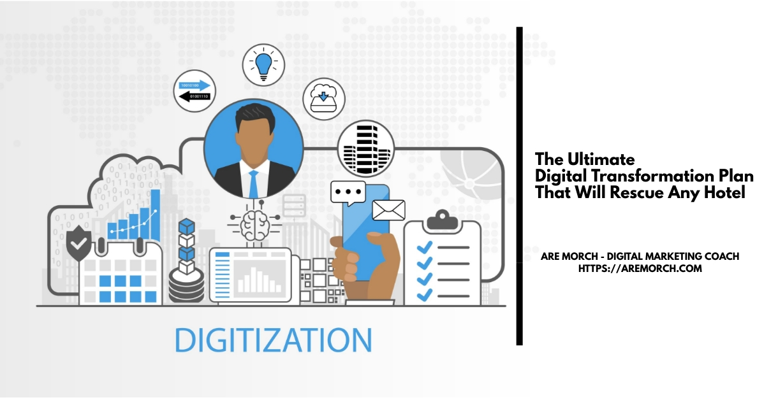
Introduction
The hospitality industry is in the middle of a large shift towards digitization that alters the way companies, customers, and employees engage
This shift makes use of technologies to promote operation effectiveness and consumer relations hence presenting many opportunities to the business person and the customer
In this respect, despite some damage to the environment, the use of digital tools, including combined Property Management Systems (PMS), as well as data analysis tools, is critical for sustaining competition
Notes:
The hospitality industry is in the middle of a large shift towards digitization that alters the way companies, customers, and employees engage. This shift makes use of technologies to promote operation effectiveness and consumer relations hence presenting many opportunities to the business person and the customer. In this respect, despite some damage to the environment, the use of digital tools, including combined Property Management Systems (PMS), as well as data analysis tools, is critical for sustaining competition.

Slide 3
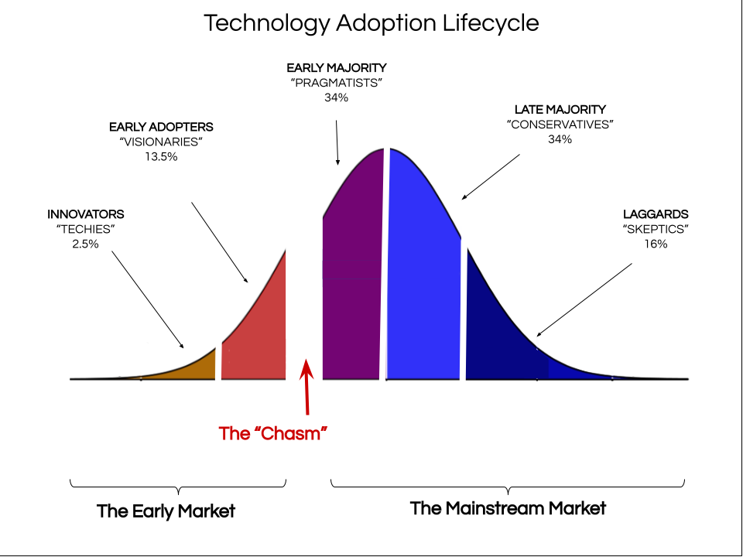
Literature Review
Impact of Digital Transformation on Hospitality and Tourism
Innovation theory in the hospitality industry modifies the procedure of the tourism companies to connect with the guests and employees
It has also transformed the operational procedures utilizing advanced technologies and systems (Vaska et al., 2021, p.5)
Intrepid Travel which registered a high sales in 2023, plans to incorporate the digital transformation to enable it meet demand for travel services with an aggressive expansion plan that the firm intends to embark on (Intrepid Travel, 2024, p.1)
Notes:
Innovation theory in the hospitality industry modifies the procedure of the tourism companies to connect with the guests and employees. It has also transformed the operational procedures utilizing advanced technologies and systems (Vaska et al., 2021, p.5). On the contrary, this change has significant advantages for entrepreneurs, consumers, and society even though there is a rise in concerns about the environment. According to Llopis-Albert et al., (2021, p.1), tourism companies must adopt new business models such as incorporating digital technologies for operational purposes and keeping car-sharing websites. For instance, Intrepid Travel which registered a high sales in 2023, plans to incorporate the digital transformation to enable it meet demand for travel services with an aggressive expansion plan that the firm intends to embark on (Intrepid Travel, 2024, p.1). However, these innovations have helped in making travel experiences easier to share with other people. In the hotel industry, these digital modifications have given advantages to tourism companies such as increased accessibility.

Slide 4

Challenges of Digital transformation in Hospitality and Tourism
The Technology Acceptance Model (TAM) is predict the willingness of person or group to adopt a new technology
The theory is based on the idea that a person's beliefs, attitudes, and intentions can explain the ways of using or adopt a technology (Na et al., 2022, p. 3).
There has been a rise in several challenges such as a shortage of funds, and a lack of professional digital employees in the process of digital transformation in the hospitality and tourism sector.
Notes:
The Technology Acceptance Model (TAM) is predict the willingness of person or group to adopt a new technology. The theory is based on the idea that a person's beliefs, attitudes, and intentions can explain the ways of using or adopt a technology (Na et al., 2022, p. 3). There has been a rise in several challenges such as a shortage of funds, and a lack of professional digital employees in the process of digital transformation in the hospitality and tourism sector. Other than this, there has been the rise of several competitors in the tourism industry which are also causing challenges in this industry (Sarfraz et al., 2023, p.3). In contrast, this has increased the pressure on companies to adopt innovations regularly. The digital transformation also raises challenges such as Data Piracy and misuse of consumer data which increases the demand for incorporating stringer data security. In staying competitive within the market the firms of the tourism industry are mandated to incorporate training that incorporates financial burden. Also, according to Tien et al., (2023, p.2), the local population or community near tourism areas should have advantages from the growth of tourism. The increase in the usage of technologies has raised the competition within the market as the competitors are continuously evolving and it creates pressure for innovation every time. However, social media platforms have also made experiences of travel more reachable and easy to share detail about local activities and give travellers the possibility to share and evaluate their own experience (Terziev, 2023, p.70).

Slide 5

PESTLE Analysis - Political Factor
This evaluates the Political, Economic, Social Technology, Environment and Legal factors of the external environment (Lib Guides, 2024, p.1).
The government of the UK regulates the hospitality sector heavily and places a strong emphasis on campaigns like the “Visit Britain” campaign.
In addition, there was a decrease of 460,000 EU workers and the number of non-EU workers rose by 130,000 (Springford and Portes, 2023, P.1).
Notes:
This evaluates the Political, Economic, Social Technology, Environment and Legal factors of the external environment (Lib Guides, 2024, p.1). The government of the UK regulates the hospitality sector heavily and places a strong emphasis on campaigns like the “Visit Britain” campaign. On the other hand, the government of the UK also provides funds for hotels to implement digitalized services like as innovations such as contactless check-ins and amounts. There was a shortage of labour in the tourism sector of the UK due to political instability such as the impact of Brexit. In addition, there was a decrease of 460,000 EU workers and the number of non-EU workers rose by 130,000 (Springford and Portes, 2023, P.1).

Slide 6
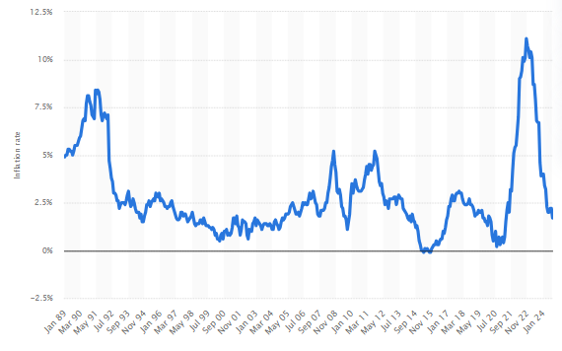
PESTLE Analysis - Economic Factor
The hospital industry’s advancement relies on GDP, with a modest enhancement noted in 2023 (Clark, 2024b, p.1).
The inflation has also impacted the operating cost of the hospital business but there was also a growth of GDP by 2.2% in August 2024 (Clark, 2024b, p.1).
In terms of technology, there has been a rise in technologies such as mobile check-ins and AI chatbots to improve services in the hospitality sector
Notes:
The hospital industry’s advancement relies on GDP, with a modest enhancement noted in 2023 (Clark, 2024b, p.1). The inflation has also impacted the operating cost of the hospital business but there was also a growth of GDP by 2.2% in August 2024 (Clark, 2024b, p.1). However, global consumers are also demanding personalised and eco-friendly travel experiences. On the contrary, consumers are influenced by social media to incorporate sustainable tourism and share their experiences on social media. In terms of technology, there has been a rise in technologies such as mobile check-ins and AI chatbots to improve services in the hospitality sector. On the other hand, the incorporation of the technology also emphasises the usefulness of strong cyber-security to prevent the misuse of Consumer Data. For instance, InterContinental Hotels experienced cyber-attack some years back (Mascellino, 2022, p.1). In the Legal section, the hotels and other businesses in the tourism sector are mandated to incorporate sustainability measures and data protection to fulfil the requirements of the customers and operate in eco eco-friendly manner.

Slide 7

PESTLE Analysis - Social Factor
Hospitality has been a necessary part of human civilisation and it has been evolving from ancient practices
In contrast, these practices consisted of sharing meals with strangers to the intricate dynamics of today's hospitality sector (Marques and Marques, 2023, p. 1).
A workstation takes into consideration working from a remote location, although the case comes with finding a new place during a vacation (Basu, 2023, p.1).
Notes:
Hospitality has been a necessary part of human civilisation and it has been evolving from ancient practices. In contrast, these practices consisted of sharing meals with strangers to the intricate dynamics of today's hospitality sector (Marques and Marques, 2023, p. 1). A workstation takes into consideration working from a remote location, although the case comes with finding a new place during a vacation (Basu, 2023, p.1). The protected areas provide a value-added product characterised by natural and sociocultural attributes as the basis for tourism (Stojanović et al., 2024, p.3). Big-scale AI application ratios of the transportation companies were 20% in 2016, and they were expected to grow 8% annually and one or multiple of these technologies had been employed (Huang et al., 2021, p.1082).

Slide 8
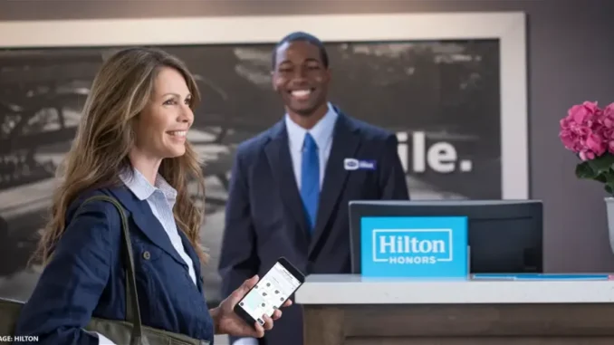
PESTLE Analysis - Technological Factor
Technological innovation is undergoing by the introduction of robotics and chatbots in interacting with consumers
For example, in late 2024, Hilton announced a new world campaign targeting more efficiency in peoples’ business travels under the technological aspect (Hotel Technology News, 2024, p.1)
The hotel industry is anticipated to incorporate technologies to make marketing strategies and adapt the recruitment process.
Notes:
Technological innovation is undergoing by the introduction of robotics and chatbots in interacting with consumers. The usage of AI chatbots has been useful in the hotel industry as they can handle complex queries and easily make bookings. These advancements facilitate the monitoring of remote employees and evaluate their performance evaluation and career growth as technology progresses. For example, in late 2024, Hilton announced a new world campaign targeting more efficiency in peoples’ business travels under the technological aspect (Hotel Technology News, 2024, p.1). Moreover, increasing the use of contactless technology is essential for good communication between employees and guests (Sharma and Bhartiya, 2023, p.5). The hotel industry is anticipated to incorporate technologies to make marketing strategies and adapt the recruitment process. The usage of Artificial Intelligence helps to provide personalized recommendations and enhance the user experience (Haven, 2024, p.1). Furthermore, the hospital sector can improve its services by incorporating these innovations.

Slide 9
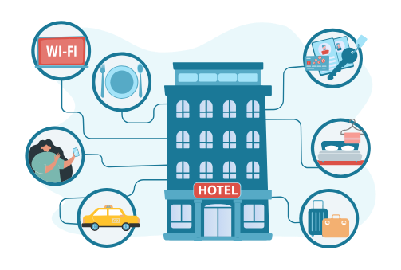
PESTLE Analysis - Environmental Factor
The hotel industry has experienced major shifts due to digitalization, leading to new prospects and hurdles
The advantages of digitalization comprise enhanced customer satisfaction, heightened operational productivity, reduced expenses, data-informed decision-making, and enhanced marketing tactics (Kumar et al., 2021, p.26)
Automation decreases labour expenses, energy-efficient systems decrease utility costs, and digitalisation helps sustainability initiatives by overseeing and enhancing energy consumption through smart sensors and automation
Notes:
The hotel industry has experienced major shifts due to digitalization, leading to new prospects and hurdles. The advantages of digitalization comprise enhanced customer satisfaction, heightened operational productivity, reduced expenses, data-informed decision-making, and enhanced marketing tactics (Kumar et al., 2021, p.26). Automation decreases labour expenses, energy-efficient systems decrease utility costs, and digitalisation helps sustainability initiatives by overseeing and enhancing energy consumption through smart sensors and automation. Utilising data to make decisions enables hotels to make informed choices using guest preferences and behaviours, ultimately boosting guest satisfaction and revenue.

Slide 10

PESTLE Analysis - Legal Factor
Businesses are required to abide by laws like GDPR in order to protect customers’ data and it is important for building trust (GDPR, 2024, p.1).
Warwickshire County Council has vowed to act quickly to reduce our carbon emissions to net zero across the council by 2030, and to help Warwickshire become net zero as a county by 2050 at the latest (Democracy, 2023, p.3).
Hotels need to carefully consider these advantages and disadvantages to effectively incorporate digital technologies and stay competitive in a rapidly changing industry (Rodrigues and Proença, 2022, p.3).
Notes:
Businesses are required to abide by laws like GDPR in order to protect customers’ data and it is important for building trust (GDPR, 2024, p.1). Drawbacks of digitalization encompass costly start-up costs, worries about security and privacy, decreased personal interaction, reliance on technology, unemployment due to automation, and disparities in access to digital tools. Warwickshire County Council has vowed to act quickly to reduce our carbon emissions to net zero across the council by 2030, and to help Warwickshire become net zero as a county by 2050 at the latest (Democracy, 2023, p.3). Hotels need to carefully consider these advantages and disadvantages to effectively incorporate digital technologies and stay competitive in a rapidly changing industry (Rodrigues and Proença, 2022, p.3). However the Working Time Regulations 1998 also caution that in the UK for instance workers have to work 48 hours a week (CIPD, 2024, p.1).

Slide 11
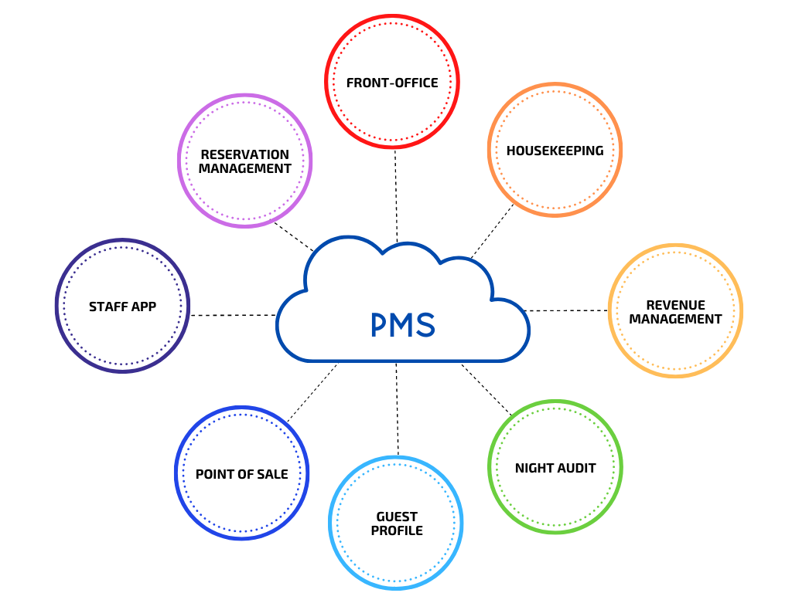
Evaluate Future Policy and Management Options for the Chosen Theme
In the contemporary world IT-enabling facilities like high-speed broadband connections and PMS integrated with other facility management systems are required for the hospitality business
The usage of property management system (PMS) software has been done in the hotels in 1980 (Wynn and Lam, 2023, p.2).
The usage of Customer Relationship Management (CRM) systems with digital strategies meant to improve the overall customer experience (Clark, 2023, p.18).
Notes:
In the contemporary world IT-enabling facilities like high-speed broadband connections and PMS integrated with other facility management systems are required for the hospitality business. The usage of property management system (PMS) software has been done in the hotels in 1980 (Wynn and Lam, 2023, p.2). In contrast, these software had features of front-office applications and also back-end financial transaction processing and reporting functions (Wynn and Lam, 2023, p.2). The usage of Customer Relationship Management (CRM) systems with digital strategies meant to improve the overall customer experience (Clark, 2023, p.18). The integration of new technologies is important for enhancing the quality of the services for the consumers. However, it is also important that the staff members of the hotel are also aware of the usage of the technologies to adopt digitalisation. In the following, digital technologies can be assumed to be capable of using resources with a focus on sustainable development (Schönherr et al., 2023, p.83). There is also a requirement of the Reliable Data Protection Initiatives for protecting the data of the consumers. Businesses are required to abide by laws like GDPR in order to protect customers’ data and it is important for building trust (GDPR, 2024, p.1). The usage of the block chain offers some important advantages such as safe digital transactions and better security of data (Narayan et al., 2022, p.14).

Slide 12

Conclusion
On a concluding note,
The digital transformation of the industry has its advantages and drawbacks.
As the current technologies improve customer experience as well as operations, the implementation of these advanced technologies brings about consideration of data security and staff training.
The ultimate effective application of these innovations requires knowledge of the benefits they bring and the risks they may have
Notes:
On a concluding note, the digital transformation of the industry has its advantages and drawbacks. As the current technologies improve customer experience as well as operations, the implementation of these advanced technologies brings about consideration of data security and staff training. The ultimate effective application of these innovations requires knowledge of the benefits they bring and the risks they may have.

Slide 13
References
Basu, A., (2023), Rising trend of workcations – the marriage of travel and remote work, Available at: https://hospitality.economictimes.indiatimes.com/news/speaking-heads/rising-trend-of-workcations-the-marriage-of-travel-and-remote-work/100845479#:~:text=A%20'workcation'%20is%20a%20vacation,with%20exploring%20a%20new%20location. [Accessed on 23/10/2024]
CIPD, (2024), Working time: UK employment law, Available at: https://www.cipd.org/uk/knowledge/employment-law/working-time/#:~:text=The%20Working%20Time%20Regulations%201998,the%20right%20to%20paid%20leave. [Accessed on 23/10/2024]
Clark, D. (2024a) Gross domestic product of the United Kingdom from 1948 to 2023(in million GBP), Available at: https://www.statista.com/statistics/281744/gdp-of-the-united-kingdom/#:~:text=GDP%20of%20the%20UK%201948%2D2023&text=The%20gross%20domestic%20product%20of,compared%20to%20the%20previous%20year. [Accessed on 03/10/2024]
Clark, D. (2024b) Inflation rate for the Consumer Price Index (CPI) in the United Kingdom from January 1989 to August 2024. Available at: https://www.statista.com/statistics/306648/inflation-rate-consumer-price-index-cpi-united-kingdom-uk/#:~:text=The%20UK%20inflation%20rate%20was,11.1%20percent%20in%20October%202022. [Accessed on 03/10/2024]
Collins, G., (2023). Impact of Digitalization on Customer Experience Management in the Hospitality Industry. Hospitality and Tourism Journal, 1(1), pp.12-23.
Democracy, (2023), WARWICKSHIRE Sustainable Futures Strategy, Available at: https://democracy.warwickshire.gov.uk/documents/s33794/Appendix%201%20for%20Sustainable%20Futures%20Strategy.pdf [Accessed on 23/10/2024]
GDPR, (2024), Principles relating to processing of personal data, Available at: https://gdpr-info.eu/art-5-gdpr/ [Accessed on 03/10/2024]
Haven, (2024), Privacy policy, Available at: https://www.haven.com/support/privacy-policy [Accessed on 03/10/2024]
Hotel Technology News, (2024), Hilton Launches Tech-Enabled Global Program Aimed at Simplifying Business Travel, Available at: https://hoteltechnologynews.com/2024/01/hilton-launches-tech-enabled-global-program-aimed-at-simplifying-business-travel/ [Accessed on 23/10/2024]
Huang, A., Chao, Y., de la Mora Velasco, E., Bilgihan, A. and Wei, W., (2022). When artificial intelligence meets the hospitality and tourism industry: an assessment framework to inform theory and management. Journal of Hospitality and Tourism Insights, 5(5), pp.1080-1100.
Intrepid Travel, (2024), Intrepid partners with Kaptio, Available at: https://www.intrepidtravel.com/en/newsroom/releases/intrepid-partners-kaptio [Accessed on 23/10/2024]
Kumar, V., Rezaei, J., Akberdina, V. and Kuzmin, E., (2021). Digital Transformation in Industry. Springer International Publishing.
Lib Guides, (2024), Industry Research, Available at: https://libguides.libraries.wsu.edu/c.php?g=294263&p=4358409 [Accessed on 23/10/2024]
Llopis-Albert, C., Rubio, F. and Valero, F., (2021). Impact of digital transformation on the automotive industry. Technological forecasting and social change, 162, p.120343.
Marques, J. and Marques, R.P., (2023). Digital transformation of the hotel industry: Theories, practices, and global challenges. Springer Nature.
Mascellino, A., (2022), Hackers Admit Destroying InterContinental Hotels Group's Data 'For Fun', Available at: https://www.infosecurity-magazine.com/news/hackers-destroying-ihgs-data-for/ [Accessed on 23/10/2024]
Na, S., Heo, S., Han, S., Shin, Y. and Roh, Y., (2022). Acceptance model of artificial intelligence (AI)-based technologies in construction firms: Applying the Technology Acceptance Model (TAM) in combination with the Technology–Organisation–Environment (TOE) framework. Buildings, 12(2), p.90.
Narayan, R., Gehlot, A., Singh, R., Akram, S.V., Priyadarshi, N. and Twala, B., (2022). Hospitality feedback system 4.0: digitalization of feedback system with integration of industry 4.0 enabling technologies. Sustainability, 14(19), p.12158.
Rodrigues, M.A. and Proença, J.F. eds., (2022). Impact of Digital Transformation on the Development of New Business Models and Consumer Experience. IGI Global.
Sarfraz, M., Khawaja, K.F., Han, H., Ariza-Montes, A. and Arjona-Fuentes, J.M., (2023). Sustainable supply chain, digital transformation, and blockchain technology adoption in the tourism sector. Humanities and Social Sciences Communications, 10(1), pp.1-13.
Schönherr, S., Eller, R., Kallmuenzer, A. and Peters, M., (2023). Organisational learning and sustainable tourism: the enabling role of digital transformation. Journal of Knowledge Management, 27(11), pp.82-100.
Sharma, S. and Bhartiya, S. eds., (2023). Technology and Social Transformations in Hospitality, Tourism and Gastronomy: South Asia Perspectives. CABI.
Springford, J., and Portes, J., (2023), The impact of Brexit on the UK labour market: an early assessment, Available at: https://ukandeu.ac.uk/the-impact-of-brexit-on-the-uk-labour-market-an-early-assessment/#:~:text=By%20September%202022%2C%20there%20was,1%25%20of%20the%20labour%20force. [Accessed on 03/10/2024]
Stojanović, T., Trišić, I., Brđanin, E., Štetić, S., Nechita, F. and Candrea, A.N., (2024). Natural and sociocultural values of a tourism destination in the function of sustainable tourism development—An example of a protected area. Sustainability, 16(2), p.759.
Terziev, V., (2023). Strategic Management in the Conditions of Global Crises and the New Social Leaders. Available at SSRN 4661025.
Tien, N.H., Van Trai, D. and Quyet, N.X., (2023). The impact of digital transformation on tourism sustainable development: a case of SMEs in Vietnam.
Vaska, S., Massaro, M., Bagarotto, E.M. and Dal Mas, F., 2021. The digital transformation of business model innovation: A structured literature review. Frontiers in Psychology, 11, p.539363.
Wynn, M. and Lam, C., (2023). Digitalisation and IT strategy in the hospitality industry. Systems, 11(10), p.501.

