Slide 1

PROGRAMME: CERTIFICATE IN HIGHER EDUCATION BUSINESS SKILLS FOR THE WORKPLACE
MODULE: ENTERPRISE AND ENTREPRENEURSHIP
MODULE CODE: LCLM4006
ASSIGNMENT 2: INDIVIDUAL PRESENTATION PITCH TO LECTURER

Slide 2
Table of contents
Slide 1: Cover page
Slide 2: Table of Contents
Slide 3: Introduction
Slide 4: Overview of the business idea
Slide 5: Legal format and management structure of a startup enterprise
Slide 6: Expert Team
Slide 7: PESTEL analysis
Slide 8: PESTEL analysis
Slide 9: Marketing strategies the enterprise will adapt to reach its customers
Slide 10: Marketing strategies the enterprise will adapt to reach its customers
Slide 11: Stating the funding required and its allocation with some future financial projections in “Kicks”
Slide 12: Future financial projections in the “Kicks”, UK
Slide 13: Conclusion
Slide 14: References

Slide 3

Introduction
Kicks vegan snacks can build up a new startup in the UK to get a position in the snacks industry.
The financial budget and complex system of budgetary inflation can help reach customers.
Notes:
The overview of this report is about a new startup and how it will reach its customers. Using policies and accumulated financial funds, how they can foster a sense of success is discussed here.

Slide 4
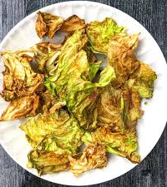
Overview of the business idea
The chosen business idea is about a company that makes healthy chips from colourful cabbages.
To grab the snacks industry in the UK, they have the attraction of young stars and are suggested by the advisors Morales Overview of the business idea (Morales, 2023)
Notes:
Kicks the company that will prepare healthy and tasty snacks that make cabbage chips with crunchy bites without any harmful ingredients. 50% of the elements and snacks are only air-fried or dipped in the microwave. Several flavoured foods will be ready to eat, and some of them must be prepared. These Kicks can attract youngsters because they are such good items and suggested by health consultants, gym trainers and others (Morales, 2023).

Slide 5

Legal format and management structure of a startup enterprise
Kicks shareholder is a PLC that has maintained a proper tax structure and has more joint investors (Cameron, 2024).
A PLC has many demerits, which can create disadvantages and hinder the increasing rate of application.
Notes:
Kicks has been registered as a private limited company or social enterprise, which can take the opportunity of holding several shareholders who come together and are funded throughout the angel investor process. They have more advantages, such as protecting tax laws and funding investment, which is more inspiring through such companies. Kicks have the responsible forces conducting the issue for the requirements of regulation (Cameron, 2024). On the other hand, the problems that PLCs have a chance to face are the constructive way of holding limited partnership processes and having less chance of breaking down and less stability in terms of practices. Kicks’ management structure will have a flat hierarchy by having separate departments for the different people and places (CFI, 2023).

Slide 6
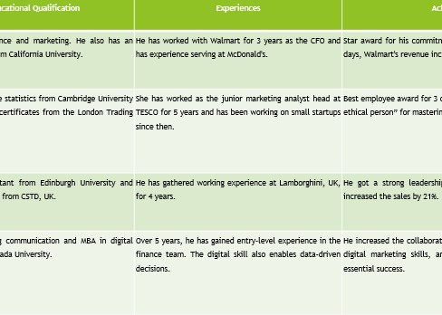
Expert Team
Huxley Smith & Oaklee Jokes will operate as the CEO & CFO in "Kick's" and will take care of supervising and advising.
Herper Brown and Jack Evans will be tackling the customer engagement and marketing team respectively as the CFA & BBA.
All of them will share their experiences and achievements to other employees.
Figure 1: Team with a specialised marketing strategist
(Source- Self-done)
Notes:
Speaker notes
Huxley Smith-CEO (MBA.LLB) will take the responsibility to guide and supervising all duties in operations together.
Oaklee Jones-CFO (BSc. quantitative finance) is the main head of taking all the responsibility of advising about the budget and planning the operations.
Harper Brown-social media manager (CFA), is the main motivator to work on how the company is getting customer engagement.
Jack Evans-Marketing expertise (BBA in marketing) will take the duty to get on the special operations of the marketing team head.

Slide 7
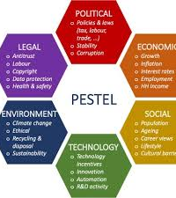
PESTEL analysis
Political actors describe the discussion of industrial operations (Siddiqui, 2021).
Economic factors also face the perception of making products of kicks.
Social factors like demographics and choices of population are discussed here (Statista, 2024).
Notes:
Pestle analysis helps describe the external macro factors that will describe the process of competing with the industry's success opportunities (Siddiqui, 2021).
Political
Overall, 15 cents to spend on eating supermarkets and going to farmers and grocery items, which are several averages of 64% sales, will affect the sales and success state of kicks (Pereira, 2021).
Social
Cultural interference, customer preferences and the traditional types of food habits will easily attract the items for kicks’ increasing market (Statista, 2024).
Economic
Consumers can discuss the issue of inflation, and it is necessary to determine the impacts of snacks on human health, which will create an impact on the snack company's kicks (M and D, 2023)

Slide 8
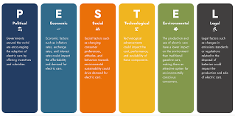
PESTEL analysis
Technological factors' adaptation can affect kicks (Munialo and Mellor, 2024).
Environmental and legal factors, such as the protection of ethical labour rules and saving the environment, are necessary (Siddiqui, 2021).
Legal rights are another element that will help kick-start the process of gaining customers' attention.
Notes:
Technological
Using advanced and modern technology, buildings have more chances in the snack industry to find errors in human appreciation for getting the legal elements, having a written concealed review by the kicks (Munialo and Mellor, 2024).
Environmental
The ground effects of community safety and protection of eco-friendly material and deliver pounces used by the ethics maintained by the new kicks will be known in sourcing material (Siddiqui, 2021).
Legal
Protection of employment law, the strictness in the UK’s legal perception and the chances for the observance will indirectly vary with the price of kicks (Pereira, 2021).

Slide 9
Through the marketing mix, the Kicks’ planned idea of price formation and how they will capture the market is given (Abedian et al. 2022).
The proportional strategy is accepted through the given ideas of generating strategies.
Marketing strategies the enterprise will adapt to reach its customers
Notes:
Marketing mix is the strategy that will help to choose the descriptive way of analysing the different factors that can help understand the desired customers (Abedian et al. 2022).
Price
Kicks will take the penetration pricing policies that can enhance the structure of describing the options through a full purchase to compete with the market strategies (Luick et al. 2023).
Promotion
Kicks will do the promotion through the social media influencers to be a part of the snack food industry and get more customers in both offline and online entry (Hyslop, 2024).

Slide 10

Marketing strategies the enterprise will adapt to reach its customers
Kicks will provide cabbage chips made only air-fried or made in the microwave and suggested as a part of a healthy diet.
Kicks has planned to develop a good design for the selected place of the product vulnerability and get the opportunities (Luick et al. 2023).
Notes:
Product
Chosen products of kicks will be gluten-free and flavourful recipes to face the global competition, as the global competition is low for these products. The supermarket will get an entry (Hyslop, 2024).
Place
Kicks will design their stores annually to get the help of automated policies for doing primary analysis and primarily removing the location (Luick et al. 2023).

Slide 11
Stating the funding required and its allocation with some future financial projections in “Kicks”
Kicks has selected angel investors for their resources of funding and gets constant budgetary support from them (Mordor Intelligence, 2025).
A small percentage of their budgetary plan is based on the future budget and the generated cash flow forecast.
Notes:
Kicks has chosen the method of selecting angel investors for their investing process and will work through to find an amazing family, and will involve time for fusion to get the products and investment portfolio. A capital association of 55000 thousand dollars can seek to attract successful investors. The small percentage investment portfolio and infusion of finance. The kicks will get the share analysis and funding and get multiple funds. Angel investors and development ideas through the Startups Capital Association have positive results. Entrepreneurs will access involvement to get successful opportunities, as customers. Financial projections and starting funds are required to allocate loans and reimbursements through the total cash flows. Followed by the structure's micro and macro findings from international startup foundations (Mordor Intelligence, 2025).

Slide 12
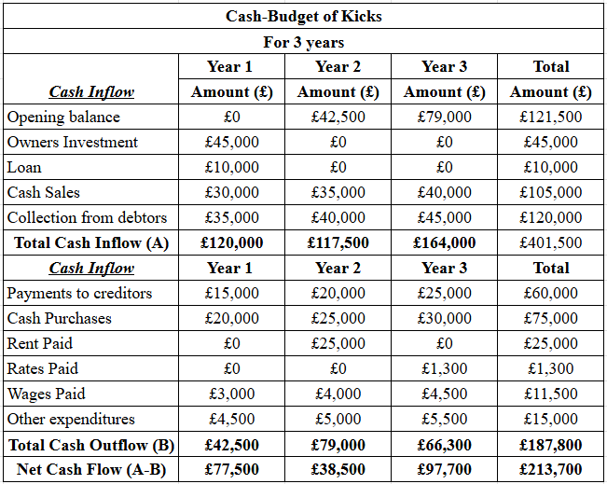
FUTURE FINANCIAL PROJECTIONS IN THE “KICKS”, UK
The opening balance for the startup has decided to be 45,000 Pounds.
The initial collection from the debtors will be 3,500 Pounds.
42,500 pounds will be the total cash flow for "Kick's".
Figure 2: Financial Project of Kicks.
(Source: Self-Created, 2025).
Notes:
Showing how the 45000 euros can get the initial years and owners to get the three years, and the next three years. The future operation of debtors has taken the respective way of getting the future generated cash flows that are 77,500 euros in year 1, 38,500 euros in year 2 97, and 000 euros in year 3, constantly. Collected cash flow is associated with the highlight of the financial projections.

Slide 13

Conclusion
The situation is to achieve the success of having your entry of visible operations.
The statutory decision is built on the marketing and sales operation.
Notes:
The expertise team described here, for kicks, is used to show the reason for one’s success. The height motivation of the team must acquire the strategy that is built on the formation of trends and experiences of collaboration with entry.

Slide 14
References
Abedian, M., Amindoust, A., Maddahi, R. and Jouzdani, J., (2022). A game theory approach to selecting marketing-mix strategies. Journal of Advances in Management Research, 19(1), pp.139-158.Link:https://www.emerald.com/insight/content/doi/10.1108/jamr-10-2020-0264/full/html
Cameron, H. (2024) What is a private limited company in the UK?, Osome. Available at: https://osome.com/uk/guides/private-limited-company/ (Accessed: 19 July 2025).
CFI (2023) Private company. Corporate Finance Institute. Available at: https://corporatefinanceinstitute.com/resources/accounting/private-company/ (Accessed: 19 July 2025).
Hyslop, G. (2024) From CSR to marketing might: 6 proven strategies to boost your bakery and snacks business, BakeryAndSnacks.com. Available at: https://www.bakeryandsnacks.com/Article/2024/09/19/6-proven-strategies-to-boost-your-bakery-and-snacks-business/ (Accessed: 19 July 2025).
Luick, M., Pechey, R., Harmer, G., Bandy, L., Jebb, S.A. and Piernas, C., (2023). The impact of price promotions on confectionery and snacks on the energy content of shopping baskets: A randomised controlled trial in an experimental online supermarket. Appetite, 186, p.106539.Link:https://www.sciencedirect.com/science/article/pii/S0195666323000922
M and D (2023) United Kingdom healthy snacks market size, share and growth 2032 (2023) Markets and Data. Available at: https://www.marketsandata.com/industry-reports/united-kingdom-healthy-snacks-market (Accessed: 19 July 2025).
Morales, P. (2023) Cabbage: Health benefits, facts, research, Medical News Today. Available at: https://www.medicalnewstoday.com/articles/284823 (Accessed: 19 July 2025).
Mordor Intelligence (2025) Snack Food Market Size: Available at: https://www.mordorintelligence.com/industry-reports/snack-food-market (Accessed: 19 July 2025).
Munialo, C.D. and Mellor, D.D., (2024). A review of the impact of social disruptions on food security and food choice. Food Science & Nutrition, 12(1), pp.13-23.Link:https://onlinelibrary.wiley.com/doi/full/10.1002/fsn3.3752
Pereira, J.L. (2021) Revealed: The true extent of America’s food monopolies, and who pays the price, The Guardian. Available at: https://www.theguardian.com/environment/ng-interactive/2021/jul/14/food-monopoly-meals-profits-data-investigation (Accessed: 19 July 2025).
Siddiqui, A.A. (2021). The use of Pestel analysis tool of quality management in the health care business and its advantages. Am J Biochem Biotechnol, 14, pp.507-12.Link:https://www.researchgate.net/profile/Ahsan-Siddiqui/publication/356505320_The_Use_of_PESTEL_Analysis_Tool_of_Quality_Management_in_the_Health_Care_Business_and_its_Advantages/links/619e6d8cd7d1af224b21efd4/The-Use-of-PESTEL-Analysis-Tool-of-Quality-Management-in-the-Health-Care-Business-and-its-Advantages.pdf?_sg%5B0%5D=started_experiment_milestone&origin=journalDetail
Statista (2024) Snack Food - United Kingdom: Statista market forecast (2024) Statista. Available at: https://www.statista.com/outlook/cmo/food/confectionery-snacks/snack-food/united-kingdom (Accessed: 19 July 2025).

