Slide 1
International Business Communication SBUS6111
Week 1
International Business Communication
SBUS6111
Dr Ejindu Iwelu Morah
BSc (Hons), MA, MBA, MPhil, PhD, ACIM, MPM, FHEA
Email: ejinduiwelu.morah@uwtsd.ac.uk

Slide 2
Culture and Linguistics
International Business Communication SBUS6111
Week 1

Slide 3
Major Themes
Bilingualism
Partial Bilingualism
unilingual
First Language Speakers
Their effectiveness on Managers

Slide 4
Culture is the way of life of a group of people

Slide 5
International Business Communication
Bilingualism
The ability to speak two languages with the facility of a native speaker. 2. spoken, written, or containing similar information in two different languages: a bilingual dictionary; Public notices at the embassy are bilingual.

Slide 6
International Business Communication
Partial Bilingualism
It is whereby an individual attains native-like proficiency in the full range of understanding, speaking, reading, and writing skills in one language but achieve less than native like skills in some or all of these skills in the other language.
e.g. A student in a Bilingual Program is able to speak, read, listen, and write in English but not in Spanish.

Slide 7
International Business Communication
Unilingual
As a definition it refers to relating to only one language, e.g. only knowing English

Slide 8
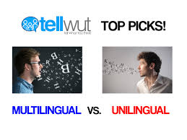

Slide 9
First Language Speaker
A first language is the language or are the languages a person has been exposed to from birth ... Native speakers are considered to be an authority on their given language because of their natural acquisition ... and the "first language" refers

Slide 10
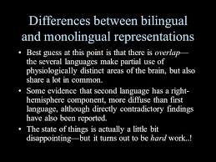
Bilingualism (Multilingualism) Used interchangably

Slide 11
Bilingualism (Multilingualism) Used interchangably
Individual Bilingualism – the use of two (or more) languages by an individual
Definition of Multilingualism - using or able to speak several or many languages with some facility.
E.g., an individual who speaks both English and Spanish as described by many of the informants in the Hinton article
Societal Bilingualism – the use of two (or more) languages within a given community
E.g., the bilingual setting in India, Canada, Switzerland, Malaysia, etc.

Slide 12
Bilingualism
Research has found a positive link between proficiency in more than one language and cognitive and academic skills (Armstrong & Rogers, 1997; Bialystock & Hakuta, 1994: Cummins, 1992; Hakuta, 1986). Some studies indicate that individuals who learn a second language are more creative and better at solving complex problems than those who do not (Bamford & Mizokawa, 1991; Cummins, 1992).
Standardized test results show that students who have focused on foreign language studies routinely achieve among the highest scores in all subjects tested (The SAT College Board, 2002).

Slide 13
Bilingualism
Being able to speak more than one language –
Bilingual helps to maintain our political and security interests, and promote tolerance and intercultural awareness.
(Pratt, 2002; Sollors, 2002 in Working Together to Build a Multilingual Society: brochure prepared by the Center for Applied Linguistics).

Slide 14
What it means to be bilingual ..
75% of the world’s population speak two or more languages.
Not all bilinguals speak two languages at the same level.
By the age of 2.5, a bilingual child begins to make choices in language use, usually the majority language.
Parents who want their children to retain their heritage language must work at it.
In the U.S. immigrants are strongly urged to assimilate and discourages from retaining their heritage language.
That is a national loss.

Slide 15
What it means to be bilingual ..
things to different people.
To the average person, bilingualism can be loosely defined as:
the use of two languages or
the native-like control of two languages.

Slide 16
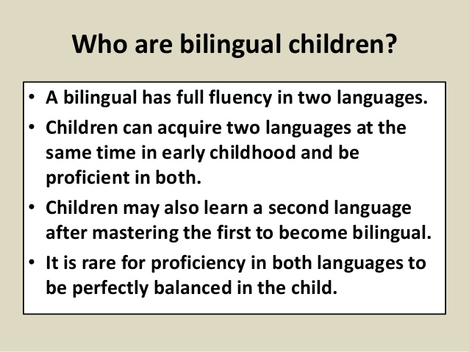

Slide 17
Describing Bilingualism & Multilingualism
Five important variables in relation to bilingualism:
1] degree of bilingualism
2] context of bilingual language acquisition
3] age of acquisition
4] domain of use of each language
5] social orientation

Slide 18
Degree of Bilingualism – Dominant Bilinguals
Individuals who are dominant in one language.
Less dominant language = ‘subordinate.’
Dominance does not apply to all domains.
One may be dominant in the subordinate language in some domains.

Slide 19
Degree of Bilingualism – Dominant Bilinguals
Individuals who are gradually losing competence in one language, usually because of disuse.
common among immigrant groups
often loose productive skills while retaining receptive skills

Slide 20
Semilinguals / Limited Bilinguals
Individuals who appear to have limited proficiency in both languages. Deficit in six language competencies:
size of vocabulary
correctness of language
unconscious processing of language (automation)
language creation
mastery of the functions of language (e.g., emotive, cognitive)
meanings and imagery

Slide 21
Age of Acquisition
Sensitive age for language learning (from Lenneberg’s 1967 ‘critical period’): We have a superior language learning capacity early in life which will disappear or decline with maturation.
evidence for exceptions
no clear cut-off age
Important references on age & acquisition:
Birdsong, D. 1992. Ultimate attainment in second language acquisition. Language 684: 706-755
Birdsong, D. 2005. Interpreting age effects in second language acquisition, In J. Kroll & A De Groot, eds., Handbook of bilingualism: Psycholinguistic approaches. New York: Oxford University Press.

Slide 22
Age of Acquisition
Possible factors:
neurological
aptitudes
attitude
identity and motivation
nature of exposure
What is a ‘native speaker’?

Slide 23
Age of Acquisition
Rate your competence in your first language in the four macro skills (LSRW). Are you equally competent in all skills? What would be considered ‘native-like’ proficiency for a learner of that language? What levels of competence do you expect native speakers to have?
Who would you rule out as a native speaker? What standards of norms do you use in your assessment? (Consider someone brought up in India or the Philippines who speaks English as a first language. Would you consider that person a native speaker?)

Slide 24
Influence and Variables on Language Acquisition
Domains: the different spheres of influence in a speaker’s life –
Family
Friendship
Religion
Education
Employment
etc.

Slide 25
Influence and Variables on Language Acquisition
Interlocutors: a language relationship tends to evolve naturally. And once established, it is usually not easy to alter
Place or Location: work vs. home; physical location like neighborhoods
Topic: language of technical discourse or cooking, gardening, etc.

Slide 26
Social Orientation
Attitudes of bilinguals toward their bilingual status;
Attitudes toward the larger community;
Attitudes of the larger community toward them and their bilingual status.

Slide 27
Additive vs. Subtractive Bilingualism
Subtractive bilingualism / differential bilingualism: Without first language support, the learning of a new language may entail the loss of that first language.
Additive bilingualism: an environment conducive to the development of the first language as well as the development of the second language results in the maintenance of both.

Slide 28
Multilingualism and Business Context
Managers need to be aware of their audience
Managers with international teams need to ensure their communication is effective
Managers should ensure they have a feedback mechanism so personnel who are unsure can have a route to clarify the communication in a non- threatening way

Slide 29
Next Week........
Business English as a Foreign Language
Lingua franca
Language effects on business
Global consumer culture

Slide 30
Seminar
Assume you are the manager of Nestle Plc in India, what skill do you need to get along with your Hindi speaking colleagues?
What are the benefits of language to the modern manager?
What cultural factors would you consider in communicating with a nationally diverse group?
To what extent would you consider bilingualism relevant in an international business context?
What effects are subtractive and additive bilingualism amongst managers?

