Slide 1



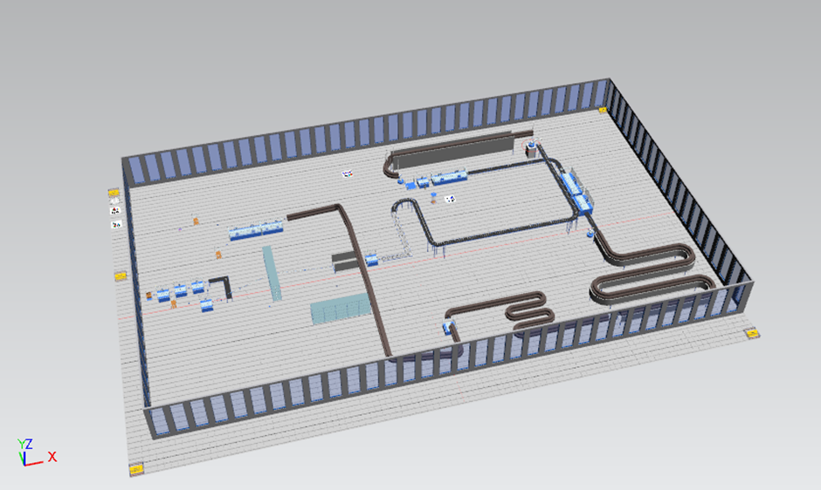
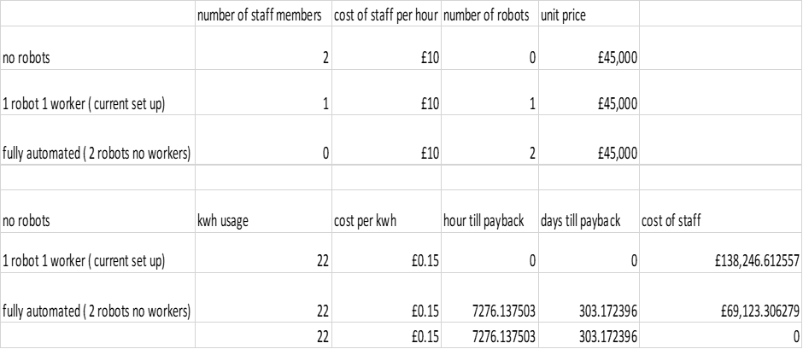
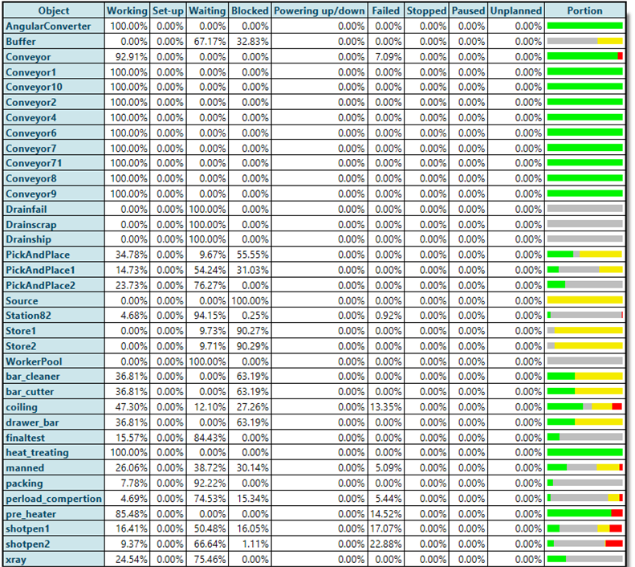
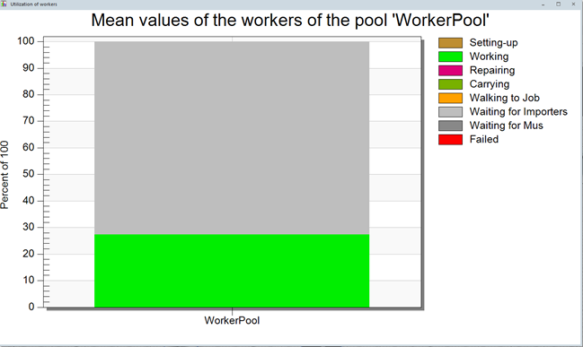
Your Pic
OPTIMISASTION OF PRODUCTION LINES USING LEAN PRICEABLE, SIMULATIONS AND AUTOMATION
Iwan Rhys Dyer, p149128
Dr Arnaud Marotin and Richard Morgan
School of Engineering
BEng (Hons) Mechanical Engineering
Introduction
This report aims to discuss techniques that are commonly used in industry to optimise a production line, then coupling these techniques with higher levels of mechanisation to further improve the line and reduce the overheads of the facility and in turn boosting profits.
This report will use Allevard Springs as a case study and will discuss in detail their production line. It will then identify weakness in their production line or supply chain, and then suggest improvements that could result in increasing their profit margins.
Below is a table showing the time to pay back for a stranded industry robot if it was to replace a manned operation.
Above is an image of the simulated plant. This plant in the moment of this image is in a state of change over.
This report found there was some significant short comings in Allevard's production line primarrery coming from there need to over enginer there product and the massive amount of transportation parts would undergone during there production cycle.
Background history
during the research, the collective consciences was that lean manufacturing was a great set of principle that will boost more production lines efficiency far beyond what. [1][2]
Striving to achieve the fastest line speed possible may lead to a lot more failures down the line. Quality, failure rates, scrap rates, and down time all effect the effectiveness of a line. All of these have their own measurements for example for failure the most used in industry is six sigma. [3]
You can also continue mentioning your key literature survey findings here.
Acknowledgements
I would like to express my gratitude to my supervisor’s Dr Arnaud Marotin and Richard Morgan for their assistance and support throughout this project.
I would also like to thank Dr Robert Goodson, Dr Greg Owen for there advice and guidance. I would also like to thank Ryan Cording for his help teaching me plant sim.
This table shows the effectiveness of each process in the production line.
References
James P. Womack, Daniel T. Jones, Daniel Roos, 1991. Machine That Changed the World: The Story of Lean Production.
Michal Leporis and Zdenka Králová, 2010. A SIMULATION APPROACH TO PRODUCTION LINE BOTTLENECK ANALYSIS, Slovak: Slovak university.
Thomas Pyzdek, Paul Keller, 2000. six-sigma handbook 4th addition.
This table shows the effectiveness of a manned opination
School of Engineering

