Slide 1

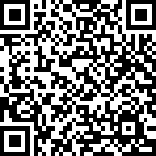
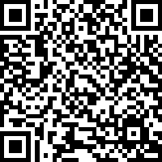
Arholwg Profiad Academaidd
Academic Experience Survey
Israddedigigion: Myfyrwyr Blwyddyn 1 a 2
(Ac eithrio dechreuwyr newydd a myfyrwyr HND ar eu blwyddyn olaf )
Undergraduates:
1st & 2nd year students
(Excluding new starters and final year HND students)
Mewngofnodi: Manylion Adnabod myfyriwr PCYDDS
Cyfrinair: 2025
Login: Student ID number
Password: 2025

