Slide 1

BMHP5032 Introduction to Physiology
Component 2 – Presentation
Care Plan
Student ID: 2415803
Student name: Paula Gavriloaei
Lecturer Name: Shaila Hussain

Slide 2
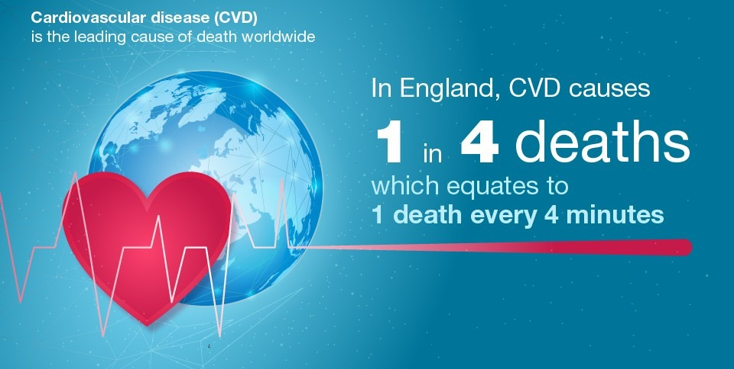
Introduction
Stroke and cardiovascular disease are identified as major health issues in the UK (Public Health England, 2019).
Michael is at high risk of repeated strokes.
Evidence-based and structured care plans are important.
The evidence-based care plan recommendations align with NICE and NHS guidelines.
Public Health England (2019). Health matters: preventing cardiovascular disease. GOV.UK
Notes:
Cardiovascular disease amongst other health diseases, is considered the major causes of disability and mortality in people in the UK. As per the NHS, people with diabetes, hypertension, stroke history and obesity are at high risk of cardiovascular disease with recurrent events (Public Health England, 2019). From the case study, it is evident that in 2022, Michael had ischaemic stroke, with Type II diabetes and uncontrolled hypertension that puts him in the high-risk segment. The evidence-based recommendations will help him prevent recurrent events.

Slide 3
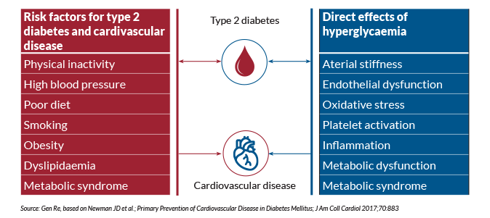
Information about the person
Michael lives in the United Kingdom.
58-year male.
BMI- 31.
Blood pressure level- 155/95 mmHg.
Type 2 diabetes.
Medical history- ischemic stroke during 2022.
“Diabetes–Cardiovascular Disease Relationship Overview”
Notes:
Michale Smith is a 58 year old UK resident live in London. He is married and has two children. Michale is working in a corporate sector. His BMI is 31 that indicate his obese issues and enhance the possibility of cardiovascular threat. Michael's blood pressure level is 155/90 mmHg on average. This level refers a strong sense of uncontrolled hypertension and from laboratory findings it is presented that his Hemoglobin A1C is 8.2% (Type 2 diabetes). During 2022 he has went through an ischemic stroke that further create a high risk for recurring cardiovascular issues. A proper reshaping of lifestyle modification and strict medical treatment is vital for prevention.

Slide 4
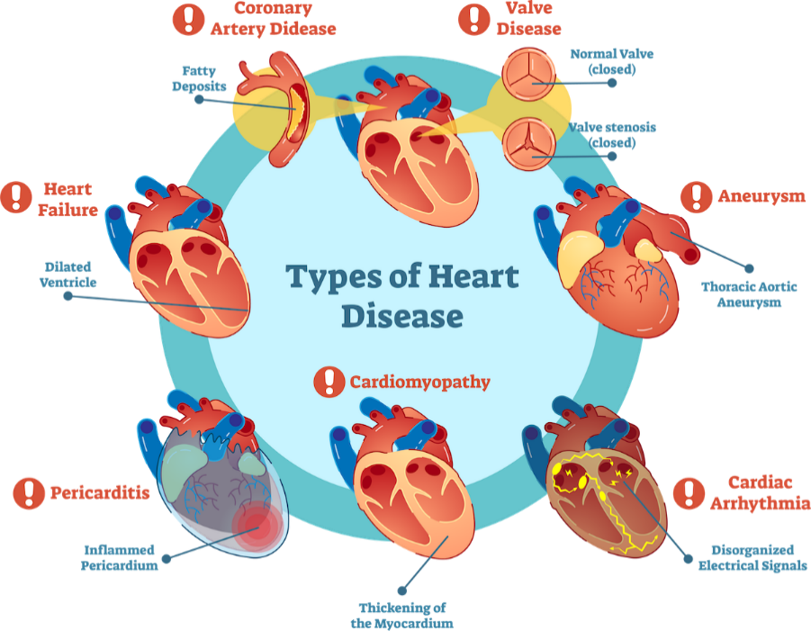
Anatomy and Physiology (cardiovascular disease and stroke)
Adversely impacted heart and blood vessels.
Fatty deposits like Plaque develop inside the arteries.
Hypertension impacted and weakens the blood vessels (Kućmierz et al., 2021).
Diabetes make the blood vessels inflamed and create higher scope of health disorders.
UDMI (2024), Types of Cardiovascular Disease
Notes:
The disease directly impacted cardiovascular system that involve heart as well as blood vessels. Similarly, Atherosclerosis generates when the fatty plaques intended to accumulate inside the arterial walls and restricted proper blood flow in the body. Due to this issue a sense of hypertension intended to increases the possibility of higher pressure against the vessel walls and causes endothelial damage. Other than these, it also promote plaque formation. When blood vessels get blocked in the brain, the flow of oxygen is feel restricted to reach that part of the brain (Kućmierz et al., 2021). It causes ischemic stroke because without proper oxygen flow brain cells intended to die quickly. Diabetes issue make the scenario worst as blood sugar levl is comparatively in higher position and it creates inflammation in body. In a simple manner it can state that blocked artery generate the scope of stroke and diabetes weaken the blood vessels. It create higher complication in the body of the Michale.

Slide 5
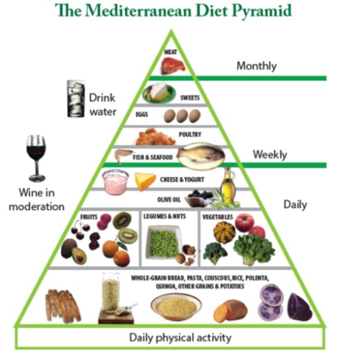
Care Plan (1/3) Lifestyle and health behaviour
Maintain a diet plan in Mediterranean-style.
Eliminate the consumption of sodium, sugar and fats.
Maintain a regular walking at least for 30 minutes in weekdays and minimal exercise in weekend.
Consistent monitoring of blood sugar and pressure in a regular basis (Do et al., 2023).
Take necessary medicines as per medical professional’s direction.
Maintain regular check-up.
Ag Center (2020), The Mediterranean Diet
Notes:
Michales’s care plan has stresses on developing lifestyle along with health behaviour for eliminating cardiovascular disease as well as stroke risks. He is directed to follow Mediterranean style diet regulation which include fruits, vegetables, lean proteins as well as whole grains. Most importantly, it restricted sodium and refined sugar consumption as well. by optimising regular physical activity approximately for 30 minutes regular walking and taking rest on weekends can able to improve the issue of blood pressure and control glucose (Do et al., 2023). By managing a consistent monitoring of blood pressure allows to track progression along with prevention plan for any complications. In a deeper insight medication adaption is also necessary in the regular care plan. Michale can further develop his health by engaging a consistent check-up to assure any disease detection at early stage and able to manage the complications further.

Slide 6
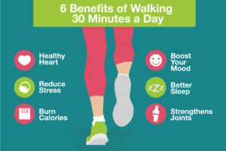
Care Plan (2/3) Regular routine approach
Regular blood and sugar check-up at morning.
Take medicine and complete breakfast within 8am.
30 minutes walking after office work.
Balanced diet meals including vegetables, toned milk etc (Pallazola et al., 2019).
Limited screen time and evening yoga.
NM Crystal Lake and Huntley Fitness Staff (2022), Six Benefits of Walking 30 Minutes a Day
Notes:
Michale’s regular routine framework has precisely focuses on managing the issue of cardiovascular and diabetes issues. In everyday morning, he has maintain a pattern of monitoring blood pressure and sugar level. It allows to make him assure about his physical health. After that, he takes medicine that has been prescribed by the medical professional for his health and completed his breakfast after that. It helps in assessing a proper sense of consistent along with effectiveness. In weekdays he is unable to manage strict exercise but somehow manage at least 30 minutes to walk in a regular basis. It is mainly done after his office. This thing allows to develop blood circulation as well as glucose metabolism. A strict diet-based meal plan is used by Michale where he include low-sodium, fresh vegetables to stabilise the blood sugar (Pallazola et al., 2019). In evening some yoga session has conducted by him.

Slide 7
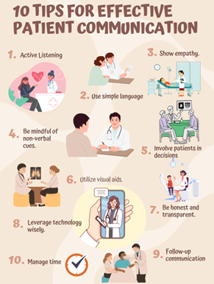
Care Plan (3/3) communication and ethical consideration
Clear, concise language for treatment.
Encourage a participative medical session where Michale’s can raise his concerns (Diab et al., 2023).
Maintain proper medical confidentiality.
Promote family involvement and informed consent before medication service.
LinkedIn (2023), 10 Tips for Effective Patient Communication: Improving Patient Satisfaction and Outcomes
Notes:
Clear communication system with ethical care plan is crucial for Michale’s cardiovascular and diabetes management. His health professionals need to clearly explain his condition and a proper recommended lifestyle for his long-life survival in an understandable approach. It is also essential for Michale to get the opportunity about asking clear questions to his doctor and get into a participatory health plan. While generating communication cultural believes and personal preference play a vital role and the healthcare professionals need to pay attention to this factor and show respect accordingly (Diab et al., 2023). Similarly, confidentiality of the medical records has to be managed with proper ethical integration. By involving Michale’s family in his medical health discussion an additional support can be created. It allows to reinforce potential decision-making and patient satisfaction.

Slide 8
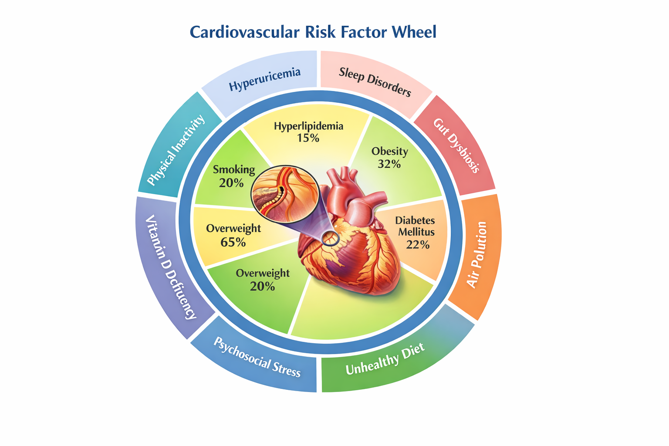
Risk factors
High obesity and BMI increase heart attack possibility.
High BP damage arteries.
Inactive lifestyle reduce body fitness (Park et al., 2020).
Unhealthy diet plan with inaccurate sodium and sugar Intak (Locke, Schneiderhan and Zick, 2018).
Wang, L., Lei, J., Wang, R. and Li, K., (2023). Non-traditional risk factors as contributors to cardiovascular disease. Reviews in Cardiovascular Medicine, 24(5), p.134
Notes:
Michale experience several risks that contributed to his cardiovascular disease, stroke and diabetes. High BMI and obesity rate pushes stress on his heat and minimal exercise activity keep things harder for him to control weight. High BP impacted arteries and create scope of plaque generation (Park et al., 2020). In effective control of diabetes can causes blood vessel inflammation and threat towards heart attack. Unhealthy eating habits and overconsumption of salt, fatty foods increases cholesterol level and lead towards atherosclerosis (Locke, Schneiderhan and Zick, 2018). A healthy lifestyle, proper medicine and regular health monitoring is essentials to prevent issues.

Slide 9
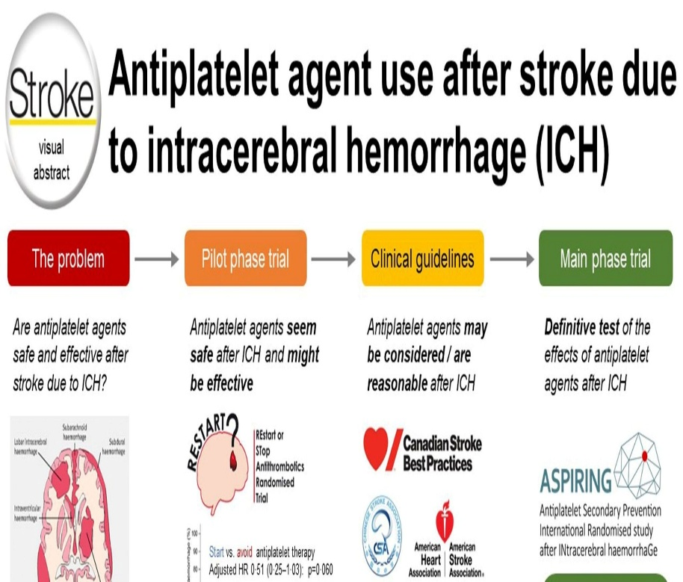
Evidence-Based Recommendations (Care Routine and Monitoring)
Strict blood pressure (BP) target of less than 140/90 mmHg.
Target HbA1c between 48 and 53 mmol/mol.
Take appointments for diabetic review.
Undertake antiplatelet therapy to prevent stroke (Rustam Al-Shahi Salman and Greenberg, 2023).
Statin therapy to manage cholesterol.
Stoke evidence: Rustam Al-Shahi Salman and Greenberg, S.M. (2023). Antiplatelet Agent Use After Stroke due to Intracerebral Haemorrhage. Stroke, 54(12), pp.3173–3181
Notes:
NICE guidelines on preventing stroke and hypertension suggest keeping BP around and less than 140.90 mmHg (adults), targeting Michael’s health conditions. Currently he has 155/95 mmHg BP, which requires consistent monitoring and medication adjustment. The patient should undergo statin therapy to minimise LDL cholesterol level and avoid plaque progression. Antiplatelet medications like clopidogrel or aspirin can prevent formation of clots; thus, minimising the occurrence of ischaemic stroke (Rustam Al-Shahi Salman and Greenberg, 2023).

Slide 10
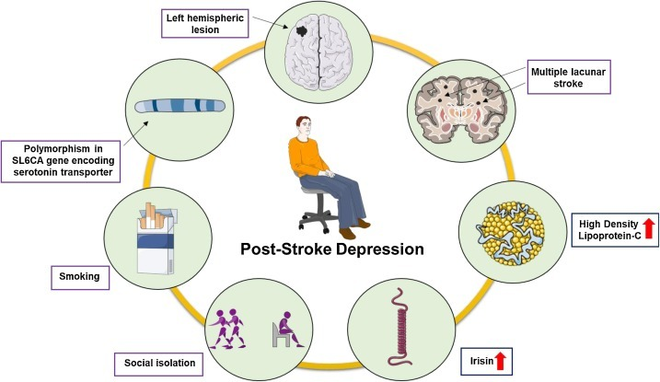
Evidence-Based Recommendations (Multidisciplinary Support and Care Planning)
Develop personalised care service plans.
Refer to specialists, such as diabetic nurses and dieticians.
Join cardiac rehabilitation initiatives.
Screen mental health post-stroke (Sarkar et al., 2021).
Take support for quitting smoking.
Sarkar et al., (2021). Post-stroke depression: Chaos to exposition. Brain Research Bulletin, 168, pp.74–88.
Notes:
The long-term health condition management practices of the NHS encourages tailored care planning by considering patients’ lifestyle, preferences and cultural background. Michael should consult a dietician to get nutritional guidance. He should also visit a diabetic specialist to manage his glucose level. A multidisciplinary approach consisting of dietician, general practitioner, nurse specialist, cardiologist and neurologist, will ensure safe and coordinated care delivery (Sarkar et al., 2021). In addition, emotional and psychological assessment will be beneficial.

Slide 11
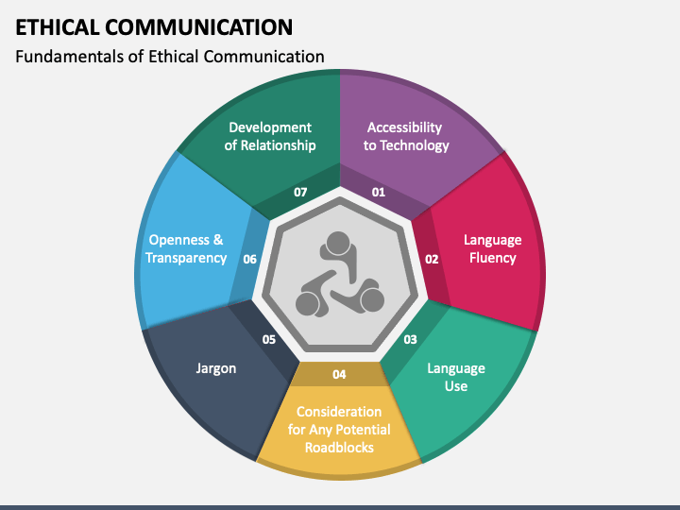
Evidence-Based Recommendations (Ethical Considerations and Communication)
Develop a shared model for effective decision-making.
A person-specific communication approach will be beneficial.
Informed consent from the patient prior to treatment changes (Tingle and Cribb 2018).
Respect for cultural values and autonomy.
Medical records to be handled confidentially.
Ethical Communication PowerPoint and Google Slides Template SlideShare. (2026)
Notes:
Effective direct communication is core to strategic disease management. Prior to implementing treatments or adjusting medications, the patient’s consent should be taken to understand the associated risks and benefits. The shared approach of decision-making will help Michael improve his lifestyle and take proper medications. Ethical considerations for beneficence, autonomy, justice and non-maleficence will support the treatment plan (Slideshare, 2026).

Slide 12

Conclusion
Michael possesses multiple cardiovascular-related risk factors.
His stroke history creates recurrence risk.
Ethical and multidisciplinary care services improve health outcomes (Cowley, 2025).
Evidence-based medical and lifestyle management is necessary.
Cardiovascular System: Cowley, E. (2025). A guide to multidisciplinary healthcare teams | GHE Australia. Globalhealtheducation.com
Notes:
To conclude, it can be safely stated that Michael’s hypertension, obesity, ischaemic stroke and Type II diabetes increase the risk of severe cardiovascular complications. Following NICE and NHS-based recommendations ensure effective and safe disease management for Michael. More importantly, following an ethically grounded, multidisciplinary and person-focused approach will minimise the recurrence of stroke and improve overall life quality (Cowley, 2025).

Slide 13
References
Ag Center (2020), The Mediterranean Diet Available at: https://www.lsuagcenter.com/profiles/rmiller/articles/page1656610049514 [Accessed on February, 2026]
Cowley, E. (2025). A guide to multidisciplinary healthcare teams | GHE Australia. Globalhealtheducation.com. Available at: https://globalhealtheducation.com/au/resources/multidisciplinary-healthcare-teams [Accessed 22 Feb. 2026].
Diab, A., Dastmalchi, L.N., Gulati, M. and Michos, E.D., (2023). A heart-healthy diet for cardiovascular disease prevention: where are we now?. Vascular health and risk management, pp.237-253. https://www.tandfonline.com/doi/pdf/10.2147/VHRM.S379874
Do, D.V., Han, G., Abariga, S.A., Sleilati, G., Vedula, S.S. and Hawkins, B.S., (2023). Blood pressure control for diabetic retinopathy. Cochrane Database of Systematic Reviews, (3). https://www.cochranelibrary.com/cdsr/doi/10.1002/14651858.CD006127.pub3/full
Kućmierz, J., Frąk, W., Młynarska, E., Franczyk, B. and Rysz, J., (2021). Molecular interactions of arterial hypertension in its target organs. International Journal of Molecular Sciences, 22(18), p.9669. https://www.mdpi.com/1422-0067/22/18/9669
LinkedIn (2023), 10 Tips for Effective Patient Communication: Improving Patient Satisfaction and Outcomes Available at: https://www.linkedin.com/pulse/10-tips-effective-patient-communication-improving-satisfaction [Accessed on February, 2026]
Locke, A., Schneiderhan, J. and Zick, S.M., (2018). Diets for health: goals and guidelines. American family physician, 97(11), pp.721-728. https://www.aafp.org/pubs/afp/issues/2018/0601/p721.pdf
NM Crystal Lake and Huntley Fitness Staff (2022), Six Benefits of Walking 30 Minutes a Day Available at: https://www.nmhfc.com/blog/six-benefits-of-walking-30-minutes-a-day/ [Accessed on February, 2026]

Slide 14
Pallazola, V.A., Davis, D.M., Whelton, S.P., Cardoso, R., Latina, J.M., Michos, E.D., Sarkar, S., Blumenthal, R.S., Arnett, D.K., Stone, N.J. and Welty, F.K., (2019). A clinician's guide to healthy eating for cardiovascular disease prevention. Mayo Clinic Proceedings: Innovations, Quality & Outcomes, 3(3), pp.251-267. https://www.sciencedirect.com/science/article/pii/S2542454819300724
Park, J.H., Moon, J.H., Kim, H.J., Kong, M.H. and Oh, Y.H., (2020). Sedentary lifestyle: overview of updated evidence of potential health risks. Korean journal of family medicine, 41(6), p.365. https://pmc.ncbi.nlm.nih.gov/articles/PMC7700832/pdf/kjfm-20-0165.pdf
Public Health England (2019). Health matters: preventing cardiovascular disease. GOV.UK. Available at: https://www.gov.uk/government/publications/health-matters-preventing-cardiovascular-disease/health-matters-preventing-cardiovascular-disease [Accessed 22 Feb. 2026].
Rustam Al-Shahi Salman and Greenberg, S.M. (2023). Antiplatelet Agent Use After Stroke due to Intracerebral Hemorrhage. Stroke, 54(12), pp.3173–3181. https://doi.org/10.1161/strokeaha.123.036886 [Accessed 22 Feb. 2026].
Sandra Mitic (2021), Understanding the Cardiovascular Consequences of Diabetes Available at: https://www.genre.com/us/knowledge/publications/2021/november/understanding-the-cardiovascular-consequences-of-diabetes-en [Accessed on February, 2026]
Sarkar et al., (2021). Post-stroke depression: Chaos to exposition. Brain Research Bulletin, 168, pp.74–88. https://doi.org/10.1016/j.brainresbull.2020.12.012 [Accessed 22 Feb. 2026].
SlideShare. (2026). Client Challenge. Available at: https://www.slideshare.net/slideshow/informed-consent-11521564/11521564 [Accessed 22 Feb. 2026].
UDMI (2024), Types of Cardiovascular Disease Available at: https://www.udmi.net/cardiovascular-disease-risk/ [Accessed on February, 2026]
Tingle, J. and Cribb, A. (2018) Nursing law and ethics. 5th edn. Chichester: Wiley‑Blackwell.
Wang, L., Lei, J., Wang, R. and Li, K., (2023). Non-traditional risk factors as contributors to cardiovascular disease. Reviews in Cardiovascular Medicine, 24(5), p.134. https://pmc.ncbi.nlm.nih.gov/articles/PMC11273054/pdf/2153-8174-24-5-134.pdf
https://www.genre.com/content/dam/generalreinsuranceprogram/images/charts/understanding-the-cardiovascular- consequences-of-diabetes

