Slide 1



How do students use technology to collaborate at UWTSD?
Which digital tool is most used by students at UWTSD to collaborate together?
Alexandra-Valentina Ghita 2127554
Elena Mihaela Radu
2126383
Module: Digital Skills and Research Methods
Module code: BMSW400
Lecturer: Seyed Navid Nasirpour

Slide 2
Introduction
We will try to find the most used method of communication between students at UWTSD.
In our opinion today is a normality for students to use online ways to communicate.
We are considering that using the online collaboration method is much easier to share what we have learned.
Name of presenter: Alexandra Ghita

Slide 3
Using digital tools we can find a wealth of information.
We are considering that using digital tools is much faster to get the work done.
Tools used: University platform – Outlook, WhatsApp, Skype, MS Teams, Zoom, OneDrive, Google Docs.
Name of presenter: Elena Radu

Slide 4

Research question | Research aim
Which digital tool is most used by students at UWTSD to collaborate together? | The aim of this research is to find out which is the digital tool most used by students of UWTSD.
Which digital tool is most used by students at UWTSD to collaborate together?
RESEARCH QUESTION
Name of presenter: Alexandra Ghita

Slide 5
Rational
‘
‘The three types of learning that students need to engage in are: learning on the fly, learning by collaborating, and learning by observing’.(Garrison, 2018, p. 36).
Elaine and Matthew (2011) stated that the online learning environment helps students to understand a material much easier because they have the possibility of debate and revisit their work.
Kasprazak (2012) argues that online collaboration can help us communicate easily and work on long-or short-term online projects.
Name of presenter: Elena Radu

Slide 6
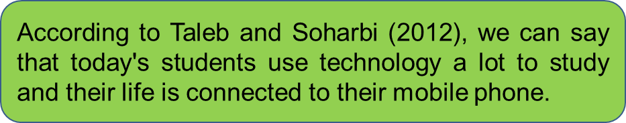
Why online tools?
Manage time
Provide skills and perspectives to each other
Knowledge sharing
Assign responsibilities
Increase the efficiency of the work
Identifying and solving problems
Saunders (2019) stated that we are subject to the online environment daily and that our lives are surrounded by mass media.
Student collaboration is a complex, but critical process for learning.( See picture).
Name of presenter: Alexandra Ghita

Slide 7


PROPOSED METHOD
For this research we will use the quantitative method.
Name of presenter: Elena Radu

Slide 8
The participants for this research will be students of UWTSD.
In this survey, peers will be asked to complete a questionnaire made in Ms Forms.
The questionnaire will have ten questions and the results will disclose which digital tool is used the most by students at the university.
Name of presenter: Elena Radu

Slide 9
10 questions
Closed questions
Rank order
Likert scale questions
Name of presenter: Alexandra Ghita

Slide 10
Creating the questionnaire
Reflection on the questionnaire
Applicating the questionnaire
Interpretating the results of the questionnaire
Step 1
Step 4
Step 2
Data collection
Step 3
Name of presenter: Elena Radu

Slide 11
There will be no restrictions on whether or not participants will join the study.
It will be our goal to keep all kinds of harm to a minimum.
The identity of the participants will not be exposed, and their data will not be used in other future studies.
Ethical consideration
Name of presenter: Alexandra Ghita

Slide 12
Personally identifiable data will not be collected.
Before they decide to join the study, participants will be told about its purpose, benefits and risks.
Integrity will be promoted, and plagiarism will be kept at a minimum level.
Ethical consideration
Name of presenter: Elena Radu

Slide 13
RESEARCH
TIMELINE
Name of presenter: Alexandra Ghita

Slide 14
  Our hypothesis is that online collaboration will be the new method of studying and communicating with your peers at university.
  We will expect that the students use at least one online tools indicated in the questionnaire provided.
HYPOTHESIS
Name of presenter: Elena Radu

Slide 15
REFERENCE LIST
Elaine, T. and Matthew, A., (2011), ‘Designing social media into university learning: technology of collaboration or collaboration for technology?’, Educational Media International Aquatic Insects, Vol. 48(3),Available at: https://doi.org/10.1080/09523987.2011.607319 (Accessed: 15 June 2022).
Garrison, C., 2018. ‘Technical College Student Attitudes Toward 21st Century Work Skills, p.36, Northeastern University. Available at: https://www.proquest.com/pagepdf/2030565836?accountid=130472 (accessed: 16 June 2022).
Kasprazak, L. (2012) ‘Use cloud tools to collaborate’, Chemical Engineering Progress, Vol.108(7). Available at: Use Cloud Tools to Collaborate – ProQuest ( Accessed: 18 June 2022).
Saunders, M., et al., (2019), ’Research Methods for Business Students’, Ebook, Pearson Education, Limited. Available at: http://ebookcentral.proquest.com/lib/trinity/detail.action?docID=5774742 ( Accessed: 19 June 2022).
Taleb, Z. and Sohrabi, A.,( 2012), ‘Learning on the move: the use of mobile technology to support learning for university students’, International Conference on Education and Educational Psychology. Available at: Learning on the Move: The use of Mobile Technology to Support Learning for University Students – ScienceDirect ( Accessed: 23 June 2022).

