Slide 1

Why are we here…
During the next 15 minutes we will present the Mercedes – Benz automotive brand
We will take you on a tour, to include:
History
Industry
Products
Rivals
Improvement
Plans for future
Conclusion
Loredana Chirana -1918446
Elena Oprea - 1918800
Corneliu Dinica - 1918442
Module: Academic Skills LCBB4000_BIRM
Module Coordinator: Chijioke Uba

Slide 2
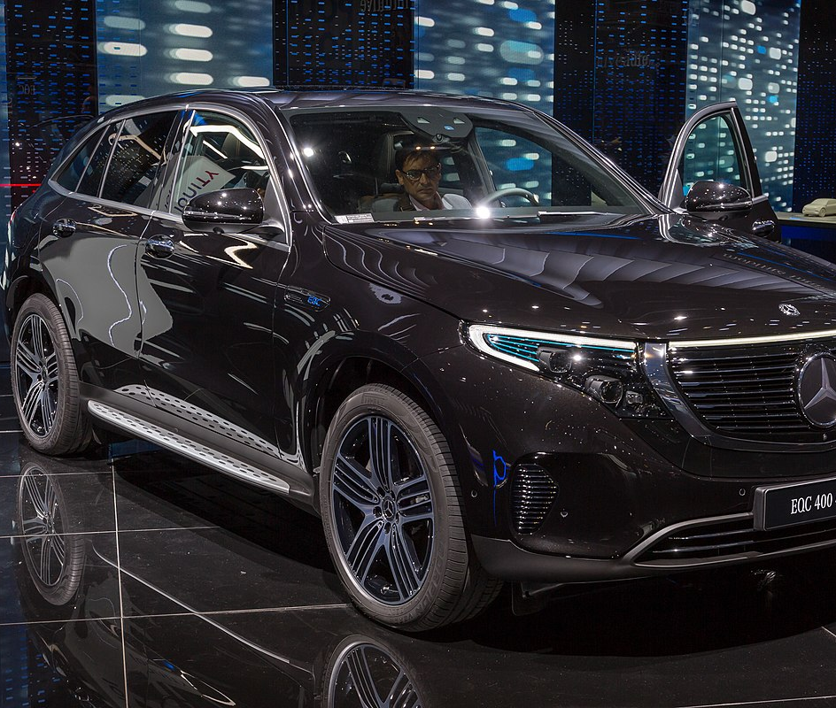
Mercedes-Benz
Cars made different
Elegance
Style
Power
Diversity

Slide 3
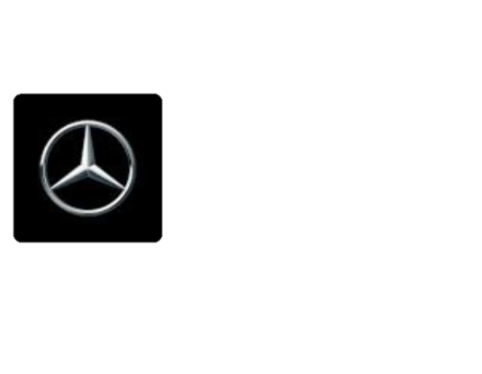
About
Founded:28 June 1926
Headquarters: Stuttgart, Germany
Industry: Automotive
Products: Automobiles, trucks, buses, luxury vehicles.

Slide 4
"The Best or Nothing!"
The Smart marque of city cars are also produced by Daimler AG, as well as the Mercedes-Maybach ultra-luxury brand.
On top of that, the world-renowned Lewis Hamilton is part of the Mercedes AMG Petronas Formula One Team.
Since its inception, Mercedes-Benz has maintained a reputation for its quality and durability.

Slide 5
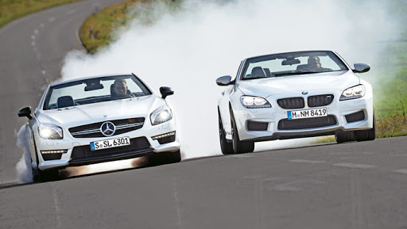
Mercedes or BMW
One of the biggest rivals of Mercedes-Benz is BMW group.
During the next few slides we will focus our attention on comparison between the two giants as well as a conclusion at the end of presentation.
In order to present the next material, primary and secondary data has been gathered.
For primary data we have used opinions of our friends, colleagues and random persons who owns and use the two brands, as for secondary data we have used trusted sources as Marketline , official sites belonging to the companies and review sites as What car.

Slide 6
The difference
BMW and Mercedes-Benz are both German car producers that have been ruling the auto world in their own way for about a century now.
Both makes are well known as top of the German quality but being always on top of the innovations and evolution in matter of technology, the prices and maintenance requirements can reach a higher level than the rest.
The evolution of this century made them produce the hybrid options and the full electric models, so they can keep up with the world’s never-ending changes.

Slide 7
Let’s have a look to the below data collected from users and owners of the two brands

Slide 8

How can Mercedes improve?
"If we listen to our customers, we will continue to improve our position’’
‘’We want to maintain our profitable growth. We have products, we have marketing plans, and of course we see economies developing in different markets.’’
(Hubertus Troska, member of the board of management of Daimler AG responsible for China - Mercedes continues to improve its position by listening to customers, 2016)

Slide 9
Entering the new millennium
Electronic Stability Program
Pre-Safe Technology
SmartKey Technology
Autonomous Driving

Slide 10
Mercedes, plans for future
"We need to be innovative, and we need to be younger in the way we market out products.”
More than 30 new models – all scheduled to arrive by the end of 2022.
More safety and many changes for younger clients.
"There’s not one perfect way of interacting with the car, which means the carmaker will continue investing in multiple interfaces."
(Klaus Frenzel - Carscoops, 2020 https://www.carscoops.com/2020/06/mercedes-bespoke-mbux-tech-could-soon-generate-profits/)

Slide 11
Conclusions
The world’s first car - this invention pioneered a path of innovation and technology which remains with us today.
Driven by one simple goal - To be the very best at all things Mercedes-Benz.
The best or nothing, Mercedes-Benz Retail has become synonymous with quality, excellence and efficiency.

Slide 12
References:
Dieter Zetsche, head of Mercedes-Benz Cars - Mercedes continues to improve its position by listening to customers, 2016
Hubertus Troska, member of the board of management of Daimler AG responsible for China - Mercedes continues to improve its position by listening to customers, 2016
Klaus Frenzel - Carscoops, 2020 https://www.carscoops.com/2020/06/mercedes-bespoke-mbux-tech-could-soon-generate-profits/
Nils Schanz, MBUX head of user interactions – Interview Alisa Priddle, 2020 https://www.motortrend.com/news/mercedes-mbux-upgrades/

