Slide 1
ECIE5005 – Session 2 – Theory and Policies
Children’s Mental Health and Wellbeing

Slide 2

Bronfenbrenner's Bioecological Model (1979)
Focuses on the quality and context of a child’s environment
Micro system – immediate environment
Meso system – relationships/ connectedness
Exosystem – indirect influeces
Macro system—cultural influencers

Slide 3
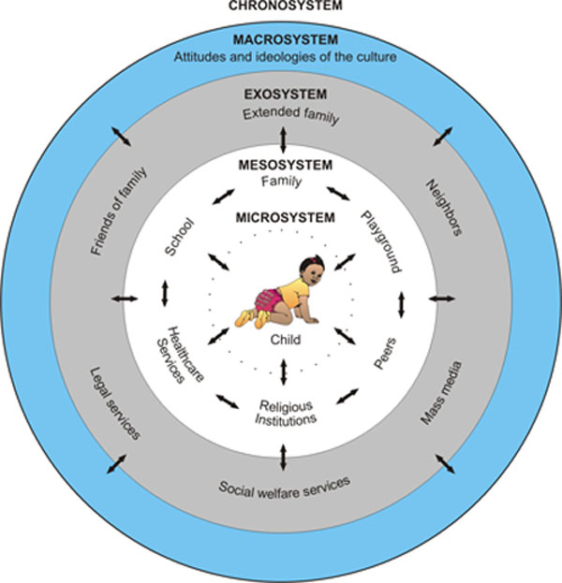

Slide 4
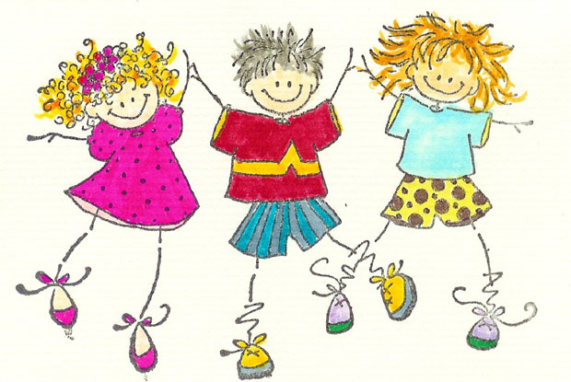
Microsystem
This system is made up of the elements that are closest to the child and have the most direct influence.
When the relation between different microsystems is a compatible one,
development progresses more smoothly
= well-being.
For example: positive relationships between home and school. When expectations are similar in both settings (try your hardest, do your own work, be on time) children perform better than if role expectations differ between the two settings.

Slide 5
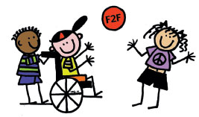
Mesosystem
The most positive outcomes occur when all elements within the system are supportive of each other.
Neighbourhoods that are supportive of their schools are likely to have a more positive academic environment.
Effective communication between parents and teachers about a child's experiences and progress supports and enhances that child's growth and development.

Slide 6

Exosystem
The structures within this system have an indirect influence on the child
This includes
Community resources such as community health services.
Informal social support system such as friends and extended family relationships
Families without a social support network have fewer resources to draw upon and this has a negative impact on the child during difficult times.
Working environments that are supportive of parenting responsibilities have a positive impact on child development without direct interaction with the child.

Slide 7

Examples of the Exosystem and Children’s Wellbeing
Events which occur at the parent’s place of employment -for example, if the parent has a bad day at work, or is laid off, or promoted, or has to work overtime--impact upon children.
A new recreational facility opening in the neighborhood providing children with a place to play and be with friends and family can enhance children's development.
A parent’s gaining increased competence, self-sufficiency and self respect through a job training program can positively impact on a child's development.
A school focuses on wellbeing and provides staff with training, better outdoor play facilities, and improves parental involvement

Slide 8
Macrosystem
Consists of cultural values, customs, laws, and policy, e.g. Welsh Government
The driving force behind establishing an environment that supports the overall well-being of the child.
The priorities of the macrosystem are evidence of the value placed upon tending to the needs of a developing child.
Macrosystems that value the child, put structures in place to support parents and families so that they can attend to the responsibilities of raising healthy children.

Slide 9

Support for positive mental health and wellbeing
Bronfenbrenner’s approach suggests that communities and social institutions need to work to develop connections between the systems to make sure there is support and positive influences on children and families.
This is often described as developing ‘social capital’ and the ‘social glue’ which binds communities and supports the mental health and wellbeing of its members
Giddens, (1998)

Slide 10

How are some children affected if they have poor mental health and well-being?
Increased tearfulness – crying without any apparent reason
Irritability
Aggression
Self-harming behaviour
Property damage
Severe sleep disturbance – difficulty sleeping or waking up too early in the
morning
Weight loss/weight gain
Total social withdrawal
Unwillingness to use speech
Slowness in thought and movement
Deterioration in social and self-help skills

Slide 11

Child wellbeing indicators for education
Attendance at school
Enrolment in childhood care and education
Enrolment in education/completion of school
Parental education level attained
Quality of childhood care

Slide 12

Education disengagement
A minority of children are disengaged or have difficulty in fully engaging in education.
Disaffection can result in:
Truancy
Exclusion
Young people not in education or training (NEET)
ALN
Behaviour

Slide 13
What else affects a child’s wellbeing, home and school life?
Poor housing
Homelessness
Poverty
How do they affect a child?

Slide 14
Mental health and wellbeing statistics
There were 1 in 8 children aged 10 to 15 who reported symptoms of mental ill-health in 2011 to 2012. (Office for National Statistics, 2015)
ChildLine (UK) has revealed that it held 34,517 counselling sessions in 2013/14 with children who talked about suicide – 116% increase since 2010/11. (Youngminds, 2015)
Suicide is one of the three most common causes of death in youth and is now is rising: in 2014 there was a 43 per cent rise in the number of young people who admitted attempting suicide, while self-harm and eating disorders are a growing problem. (Weare, 2015)

Slide 15
Layard and Hagell, 2015
Early intervention is crucial.
Mental health problems need to be tackled when they first appear.
They need to be recognized by parents, doctors and teachers, and our whole society needs to become much more open and matter-of-fact about what is a common part of life.
Our schools need to adopt children’s wellbeing as one of their major objectives – both in their ethos and their teaching.
Life skills can and should be taught as professionally as mathematics or literature.

Slide 16

What can schools do?
What can schools do?
Effective resilience strategies for
children include:
having a sense of belonging in their school and community
being in good physical health
having time and the freedom to play, indoors and outdoors
eating a balanced diet and getting regular exercise
being part of a family that gets along well most of the time
going to a school that looks after the well-being of all its pupils
taking part in local activities for young people
IEPs

Slide 17
Policies relating to Mental health in Children and Young People
Mental Health Strategy by the Welsh Government - ‘Together for Mental Health’ (Oct 2012)
relates to all relevant Welsh Government department’s and functions relating to services to children, young people and their families.
covers all age groups and replaces previous age specific Government strategies and service frameworks, including the CAMHS strategy ‘Everybody’s Business’.
age inclusive and cross governmental approach
aims to counter ‘silo’ working and
promote fully integrated partnership working to improve health and wellbeing

Slide 18
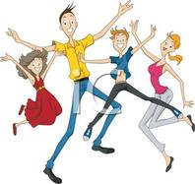
What can schools do?
Effective resilience strategies for
adolescents include:
strong social support networks
positive school experiences,
a sense of being in control of decisions that affect them
participation in extra-curricular activities
the ability to help others and ‘make a difference’
not being sheltered from challenging situations
person centred planning

Slide 19
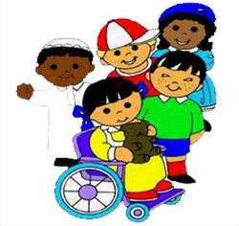
Learning and Physical disabilities and mental health
Children with learning and physical disabilities are at much greater risk of having mental health problems than the general population
Over one in three children and adolescents with a learning disability in Britain (36%) have a diagnosable psychiatric disorder They are also more likely to:
live in poverty
have few friends
have additional long term health problems and disabilities
find it hard to build social relationships
say that they have difficulties getting on with their peers than children without learning disabilities
(mentalhealth.org.uk, 2015)

Slide 20

Autism and Mental Health
70 % children with ASD will have a mental health concern at some point in
their life
40% will have two or more
How do schools support the wellbeing of these learners?
This high prevalence rate of mental health problems is reflected in the use of Child and Adolescent Mental Health Services: 1 in 10 of the children who use CAMHS have autism
(Youngminds/CAMHS, 2015)

Slide 21

Child & Adolescent Mental Health Services
CAMHS refers to all services that involve or affect the mental health of children and young people.
Include specialist in-patient and community services, social services, GP, voluntary and educational support services.
Children, young people, their families and carers want consistent relationships with people who can help and to be treated with dignity and respect.

Slide 22


The 4-tier model for CAMHS
Health Advisory Service, 1995. Together We Stand
Very specialist services, incl. children away from home | Tier 4
Specialist Multi-disciplinary Teams | Tier 3
Individual Professionals Trained in Children and Young People’s Mental Health e.g. Psychiatrists, Psychologists, Therapists etc | Tier 2
GPs, Paediatricians, Teachers, School Nurses, Youth Justice Workers, Health Visitors, Social Workers, Voluntary Agencies etc | Tier 1
Primary Mental Health Workers etc

Slide 23
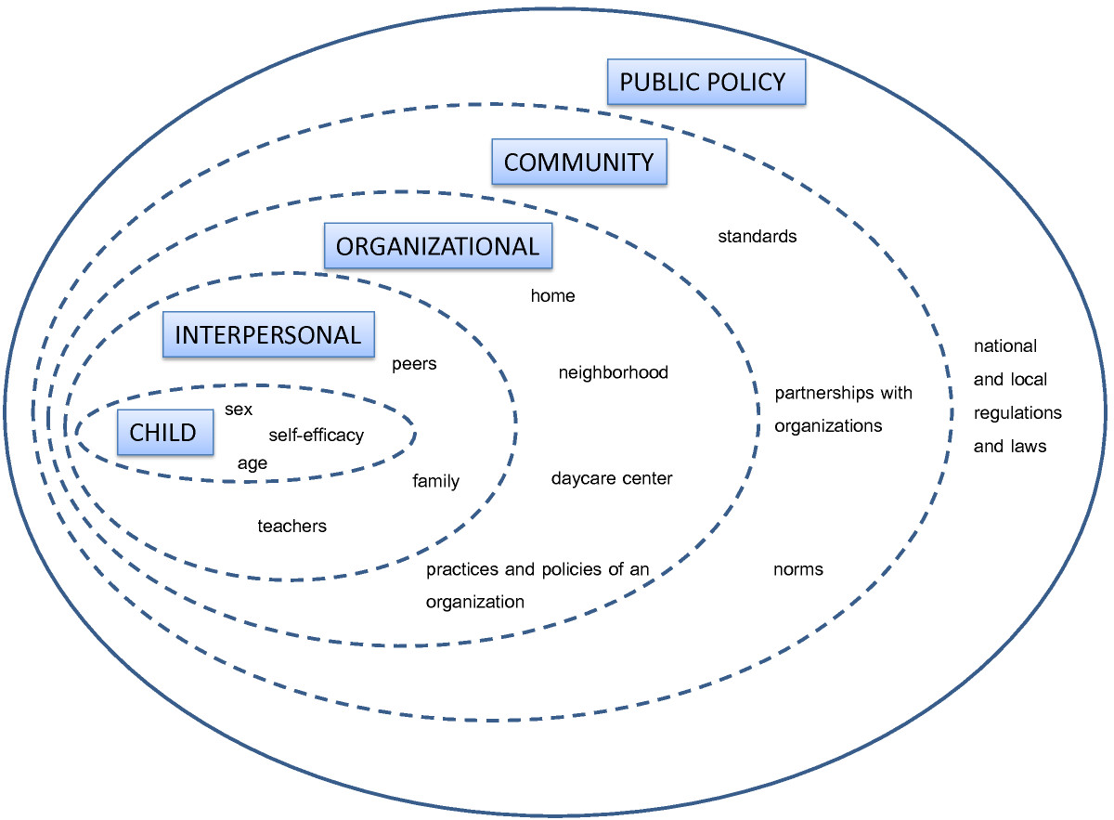
Remember Bronfenbrenner’s Ecological Theory?
Intervene Earlier!

Slide 24
Bronfenbrenner in thinking behind interventions
Theory : ‘Children interact with others in their most immediate learning and development environment. This approach identifies the family as the most influential and proximal system. It also recognizes the importance of partnership between families and childcare.
Hypothesis - There is positive associations found between parental support and children’s PA; parental support was expected to be a potential strategy.
Result – Unlclear; 1 in 8 eight studies with a parental component showed that high quality intervention succeeded in increasing Physical Activity in children. It may be that families need to be more strongly committed to the intervention, and that merely giving parents knowledge or materials is not enough in a centre-based intervention
(Mehtälä, et. al. 2015)

Slide 25
However….
The use of PA-specific in-service teacher training as intervention strategy was potentially fruitful
Teachers’ experience and personal characteristics play an important role in increasing PA among children
Teachers’ cultural beliefs about play and learning are translated into actions which, in turn, influence children’s play behavior (i.e. PA)
Policies of childcare concerning children’s safety and school readiness may hinder children’s physical development.
The question is could we enhance children’s PA by changing environmental policies without jeopardizing their safety and school readiness?
Intervention at the community level, while requiring a lot of resources, may eventually prove a sustainable and a cost-effective strategy.

Slide 26
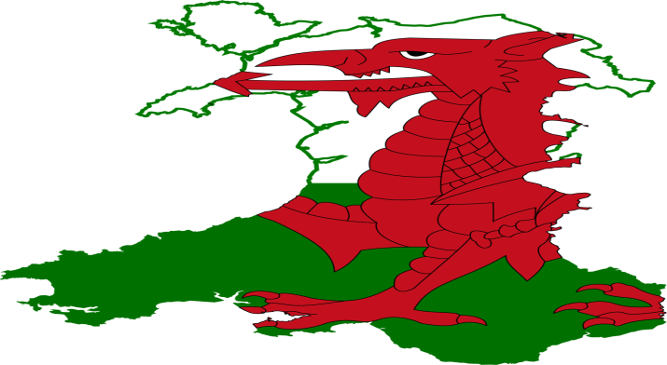
Welsh Government Policy
Wellbeing of Future Generations (Wales) Act 2015
About improving the social, economic, environmental and cultural well-being of Wales.
Will make the public bodies listed in the Act:
think more about the long-term
work better with people and communities and each other
look to prevent problems and take a more joined-up approach.
Link this to Bronfenbrenner (1979)

Slide 27
Welsh Government Policy
Wellbeing of Future Generations (Wales) Act 2015
The Act puts in place seven well-being goals:
Resilient Wales
Prosperous Wales
Healthier Wales
More equal Wales
A Wales of cohesive communities
A Wales of vibrant culture and thriving Welsh language
A globally responsible Wales

Slide 28
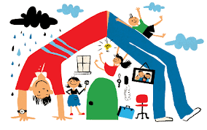
Layard & Hagell, (2015)
‘… if we care about wellbeing, the wellbeing of children must be a top policy priority for communities and families, healthcare systems and schools. This is a matter of basic human rights, as set out in the United Nations Convention on the Rights of the Child. And we must talk about mental health issues much more openly and destigmatize the issue. Second, if we do all of this, we shall certainly incur costs but we will also save huge expense in future.’

Slide 29
Key challenges in implementing mental health and wellbeing
Austerity and spending cuts
Welfare Reforms/Benefit cuts
realising large scale sustainable improvement and realisation of fully Integrated network of care
Problem of reach across a complex system
Integration of physical and mental health
Bringing about large scale change
An ageing population
Influencing other agencies
Recession
Relate to Bronfenbrenner
Public Health Wales, (2012)

Slide 30
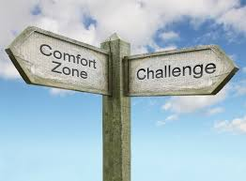
Key challenges in implementing mental health and wellbeing
Discussion: what are the challenges in schools?

Slide 31
References
Bronfenbrenner Bioecological Model. Available at http://nacce.org/ecological-theory-of-bronfenbrenner/ (Accessed 31.10.20)
Giddens, A. (1998) The Third Way: The Renewal of Social Democracy. Cambridge: Polity Press
Mehtala MA, Saakslahti AK, Inkinen ME, Poskiparta ME. A socio-ecological approach to physical activity interventions in childcare: a systematic review. International Journal of Behavioral Nutrition and Physical Activity 2014; 11(1): 22. https://www.ncbi.nlm.nih.gov/pmc/articles/PMC3936868/
Mental Health data. Available at http://mentalhealth.org.uk/ (Accessed 28.10.20)
Office for National Statistics: Insights into children's mental health and well-being (2015) Available at http://backup.ons.gov.uk/2015/10/20/insights-into-childrens-mental-health-and-well-being/ (Accessed 28.10.20)
Weare, 2015. Available at http://www.ncb.org.uk/media/1197143/ncb_framework_for_promoting_well-being_and_responding_to_mental_health_in_schools.pdf (Accessed 31.10.20)

