Slide 1
Evaluation of a High-Intensity Interval Training Intervention on Cardiovascular Fitness and VO₂ Max
Evidence Based Practice Presentation
Student: Jacob James
Student Number: 2316509
Duration: 6-week intervention

Slide 2

Introduction & Aim
High-Intensity Interval Training (HIIT) involves repeated bursts of high-intensity exercise interspersed with recovery periods.
HIIT has been shown to improve cardiovascular fitness and aerobic capacity efficiently.
VO₂ max is considered the gold-standard measure of aerobic fitness.
Aim: To evaluate the effectiveness of a 6-week HIIT intervention on VO₂ max and cardiovascular fitness.

Slide 3

Client Profile
Assessment Variable | Client Data
Age | 22 years
Height | 179 cm
Weight | 67 kg
BMI | 22.93
Resting HR | 62 bpm
HRV Average | 66.5 ms
Blood Pressure | 120/80 mmHg
Fitness Level | Recreational athlete
Lifestyle | Walks dogs daily, generally healthy
Limitations | No experience of structured training programs

Slide 4

Baseline Testing Protocol
Incremental Wattbike VO₂ max test used pre- and post-intervention.
Test started at 100 W and increased by 15 W increments.
Expired gas collected using Douglas bag methodology.
Nose clip and mouthpiece used during final maximal stage.
Polar heart rate monitor used throughout testing.
VO₂ STPD and Respiratory Exchange Ratio (RER) calculated.

Slide 5
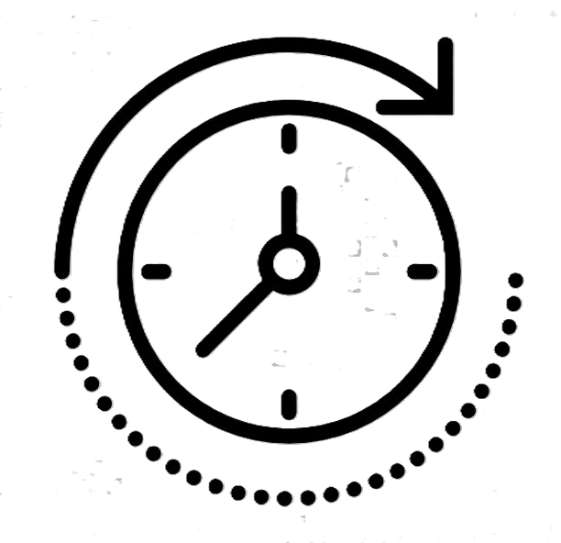
Pre-Intervention Results
Physiological Measure | Pre-Intervention Value
VO2 Max | 46.6 ml.kg-1.min-1
RER | 1.31 (Indicating maximal effort achieved)
Max HR | 187
Resting HR | 69 bpm
HRV | 68 ms
Body Mass | 67 kg
Running Pace | 5:37 min/km
Session Duration | 16 minutes

Slide 6
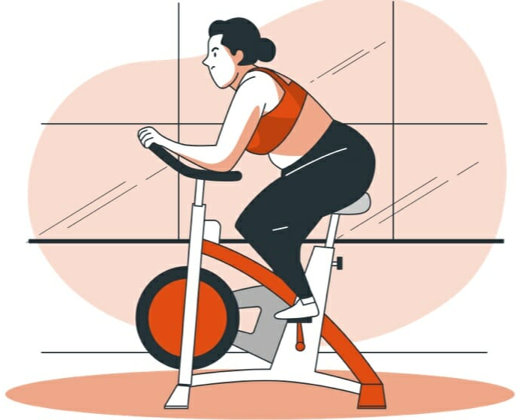
Why HIIT Was Chosen
HIIT is highly effective for improving VO₂ max and aerobic capacity.
Time-efficient method for recreationally active populations.
Allows exercise intensity to be prescribed using HR zones.
Research demonstrates significant cardiovascular adaptations following HIIT.
Heart rate monitoring allowed objective control of exercise intensity.

Slide 7
Literature Review – HIIT Adaptations
VO2 max improvements following HIIT have consistently been reported within endurance literature, with Helgerud et al. (2007) demonstrating significantly greater aerobic adaptations compared to moderate-intensity training.
Milanović et al. (2015) found HIIT to be an effective method for improving cardiovascular fitness and aerobic performance across multiple populations, suggesting HIIT can produce substantial physiological adaptations within relatively short intervention periods.
Buchheit & Laursen (2013) highlighted HIIT as an effective strategy for improving cardiovascular performance through increases in stroke volume, mitochondrial adaptations and oxygen utilisation.
Weston et al. (2014) reported that even low-volume HIIT interventions can significantly improve aerobic fitness, supporting the time-efficient nature of HIIT training.
Buchheit (2024) further suggested that repeated exposure to high-intensity exercise may improve exercise tolerance, cardiovascular efficiency and repeated sprint performance through progressive overload and metabolic adaptation.
Repeated sprint training literature (Bishop, Girard and Méndez-Villanueva 2011) has also demonstrated improvements in anaerobic capacity, recovery ability and cardiovascular demand during high-intensity exercise protocols.

Slide 8
Literature Review – HR & HRV Monitoring
Heart rate monitoring allows accurate prescription and monitoring of exercise intensity, ensuring training is performed within targeted physiological zones associated with cardiovascular adaptation.
Kiviniemi et al. (2010) demonstrated that HRV-guided training improved aerobic adaptations and exercise prescription by adjusting training intensity based on recovery status and autonomic readiness.
HRV monitoring may help assess parasympathetic nervous system activity and recovery, with higher HRV values generally associated with improved recovery and cardiovascular efficiency.
Training prescription guided by HRV has been suggested to optimise adaptation while reducing the likelihood of excessive fatigue or overtraining (Kiviniemi et al., 2007).
Wearable HR technology, such as Polar heart rate monitoring systems, provides practical and objective measurement of training load, exercise intensity and recovery within applied sport settings.
Systematic reviews investigating HRV-guided endurance training have reported improvements in aerobic performance, VO₂ max and recovery management through individualised training prescription.

Slide 9
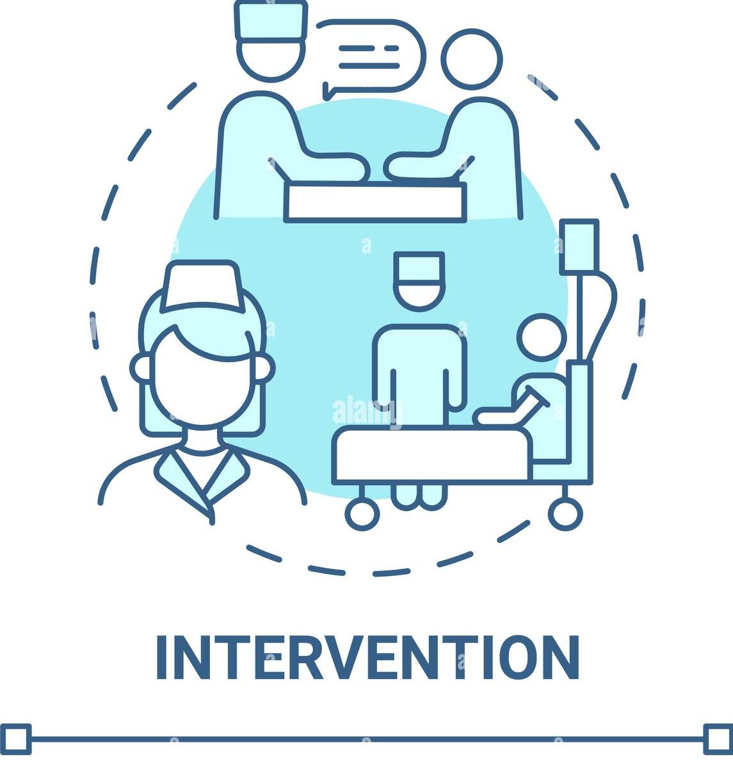
Intervention Design
Duration: 6 weeks
Frequency: 2 sessions/week progressing to 3 sessions/week
Intensity: 85–95% HRmax
Type: Running-based HIIT with continuous running and high-intensity bursts
Monitoring: Polar HR sensor and Polar Beat app
Progressive overload applied through increased duration and intensity

Slide 10

Weekly Progression
Week 1–2: Continuous runs with short bursts and adaptation focus
Week 3–4: Increased interval duration and reduced recovery
Week 5: Greater exposure to Zone 4–5 intensity
Week 6: Peak intensity sessions and maximal effort intervals
Pace, distance and session duration improved progressively

Slide 11
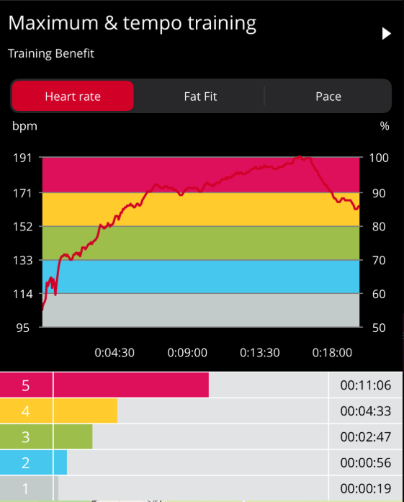
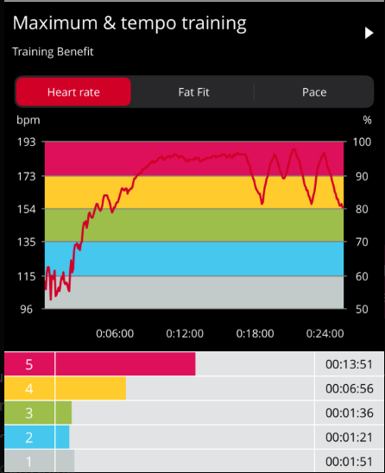
Heart Rate & HRV Monitoring
Week 1
Week 6
Average session HR ranged between approximately 166–170 bpm.
Majority of training time spent in HR Zone 4–5.
Training sessions classified as ‘Maximum’ and ‘Tempo’ by Polar software.
HRV monitoring used to assess recovery and readiness.
Lower resting HR post-intervention suggested improved cardiovascular efficiency.
Add Polar screenshots here.

Slide 12
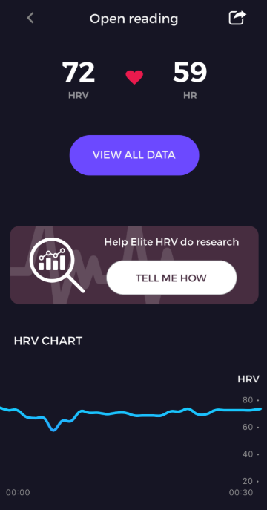
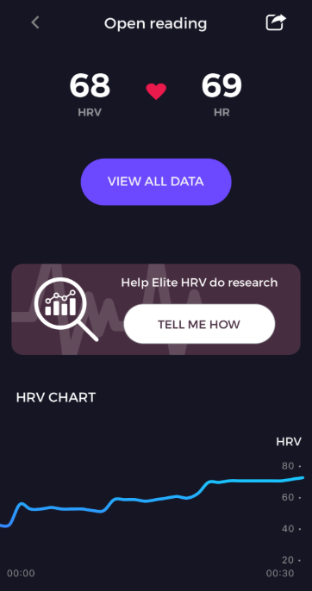
Resting HR and HRV Data
Week 6
Week 1
Both Resting HR and HRV showed to improve within the client after implementing the training program, these two screenshots are from week 1 and week 6 of the intervention

Slide 13
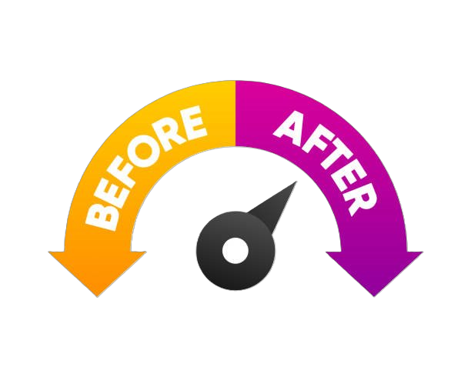
Post-Intervention Results
Physiological Measure | Pre-Intervention Value
VO2 Max | 50.6 ml.kg-1.min-1
RER | 1.24 (Indicating maximal effort achieved)
Max HR | 193
Resting HR | 59 bpm
HRV | 72 ms
Body Mass | 66 kg
Running Pace | 4:21 min/km
Session Duration | 25 minutes

Slide 14

Discussion & Evaluation
VO₂ max improvements suggest enhanced aerobic capacity and oxygen utilisation.
Reduced resting HR may indicate improved stroke volume and cardiac efficiency.
Slight HRV improvements suggest positive autonomic adaptations.
Findings align with HIIT literature demonstrating improvements in cardiovascular fitness.
Heart rate monitoring allowed objective control of exercise intensity throughout the intervention.

Slide 15

Limitations
Single participant limits generalisability.
Some intervention sessions and training data were incomplete.
Nutrition, sleep and daily stress were not controlled.
Post-test Douglas bag sampling duration differed from pre-test.
Short intervention duration may limit long-term conclusions.

Slide 16

Conclusion
The 6-week HIIT intervention successfully improved cardiovascular fitness and VO₂ max.
Heart rate and HRV monitoring provided objective insight into physiological adaptation.
Results support current evidence regarding HIIT and aerobic performance improvements.
HIIT appears to be an effective and practical training strategy for recreationally active individuals.

Slide 17
References
Bellenger, C.R., Fuller, J.T., Thomson, R.L., Davison, K., Robertson, E.Y. and Buckley, J.D. (2016). Monitoring Athletic Training Status Through Autonomic Heart Rate Regulation: A Systematic Review and Meta-Analysis. Sports Medicine, 46(10), pp.1461–1486. doi:https://doi.org/10.1007/s40279-016-0484-2.
‌Addleman, J.S., Lackey, N.S., DeBlauw, J.A. and Hajduczok, A.G. (2024). Heart Rate Variability Applications in Strength and Conditioning: A Narrative Review. Journal of Functional Morphology and Kinesiology, [online] 9(2), p.93. doi:https://doi.org/10.3390/jfmk9020093.
‌Javaloyes, A., Sarabia, J.M., Lamberts, R.P., Plews, D. and Moya-Ramon, M. (2020). Training Prescription Guided by Heart Rate Variability Vs. Block Periodization in Well-Trained Cyclists. Journal of Strength and Conditioning Research, 34(6), pp.1511–1518. doi:https://doi.org/10.1519/jsc.0000000000003337.
‌Kiviniemi, A.M., Hautala, A.J., Kinnunen, H. and Tulppo, M.P. (2007). Endurance training guided individually by daily heart rate variability measurements. European Journal of Applied Physiology, 101(6), pp.743–751. doi:https://doi.org/10.1007/s00421-007-0552-2.
‌KIVINIEMI, A.M., HAUTALA, A.J., KINNUNEN, H., NISSILÄ, J., VIRTANEN, P., KARJALAINEN, J. and TULPPO, M.P. (2010). Daily Exercise Prescription on the Basis of HR Variability among Men and Women. Medicine & Science in Sports & Exercise, 42(7), pp.1355–1363. doi:https://doi.org/10.1249/mss.0b013e3181cd5f39.
‌Buchheit, M. and Laursen, P.B. (2013). High-Intensity Interval Training, Solutions to the Programming Puzzle. Sports Medicine, [online] 43(5), pp.313–338. doi:https://doi.org/10.1007/s40279-013-0029-x.
Bishop, D., Girard, O. and Méndez-Villanueva, A. (2011) ‘Repeated-sprint ability part II: recommendations for training’, Sports Medicine, 41(9), pp. 741–756. doi: 10.2165/11590560-000000000-00000

Slide 18
References Continued
Buchheit, M. and Laursen, P.B. (2013). High-Intensity Interval Training, Solutions to the Programming Puzzle. Sports Medicine, 43(10), pp.927–954. doi:https://doi.org/10.1007/s40279-013-0066-5.
‌Milanović, Z., Sporiš, G. and Weston, M. (2015). Effectiveness of High-Intensity Interval Training (HIT) and Continuous Endurance Training for VO2max Improvements: A Systematic Review and Meta-Analysis of Controlled Trials. Sports Medicine, 45(10), pp.1469–1481. doi:https://doi.org/10.1007/s40279-015-0365-0.
‌Buchheit, M., Vescio, F. and Laursen, P. (2024). Zone 2 training in Football Aerobic Conditioning in Football: Is Zone 2 Training Outdated? [online] Available at: https://martin-buchheit.net/wp-content/uploads/2024/05/SPSR224_Buchheit.pdf.
‌Coates, A.M., Joyner, M.J., Little, J.P., Jones, A.M. and Gibala, M.J. (2023). A Perspective on High-Intensity Interval Training for Performance and Health. Sports Medicine, [online] 53(1). doi:https://doi.org/10.1007/s40279-023-01938-6.
‌Thurlow, F., McLaren, S.J., Townshend, A. and Weakley, J. (2025). The Application of Repeated-Sprint Training. Strength & Conditioning Journal. [online] doi:https://doi.org/10.1519/ssc.0000000000000881.
‌Helgerud, J., Hoydal, K., Wang, E., Karlsen, T., Berg, P., Bjerkaas, M., Simonsen, T., Helgesen, C., Hjorth, N., Bach, R. and Hoff, J. (2007). Aerobic high-intensity intervals improve VO2max more than moderate training. Medicine & Science in Sports & Exercise, 39(4), pp.665–671. doi:https://doi.org/10.1249/mss.0b013e3180304570.
‌Kuno Hottenrott, Sebastian Ludyga, Stephan Schulze. (2012) Effects of High Intensity Training and Continuous Endurance Training on Aerobic Capacity and Body Composition in Recreationally Active Runners. Journal of Sports Science and Medicine (11), 483 - 488.

