Slide 1
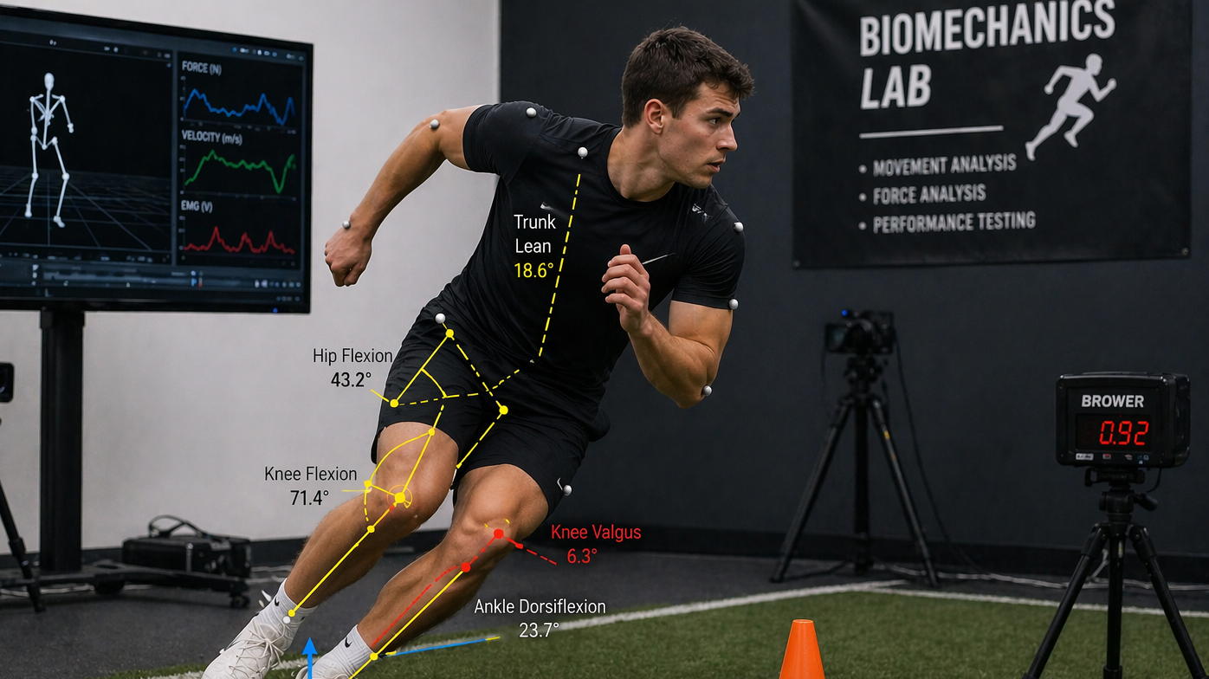
Does countermovement jump (CMJ) height predict change of direction (COD) performance?
By Jayden Rees
Module: BMST5001

Slide 2

Aims & Objectives.
Aim.
The aim of this study was to find whether CMJ height is predictive of COD performance.
Hypothesis.
Greater CMJ height will result in faster COD performance.
Null-Hypothesis.
CMJ height will not significantly predict COD performance.

Slide 3
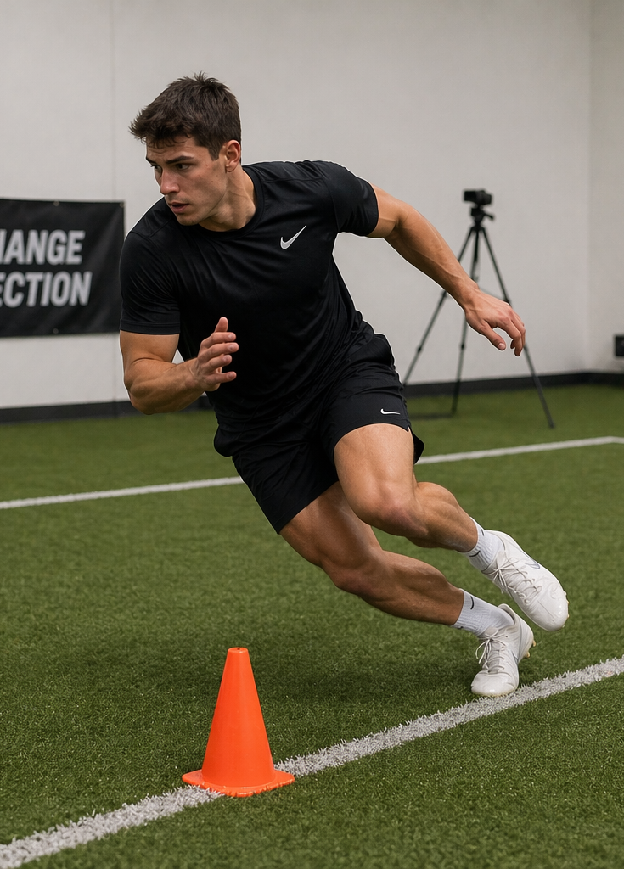
Introduction.
Biomechanics of COD.
COD refers to the capability of an athlete to effectively decelerate, change direction, and accelerate efficiently (Brughelli et al., 2008).
The ability to perform COD at high speeds requires adequate concentric power, eccentric strength, and neuromuscular control (Bartlett, 2007).
Performance Outcomes.
Change of direction (COD) is crucial for sporting performance to evade opponents, create space, and react to oncoming opponents in game situations (Lin et al., 2025).
Faster COD is correlated with increased acceleration and deceleration, as well as increased agility in competitive situations (Brughelli et al., 2008).
Application.
Understanding the relationship between CMJ and COD may help inform performance testing, future programming, and injury prevention strategies.

Slide 4
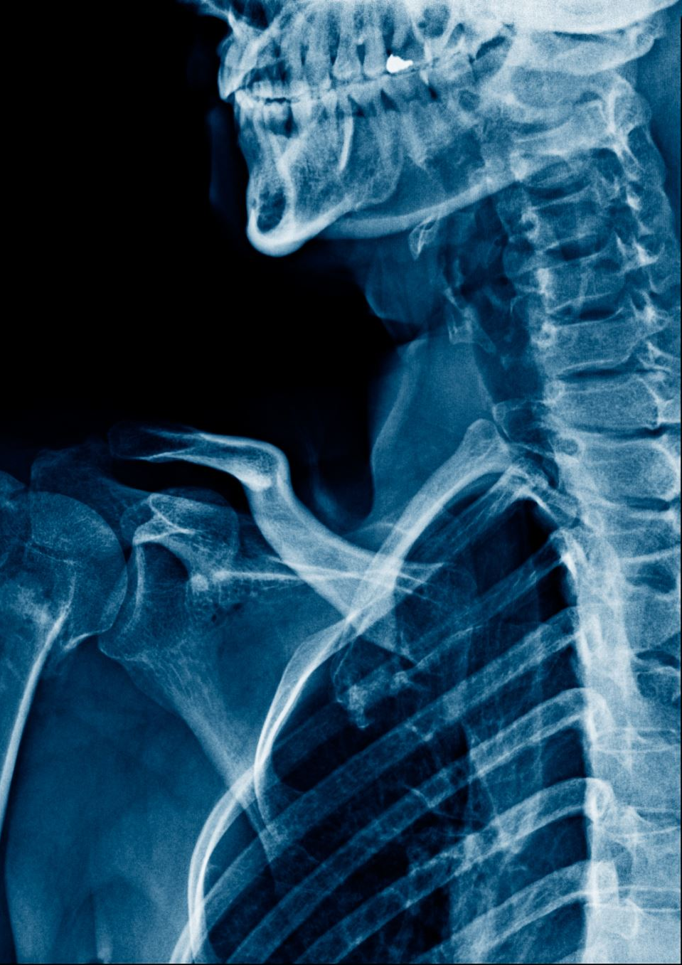
CMJ Relevance.
A CMJ is a biomechanical test to measure lower-body power output (Haff and Triplett, 2016).
The CMJ utilizes the stretch shortening cycle and rapid rate of force development, both are strongly related to the ability to perform COD performance (Hamill et al., 2020).
Earlier research has shown relationships between CMJ performance, acceleration, and explosive ability (He et al., 2025; McFarland et al., 2016)
Injury Risks.
Deficient performance mechanics will increase the risk of injury, especially at the knee with anterior cruciate ligament (ACL) and Medial collateral ligament (MCL) (Leppänen et al., 2021).
Key indicators for injury risk, include knee valgus, poor neuromuscular control, and inadequate braking capacity.(Bartlett, 2007)
Female athletes are at increased risk of ACL injuries due to anthropometric and biomechanical differences, such as Q-angle, reduced hip strength and increased knee valgus. (Hewett et al., 2005)

Slide 5
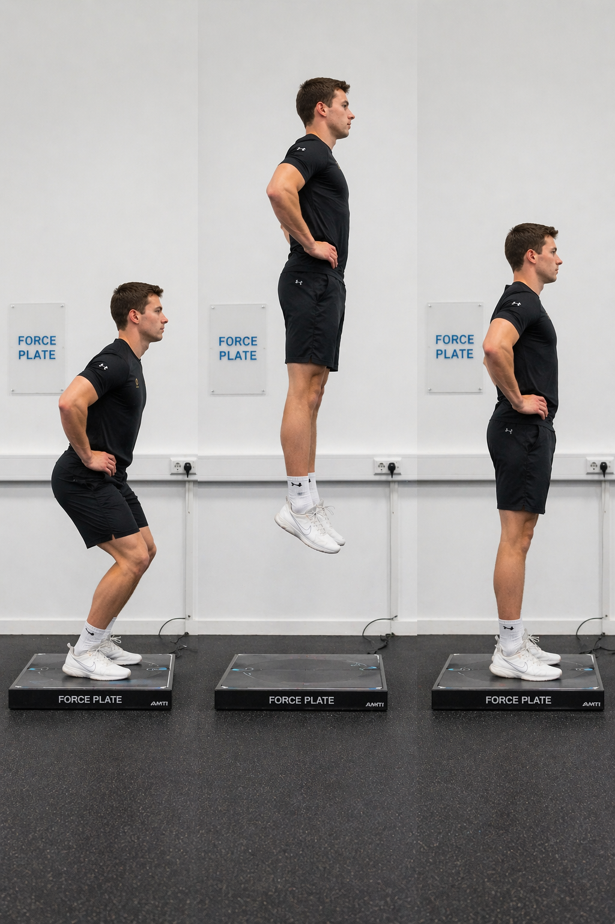
Methods.
Participants.
Participants were recreationally trained university students (n = 20). The mean age was 22.75 ± 4.25 years, with a mean height of 170.9 ± 8.54 cm and body mass of 72.2 ± 10.6 kg. Prior to completion of testing, each participant completed an informed consent form and PAR-Q health screening.
Study Design
A cross-sectional design was used to examine the relationship between CMJ height and COD performance.
Tests and Equipment.
CMJ was performed to assess lower body power output, with jump height measured using a force plate (HUR Oy, Kokkola, Finland).
COD performance was assessed using a timed agility test, with performance recorded using light gates (Brower Timing Systems, Draper, UT, USA) and analysed using Dartfish motion analysis software.

Slide 6

Pre-Testing Protocols.
Before testing was conducted, all participants were instructed to wear appropriate footwear. Furthermore, a standardised RAMP warm-up was used prior to the commencement of testing.
CMJ Protocol
Each participant performed a CMJ, with a maximum of 3 trial attempts. To standardise the test, hands remained on hips to minimise momentum from arm swing. The highest score across 3 attempts was recorded and analysed.
COD Protocol
Each participant performed a planned 45° COD test, with a maximum of 3 trial attempts, with timing gates and motion capture software used to record performance. The fastest attempt across 3 attempts was recorded and analysed.
Measured Variables
CMJ height (cm) was measured as the independent variable, with COD time (s) measured as the dependent variable.

Slide 7
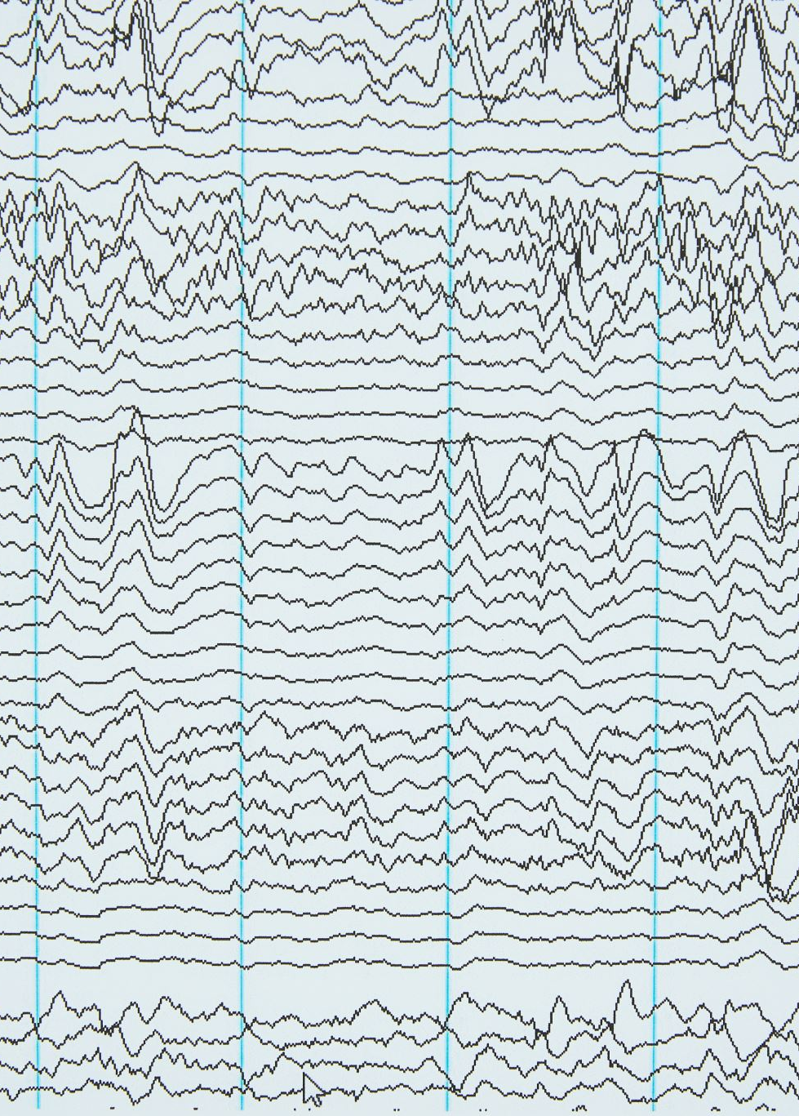
Results.
A weak negative correlation was recorded between CMJ height and COD performance (r = -0.338, p = 0.145, n =20).
A Pearson's correlation was performed using SPSS to find a correlation between CMJ height and COD performance.
Table 1 – Descriptive statistics for CMJ height and COD Performance (Mean ± SD).
Table 2 – Pearsons's correlation between CMJ height and COD performance.
Variables | Mean | SD | n
CMJ | 44.4 cm | 13 cm | 20
COD | 0.499 ms | 46.3 ms | 20
Variables Comparison | r Value | p Value | n
CMJ vs COD | -0.338 | 0.145 | 20

Slide 8
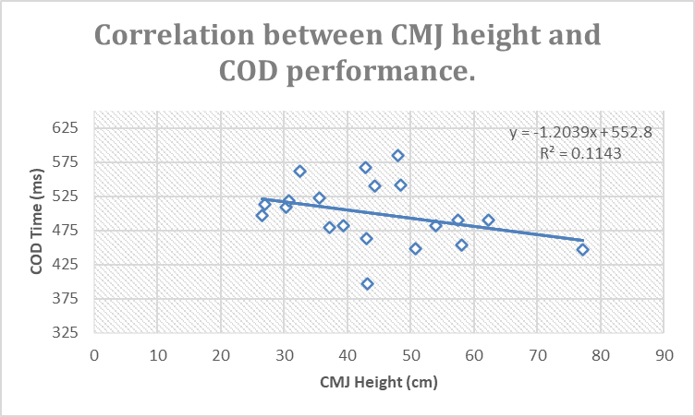
Figure 1 – Pearson's Correlation between CMJ height (cm) and COD time (s).

Slide 9
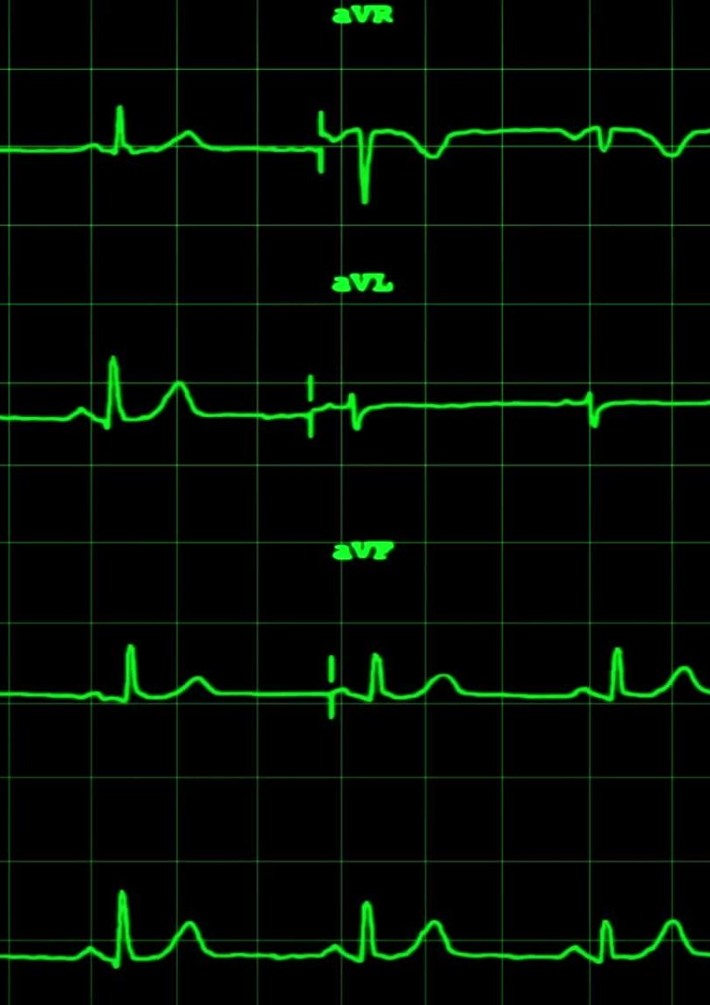
Discussion.
The aim of this study was to find whether CMJ height was predictive of COD performance.
The results show a negative weak correlation between CMJ height and COD performance (r = -0.338, p = 0.145). Indicating there is an association with greater lower-body power and COD performance, although the correlation did not show statistical significance.
This suggests lower-body power may be associated with COD performance, but CMJ height it is not a strong standalone predicator of performance.
CMJ primarily assesses vertical force production, while COD requires horizontal braking, lateral movement, eccentric loading, and motor skill.
Athletes with high CMJ performance may not record the fastest COD performance if they lack braking mechanics, eccentric strength, or neuromuscular control.
Study Limitations
Participants had no earlier familiarization session with CMJ or COD tests. This may have influenced performance because of learning effects compared to physical ability.
The sample group consisted of both recreationally trained individuals and competitive athletes, which may have introduced variability in performance and reduced the strength of the correlation.

Slide 10

Recommendations.
Primary training recommendations should concentrate on increasing eccentric strength to improve braking and deceleration capabilities (Brughelli et al., 2008).
Plyometrics as the primary training modality to further increase reactive strength and movement effectiveness (Haff and Triplett, 2016).
Including unilateral and isolation exercises into programming could potentially increase stability during COD and improve muscular imbalances (Bishop et al., 2018).
Focusing on development of COD technique is critical, especially foot placement and neuromuscular control (Lockie et al.,2014).
Although CMJ performance was not a significant predictor of COD performance through testing, supporting lower-body power is still important for overall performance output (Suchomel et al., 2016).

Slide 11

Conclusion
CMJ height showed a non-significant correlation with COD performance. These findings are supported by previous research, McFarland et al (2016) found summarily weak relationships between CMJ performance and COD ability.
However, earlier research has shown contrasting results, with significant negative correlations seen between CMJ height and COD performance (Katsumata and Aoki, 2021).
To conclude, current research suggests CMJ height is not a statistically significant predicator of COD performance although it still may contribute. This shows that COD has multiple variables to effective performance, rather than a single variable. Factors such as muscular strength, neuromuscular control, movement technique and task-specific demands all account for the ability to perform effective COD.

Slide 12
AI Acknowledgement
Generative AI tools (ChatGPT, OpenAI) were used to aid with literature searching, image generation, structuring of the presentation, and proofreading for clarity and grammar. No AI-generated content was directly submitted, and all final written work and analysis are my own

Slide 13
References
Bartlett, R. (2007). Introduction to sports biomechanics : analysing human movement patterns. Milton Park, Abingdon, Oxon: Routledge.
Bishop, C., Turner, A. and Read, P. (2018). Effects of inter-limb asymmetries on physical and sports performance: a systematic review. Journal of Sports Sciences, 36(10), pp.1135–1144. doi:https://doi.org/10.1080/02640414.2017.1361894.
Brughelli, M., Cronin, J., Levin, G. and Chaouachi, A. (2008). Understanding Change of Direction Ability in Sport. Sports Medicine, [online] 38(12), pp.1045–1063. doi:https://doi.org/10.2165/00007256-200838120-00007.
Haff, G. and Tripplet, T. (2016). Essentials of Strength Training and Conditioning, 4th Edition. Medicine & Science in Sports & Exercise, 48(10), p.2073. doi:https://doi.org/10.1249/mss.0000000000001081.
Hamill, J., Knutzen, K. and Derrick, T. (2020). Biomechanical Basis of Human Movement. Lippincott Williams & Wilkins.
Hewett, T.E., Myer, G.D., Ford, K.R., Heidt, R.S., Colosimo, A.J., McLean, S.G., van den Bogert, A.J., Paterno, M.V. and Succop, P. (2005). Biomechanical Measures of Neuromuscular Control and Valgus Loading of the Knee Predict Anterior Cruciate Ligament Injury Risk in Female Athletes: a Prospective Study. The American Journal of Sports Medicine, 33(4), pp.492–501.
He, J., Li, M., Zhang, Q. and Zhang, Z. (2025). Associations between the performance of vertical jump and accelerative sprint in elite sprinters. Frontiers in Bioengineering and Biotechnology, 13. doi:https://doi.org/10.3389/fbioe.2025.1539197.
Katsumata, K. and Aoki, K. (2021). Jumping ability is related to change of direction ability in elite handball players. Journal of Electromyographyand Kinesiology, 60, p.102575.doi:https://doi.org/10.1016/j.jelekin.2021.102575.

Slide 14
Leppänen, M., Parkkari, J., Vasankari, T., Äyrämö, S., Kulmala, J.-P., Krosshaug, T., Kannus, P. and Pasanen, K. (2021). Change of Direction Biomechanics in a 180-Degree Pivot Turn and the Risk forNoncontact Knee Injuries in Youth Basketball and Floorball Players. The American Journal of Sports Medicine, 49(10), pp.2651–2658. doi:https://doi.org/10.1177/03635465211026944.
Lin, S., Yan, Z., Xu, T., Xie, H. and Liu, R. (2025). Effect of Complex Contrast Training on Change of Direction Performance in Team-Sport Athletes: A Meta-Analysis. Applied Sciences, [online] 15(13),pp.7385–7385. doi:https://doi.org/10.3390/app15137385.
Lockie, R.G., Callaghan, S.J., Berry, S.P., Cooke, E.R.A., Jordan, C.A., Luczo, T.M. and Jeffriess, M.D. (2014). Relationship Between Unilateral Jumping Ability and Asymmetry on MultidirectionalSpeed in Team-Sport Athletes. Journal of Strength and Conditioning Research, 28(12), pp.3557–3566. doi:https://doi.org/10.1519/jsc.0000000000000588.
McFarland, I., Dawes, J.J., Elder, C. and Lockie, R. (2016). Relationship of Two Vertical Jumping Tests to Sprint and Change of Direction Speed among Male and Female Collegiate Soccer Players.Sports, 4(1), p.11. doi:https://doi.org/10.3390/sports4010011.
Suchomel, T.J., Nimphius, S. and Stone, M.H. (2016). The importance of muscular strength in athletic performance. Sports Medicine, [online] 46(10), pp.1419–1449. doi:httpsSports Medicine, [online]46(10), pp.1419–1449. doi:httpsSports Medicine, [online] 46(10), pp.1419–1449. doi:https://doi.org/10.1007/s40279-016-0486-0.

