Slide 1
Leading Restaurant Strategy
International Gastronomy Management
[BMGM6001]
Week 3 – Financial Planning

Slide 2
Today’s objectives
Financial planning overview
How to be sustainable in hospitality
Costing analysis for short- and long-term decision making
Business plan suggestions
SWOT/PEST refresh

Slide 3

Recap of last week
Restaurant design
Planning laws and building regulations
Business plan template overview
Any questions?

Slide 4

Financial Planning

Slide 5
Financial Planning Overview
The strategic process of managing finances to achieve financial goals
Short and long-term planning is crucial!

Slide 6

Key Steps - what order?
Evaluate the current situation
Plan to mitigate risks (contingency)
Set realistic & achievable objectives
Notes:
1 – evaluate
2 – set objectives
3 – plan to mitigate risks

Slide 7
Points to consider
ENSURE YOU EVALUATE & ANALYSE!
Assets/Liabilities/Equity
Short term goals = operational budgets (the purchases and costs required to function)
Long term goals = larger investments (expansion and entry into new markets)
YOUR FINANCIAL GOALS MUST BE IN LINE WITH YOUR OVERALL BUSINESS STRATEGY – BE AGILE!
Notes:
Evaluate = reaching conclusions
Analyse = in depth study to better understand
Assets – resources owned or controlled
Liabilities – debts or obligations
Equity – difference between assets and liability – how much you have left
Agile – flexible and adaptable

Slide 8

Forecasting
Future revenue
Expenses
Cash flow – can you access funds easily?
Return on Investment (ROI)
Notes:
Forecasting – planning/estimating based on previous data or market/competitor trends

Slide 9

Strategic Approach
Plan investments carefully
Incorporate cost-control measures
Review regularly!

Slide 10

Questions to ask yourself
When will you break even?
When will you begin to make a profit?
Do you have enough cash available to control debts and obligations?

Slide 11
Why is this important?
Business sustainability
Stakeholder trust – investors & employees
Agility & strategic decision making
Legal compliance

Slide 12

Watch out for…
Economic fluctuations
Changing business needs
Being optimistic when you should be realistic

Slide 13
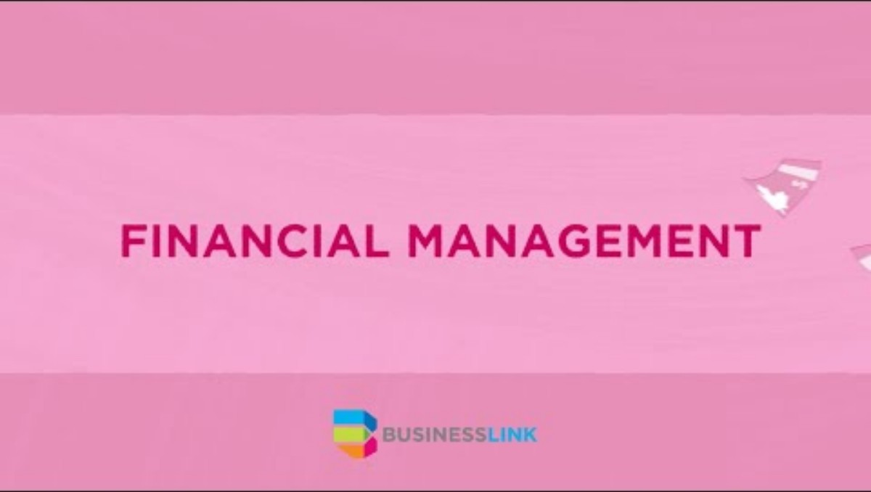

Slide 14


Slide 15
How to be financially sustainable in hospitality

Slide 16
Important points/requirements
Adaptability
Resiliance
Environmental Risks
Awareness
Economic Challenges
Notes:
Points to consider and requirements needed.

Slide 17

How can I achieve this?
Be transparent – open communication
Be innovative – new products, services and processes
Be responsible – ethical and accountable operations
Notes:
Open communication with stakeholders – investors/higher management and staff (where applicable).

Slide 18

In hospitality, be mindful of:
Seasonal fluctuations
Economic fluctuations
Changing consumer preferences

Slide 19
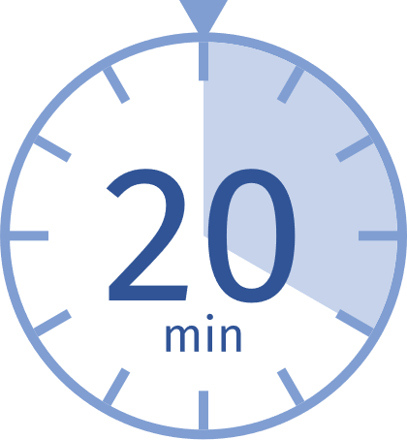
Activity – 20 mins
What would you do to prepare for this?
Seasonal fluctuations
Economic fluctuations
Changing consumer preferences
Notes:
Allocate one each and ask them to feedback a list of what they would do to prepare for the issue – discuss afterwards as a group.
Seasonal – summer = peak – tourism
Christmas/special events – mother’s day/Valentine's day etc
Changing demand for products – cold items in summer for example
Increased demand for delivery in winter months?
Economic – inflation – rising costs – higher menu prices?
Reduced customer spending due to lower disposable income
Increased utility & labour costs – reduced portions? Shorter staffed shifts?
Booming economy = more people spending on luxuries
Employment rates – higher = more spending, lower = less
Minimum wage increases – impact on staff wages
Rising food costs – changes to menus? Or pricing?
Supply chain disruption – Covid/Brexit etc delays in shipping/increased costs
Preferences – expectations/tastes/priorities
Influence menus/operations/overall dining experience.
E.g. – demand for alternatives – healthier/vegan/free from options
Sustainable options – recyclable packaging/paper straws/sustainably sourced products
Growing demand for international flavours & niche cuisines
Experiential dining – themed dining/live entertainment/interactive or tableside cooking
Tech – QR code ordering/payments
Transparency – where has product been sourced from? Nutritional content/calorie contents/allergens
Clear pricing
Increased demand for non alcoholic alternatives - could you do a dry happy hour?
Social media – make your dish look good enough for Instagram/TikTok
Promotions/discounts if customers share experiences online
Customisation – make your own items, smaller or larger portion options, add extras options

Slide 20

Preparation is key!
Diverse offerings
Promotions & events
Price based on demand
Staffing options/ratios
Reduce waste
Monitor inventory
Negotiate with suppliers
Notes:
Be diverse in your offering
Consider promotions and events during periods of lower demand
Price based on demand to turn profit consistently
Consider staffing options/ratios
Reduce waste
Monitor inventory to avoid unnecessary purchases
Negotiate with suppliers

Slide 21
Preparation is key!
Tools & resources
Staff training
Financial reserves
Regular financial risk assessments
Customer loyalty systems
Online presence – reviews/advertising
Brand reputation - CSR
Notes:
Correct tools & resources
Staff training – efficiency & improved service offering
Financial reserves – emergency fund!
Regular financial risk assessments
Customer loyalty systems
Manage online presence – reviews/advertising
Brand reputation - CSR

Slide 23
Costing analysis for short and long-term decision making

Slide 24

Costing analysis = evaluating business costs to assist with strategic decision making

Slide 25
How?
Identify costs
Estimate costs
Allocate funds
Analyse – projected vs actual costs
Optimise – cost reduction/heightened efficiency

Slide 26

Short term – immediate (within 12 months)
Fixed costs – rent/equipment
Variable costs – ingredients/utilities
Determine the sales needed to cover costs
Does cheaper compromise quality?
Are you profitable & competitive?
Notes:
Determine the sales needed to cover costs including rent/equipment (fixed) and ingredients/utilities (variable)
Are there cheaper alternatives? Will this compromise quality? Is it worth it?
Are you priced to ensure profit but also remain competitive?
Consider inventory – is it better to hold stock or restock regularly?
Is it better to pay overtime or hire temp staff?

Slide 27
Short term – immediate (within 12 months)
In practice:
Reduced menu
Reduced number of staff on shift – no overtime/agency staff/zero hours
Utilise holiday entitlement to ensure contracted staff are available at peak times to avoid overtime
Close on certain days/times?
Notes:
This is what it could look like in reality

Slide 28
Long term – several years
Costs that will impact over several years
Major investments – equipment purchases etc
Lifecycle – all costs for an entire project from start to finish
Expanding into new markets or locations
Outsourcing – 3rd party services

Slide 29
Long term – several years
Sustainability – eco-friendly alternatives
Asset depreciation – loss of value & performance
HR – recruiting/training/retaining
Notes:
Must consider these elements!

Slide 30
Long term – several years
In practice:
Equipment/tech upgrades – is it worth it?
Menu additions – sourcing ingredients, training, marketing
Opening new locations
Interior/décor upgrades
Sustainable options
Build your brand - effective marketing
Product/supplier sourcing (supply chain)
Notes:
What does it bring to your business? Is it worth it? What is the return on investment time frame? Can you commit to this?
These options are all worthy investments to grow your business, but when is the right time and are they all necessary for your establishment in particular?

Slide 31

Business Plan Resources
steak_restaurant_business_plan.pdf
How to Write a Business Plan
FSB | What is a business plan?
How To Easily Write A Restaurant Business Plan [Step-by-step] | open a restaurant 2022
Business Plan

Slide 32

Business Plan Q&A
Notes:
5 mins to ask and answer any assignment related questions.

Slide 33

Business Plan Practical – 20 mins
Notes:
10 mins to brainstorm ideas, concepts, thoughts to discuss/get feedback on. Or if they have already prepared some concepts – ask them to begin considering costings etc and how they may plan for these – generate some research options that they can use for their assignments.

Slide 34

SWOT/PEST

Slide 35
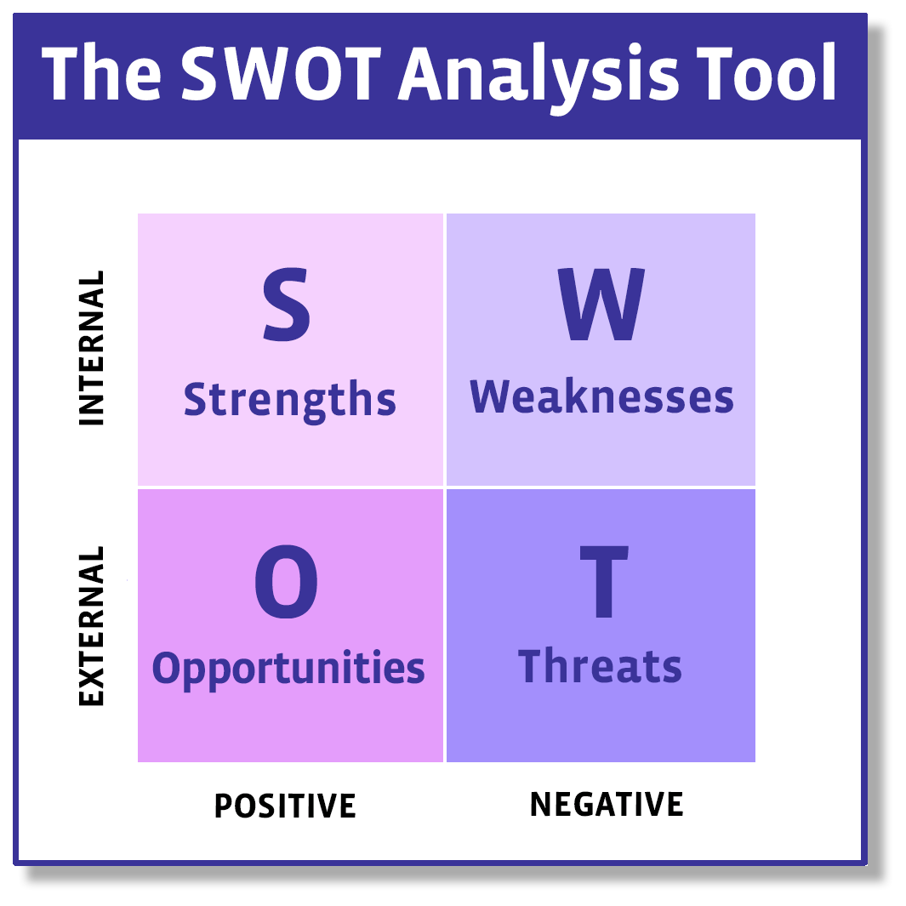
Strengths – reputation/connections/customer loyalty/unique products/skilled workforce
Weaknesses – lack of financial resources/outdated tech or equipment/lack of market presence/negative reviews/lack of marketing
Opportunities – Emerging markets/innovative ideas/changes in demand and consumer preferences/reduced competition
Threats – Economic (inflation)/competitors/changing laws or regulations/supply chain disruptions/rising costs

Slide 36
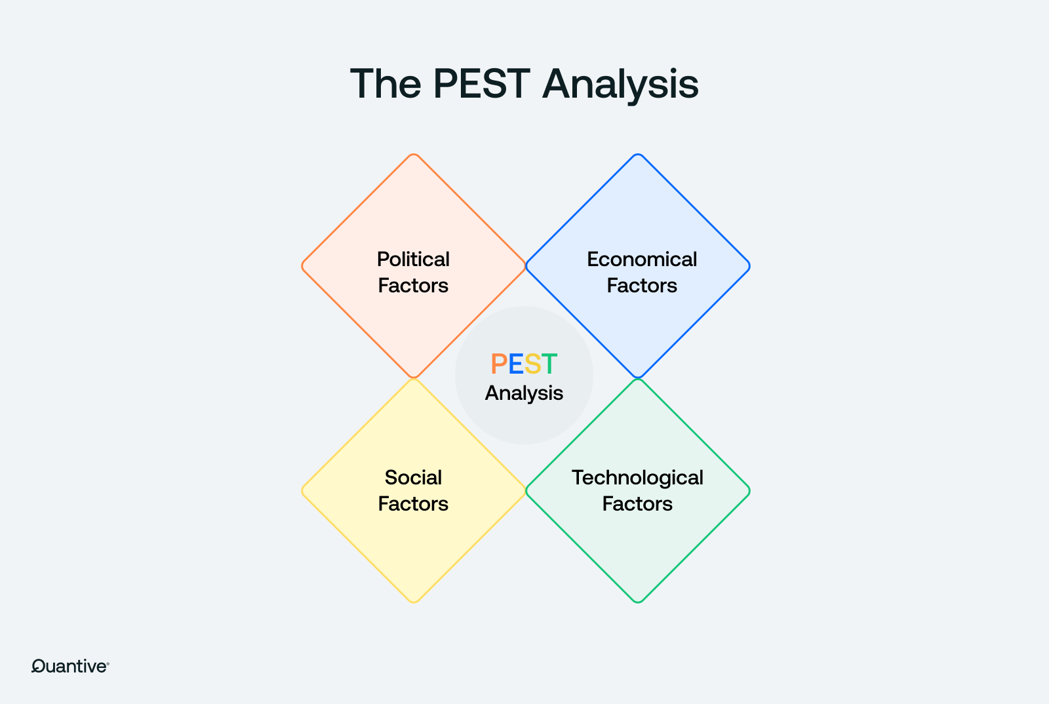
Political – Tax/government policies/regulations/political stability/employment, environmental & food safety laws
Economic – Inflation/interest rates/exchange rates/unemployment/income/economic growth or decline
Social – Population growth/age demographics/culture/attitudes/lifestyle changes/education levels/consumer trends
Technological – AI and digital tech/e-commerce/data protection/online ordering/marketing

Slide 37
Next Week
Reading Week – no class.

Slide 38
Reference List
Bplans. (2025) Steak Restaurant Business Plan, [online], available at: Steak Restaurant Business Plan Example | Bplans
Business Link. (2021) Small Business Basics: Financial Management, [online], available at: Small Business Basics: Financial Management
Fsb50. (2024) What is a business plan?, [online], available at: FSB | What is a business plan?
Lee, W K. (2022) How To Easily Write A Restaurant Business Plan [Step-by-step] | open a restaurant 2022, [online], available at: How To Easily Write A Restaurant Business Plan [Step-by-step] | open a restaurant 2022 – YouTube
Schooley, S. (2024) Guide To Creating a Business Plan With Template, [online], available at: How to Write a Business Plan
Two Teachers. (2023) Business Plan [online], available at: Business Plan
Two Teachers. (2023) Fixed, Variable & Total Costs | Business Costs, [online], available at: Fixed, Variable & Total Costs | Business Costs

