Slide 1
Defamation
By Zita Draper and Laura Knight

Slide 2
Content
Aims and Learning objectives.
Kahoot
Deformation- Recap of the lecture.
Activities
Kahoot
Summary
References
Thank you

Slide 3
Aims and Learning Objectives
The aim of todays session is to recap the lecture content and apply what has been learnt.
By the end of todays session students should be able to understand defamation and apply what has been learnt to the activities set.

Slide 4
Kahoot
Now is the time for the Kahoot.
This is to test your knowledge before the recap of the lecture content and the workshop.

Slide 5
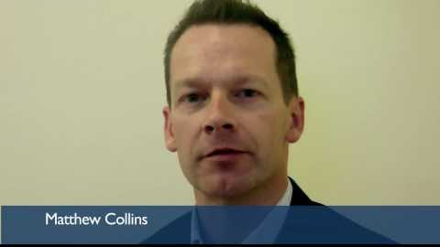
Defamation
Notes:
Parliament have protection from defamation because of parliamentary supremacy.
Introduction to UK Defamation law - https://www.youtube.com/watch?v=sl9Z1lk7vwQ
Approx 3 mins

Slide 6
Defamation
Notes:
https://youtu.be/Rs86AgI69q0
Key Reforms of the Defamation Act 2013
Approx 5 mins

Slide 7
Defamation
What is it?-
‘’ An unture statement that’s been presented as fact and causes harm to the character of the person it describes’’ (Hiscox, no date)
What are the two types of defamation?
- Libel
- Slander
What does the court aim to balance?
Notes:
Ask students what libel and slander are.
Hiscox, [ no date], ‘What is defamation?’, doi; https://www.hiscox.co.uk/business-insurance/professional-indemnity-insurance/faq/what-is-defamation#:~:text=The%20term%20'defamation'%20describes%20an,statement%20will%20be%20considered%20defamatory.(accessed 2nd March 2022)

Slide 8



Defamation
Defamation Act 2013.
Came into force in 2014.
Consolidates case law and Statute.
Notes:
Reference: Brett Wilson [2020], The defamation act 2013; A summary doi; https://www.brettwilson.co.uk/blog/defamation-act-2013-a-summary-of-the-act/ (accessed 7th February 2022).
Reference: Brett Wilson [2020] ‘ Defamation Act 2013: A summary and overview six years on, doi: https://www.brettwilson.co.uk/blog/defamation-act-2013-a-summary-and-overview-six-years-on/ (accessed 19th February 2022

Slide 9
Defamation
S.1 of the Defamation Act 2013- Serious Harm.
Need to prove that there is likely to be serious harm to the individuals reputation.
If there is a body that is earning money for example a business, then they must prove that there will be serious harm to the degree that it will cause financial loss.
Jammel v Dow Jones and Co Inc [2005] EWCA Civ 75.
Notes:
Reference: Brett Wilson [2020], The defamation act 2013; A summary doi; https://www.brettwilson.co.uk/blog/defamation-act-2013-a-summary-of-the-act/ (accessed 7th February 2022).
Reference: Brett Wilson [2020] ‘ Defamation Act 2013: A summary and overview six years on, doi: https://www.brettwilson.co.uk/blog/defamation-act-2013-a-summary-and-overview-six-years-on/ (accessed 19th February 2022

Slide 10

Defamation
S.2 - Defence of Truth – ‘’ Justification’’
S.3 – Defence of Honest opinion.
S.4 – ‘’The defence of publication on the matter of public interest’’.
S.12 – power to order the defendant to publish a summary of judgment.
Notes:
Act has given freedom of speech but has not pleased everyone.
It is a very short act in comparison to other legislation.
Problem with the act is that fails to include definition of when a statement is defamation.
Reference: Brett Wilson [2020], The defamation act 2013; A summary doi; https://www.brettwilson.co.uk/blog/defamation-act-2013-a-summary-of-the-act/ (accessed 7th February 2022).
Reference: Brett Wilson [2020] ‘ Defamation Act 2013: A summary and overview six years on, doi: https://www.brettwilson.co.uk/blog/defamation-act-2013-a-summary-and-overview-six-years-on/ (accessed 19th February 2022

Slide 11

Defamation
S.2 of the Defamation Act 2013
S.3 of the Defamation Act 2013
The defence of truth.
Hewson v TNL and ANL [2019] EWHC 650 (QB).
Common law defence of fair comment.
Butt v Secretary of state for the home department [2017] EWHC 2619.
Notes:
Reference: Brett Wilson [2020], The defamation act 2013; A summary doi; https://www.brettwilson.co.uk/blog/defamation-act-2013-a-summary-of-the-act/ (accessed 7th February 2022).
Reference: Brett Wilson [2020] ‘ Defamation Act 2013: A summary and overview six years on, doi: https://www.brettwilson.co.uk/blog/defamation-act-2013-a-summary-and-overview-six-years-on/ (accessed 19th February 2022

Slide 12
Defamation
S.4 of the Defamation Act 2013
S.12 of the Defamation Act 2013
Economou v de Freitas [ 2016] EWHC 1853 (QB).
Doyle v Smith [2018] EWHC 2935 (QB)
Monir v Wood [2018] EWHC 3525 (QB).
Interfere with article 10 right- but is justified.
Notes:
Reference: Brett Wilson [2020], The defamation act 2013; A summary doi; https://www.brettwilson.co.uk/blog/defamation-act-2013-a-summary-of-the-act/ (accessed 7th February 2022).
Reference: Brett Wilson [2020] ‘ Defamation Act 2013: A summary and overview six years on, doi: https://www.brettwilson.co.uk/blog/defamation-act-2013-a-summary-and-overview-six-years-on/ (accessed 19th February 2022.
Economou -------
* Queens Bench Division
The claimant issued proceedings for libel against the father of a woman with whom he had had a brief relationship.
The woman had accused the claimant of rape. He was arrested but never charged. He began private prosecution alleging that she had intended to pervert the course of justice by falsely accusing him. The CPS took over the prosecution. The woman, who suffered from bipolar, killed herself just before the trial. The father criticised the CPS for prosecuting a mentally vulnerable person where there was no evidence that she had lied about the rape. In November and December 2014, the father issued press statements, gave media interviews and wrote an article. He attached to the publications that they had accused him of having falsely prosecuted the deceased when he had raped her.
Held: the publications undisputedly concerned a public interest matter.

Slide 13
Protection of journalists’ sources –
S.10 Contempt of Court Act 1981
No court may require a person to disclose, nor is any person guilty of contempt of court for refusing to disclose, the source of information contained in a publication for which he is responsible.
The courts may order disclosure in the interests of justice or national security or for the prevention of disorder or crime.
However, S.3 Human Rights Act 1998 requires the courts to interpret S.10 with Article 10 ECHR (freedom of expression) so far as possible.
Case law suggests the courts are very likely to order disclosure on national security grounds.
Notes:
Secretary of State for Defence v Guardian Newspapers Ltd (1985) UKHL
Interbrew SA v Financial Times Ltd (2002) EWCA Civ 274.
Financial Times Ltd v UK (2009) application no.821/03

Slide 14
Scenario
Mary owns a café called ‘ Marty’s’, named after her eldest son. Bertha ordered from the café and sat in the café and ate. Paying in full and then leaving the Café after complementing Marys food. That same evening, Bertha posted a lengthy status on face book accusing the Café of being unclean and that the food was not to a high standard. She went on to accuse Mary of being rude and charging her a different price compared to the other customers. Along with a number of further allegations which would cause considerable damage to Mary’s business. The article was later sent to a local newspaper and published on the front page.
Can Mary bring a case against Bertha for defamation?
Notes:
Case illustration | Community Legal Information Centre (CLIC)
S.1 of the defamation Act 2013-
S.2 of the defamation Act 2013-

Slide 15
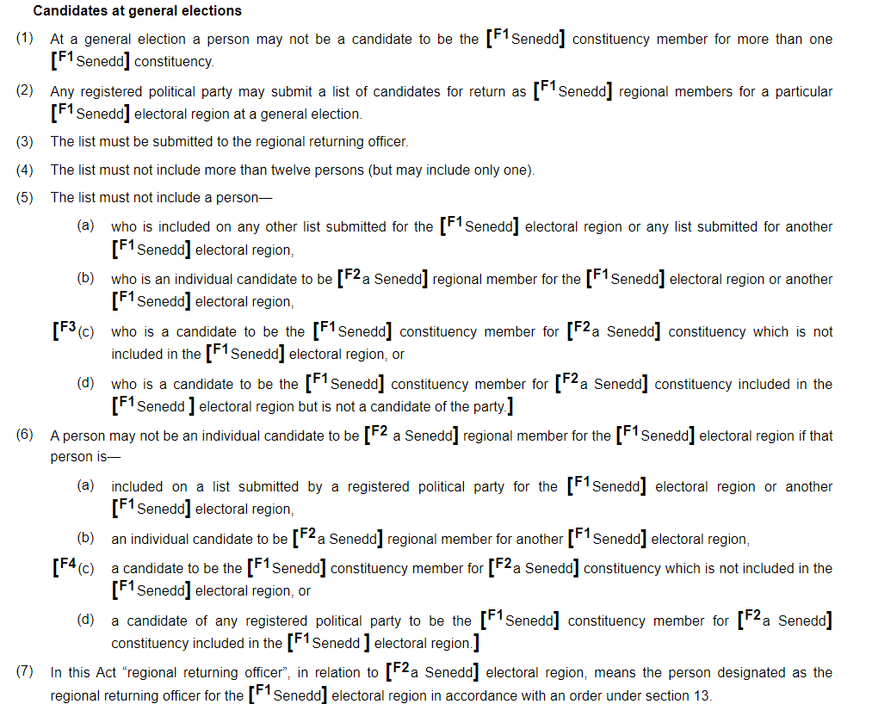
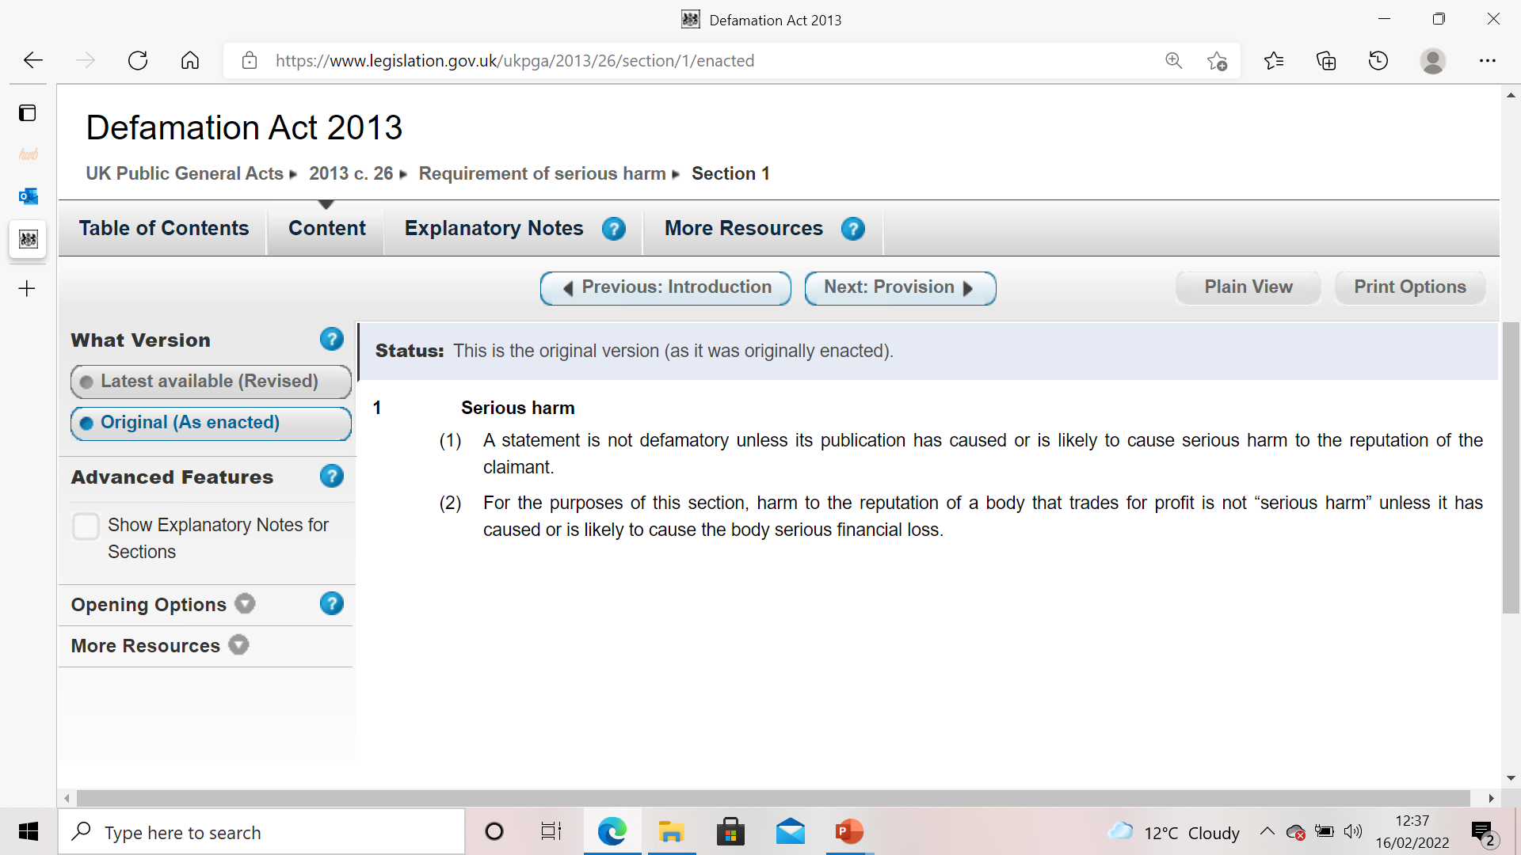
The Defamation Act 2013 problems?
Notes:
The defamation Act 2013 – fails to include definitions. Left open to interpretation by the courts.
This causes issues with regards to fairness of an outcome.
Reference: Brett Wilson [2020], The defamation act 2013; A summary doi; https://www.brettwilson.co.uk/blog/defamation-act-2013-a-summary-of-the-act/ (accessed 7th February 2022).
Defamation Act 2013 doi; https://www.legislation.gov.uk/ukpga/2013/26/contents/enacted
Governemnt of Wales Act 2006 doi; https://www.legislation.gov.uk/ukpga/2006/32/contents
Reference: Brett Wilson [2020] ‘ Defamation Act 2013: A summary and overview six years on, doi: https://www.brettwilson.co.uk/blog/defamation-act-2013-a-summary-and-overview-six-years-on/ (accessed 19th February 2022

Slide 16
Activity
In groups find a recent example of defamation.
This can be anyone from a celebrity to a business.
20 Minutes to do this and prepare to feedback to the class.
Please include: 1. What the case is about?
2. The Judgement

Slide 17

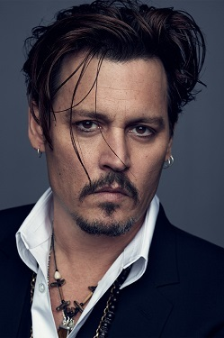
Some example answers
Defamation law suit- awarded £2m in damages.
Against Latasha Kebe.
Degrading statements.
Depp v News Group Newspapers [2020] EWHC 2911 (QB)
Notes:
Cardi B awarded over £2m in damages in defamation case win - BBC News

Slide 18
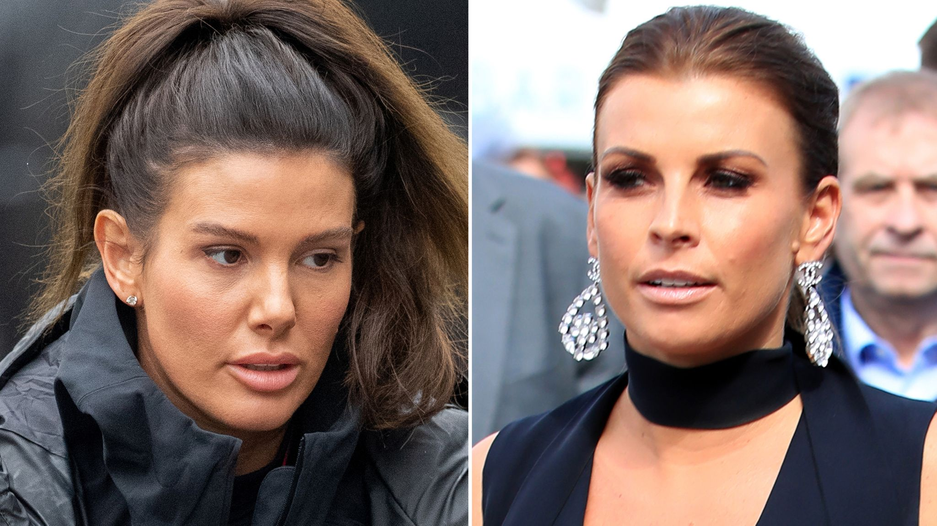
Some examples
Vardy v Rooney [2020] EWHC 3156 (QB)
Notes:
Top 10 Defamation Cases of 2020: a selection – Suneet Sharma – Inforrm's Blog

Slide 19
Activity
In the groups I assign you to, please create a power point slide concerning defamation.
Then one individual will be chosen to feedback to the class.
20 minutes to do this.

Slide 20
Kahoot
Now is time for a Kahoot.
Simply head to Kahoot.com and enter the game pin

Slide 21
Summary
What is it?
Why is it important?
Parliament Supremacy and defamation?

Slide 22
References
Lisa Webley & Harriet Samuels, ‘ Public Law’, Oxford University Press.
My contact: 2107156@students.uwtsd.ac.uk

Slide 23
Thank you!
Any Questions?
Notes:
Refence: 5RB [ no date], ‘ Financial Times Ltd & Ors v United Kingdom’, doi; https://www.5rb.com/case/financial -times-ltd-ors-v-united-kingdom-/ (accessed 11th Feburary 2022)
Swarb [no date], ‘ Attorney General v Guardian Newspaper Ltd (No 2) (Spycatcher): HL 13 Oct 1998’, doi; https://swarb.co.uk/attorney-general-v-guardian-newspapers-ltd-no-2-spycatcher-hl-13-oct-1988/ (accessed 9th February 2022)

